Slide 1
Data Science 5

Slide 2
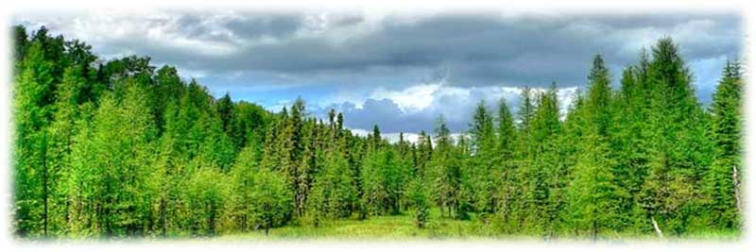
Overview
Decision Trees
Random Decision Forests
Decision Trees and Random Forests in Orange

Slide 3
Classification Problem (blue or green?)
Feature 2
Train instances
blue and green
Test instance
gray
Classifier induced from the data defines decision boundaries
Feature 1

Slide 4
Decision Trees
Decision Trees take one feature at a time and test a binary condition For instance: is the feature larger than 0.5? If the answer is YES, grow a node to the left If the answer is NOW grow a node to the right
Is Feature 1 > 0.5?
YES
NO
Is Feature 2 < 0.1?0.5?
Is Feature 3 > 10? 0.5?

Slide 5
This results in the following decision Boundary
Feature 2
NO
YES
Is Feature 1 > 0.5?
YES
NO
0.5
Feature 1

Slide 6
Decision Tree grows with each level of questions
Each node (box) of the decision tree tests a condition on a feature
The order of features is important
It is like playing “20 questions”
“Guess the person”: it is better to start with the question “Is she female?”, rather than with “Is it Marie?”
The reason is that the answer to the first question maximises the information (“entropy”) gained from the answer.*
In decision trees the order of features to be tested is determined by means of information theory (ID3 algorithm)
* Alternative: Gini impurity is a measure of how often a randomly chosen element from the data set would be incorrectly labeled if it were randomly labeled.

Slide 7
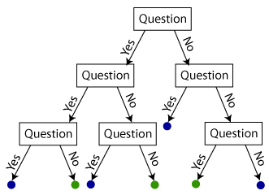
Decision Tree
test instance
Is it blue or green?
Reproduced from: https://shapeofdata.wordpress.com/2013/07/02/decision-trees/

Slide 8
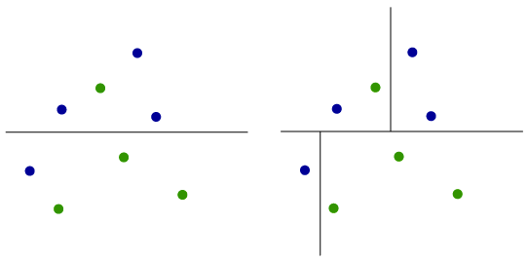
Each test (box) adds a decision boundary
Reproduced from: https://shapeofdata.wordpress.com/2013/07/02/decision-trees/

Slide 9
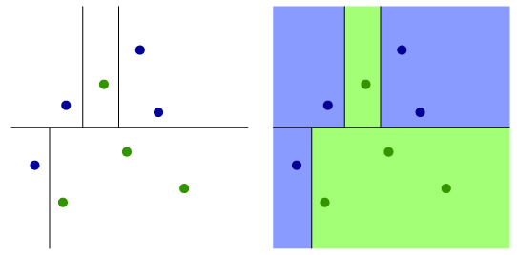
Adding another decision boundary
Reproduced from: https://shapeofdata.wordpress.com/2013/07/02/decision-trees/

Slide 10
Complexity of the induced model
The complexity of the model induced by a decision tree is determined by the depth of the tree
Increasing the depth of the tree increases the number of decision boundaries
All decision boundaries are perpendicular to the feature axes, because at each node a decision is made about a single feature
Is Feature 1 > 0.5?
YES
NO
Is Feature 2 < 0.1?0.5?
Is Feature 3 > 10? 0.5?

Slide 11
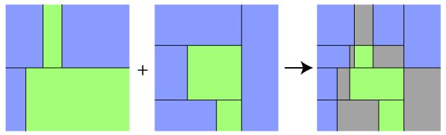
Random Decision Forests
From one tree to many
Decision Tree 1
Decision Tree 2
Decision Forest
Feature 2
Feature 1
Feature 1
Feature 1

Slide 12
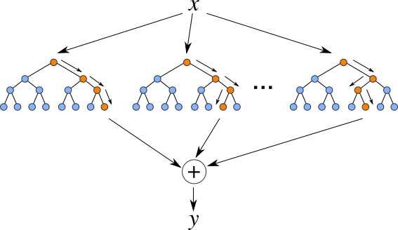
Classification and Regression with RDFs
Classification: the mode of the classes outputted by the trees.
Regression: the mean of the values outputted by the trees.

Slide 13
Complexity of Random Decision Forests
The complexity of RDFs is determined by the number of trees (and their depths)
In some decision forests trees are induced on the same complete set of features
In random decision forests, trees are induced on randomly selected subsets of features

Slide 14
Inducing and Visualising a Tree

Slide 15
Evaluating and Comparing Tree and Forest

Slide 16
Performance Measure: Classification Accuracy
CA: proportion correctly classified

