Slide 1
Data Science 6

Slide 2
Overview
the trade off between model complexity and feature sparsity
the curse of dimensionality
dimensionality reduction
PCA
overfitting-underfitting

Slide 3
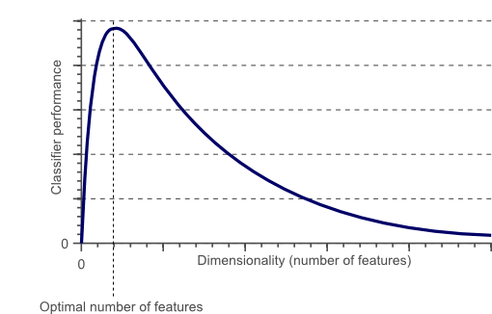
The curse of dimensionality
http://www.datasciencecentral.com/profiles/blogs/about-the-curse-of-dimensionality

Slide 4
Trade-off in machine learning
Informative features. We want to increase the number of features to put all the relevant information in the classifier
Curse of dimensionality. We want to decrease the number of features to avoid the curse of dimensionality
Machine learning algorithms should optimise the trade-off between informative features and curse of dimensionality by means of dimensionality reduction techniques

Slide 5
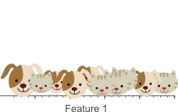
Curse of dimensionality and overfitting
Classification task: CATS versus DOGS
10 instances (images of cats and dogs)
First feature: average amount of red color in image
http://www.datasciencecentral.com/profiles/blogs/about-the-curse-of-dimensionality

Slide 6
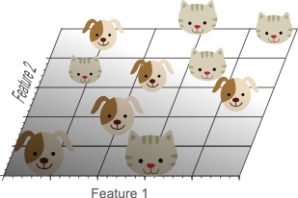
Curse of dimensionality and overfitting
More information is needed for classification, therefore we add a second feature
Feature 2: average amount of green color in image

Slide 7
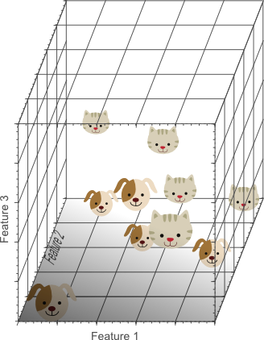
Curse of dimensionality and overfitting
Even more information is needed for classification, therefore we add a third feature
Feature 3: average amount of blue color in image

Slide 8
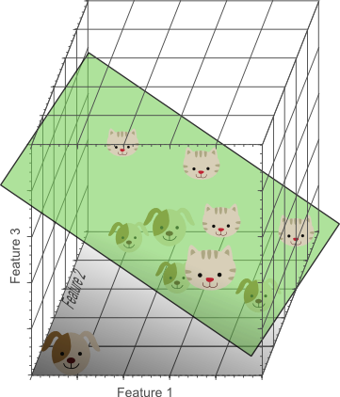
In three dimensions (= three features), perfect separation of CATS and DOGS is possible with a decision boundary (plane)

Slide 9
Adding features improves classification!…?
This examples suggests that by adding (informative) features, classification is improved.
This is often the case, but…
Adding new features increase the volume of feature space exponentially
For instance: 1 feature has 10 different values
1 feature: 10 possible feature values
2 features: 100 possible feature values
3 features: 1000 possible feature values
….
….

Slide 10
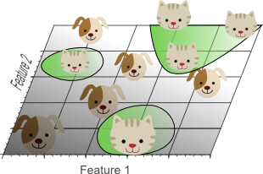
Projecting 3D space onto 2D space
linear decision boundary
nonlinear decision boundaries

Slide 11
High-dimensional vs low-dimensional feature space
A simple classification model in a high-dimensional space
e.g., a linear decision boundary (plane) in 3D
Corresponds to a complex classification model in low-dimensional space
e.g., non-linear decision boundaries in 2D
Overfitting is associated with (too) complex models
Hence, too many features may lead to overfitting too

Slide 12
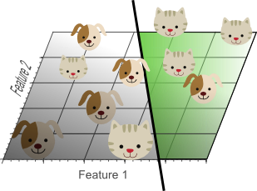
Complex vs simple model
This model makes no mistakes on the training set, but doesn’t generalise well…
Although this model does make some mistakes on the training set, it generalises much better to unseen instances

Slide 13
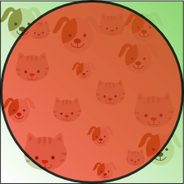
High-dimensional feature space
hard to classify
easy to classify
What happens if dimensionality (number of features) increases?

Slide 14
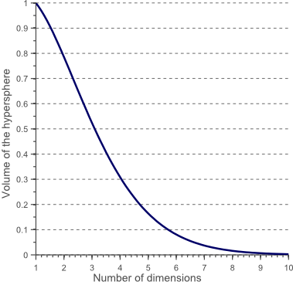
High-dimensional feature space
The “hard to classify” corner regions become larger
= number of features

Slide 15
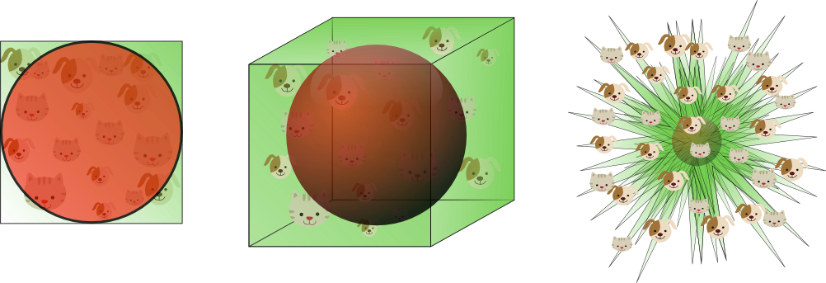
Curse of dimensionality (illustration)
2 dimensional
feature space
(2 features)
3 dimensional
feature space
(3 features)
“8 dimensional
feature space”
(8 features)
98% of the instances
are of the “hard to classify”
type

Slide 16
How many features?
“Regrettably there is no fixed rule that defines how many features should be used in a classification problem. In fact, this depends on the amount of training data available, the complexity of the decision boundaries, and the type of classifier used.”
http://www.datasciencecentral.com/profiles/blogs/about-the-curse-of-dimensionality

Slide 17
Dimensionality Reduction
Feature Selection
Feature combination

Slide 18
Principal Component Analysis (PCA)
PCA operates on the features without labels
= unsupervised learning
Each feature is an axis of a N-dimensional coordinate system
Two features: XY coordinate system
PCA rotates the XY coordinate system

Slide 19


PCA example
Two features describing a website
Number of inbound links
Google Rank
These features are correlated and therefore redundant

Slide 20
Correlated Features
number of inbound links
Google Rank

Slide 21
PCA
number of inbound links
Principal Component 2
Principal Component 1
Google Rank

Slide 22
Principal Component 2
Principal Component 1

Slide 23
PCA
Takes 2 features as input
Number of inbound links
Google Rank
… and gives 2 new features as output
Principal Component 1
Principal Component 2
a
+ b
c
+ d

Slide 24
Principal Component 1 describes the data (almost) completely
Principal Component 2 describes the “noise”
Therefore, Principal Component 2 can be removed.
Principal Component 2
Principal Component 1

Slide 25
PCA (highest component removed)
Takes 2 features as input
Number of inbound links
Google Rank
… and gives 1 feature as output
Principal Component 1
a
+ b

Slide 26
Dimensionality Reduction
PCA performs dimensionality reduction
It reduces 2 dimensions (features) to 1
PCA
Principal Component 1

Slide 27
PCA in higher dimensions
For datasets with more than 2 features, PCA rotates the coordinate system in such a way that:
the projection of the data on the first principal component (new axis) has the largest variance,
the projection of the data on the second principal component (new axis) has the one-but-largest variance,
and so forth…
If the variation in the data is associated with relevance for classification (or regression), the most relevant features are captured by the first principal components (and the rest captures noise)
Retaining the first principal components and throwing away the rest effectively reduces the dimensionality

Slide 28
Scree Plot

Slide 29
PCA is color blind! (unsupervised)

Slide 30
Unlabelled points
PC2 (discarded)
PC1 (retained)

Slide 31
PC2 separates, PC1 does not!
PC2 (discarded)
PC1 (retained)

Slide 32
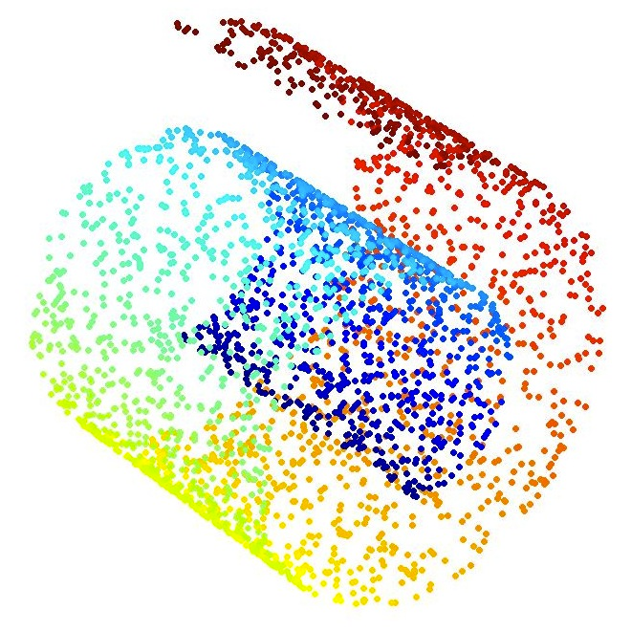
Swiss Roll

Slide 33
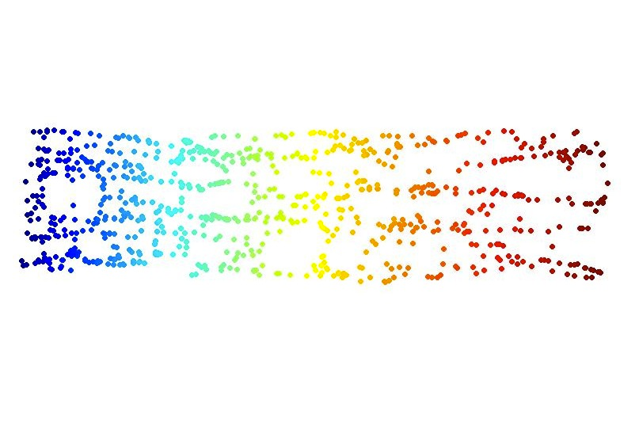
Unfolded Swiss Roll (2D)

