Slide 1
Data Science 8

Slide 2
Overview
Bayesian learning
Bayes’ Rule
Naive Bayes classifier

Slide 3

Bayesian Learning: Key Concepts
Data (d)
Hypotheses (hi)
Evidence
Bayes’ rule

Slide 4
Bayes in Action
posterior
probability
hypothesis
prior
likelihood

Slide 5
New observations update your beliefs
posterior
probability
hypothesis
prior
likelihood
You encounter a person with long hair and try to determine the probability of the person being female
prior = 0.5 (both genders are equally likely)
likelihood = P(long hair | female)
Posterior probability updates the future prior (e.g., flower power)

Slide 6
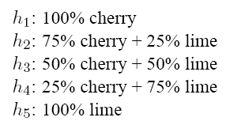

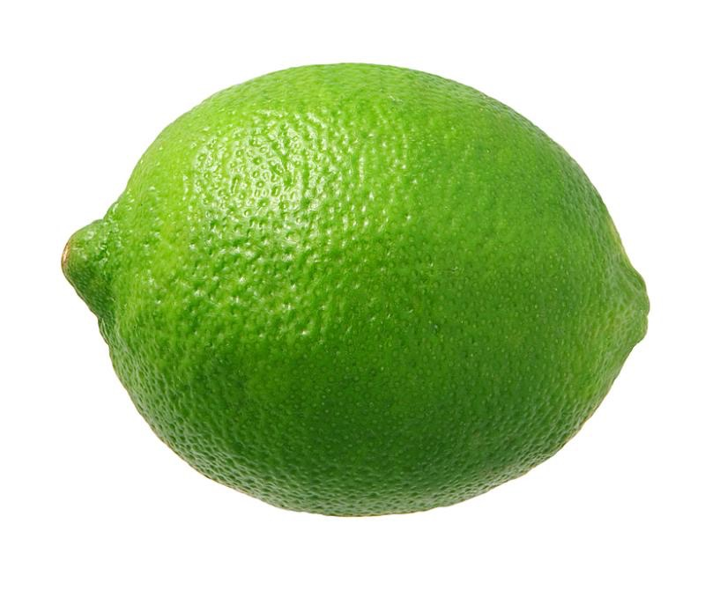
Example (adapted from Russell & Norvig)
Five types of candy bags
Which one is it?
?
Candy in two flavors

Slide 7
Bayesian prediction
Given a new opaque bag of candy
H denotes the type of bag (h1,h2,h3,h4,h5)
d denotes all observations of cherry and lime
TASK: predict the flavour of the next piece of candy
In Bayesian learning: Calculate the probability of each hypothesis, given the observations (data)

Slide 8
Calculating Likelihoods
With each observation, the likelihood is computed according to P(d|h) = P(cherry|h) x P(lime|h) <— assuming independence
In case the bag is all lime (h5) and the first 10 observations are lime, than P(d|h3) = 0.5¹⁰ and P(d|h5) = 1¹⁰

Slide 9
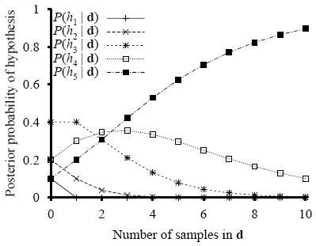
Development of the posterior probabilities (h5 is the true hypothesis, all observations are ‘lime’)

Slide 10
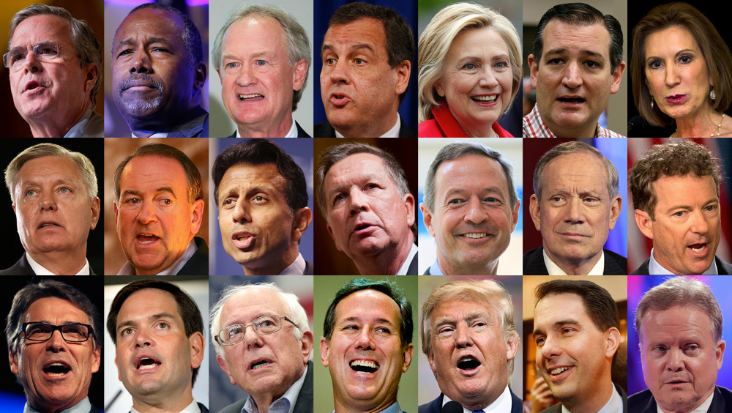
Naive Bayes Classifier
Given a dataset with two classes (Dem,Rep) and three features (A,B,C), compute P(Dem|data) = P(Dem) P(A|Dem) x P(B|Dem) x P(C|Dem) P(Rep|data) = P(Rep) P(A|Rep) x P(B|Rep) x P(C|Rep)
IF P(Dem|data) > P(Rep|data) THEN Classification is Dem ELSE Classification is Rep

Slide 11
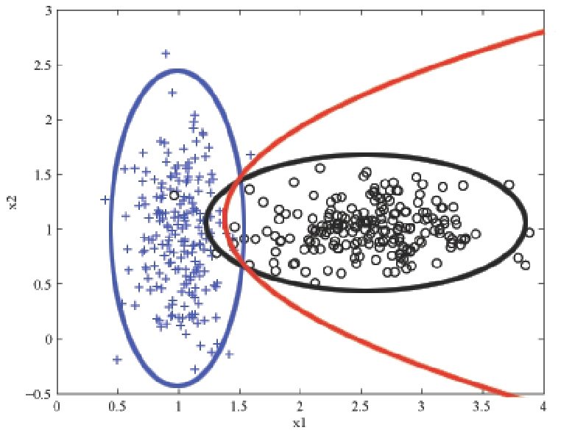
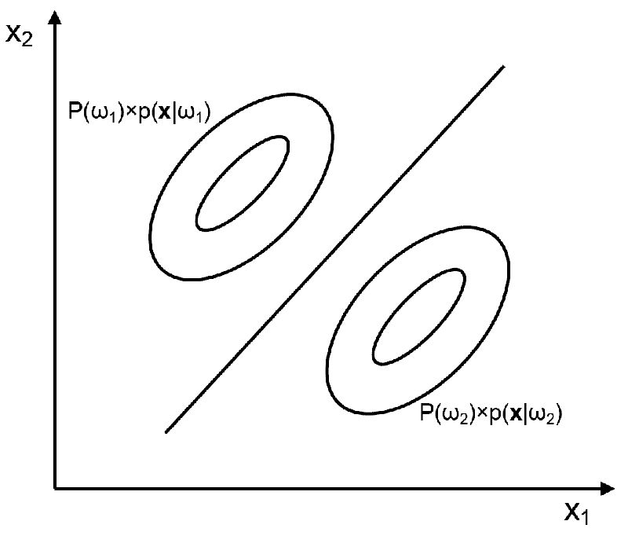
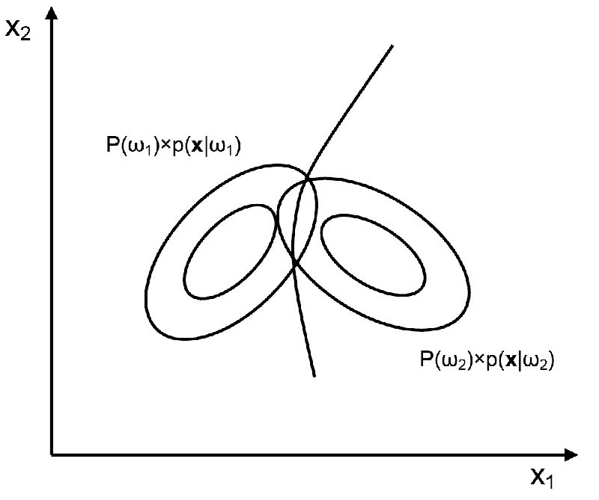
Naive Bayes decision boundaries
probabilities for black and blue classes are equal
can be straight or curved

Slide 12
ORANGE
Use VOTING.TAB

