Slide 1
Data Science 9

Slide 2
Overview
Pre-processing
Normalization
Outlier removal
Feature Selection
Dimensionality Reduction
Error measures

Slide 3
Pre-processing
What are the features?
-> what is available? what domain knowledge do we have (access to)?
What are their distributions (min, max, mean, histogram, outliers)?
-> does the distribution looks approximately normal, uniform, …?
Which features are relevant and why?
-> effect of inclusion/exclusion on prediction performance
-> domain knowledge
Which features are highly correlated? (“collinearity”)
-> correlation matrix
Are there missing feature values? How can they be dealt with?
-> imputation, prediction
Which information is missing in the features and can it be represented by constructed features?
-> domain knowledge!

Slide 4
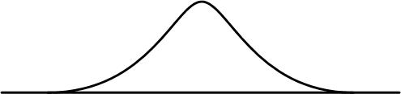
Data normalization
Centering by mean = subtract mean from all values
Scale by std = divide all values by the standard deviation
10
1
100
0
Centering by median = subtract median from all values
Scale by span = divide all values by (max. value - min. value)
(less sensitive to outliers)

Slide 5
Normalization
ionosphere.tab

Slide 6
Outlier Removal/Detection
What is an outlier?
In statistics defined in terms of standard deviations…
In Orange: two methods
- One-class classification (SVM with RBF kernel) -> for non-Gaussian data
- Covariance estimator (for Gaussian data)

Slide 7
One-class classification

Slide 8
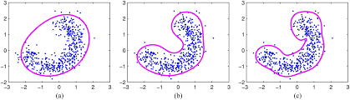
SVM for one-class classification
The banana-shaped decision boundary is formed by the SVM

Slide 9
Outlier removal/detection with SVM

Slide 10
SVM parameters
percentage of support vectors
= minimum complexity of boundary
larger value = smoother boundary

Slide 11
Feature Selection
Three methods for feature selection in Orange
Information Gain (entropy/information)
Gain Ratio (entropy/information)
Gini Index (impurity measure)
Information Theory

Slide 12
The odd-one-out of a dozen
You are given 12 balls, all equal in weight except for one that is either heavier or lighter. You are also given a two-pan balance to use. In each use of the balance you may put any number of the 12 balls on the left pan, and the same number on the right pan, and push a button to initiate the weighing; there are three possible outcomes: either the weights are equal, or the balls on the left are heavier, or the balls on the left are lighter. Your task is to design a strategy to determine which is the odd ball and whether it is heavier or lighter than the others in as few uses of the balance as possible.

Slide 13
(a) How can one measure information?
(b) When you have identified the odd ball and whether it is heavy or light, how much information have you gained?
(c) Once you have designed a strategy, draw a tree showing, for each of the possible outcomes of a weighing, what weighing you perform next. At each node in the tree, how much information have the outcomes so far given you, and how much information remains to be gained?
(d) How much information is gained when you learn
(i) the state of a flipped coin;
(ii) the states of two flipped coins;
(iii) the outcome when a four-sided die is rolled?
(e) How much information is gained on the first step of the weighing problem if 6 balls are weighed against the other 6? How much is gained if 4 are weighed against 4 on the first step, leaving out 4 balls?

Slide 14
The odd-one-out of a dozen
Number of possible outcomes for K uses of the balance equals 3^{K} (= 27 for K = 3)
Number of possible states equals 24
The odd ball can be any of 12 and can be lighter or heavier
Hence three weighings suffice
HINT: what weighing has the maximal information content?

Slide 15
Optimal strategy
The three outcomes
Left heavier
Right heavier
Balance
Should be as close as possible to equiprobable
E.g., starting with balancing balls 1-6 agains 7-12 is suboptimal because “balance” has probability zero in this case

Slide 16
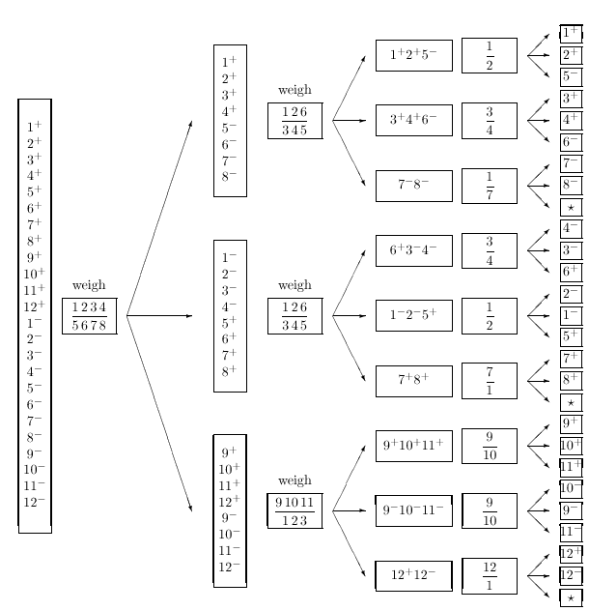
Left
heavier
right
heavier

Slide 17
Conclusion
The outcome of a random experiment is to be most informative if the probability distribution over outcomes is uniform

Slide 18
Feature Selection
ionosphere.tab

Slide 19
Feature Selection
Number of features

Slide 20
Dimensionality Reduction
Principal Component Analysis - continuous features
Correspondence Analysis - discrete features (not for preprocessing)
Multidimensional Scaling (MDS) (not for preprocessing)
k-Means clustering
hierarchical clustering

Slide 21
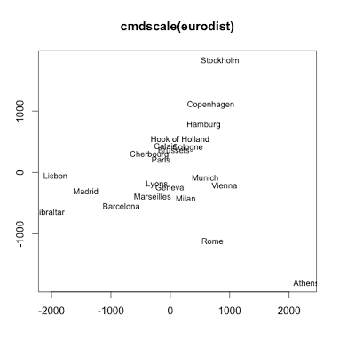
MDS
Input:
Distance table of European cities

Slide 22
MDS in action

Slide 23
k-means clustering
Given k clusters, k-means clustering assigns instances to their nearest cluster
Animation of k-means clustering in action: https://youtu.be/BVFG7fd1H30
Best clustering is obtained for a specific value of k
This value can be determined automatically

Slide 24
k-means clustering in Orange

Slide 25
Hierarchical clustering

Slide 26
Hierarchical clustering in Orange

Slide 27
Error Measures for Regression
MSE = Mean Squared Error
RMSE = Square Root of Mean Squared Error
MAE = Mean Absolute Error
R2 = R-squared (coefficient of determination) = proportion of the variance in the target that is predictable from the feature(s)

Slide 28

Error Measures for Classification
CA = Classification Accuracy
Precision = the fraction of detected instances that are relevant
Recall = the fraction of relevant instances that are detected
Confusion Table is preferred

Slide 29
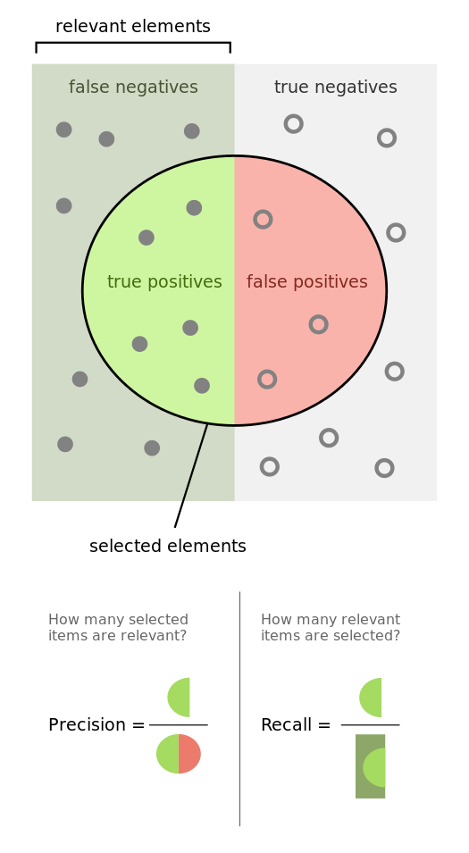
precision is the fraction of retrieved instances that are relevant
recall is the fraction of relevant instances that are retrieved

Slide 30
