Slide 1
Introduction to Data Science 2

Slide 2
Overview
Classification
k-Nearest Neighbour classifier
Decision boundaries
Decision Trees
Trump versus Clinton

Slide 3
Classification
Things are represented by feature vectors (points)
Each thing (point) has a class label, which we represent by colours
Examples of classification tasks:
Stock Market features —> BUY/SELL?
BLOGpost features —> MALE/FEMALE?
Fruit features —> ORANGE/APPLE/KIWI?
Image features —> INDOOR/OUTDOOR?
Strongly idealised!
We almost never see
such clear separation
in real datasets.

Slide 4
Scatterplots (WEKA Visualise - Titanic.arff)
Please note that we can have two types of scatterplots:
feature against feature (e.g., age against fare)
feature against label (e.g., survived against fare)

Slide 5
2 classes (blue and red) defined by 2 features
Feature 2
Feature 1

Slide 6
What are the class labels assigned to the grey instances?
Feature 2
Feature 1

Slide 7
Decision Boundaries
Classifiers are trained on the dataset (labelled data points) and automatically “draw” a decision boundary between the two classes
The decision boundary can be a straight line (“stiff”) or a wiggly line (“flexible”)
The decision boundary is considered to be a model of the separation between the two classes
The model is induced from the data

Slide 8
Decision Boundaries: linear decision boundary
“BLUE”
“RED”
Feature 2
Feature 1
simple model

Slide 9
Decision Boundaries: nonlinear decision boundary
“BLUE”
“RED”
Feature 2
Feature 1
complex model

Slide 10


PLEASE NOTE!
Classification versus Regression (related to 2 types of scatterplots)
In classification, the model induced from the data defines a decision boundary that separates the data described by 2 features into 2 classes (e.g., cats versus dogs) or more.
In regression, the model induced from the data fits the data to describe the relation between 2 features or between a feature (e.g., furriness) and the label (e.g., cuteness)
separates the data
NOT NOW
fits the data

Slide 11
k-Nearest Neigbour classifier
IBk (“lazy learner”)

Slide 12
Two Classes (blue & red)
Feature 2
Feature 1

Slide 13
What are the class labels of the white dots?
Feature 2
Feature 1

Slide 14
Nearest-neighbour classifier
Given a set of labeled instances (training set), new instances (test set) are classified according to their nearest labeled neighbour

Slide 15
Nearest Neighbour Classification (“estimates”)
RED
BLUE
RED
Feature 2
BLUE
Feature 1

Slide 16
Evaluating 1-NN performance
or actually: evaluating classifier performance

Slide 17
does the estimated color agree with the actual color?
actual color
test instance
training instances
test instances
# test | c | ok??
1 | R | 0
2 | B | 1
3 | B | 1
4 | B | 0
5 | R | 0
6 | R | 1
7 | R | 1
8 | B | 1
9 | R | 1
10 | B | 0
4
1
3
2
5
7
Feature 2
6
8
9
10
Feature 1
￼

Slide 18
Two evaluation measures
Accuracy: (number of 1’s)/10 x 100%=60%
Confusion Table
 | estimate = Red | estimate = Blue
actual = Red | 3 | 2
actual = Blue | 2 | 3

Slide 19
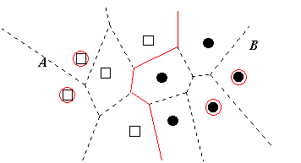
Decision Boundary in
1-NN classifier

Slide 20
k-NN
In the k-NN classifier, the parameter k represents the number of labeled neighbours considered
k = 3: test examples are assigned the labels of the (majority of the) 3 nearest neighbours
k = N: test examples are assigned the labels of the (majority of the) N nearest neighbours
For even N in case of an equal number of nearest neighboring labels of two classes: flip a coin

Slide 21
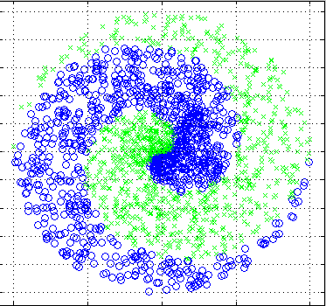
Toy dataset: spirals

Slide 22
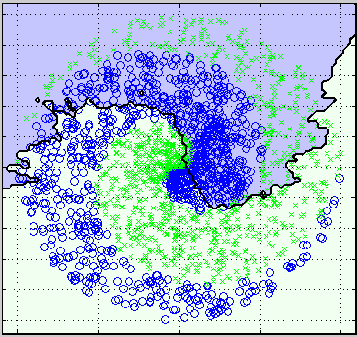
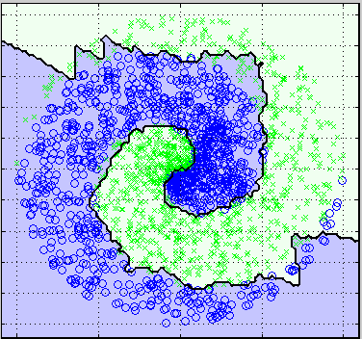
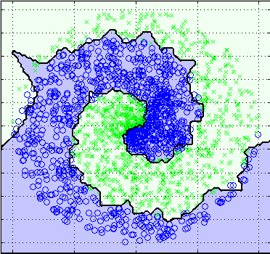
k = 100
k = 10
k = 1
Decreasing number of neighbours

Slide 23
Decision Tree

Slide 24
Classification Problem (blue or green?)
Feature 2
Train instances
blue and green
Test instance
gray
Classifier induced from the data defines decision boundaries
Feature 1

Slide 25
Decision Trees
Decision Trees take one feature at a time and test a binary condition For instance: is the feature larger than 0.5? If the answer is YES, grow a node to the left If the answer is NOW grow a node to the right
Is Feature 1 > 0.5?
YES
NO
Is Feature 2 < 0.1?0.5?
Is Feature 3 > 10? 0.5?

Slide 26
This results in the following decision Boundary
Feature 2
NO
YES
Is Feature 1 > 0.5?
YES
NO
0.5
Feature 1

Slide 27
Decision Tree grows with each level of questions
Each node (box) of the decision tree tests a condition on a feature
The order of features is important
It is like playing “20 questions”
“Guess the person”: it is better to start with the question “Is he male?”, rather than with “Is it Chris?”
The reason is that the answer to the first question maximises the information (“entropy”) gained from the answer.*
In decision trees the order of features to be tested is determined by means of information theory (ID3 algorithm)

Slide 28
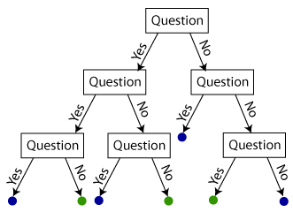
Decision Tree
test instance
Is it blue or green?
Reproduced from: https://shapeofdata.wordpress.com/2013/07/02/decision-trees/

Slide 29
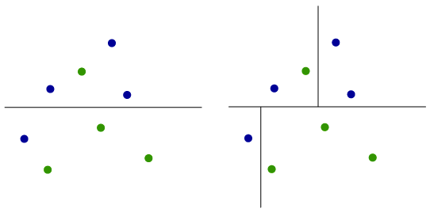
Each test (box) adds a decision boundary
Reproduced from: https://shapeofdata.wordpress.com/2013/07/02/decision-trees/

Slide 30
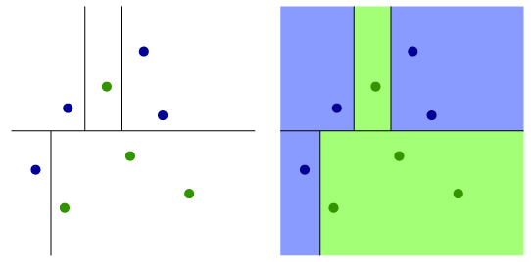
Adding another decision boundary
Reproduced from: https://shapeofdata.wordpress.com/2013/07/02/decision-trees/

Slide 31
Complexity of the induced model
The complexity of the model induced by a decision tree is determined by the depth of the tree
Increasing the depth of the tree increases the number of decision boundaries
All decision boundaries are perpendicular to the feature axes, because at each node a decision is made about a single feature
Is Feature 1 > 0.5?
YES
NO
Is Feature 2 < 0.1?0.5?
Is Feature 3 > 10? 0.5?

Slide 32
Summary
We have introduced two classifiers
- nearest neighbour classifier
- decision tree classifier
We know what decision boundaries are
We know how they relate to the complexity of induced models in the classifiers
We have introduced two evaluation measures

Slide 33

Required Reading
WEKA book: Chapter 2
Section 3.5 Instance-based representation
A “data science = statistics” overview

