Slide 1
Introduction to Data Science 5

Slide 2
Overview
Optimisation of parameters in J48
Comparing (variants) of classifiers
Evaluation with the t-test
WEKA’s Experimenter

Slide 3
J48

Slide 4
Pruning

Slide 5
Pruning

Slide 6
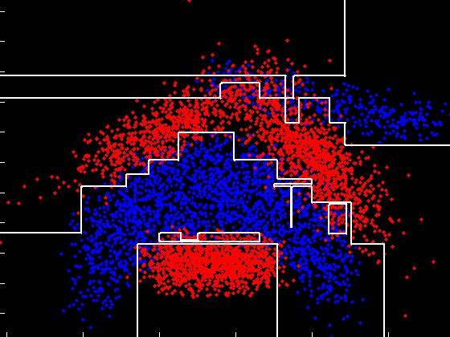
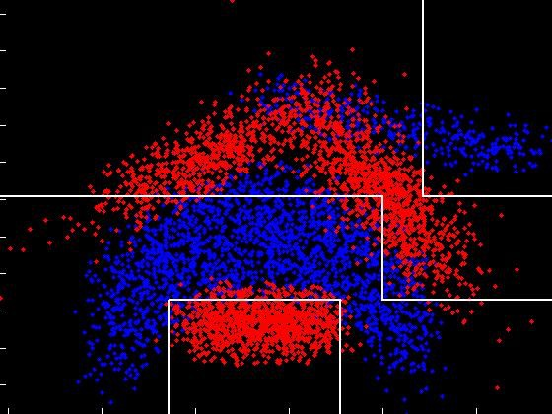
Pruning reduces the complexity of the decision tree
complex tree (unpruned)
Less complex tree (pruned)

Slide 7
Model complexity
A pruned decision tree is less complex, than an unpruned one
Less complex models tend to generalise better (= perform better on unseen data), provided that they are sufficiently complex to capture the structure of the data

Slide 8
kNN versus decision tree
In the kNN classifier, the k parameter tunes the complexity
In the decision tree classifier, pruning tunes the complexity
Increasing k or pruning: less complexity
Decreasing k or pruning: more complexity

Slide 9
Comparing (variants) of classifiers

Slide 10
Parameter optimisation
(example, see also p.149 WEKA book)
1-NN
2-NN
3-NN
4-NN
5-NN
TRAIN
TRAIN
TRAIN
TRAIN
TRAIN
VALIDATION
VALIDATION
VALIDATION
VALIDATION
VALIDATION
70%
80%
86%
60%
55%
TEST
74%

Slide 11
Model selection / parameter optimisation
1-NN
3-NN
J48mno2
J48mno5
J48mno9
TRAIN
TRAIN
TRAIN
TRAIN
TRAIN
VALIDATION
VALIDATION
VALIDATION
VALIDATION
VALIDATION
70%
80%
86%
60%
55%
TEST
74%

Slide 12
Significant differences?
1-NN
3-NN
J48mno2
J48mno5
J48mno9
TRAIN
TRAIN
TRAIN
TRAIN
TRAIN
VALIDATION
VALIDATION
VALIDATION
VALIDATION
VALIDATION
70%
84%
86%
85%
55%
the best?

Slide 13
Validation performance is an average score
In case of 10-fold cross validation, it is an average of the scores over 10 folds
So, each validation performance has a standard deviation associated with it
To decide if two scores (averages) differ, you need to perform a statistical test

Slide 14
t-test and p-value
p=0.05 means: in 1 of 20 experiments you wrongly declare a difference to be significant
p=pvalue means: in 1 of 1/pvalue experiments you wrongly declare a difference to be significant

Slide 15
WEKA Experimenter

Slide 16
In total 100 runs (10 x 10cv experiments) will be performed

Slide 17
v = performs significantly better than the Test base
* = performs significantly worse than the Test base

Slide 18
Required Reading
Bouckaert, R.R. & Frank, E. (2004). Evaluating the Replicability of Significance Tests for Comparing Learning Algorithms. In H. Dai, R. Srikant, & C. Zhang (Eds.), Advances in Knowledge Discovery and Data Mining, Volume 3056 of the series Lecture Notes in Computer Science pp 3-12. Springer.
http://www.cs.waikato.ac.nz/~eibe/pubs/bouckaert_and_frank.pdf

