Slide 1
Introduction to Data Science 6

Slide 2
Overview
Precision & Recall (reprise)
PCA is color blind
3 new classifiers
- Random Decision Forests
- Naive Bayes
- Support Vector Machines

Slide 3
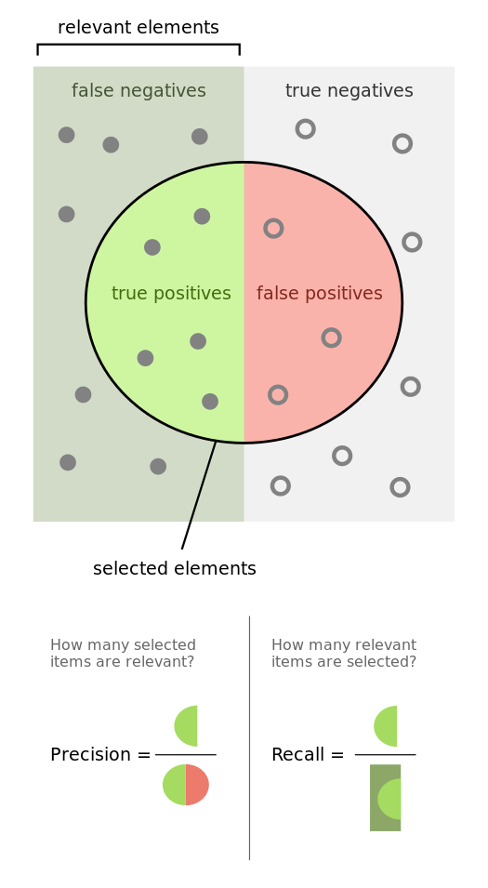
precision is the fraction of retrieved instances that are relevant
recall is the fraction of relevant instances that are retrieved

Slide 4
1D structure in
2D feature space
number of inbound links
Google Rank

Slide 5
PCA
number of inbound links
Principal Component 2
Principal Component 1
Google Rank

Slide 6
Principal Component 2
Principal Component 1

Slide 7


PCA
Takes 2 features as input
Feature 1: Number of inbound links
Feature 2: Google Rank
… and gives 2 new features as output
Principal Component 1
Principal Component 2
a
+ b
c
+ d

Slide 8
Principal Component 1 describes the data (almost) completely
Principal Component 2 describes the “noise”
Therefore, Principal Component 2 can be removed.
Principal Component 2
Principal Component 1

Slide 9
PCA + discarding highest PCs
Takes 2 features as input
Feature 1: Number of inbound links
Feature 2: Google Rank
… and gives 1 new feature as output
Principal Component 1
a
+ b

Slide 10
Dimensionality Reduction
PCA performs dimensionality reduction
It reduces 2 dimensions (features) to 1
PCA
Principal Component 1

Slide 11
PCA in higher dimensions
For datasets with N features (N>2), PCA rotates the coordinate system in such a way that:
- the projection of the data on the first principal component (new axis) has the largest variance,
- the projection of the data on the second principal component (new axis) has the one-but-largest variance,
and so forth… (up to N principal components)
If the variation in the data is associated with relevance for classification (or regression), the most relevant features are captured by the first M principal components (and the rest captures noise)
Retaining the first M principal components and throwing away the rest effectively reduces the dimensionality
M is typically much smaller than N, hence “dimensionality reduction”

Slide 12
PCA is color blind!
Feature 2
Feature 1

Slide 13
PCA is color blind!
PC1 (retained)
PC2 (discarded)

Slide 14
PCA is color blind!
PCA hinders rather than helps: proper classification requires PC2
PC1 (retained)
PC2 (discarded)

Slide 15
PCA is a “linear” method
Another reason why PCA is not beneficial to the classification/regression is that it relies on “linear” (straight) data relations
It cannot deal with nonlinear (curved) data relations

Slide 16
1D curved structure in
2D feature space
Feature 2
Feature 1

Slide 17
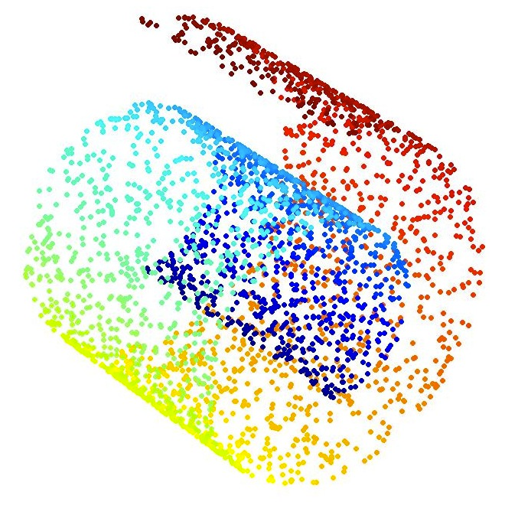
The Swiss Roll dataset
Data points in 3D (hard to classify)

Slide 18
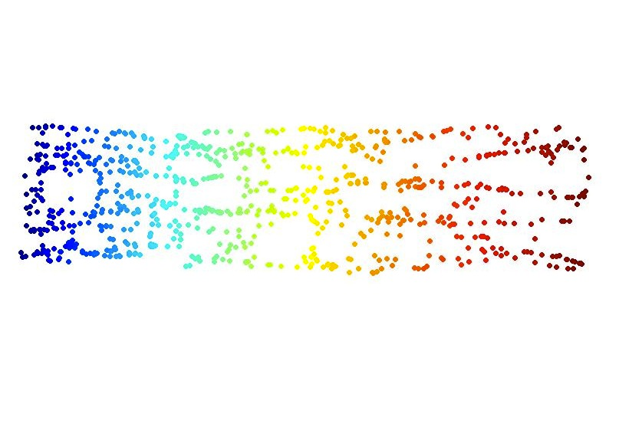
A problem PCA cannot deal with
Unfolded data points in 2D (easy to classify)

Slide 19
3 new classifiers…

Slide 20
1. Random Decision Forests

Slide 21
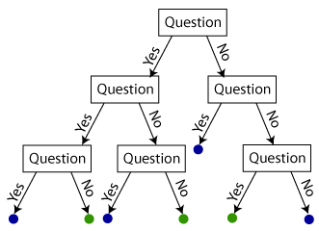
Recall: decision tree
test instance
Is it blue or green?
Reproduced from: https://shapeofdata.wordpress.com/2013/07/02/decision-trees/

Slide 22
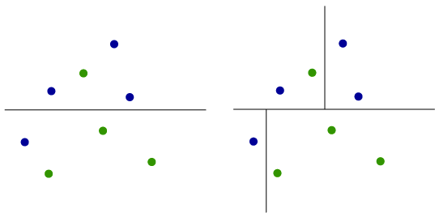
Each test (node) adds a decision boundary
Reproduced from: https://shapeofdata.wordpress.com/2013/07/02/decision-trees/

Slide 23
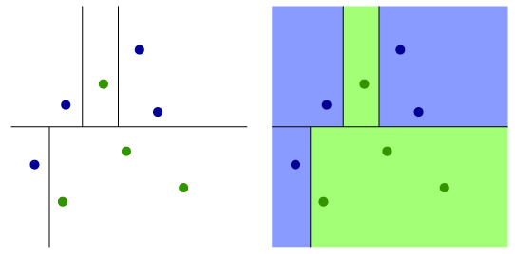
Adding another node/decision boundary
Reproduced from: https://shapeofdata.wordpress.com/2013/07/02/decision-trees/

Slide 24
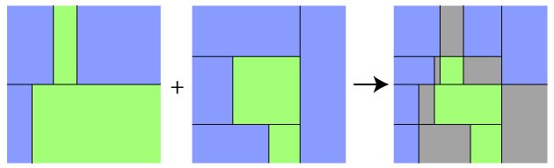
Decision Forests:
from one tree to many
Decision Tree 1
Decision Tree 2
Decision Forest
Feature 2
Feature 1
Feature 1
Feature 1

Slide 25
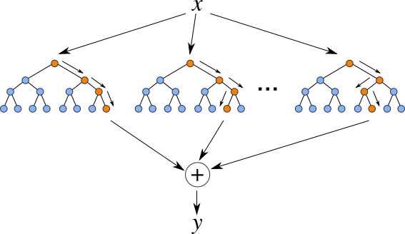
Classification and Regression with Random Decision Forests
RDFs: random distribution
of subsets of features over
the trees
Classification: y = the mode of the classes outputted by the trees.
Regression: y = the mean of the values outputted by the trees.

Slide 26
Random Decision Forests
The complexity of RDFs is determined by the number of trees (and their depths)
In some decision forests trees are induced on the same complete set of features
In random decision forests, trees are induced on randomly selected subsets of features

Slide 27
2. Naive Bayes Classifier

Slide 28

Bayes’s rule
Data (d)
Hypotheses (hi)
Evidence
Bayes’ rule:
“P(h|d)” should be read as: the probability that h is true, given d

Slide 29
Reading the Bayes equation
POSTERIOR
LIKELIHOOD
PRIOR
multiplication constant

Slide 30
New observations update your beliefs
You encounter a person with long hair and try to determine the probability of the person being female
PRIOR = 0.5 (both genders are equally likely)
LIKELIHOOD = P(long hair | female)
POSTERIOR probability updates the future prior (e.g., flower power)

Slide 31
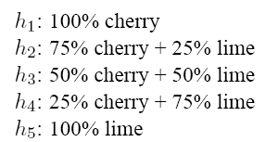

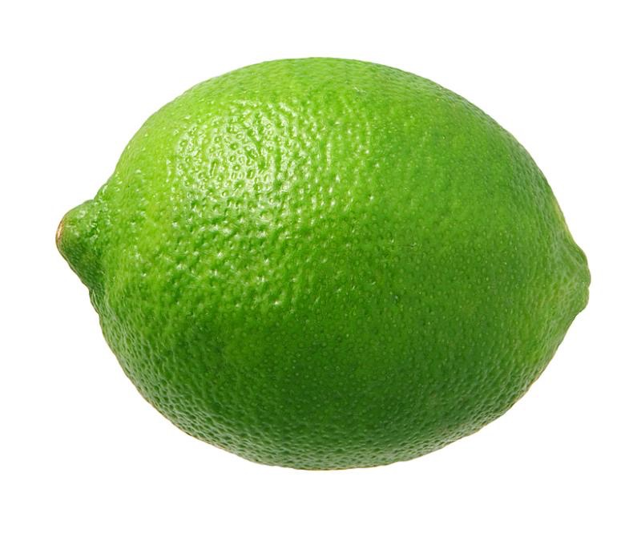
Example (adapted from Russell & Norvig)
Five types of candy bags
Which one is it?
?
Candy in two flavors

Slide 32
Bayesian prediction
Given a new opaque bag of candy
H denotes the type of bag (h1,h2,h3,h4,h5)
d denotes all observations of cherry and lime
TASK: predict the flavour of the next piece of candy
In Bayesian learning: Calculate the probability of each hypothesis, given the observations (data)

Slide 33
Calculating Likelihoods
With each observation, the likelihood is computed according to P(d|h) = P(cherry|h) x P(lime|h) <— assuming independence
In case the bag is all lime (h5) and the first 10 observations are lime, than P(d|h3) = 0.5¹⁰ and P(d|h5) = 1¹⁰

Slide 34
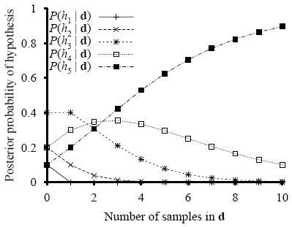
Development of the posterior probabilities (h5 is the true hypothesis, all observations are ‘lime’)
maximum likelihood

Slide 35
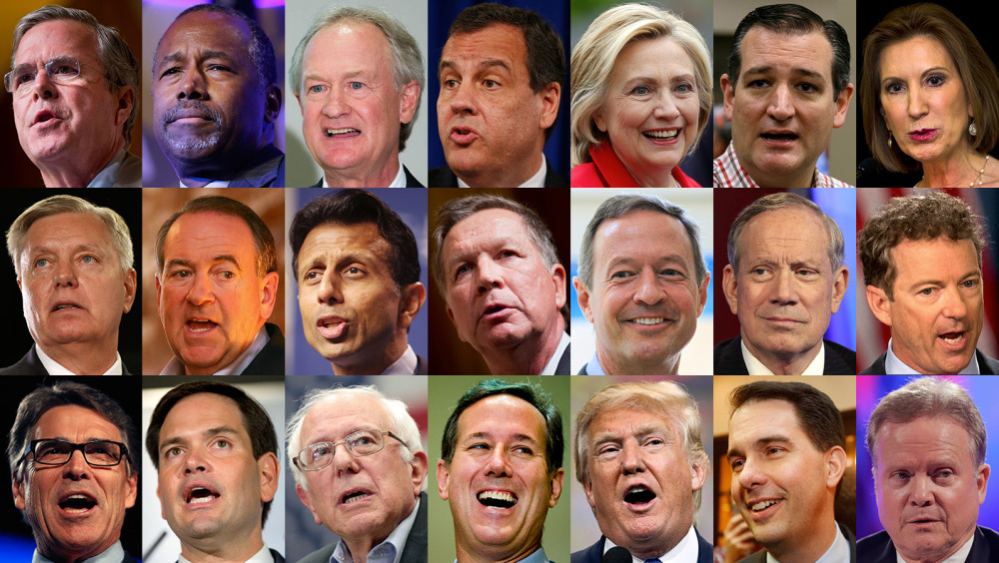
Naive Bayes Classifier
Given a dataset with two classes (Dem,Rep) and three features (A,B,C), compute P(Dem|data) = P(Dem) P(A|Dem) x P(B|Dem) x P(C|Dem) P(Rep|data) = P(Rep) P(A|Rep) x P(B|Rep) x P(C|Rep)
IF P(Dem|data) > P(Rep|data) THEN Classification is Dem ELSE Classification is Rep
maximum likelihood

Slide 36
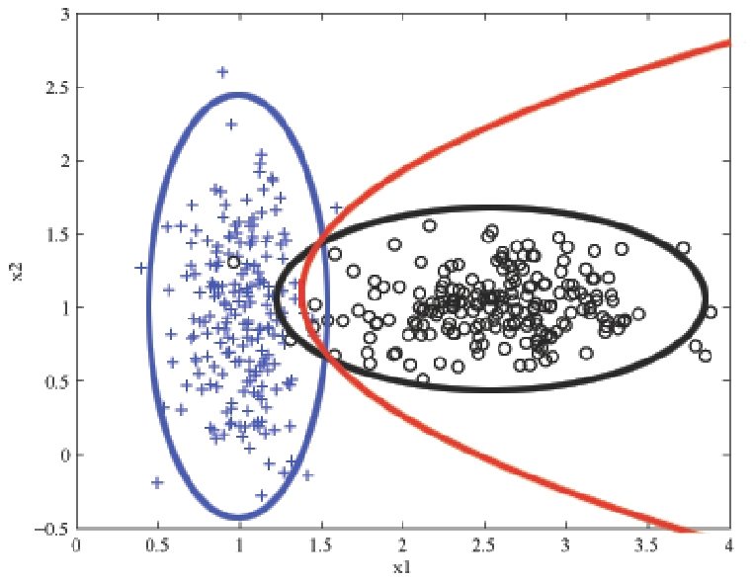
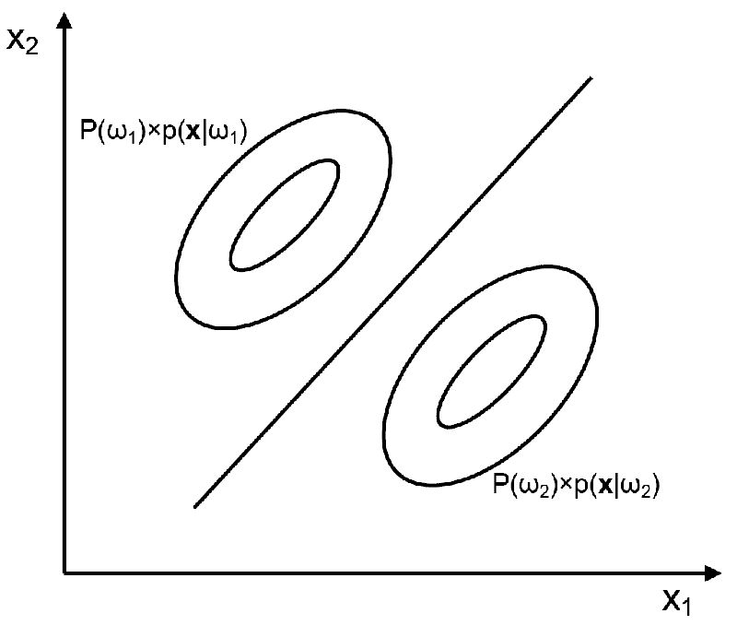
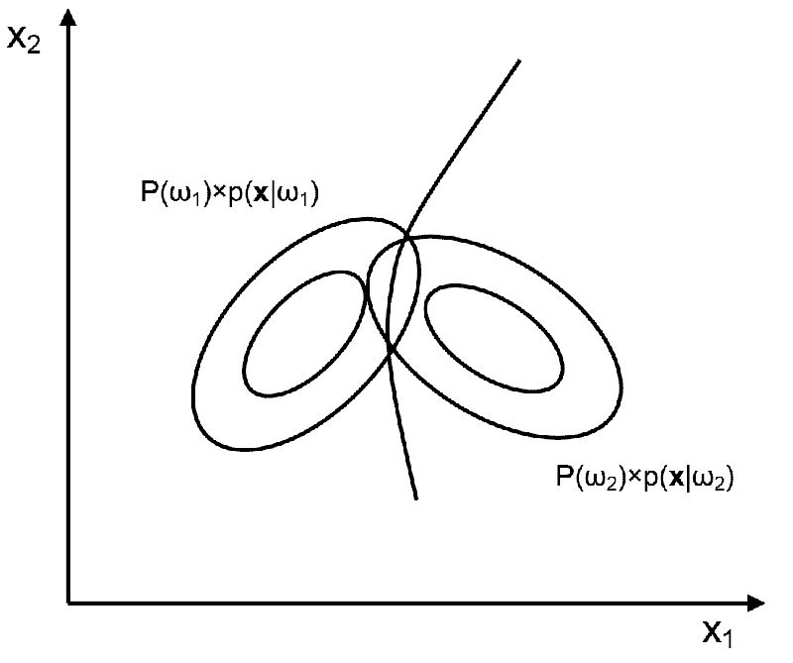
Naive Bayes decision boundaries
probabilities for black and blue classes are equal
can be straight or curved

Slide 37
3. Support Vector Machines
a.k.a. Kernel Machines

Slide 38
Simplest SVM
Linear SVM
Places a straight line between the classes (simplest model)
the instances are linearly separable
the instances are not linearly separable

Slide 39
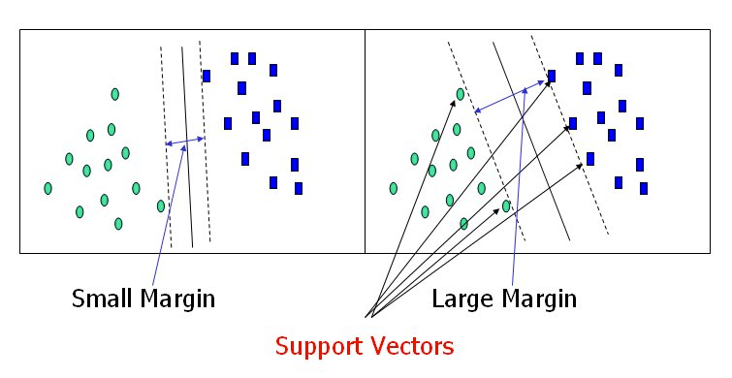
Why “Support Vector Machine”?
worse
decision
boundary
better
decision
boundary

Slide 40
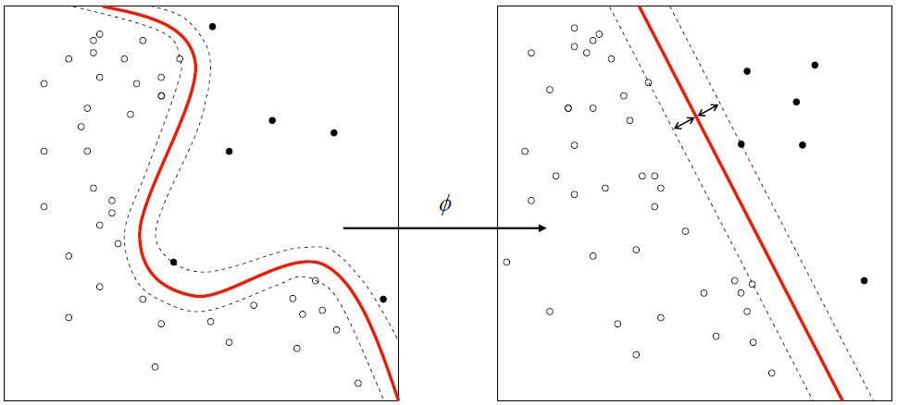
SVMs can make more complex decision boundaries by using kernels
kernel

Slide 41
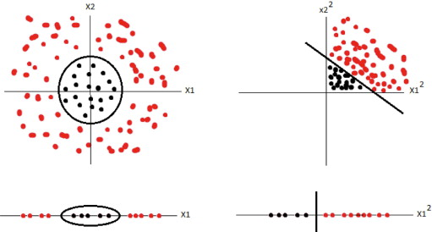
Kernel
A kernel performs a mathematical operation on instances in two classes that are not linearly separable, so that they do become linearly separable

Slide 42
WEKA

Slide 43
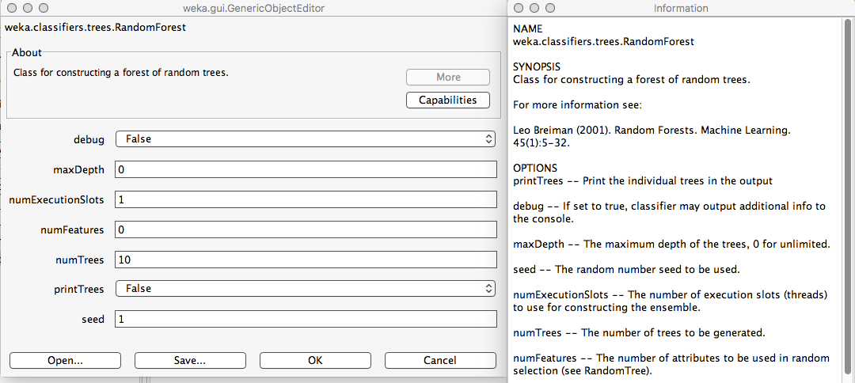
Random Decision Forests in WEKA

Slide 44
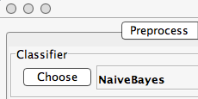
Naive Bayes in WEKA

Slide 45
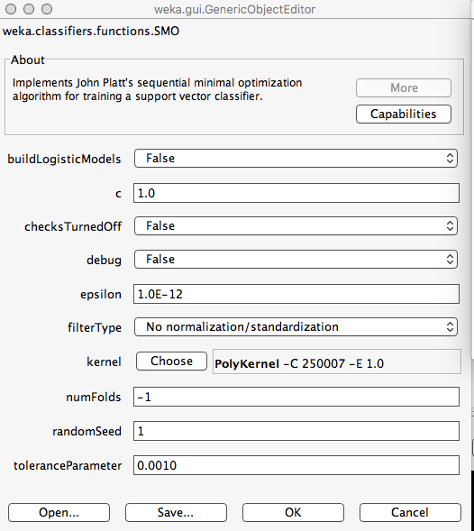
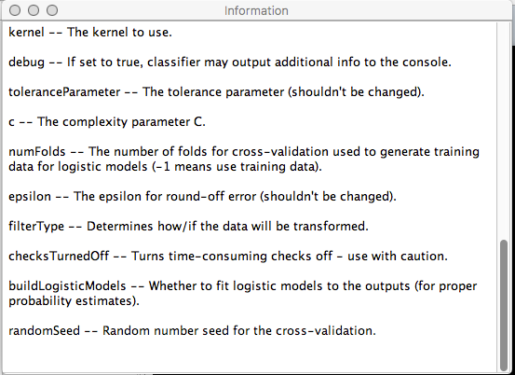
SVM (SMO) in WEKA
(There is also a LibSVM version.)

Slide 46
Suggested Reading
WEKA book
Kernel methods: Section 6.4, pp. 223-229
Naive Bayes: Section 4.2, pp. 90-99
Please note that these sections contain many equations.

