Slide 1
Real-time Application Representative (RAPR)
RAPR can generate and respond to real-time network traffic
Designed to emulate 'real' application behaviors in a controllable, repeatable, and measurable manner
Built around the MGEN toolkit and supports most of the traffic shaping functionality available in Mgen Version 5.0

Slide 2
Real-time Application Representative (RAPR)
Network traffic logged in MGEN log file format so MGEN oriented post analysis tools (e.g. TRPR, Dazle) can be used to calculate performance statistics
20:40:06.085045 LISTEN proto>UDP port>5000
20:40:06.085653 SEND proto>UDP flow>1 seq>0 srcPort>5001 dst>192.168.1.102/5000 size>1024
20:40:06.094358 RECV proto>UDP flow>1 seq>0 src>192.168.1.102/5000 dst>192.168.1.100/5000 sent>20:42:46.870052 size>1024 gps>INVALID,999.000000,999.000000,-999 data>18:020402000000030450227B43040402000064
20:40:06.095694 SEND proto>UDP flow>2 seq>0 srcPort>5000 dst>192.168.1.102/5000 size>1024

Slide 3
Real-time Application Representative (RAPR)
RAPR Behavior is defined by
  RAPR Input Script
  RAPR Behavior Table
  RAPR Run-time Interface

Slide 4
Real-time Application Representative (RAPR)
RAPR Input Script
  is used to schedule emulated application behavior over a time line
RAPR Behavior Table
  defines behavior in response to network or application generated events
RAPR Run-Time Interface
  can be used to inject and schedule additional RAPR behaviors

Slide 5
Real-time Application Representative (RAPR)
RAPR behavior is defined in the input script and behavior table by
  Reception Events that direct rapr to listen for specific network traffic
  Rapr Events & Global Commands that direct the application itself (e.g. load a dictionary, set global TTL values)
  Behavior Events that are mainly responsible initiating network traffic and monitoring responses

Slide 6
Real-time Appliation Representative (RAPR)
“Behavior Events” are rather elementary. Include:
  DECLARATIVE events that send TCP or UDP traffic to a destination address and complete
  INTERROGATIVE events that send TCP or UDP traffic to a destination address and await a response. If a response is not received within a specified time period, the message will be resent N number of times

Slide 7
Real-time Appliation Representative (RAPR)
“Behavior Events” continued:
  STREAM events that send UDP multicast traffic and wait for and react to responses from other nodes listening to the multicast address. Stream events are currently designed to facilitate VoIP traffic patterns and emulate “conversations”.
  PERIODIC events are used to spawn other behavior event types at regular intervals

Slide 8
Real-time Appliation Representative (RAPR)
It is the interaction between the generated network traffic initiated by “Behavior Events” defined in an input script over a time line and a target node(s) response as defined in its “Behavior Table” that together emulate network enable application behavior

Slide 9
Real-time Appliation Representative (RAPR)
Generated traffic can be associated with a “logic id” put in the message payload
This “logic id” is used by the target node to look up any response behavior(s) associated with it in the receiving node(s) Behavior Table

Slide 10
Real-time Application Representative (RAPR)
A DICTIONARY is available to translate name-value pairs used by the application and scripts
Journalling capability coupled with offset enables system restart mid-test
All behavior is associated with the same seed value across multiple runs of the application such that any “random” behavior in the system is repeatable

Slide 11
INPUT SCRIPT
HOSTID 100
LOAD_DICTIONARY ./dictionary-demo.xml
RAPRPIPE rapr-demo
OVERWRITE_MGENLOG ./mgenApp-demo.log
OVERWRITE_RAPRLOG ./raprApp-demo.log
TXLOG
FLUSH
CHECK
0.0 LOGICTABLE_FILE ./logictable-demo.xml
0.0 STOP 3600.0 LISTEN UDP 5000
0.0 STOP 3600.0 LISTEN UDP %MULTICAST_SERVER_SRCPORT%
0.0 STOP 3600.0 JOIN 224.225.1.3
0.0 STOP 3600.0 JOIN %MULTICAST_VIDEO_STREAM_1%

Slide 12
INPUT SCRIPT
0.0 STOP 10.0 DECLARATIVE UDP SRC 6000 DST 192.168.1.102/5001 PERIODIC [1 1024]
3.0 DECLARATIVE UDP SRC 6000 DST %CMDR%/6001 PERIODIC [1 1024]
5.0 DURATION 50.0 INTERROGATIVE RETRYINTERVAL 5 NUMRETRIES 5 UDP SRC 5001 DST 192.168.1.102/5000 PERIODIC [1 1024] PAYLOAD 1 FAILURE 2
7.0 STREAM RESPPROB 0 50 BURSTPRIORITY 5 BURSTDURATION 5 BURSTCOUNT 10 BURSTDELAY 1 3 BURSTRANGE 1 3 TIMEOUTINTERVAL 5 UDP SRC 5011 DST 224.225.1.2/5000 PERIODIC [1 1024] PAYLOAD 1

Slide 13
Input Script
HOSTID 61
START HH:MM:SS
OFFSET 5
TOS 0x10
TTL 3
INTERFACE %MANET_MULTICAST_INTERFACE%
INPUT inputScript.rapr
RAPRLOG logfile.log
OVERWRITE_RAPRLOG logfile.log
MGENLOG mgenlogfile.log
OVERWRITE_MGENLOG mgenlogfile.log
TXBUFFER 8192
RXBUFFER 8192

Slide 14
Input Script
0.0 STOP 3600.0 RAPRFLOWID 1 DECLARATIVE UDP SRC 6000 DST 192.168.1.100/6001 PERIODIC [1 1024]
25.0 STOP RAPRFLOWID 1
25.0 CHANGE_STATE %STATE_VALUE%
30.0 CLEAR ALL [declarative|interrogative|join...]
30.0 INPUT ./raprScript.rapr
35.0 LOGICID 2

Slide 15
Behavior Table
XML file
Same event syntax as used by Input Script, e.g Behavior Events, RaprEvents, and Reception Events
Each entry in the table associated with a “logic id” within a state block
Multiple events can be defined for a single logic id
Dictionary translation available

Slide 16
Behavior Table
Logic ID can come from the following triggering events:
  PAYLOAD logic id of an incoming RAPR message
  A LOGICID rapr event command
  From a SUCCESS, FAILURE, or TIMEOUT logic ID associated with a Behavior Event

Slide 17
Behavior Table
<RaprLogicTable>
<state>
<value>%NORMAL%</value>
<logicid>
<id>1</id>
<entry>DECLARATIVE UDP SRC ...</entry>
<entry>INTERROGATIVE TCP SRC ...</entry>
</logicid>
</state>
</RaprLogicTable>

Slide 18
Dictionary
“Namespace” can be used to differentiate common dictionary names e.g
  %SERVER:IP% vs
  %CLIENT:IP%
“PACKET” namespace reserved for information contained in an incoming mgen packet:
  %PACKET:SRCIP%
  %PACKET:SRCPORT%

Slide 19
Dictionary
“System” namespace reserved for access to random functions, e.g.
  %SYSTEM:RANDOMI(5,10)%
  %SYSTEM:RANDOMF(5,10,1)%
  For example:
    %SYSTEM:RANDOMI(5,10)% DECLARATIVE UDP SRC 5000 DST 192.168.1.102/6001 PERIODIC [1 1024] PAYLOAD 1
    %SYSTEM:RANDOMI(12,15)% DURATION %SYSTEM:RANDOMI(1,8)% DECLARATIVE UDP SRC %SERVER_DATA_PORT% DST %PACKET:SRCIP/%PACKET:SRCPORT% PERIODIC [%SYSTEM:RANDOMI(1,4)% %SYSTEM:RANDOMI(800,1400)%]

Slide 20
Dictionary
%HOSTID% keyword can be embedded in dictionary names such that values unique to a specific host can be put in a common dictionary used in network wide “application”, e.g.
HOSTID 61
DECLARATIVE ... DST %%HOSTID%DBSERVER% ...
<field>61DBSERVER</field>
<value 192.168.1.103</value>
<field>62DBSERVER</field>
<value 192.168.1.104</value>

Slide 21
Dictionary
<RaprDictionary>
<namespace>
<label>NAMESPACENAME</label>
<item>
<field>FIELDNAME</field>
<value>VALUE1</value>
<value>VALUE2</value>
</item>
</namespace>
</RaprDictionary>

Slide 22
Dictionary
<field>SUBORDINATES</field>
<value>192.168.1.100</value>
<value>192.168.1.101</value>
DECLARATIVE UDP SRC 5000 DST %SUBORDINATES%/5000 PERIODIC [1 1024]
results in TWO behavior events:
DECLARATIVE UDP SRC 5000 DST 192.168.1.100...
DECLARATIVE UDP SRC 5000 DST 192.168.1.101...

Slide 23
Repeatable Behavior
Each Behavior Event has a Random Number Generator seeded with running seed value upon instantiation
Default seed (based on HOSTID) can be changed w/INITIAL_SEED directive.
Seeds are sent in all messages.
Behavior events triggered by incoming messages are seeded from message seed
Same seeds assigned to behavior events upon system restart w/offset value

Slide 24

Simple
Interrogative
5.0 INTERROGATIVE RETRYINTERVAL 5 NUMRETRIES 2 UDP SRC 5001 DST 192.168.1.102/6001 PERIODIC [1 1024] PAYLOAD 1
Behavior Table
Script
Script
Script
Behavior Table
Source
Dest
Dictionary
Log File
Log File
Dictionary

Slide 25
Simple
Interrogative
5.0 INTERROGATIVE RETRYINTERVAL 5 NUMRETRIES 2 UDP SRC 5001 DST 192.168.1.102/6001 PERIODIC [1 1024] PAYLOAD 1
Behavior Table
Script
Script
Behavior Table
Interrogative
Source
dst>192.168.1.102/6001 payload>1 UBI>1
Dest
Dictionary
Log File
Log File
Dictionary

Slide 26

Simple
Interrogative
Is it my UBI? NO? Lookup Logic ID 1
Behavior Table
Script
Script
Behavior Table
Interrogative
Source
dst>192.168.1.102/6001 payload>1 UBI>1
Dest
Dictionary
Log File
Log File
Dictionary

Slide 27

Simple
Interrogative
logicid>
<id>1</id>
<entry>DECLARATIVE UDP 5001 DST %PACKET:SRCIP%/%PACKET:SRCPORT% %MGEN-PATTERN% PAYLOAD %SEND_FILE%</entry>
</logicid>
Behavior Table
Script
Script
Behavior Table
Interrogative
Lookup Logic ID 1
Source
Dest
Dictionary
Log File
Log File
Dictionary

Slide 28

Simple
Interrogative
logicid>
<id>1</id>
<entry>DECLARATIVE UDP 5001 DST %PACKET:SRCIP%/%PACKET:SRCPORT% %MGEN-PATTERN% PAYLOAD %SEND_FILE%</entry>
</logicid>
Behavior Table
Script
Script
Behavior Table
Interrogative
Source
Dest
Dictionary
Log File
LogFile
Dictionary
<namespace>
<label>DEFAULT</label>
<field>MGEN-PATTERN</field>
<value>PERIODIC [1 1024]</value>
<field>SEND_FILE</field>
<value>2</value>
</label>

Slide 29
Simple
Interrogative
logicid>
<id>1</id>
<entry>DECLARATIVE UDP 5001 DST %PACKET:SRCIP%/%PACKET:SRCPORT% %MGEN-PATTERN% PAYLOAD %SEND_FILE%</entry>
</logicid>
Behavior Table
Script
Script
Behavior Table
Interrogative
Declarative
Source
dst>192.168.1.100/5001 UBI>1 payload>2
Dest
<
Dictionary
Log File
Log File
Dictionary

Slide 30
Simple
Interrogative
Behavior Table
Script
Script
Behavior Table
Interrogative
Declarative
X
Source
dst>192.168.1.100/5001 UBI>1 payload>2
Dest
<
Dictionary
Log File
Log File
Dictionary

Slide 31

Simple
Interrogative
Behavior Table
Script
Script
Behavior Table
Interrogative
Source
dst>192.168.1.102/6001 payload>1 UBI>1
Dest
Dictionary
Log File
Log File
Dictionary
Wait 5 seconds.
Response received? No.
Send another packet

Slide 32
Simple
Interrogative
Is it my UBI? NO? Lookup Logic ID 1
Behavior Table
Script
Script
Behavior Table
Interrogative
Source
Dest
Dictionary
Log File
Log File
Dictionary

Slide 33
Simple
Interrogative
logicid>
<id>1</id>
<entry>DECLARATIVE UDP 5001 DST %PACKET:SRCIP%/%PACKET:SRCPORT% %MGEN-PATTERN% PAYLOAD %SEND_FILE%</entry>
</logicid>
Behavior Table
Script
Script
Behavior Table
Interrogative
Lookup Logic ID 1
Source
Dest
Dictionary
Log File
Log File
Dictionary

Slide 34
Simple
Interrogative
logicid>
<id>1</id>
<entry>DECLARATIVE UDP 5001 DST %PACKET:SRCIP%/%PACKET:SRCPORT% %MGEN-PATTERN% PAYLOAD %SEND_FILE%</entry>
</logicid>
Behavior Table
Script
Script
Behavior Table
Interrogative
Source
Dest
Dictionary
Log File
LogFile
Dictionary
<namespace>
<label>DEFAULT</label>
<field>MGEN-PATTERN</field>
<value>PERIODIC [1 1024]</value>
<field>SEND_FILE</field>
<value>2</value>
</label>

Slide 35
Simple
Interrogative
Behavior Table
Script
Script
Behavior Table
Interrogative
Declarative
Source
dst>192.168.1.100/5001 UBI>1 payload>2
Dest
<
Dictionary
Log File
Log File
Dictionary

Slide 36

Simple
Interrogative
Behavior Table
Script
Script
Behavior Table
Interrogative
Is it my UBI? Yes? Find interrogative object and succeed.
Source
Dest
Log success in RAPR log file
Dictionary
Log File
Log File
Dictionary

Slide 37



<ogicid>
<id>2</id>
<entry>DECLARATIVE TCP 5001 DST %PACKET:SRCIP%/%PACKET:SRCPORT% %FILE-PATTERN% </entry>
</logicid>
Behavior Table
Script
Script
Behavior Table
Source
Was there a payload ID? Yes? Get response behavior.
Dest
Dictionary
Log File
Log File
Dictionary
<name>FILE-PATTERN></name>
<value>PERIODIC [1 1048576]</value>

Slide 38
Simple
Interrogative
Behavior Table
Script
Script
Behavior Table
Declarative
Source
Dest
dst>192.168.1.102/6001 payload>1 UBI>2
dst>192.168.1.102/6001 payload>1 UBI>2
Dictionary
Log File
Log File
Dictionary

Slide 39
Simple
Interrogative
Behavior Table
Script
Script
Behavior Table
Source
Dest
Dictionary
Log File
LogFile
Dictionary

Slide 40
UBI State
Behavior Table
Script
Script
Behavior Table
Interrogative
Source
dst>192.168.1.102/6001 payload>1 UBI>1
Dest
Dictionary
Log File
Log File
Dictionary

Slide 41

<state>0,%EVENT_NOT_QUEUED%</state>
<Logicid>
<id>1</id>
<entry>DECLARATIVE UDP 5001 DST %PACKET:SRCIP%/%PACKET:SRCPORT% %MGEN-PATTERN% PAYLOAD %SEND_FILE%</entry>
<entry>%SYSTEM:RANDOMI(5,8) DECLARATIVE TCP 5001 DST %PACKET:SRCIP%/%PACKET:SRCPORT% %MGEN-PATTERN% PAYLOAD %SEND_FILE%</entry>
<entry>CHANGE_UBI_STATE %PACKET:UBI% %EVENT_QUEUED%
</logicid>
UBI State
Behavior Table
Script
Script
Behavior Table
Interrogative
Source
Dest
Dictionary
Log File
LogFile
Dictionary
<namespace>
<label>DEFAULT</label>
<field>MGEN-PATTERN</field>
<value>PERIODIC [1 1024]</value>
<field>SEND_FILE</field>
<value>2</value>
</label>

Slide 42
UBI State
Behavior Table
Script
Script
Behavior Table
Interrogative
Declarative
start>5.0
Declarative
Source
dst>192.168.1.100/5001 UBI>1 payload>2
Dest
<
Dictionary
Log File
Log File
Dictionary

Slide 43
UBI State
Behavior Table
Script
Script
Behavior Table
Interrogative
Declarative
start>5.0
X
Source
dst>192.168.1.100/5001 UBI>1 payload>2
Dest
<
Dictionary
Log File
Log File
Dictionary

Slide 44

UBI State
Behavior Table
Script
Script
Behavior Table
Interrogative
Declarative
start>8.0
Source
dst>192.168.1.102/6001 payload>1 UBI>1
Dest
Dictionary
Log File
Log File
Dictionary
Wait 5 seconds.
Response received? No.
Send another packet

Slide 45

<state>0,%EVENT_QUEUED%</state>
<Logicid>
<id>1</id>
<entry>DECLARATIVE UDP 5001 DST %PACKET:SRCIP%/%PACKET:SRCPORT% %MGEN-PATTERN% PAYLOAD %SEND_FILE%</entry>
</logicid>
UBI State
Behavior Table
Script
Script
Behavior Table
Interrogative
Declarative
start>8.0
Source
Dest
Dictionary
Log File
LogFile
Dictionary
<namespace>
<label>DEFAULT</label>
<field>MGEN-PATTERN</field>
<value>PERIODIC [1 1024]</value>
<field>SEND_FILE</field>
<value>2</value>
</label>

Slide 46
<state>0,%EVENT_QUEUED%</state>
<Logicid>
<id>1</id>
<entry>DECLARATIVE UDP 5001 DST %PACKET:SRCIP%/%PACKET:SRCPORT% %MGEN-PATTERN% PAYLOAD %SEND_FILE%</entry>
</logicid>
UBI State
Behavior Table
Script
Script
Behavior Table
Interrogative
Declarative
start>8.0
Declarative
Source
dst>192.168.1.100/5001 UBI>1 payload>2
Dest
Dictionary
Log File
LogFile
Dictionary
<namespace>
<label>DEFAULT</label>
<field>MGEN-PATTERN</field>
<value>PERIODIC [1 1024]</value>
<field>SEND_FILE</field>
<value>2</value>
</label>

Slide 47
UBI State
Behavior Table
Script
Script
Behavior Table
Declarative
start>8.0
Source
< dst>192.168.1.100/5001 UBI>2
Dest
< dst>192.168.1.100/5001 UBI>2
< dst>192.168.1.100/5001 UBI>2
Dictionary
Log File
LogFile
Dictionary

Slide 48
UBI State
Behavior Table
Script
Script
Behavior Table
Source
Dest
Dictionary
Log File
LogFile
Dictionary

Slide 49
VoIP
Listen 224.225.1.2/5000
Listen 224.225.1.2/5000
NODE 1
NODE 2
Listen 224.225.1.2/5000
Listen 224.225.1.2/5000
NODE 3
NODE 4

Slide 50

VoIP
Listen 224.225.1.2/5000
Listen 224.225.1.2/5000
NODE 1
NODE 2
INPUT SCRIPT
STREAM RESPPROB 0 25 BURSTCOUNT 5 BURSTDELAY 0 3 BURSTRANGE 5 10 UDP SRC 5001 DST 224.225.1.2/5000 PERIODIC [25 100] PAYLOAD 1
Listen 224.225.1.2/5000
Listen 224.225.1.2/5000
NODE 3
NODE 4

Slide 51
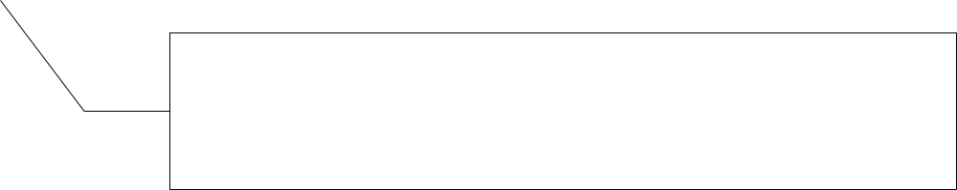
VoIP
Listen 224.225.1.2/5000
Listen 224.225.1.2/5000
NODE 1
NODE 2
Stream
Object
id>1
Stream
Object
id>1
INPUT SCRIPT
STREAM RESPPROB 0 25 BURSTCOUNT 5 BURSTDELAY 0 3 BURSTRANGE 5 10 UDP SRC 5001 DST 224.225.1.2/5000 PERIODIC [25 100] PAYLOAD 1
Listen 224.225.1.2/5000
Listen 224.225.1.2/5000
NODE 3
NODE 4

Slide 52

VoIP
Listen 224.225.1.2/5000
Listen 224.225.1.2/5000
NODE 1
NODE 2
Stream
Object
id>1
Stream
Object
id>1
MgenMsg dst>224.225.1.2/5000 raprPayload: payload>1 burstCount>5 seed>234872 burstDuration>8.5 streamId>1 burstPriority>0
Listen 224.225.1.2/5000
Listen 224.225.1.2/5000
NODE 3
NODE 4

Slide 53
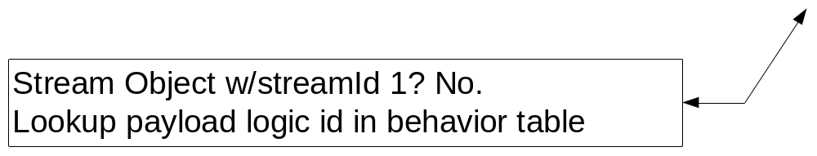
VoIP
Listen 224.225.1.2/5000
Listen 224.225.1.2/5000
NODE 1
NODE 2
Stream
Object
id>1
Stream
Object
id>1
Listen 224.225.1.2/5000
Listen 224.225.1.2/5000
NODE 3
NODE 4

Slide 54

VoIP
Behavior Table
Listen 224.225.1.2/5000
Listen 224.225.1.2/5000
NODE 1
NODE 2
STREAM RESPPROB %%HOSTID%PROB% BURSTDELAY 3 5 BURSTRANGE 4 10 UDP SRC 5000 DST 224.225.1.2/5000 %CHAT_PATTERN%
Listen 224.225.1.2/5000
Listen 224.225.1.2/5000
NODE 3
NODE 4
Behavior Table
Behavior Table

Slide 55
VoIP
Listen 224.225.1.2/5000
Listen 224.225.1.2/5000
NODE 1
NODE 2
Stream
Object
id>1
Stream
Object
id>1
Instantiate new Stream objects
Listen 224.225.1.2/5000
Listen 224.225.1.2/5000
NODE 3
NODE 4
Stream
Object
id>1
Stream
Object
id>1
Stream
Object
id>1
Stream
Object
id>1

Slide 56

VoIP
Listen 224.225.1.2/5000
Listen 224.225.1.2/5000
NODE 1
NODE 2
?
Stream
Object
id>1
Stream
Object
id>1
Stream
Object
id>1
Stream
Object
id>1
Stream
Object
id>1
Stream
Object
id>1
Probability 0-25
Probability 26-50
84 My turn to reply?
Listen 224.225.1.2/5000
Listen 224.225.1.2/5000
NODE 3
NODE 4
Stream
Object
id>1
Stream
Object
id>1
Stream
Object
id>1
Stream
Object
id>1
Stream
Object
id>1
Probability 51-75
Stream
Object
id>1
Probability 76-100

Slide 57

VoIP
Listen 224.225.1.2/5000
Listen 224.225.1.2/5000
NODE 1
NODE 2
Probability 0-25
Probability 26-50
MgenMsg dst>224.225.1.2/5000 raprPayload: burstCount>4 seed>newSeed burstDuration>7 streamId>1 burstPriority>0
Listen 224.225.1.2/5000
Listen 224.225.1.2/5000
NODE 3
NODE 4
?
Stream
Object
id>1
Probability 51-75
Probability 76-100
Yes - Draw 84
Stream
Object
id>1

Slide 58

VoIP
Listen 224.225.1.2/5000
Listen 224.225.1.2/5000
NODE 1
NODE 2
?
Stream
Object
id>1
Stream
Object
id>1
Stream
Object
id>1
Stream
Object
id>1
Stream
Object
id>1
Stream
Object
id>1
Probability 0-25
Probability 26-50
32 My turn to reply?
Listen 224.225.1.2/5000
Listen 224.225.1.2/5000
NODE 3
NODE 4
Stream
Object
id>1
Stream
Object
id>1
Stream
Object
id>1
Stream
Object
id>1
Stream
Object
id>1
Probability 51-75
Stream
Object
id>1
Probability 76-100

Slide 59

VoIP
Listen 224.225.1.2/5000
Listen 224.225.1.2/5000
NODE 1
NODE 2
?
Stream
Object
id>1
Stream
Object
id>1
MgenMsg dst>224.225.1.2/5000 raprPayload: burstCount>4 seed>newSeed burstDuration>7 streamId>1 burstPriority>0
Listen 224.225.1.2/5000
Listen 224.225.1.2/5000
NODE 3
NODE 4

Slide 60
VoIP
Listen 224.225.1.2/5000
Listen 224.225.1.2/5000
NODE 1
NODE 2
Listen 224.225.1.2/5000
Listen 224.225.1.2/5000
NODE 3
NODE 4

Slide 61

VoIP
VoIP
VoIP with Priority
Listen 224.225.1.3/5000
Listen 224.225.1.2/5000
Listen 224.225.1.2/5000
NODE 1
NODE 2
streamId>1
MgenMsg dst>224.225.1.2/5000 raprPayload: burstCount>4 seed>newSeed burstDuration>7 streamId>1 burstPriority>0
Listen 224.225.1.2/5000
Listen 224.225.1.2/5000
NODE 3
NODE 4

Slide 62

VoIP
VoIP
VoIP
VoIP with Priority
Listen 224.225.1.3/5000
Listen 224.225.1.2/5000
Listen 224.225.1.2/5000
NODE 1
NODE 2
streamId>1
MgenMsg dst>224.225.1.2/5000 raprPayload: burstCount>4 seed>newSeed burstDuration>7 streamId>1 burstPriority>0
MgenMsg dst>224.225.1.3/5000 raprPayload: burstCount>4 seed>newSeed burstDuration>7 streamId>2 burstPriority>5
Listen 224.225.1.2/5000
Listen 224.225.1.2/5000
NODE 3
NODE 4
NODE 5

Slide 63
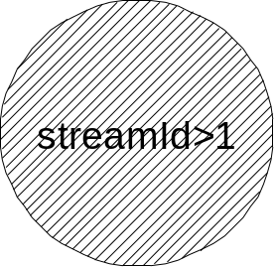
VoIP
VoIP
VoIP
VoIP with Priority
Listen 224.225.1.3/5000
Listen 224.225.1.2/5000
Listen 224.225.1.2/5000
NODE 1
NODE 2
X
MgenMsg dst>224.225.1.2/5000 raprPayload: burstCount>4 seed>newSeed burstDuration>7 streamId>1 burstPriority>0
MgenMsg dst>224.225.1.3/5000 raprPayload: burstCount>4 seed>newSeed burstDuration>7 streamId>2 burstPriority>5
Listen 224.225.1.2/5000
Listen 224.225.1.2/5000
NODE 3
NODE 4
NODE 5

Slide 64
VoIP
VoIP
VoIP
VoIP with Priority
Listen 224.225.1.3/5000
Listen 224.225.1.2/5000
Listen 224.225.1.2/5000
NODE 1
NODE 2
streamId>2
X
MgenMsg dst>224.225.1.2/5000 raprPayload: burstCount>4 seed>newSeed burstDuration>7 streamId>1 burstPriority>0
MgenMsg dst>224.225.1.3/5000 raprPayload: burstCount>4 seed>newSeed burstDuration>7 streamId>2 burstPriority>5
Listen 224.225.1.2/5000
Listen 224.225.1.2/5000
NODE 3
NODE 4
NODE 5

Slide 65
VoIP
VoIP
VoIP
VoIP with Priority
Listen 224.225.1.3/5000
Listen 224.225.1.2/5000
Listen 224.225.1.2/5000
NODE 1
NODE 2
streamId>2
MgenMsg dst>224.225.1.3/5000 raprPayload: burstCount>4 seed>newSeed burstDuration>7 streamId>2 burstPriority>5
Listen 224.225.1.2/5000
Listen 224.225.1.2/5000
NODE 3
NODE 4
NODE 5

Slide 66

VoIP
VoIP
VoIP
VoIP with Priority
Listen 224.225.1.3/5000
Listen 224.225.1.2/5000
Listen 224.225.1.2/5000
NODE 1
NODE 2
streamId>2
MgenMsg dst>224.225.1.3/5000 raprPayload: burstCount>3 seed>newSeed burstDuration>7 streamId>2 burstPriority>5
Listen 224.225.1.2/5000
Listen 224.225.1.2/5000
NODE 3
NODE 4
NODE 5

Slide 67
Fielded Applications
Situational Awareness
Logistics
Intel
VoIP
Video

Slide 68
Intel Example
Client
Server
Periodic Interrogative
1
1
Change UBI State – Event Queued
Send ACK (100 byte packet)
Wait 2-8 seconds, send URI (5 1000 byte packets)
ack
3
Change UBI State – Event Queued
Wait 3-6 seconds, send Interogative File Request (1 500-100 byte packet)
4
ack
Change UBI State – Event Queued
Send ACK (100 byte packet)
For 75-150 seconds, send 10 1300 byte pkts
Send Variable File size
<entry>0.0 DURATION %SYSTEM:RANDOMI(1,4)% DECLARATIVE UDP SRC %SERVER:SEND_DATA_PORT% DST %PACKET:SRCIP%/%CLIENT:LISTEN_DATA_PORT% PERIODIC [%SYSTEM:RANDOMI(2,4)% %SYSTEM:RANDOMI(800,1400)%] </entry>
<entry>%SYSTEM:RANDOMI(2,5)% DURATION %SYSTEM:RANDOMI(1,8)% DECLARATIVE UDP SRC %SERVER:SEND_DATA_PORT% DST %PACKET:SRCIP%/%CLIENT:LISTEN_DATA_PORT% PERIODIC [%SYSTEM:RANDOMI(1,4)% %SYSTEM:RANDOMI(800,1400)%] </entry>
<entry>%SYSTEM:RANDOMI(12,15)% DURATION %SYSTEM:RANDOMI(1,4)% DECLARATIVE UDP SRC %SERVER:SEND_DATA_PORT% DST %PACKET:SRCIP%/%CLIENT:LISTEN_DATA_PORT% PERIODIC [%SYSTEM:RANDOMI(1,4)% %SYSTEM:RANDOMI(800,1400)%] </entry>
<entry>%SYSTEM:RANDOMI(13,19)% DURATION %SYSTEM:RANDOMI(1,4)% DECLARATIVE UDP SRC %SERVER:SEND_DATA_PORT% DST %PACKET:SRCIP%/%CLIENT:LISTEN_DATA_PORT% PERIODIC [%SYSTEM:RANDOMI(1,4)% %SYSTEM:RANDOMI(800,1400)%] </entry>

Slide 69

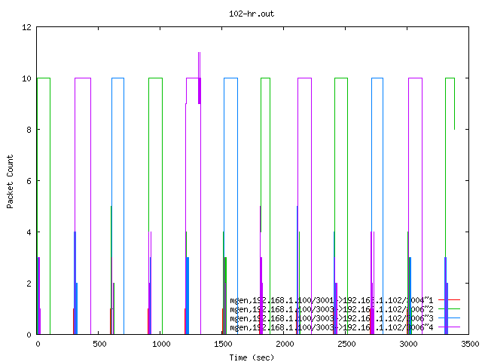
Intel Example

Slide 70
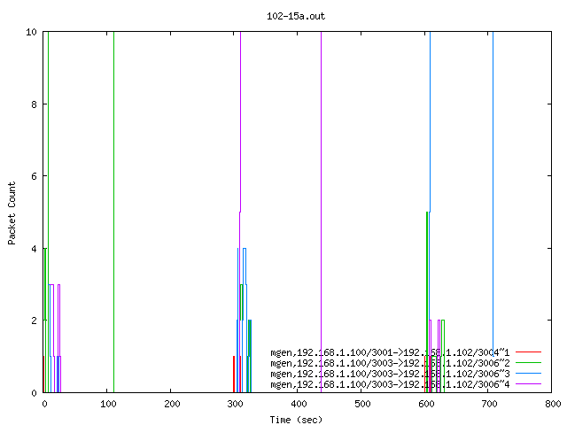
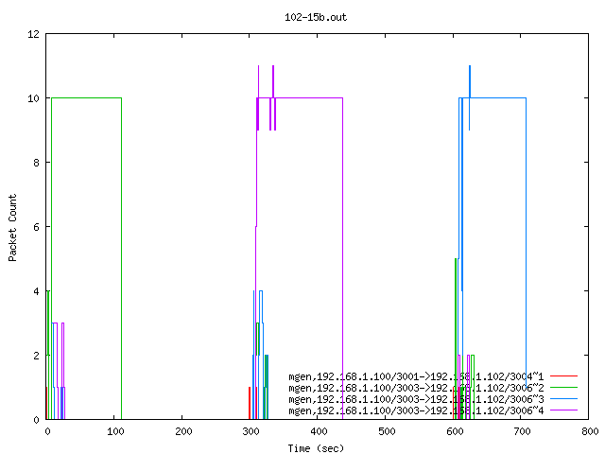

Slide 71
Data Anaylzer (DAZLE2)
Measures and analyzes flow information
Measures and analyzes arbitrary events
Based on RAPR log files and mod of PCAP lib
  Aggregate data over the interface
Able to do comparisons (Go/No-Go)
  Baseline vs performer

Slide 72
Data Anaylzer (DAZLE2)
Distinct transmission flows defined by unique flowid,source ip address/port destination address/port
For each flow consolidates data into time windows
Also consolidates “group flows” e.g. All incoming traffic to each node,

Slide 73
Data Anaylzer (DAZLE2)
Statistics include:
  Total byte rate
  Useful byte rate
  Late byte rate
  Lost byte rate
  Overhead byte rate

Slide 74
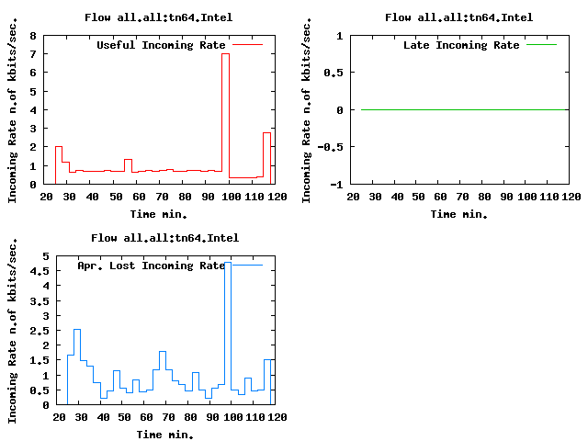
All flows, all sources
Intel application

Slide 75
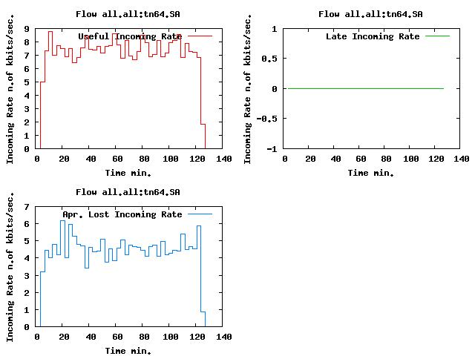
All flows, all sources
SA Application

Slide 76
DAZLE Diagram
Data Store (DB/files)
Sampling Statistics Library
RAPR Logs
pcap logger
File Reader Library
Event Flow Library
Filtering Library
Arbitrary Events
Statistics Tools Library
Viz. Library
DAZLE GUI

Slide 77
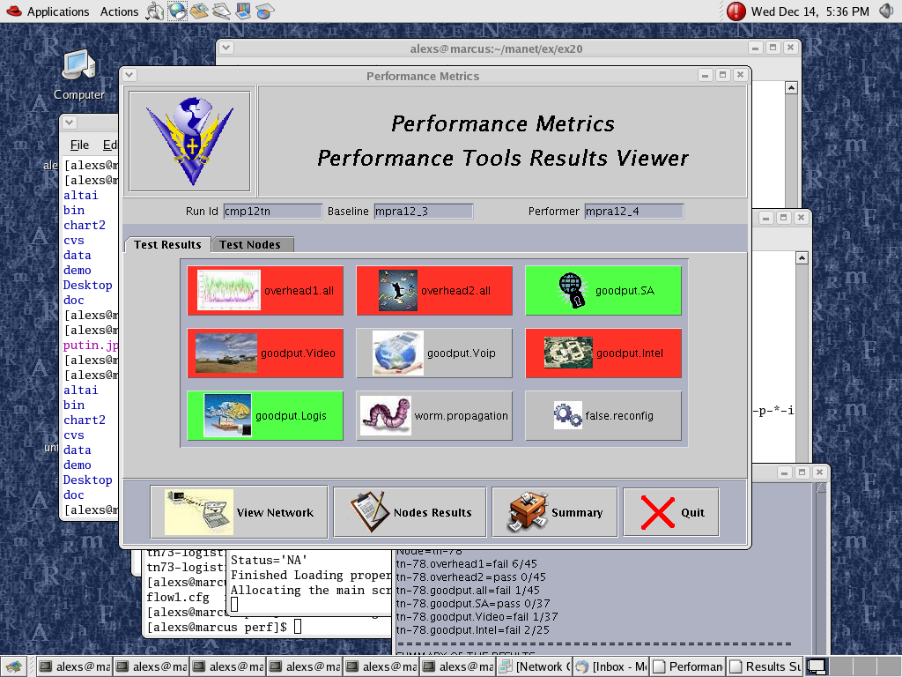
DAZLE

Slide 78
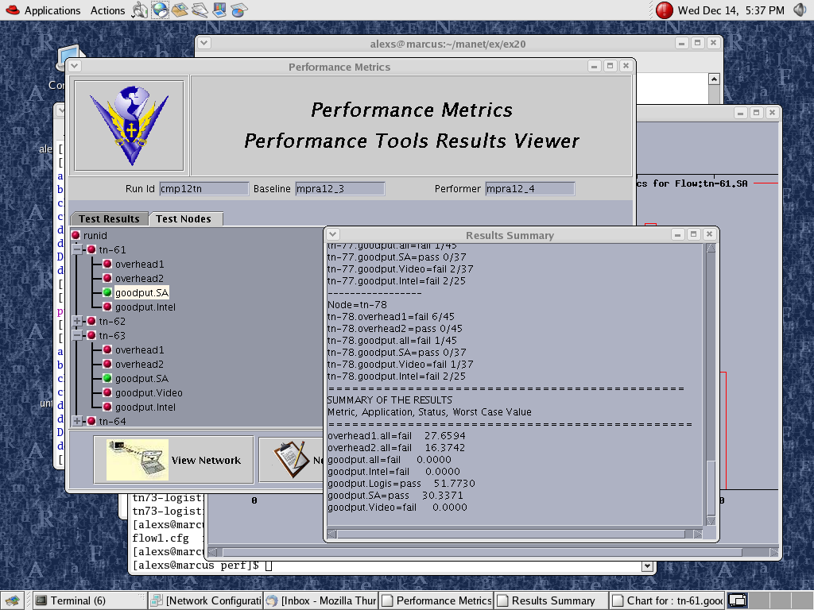
DAZLE

