Slide 1
ECE/CS 498 DS HW 1 Spring 2020
Name: Zhonghao Pan
Netid: zp3
Registration Status: Registered

Slide 2
A. Data Structure to Parse Raw Log File
Provide a (i) diagram and (ii) brief explanation of the data structure you used to parse the raw log file
i) not needed
ii) list(index, time, proc_name, pid, pfaddr, rw, major_minor, resolve_time, lib, addr, offset)
Index + (lib, addr, offset) would be the key of each row in the log
e.g. ['1', '1506816069251', 'firefox', '13179’, ‘10773289646’, 'R', 'minor', '50', '/usr/lib/x86_64-linux-gnu/libcairo.so.2.11400.10', ‘686943’, ‘16727808’] for the 1st item

Slide 3
B.a. Time Range Covered By Data
Start Time: 2017-09-30 19:01:09
End Time: 2018-01-07 12:59:50
Total Duration: 98 days 17:58:41

Slide 4
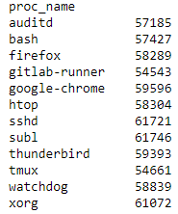
B.b. Unique Processes
name of each process
number of times
Include
The number of unique processes: 12
The name of each process
The number of times each process was executed

Slide 5
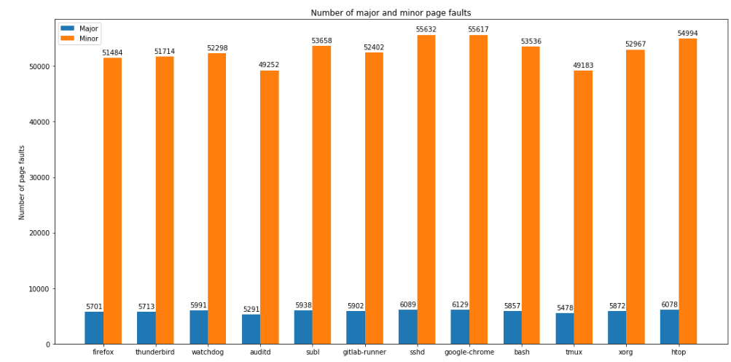
B.c. Major and Minor Page Faults

Slide 6
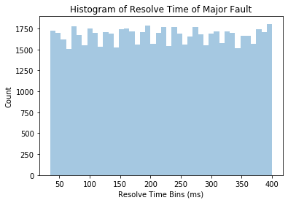
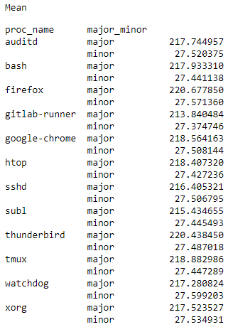
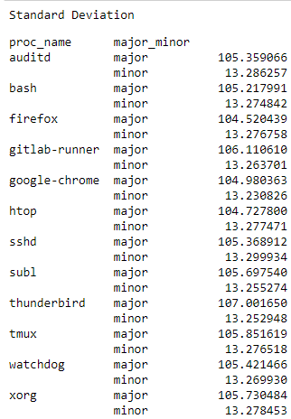
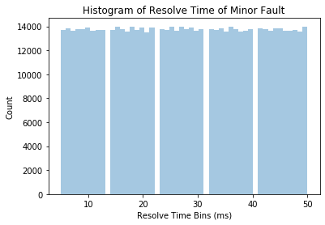
B.d. Time to Resolve Page Faults

Slide 7
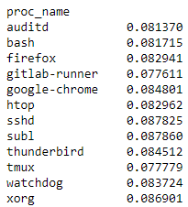
C.a. Class Priors
List the priors for all the classes

Slide 8
C.b. – C.c. : Predictions
Given that the page fault was major, which process was it most likely caused by?
subl
Given that the page fault was from a read access, which process was it most likely caused by?
subl

Slide 9
C.d. Appropriate Model
In 2 sentences or less, explain which model taught in class could be used for classifying the process given information about the fault’s (i) severity and (ii) access type.
Navie Bayes Classifier. Frist calculate P(process|fault,access type) = P(fault, access type|process) * P(process) / P(fault, access type), and then use MAP to return the argmax of P(process|fault,access type)

