Slide 1
Mini-Project 1 ECE/CS 498DS Spring 2020
Erik Pan (zp3)

Slide 2
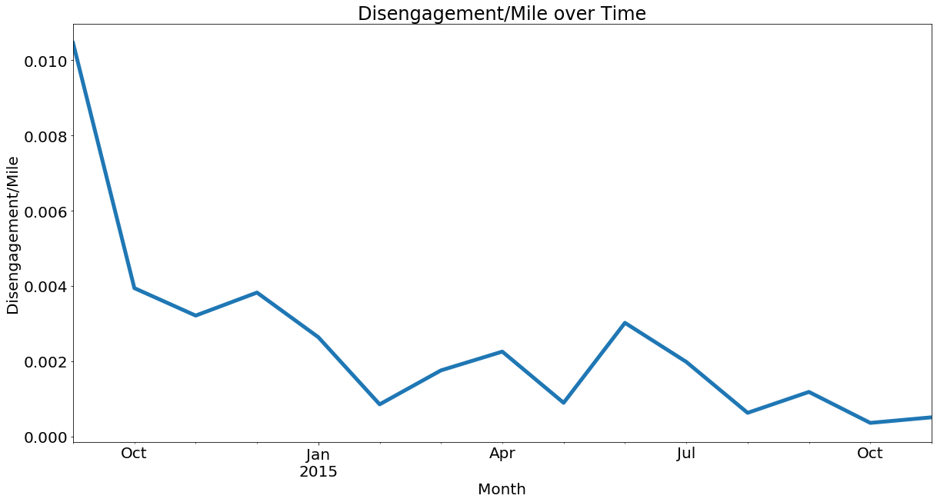
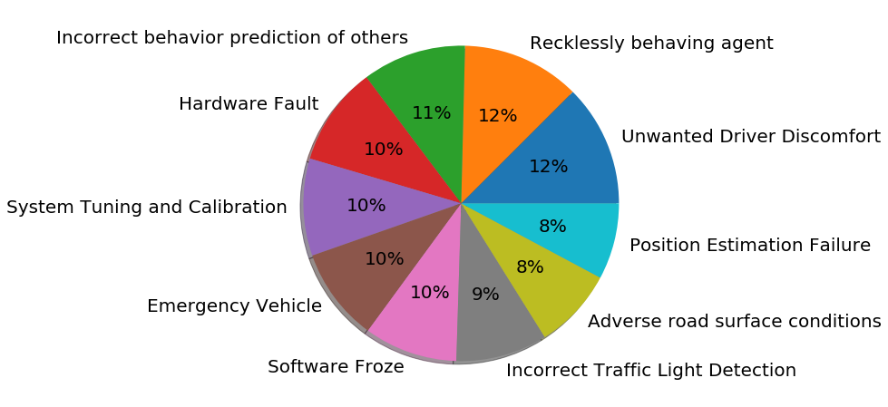
Task 0
Summarize | Answer
2(a) – Total Disengagements | 1024
2(b) - # Unique Months | 15
2(c) – Unique Locations | 'urban-street', 'highway'
2(d) - # Unique Causes | 'Incorrect Traffic Light Detection', 'Adverse road surface conditions', 'Position Estimation Failure', 'Emergency Vehicle', 'Software Froze', 'Hardware Fault', 'Incorrect behavior prediction of others', 'Recklessly behaving agent', 'System Tuning and Calibration', 'Unwanted Driver Discomfort'
2(e) - # Rows with missing values | 532
Qn 4 - Trend of disengagement/mile
Plot:
Qn 3 - Causes of AV Disengagement
Pie chart:
Top 2 causes of disengagement: Recklessly behaving agent (12%) & Unwanted Driver Discomfort (12%)

Slide 3
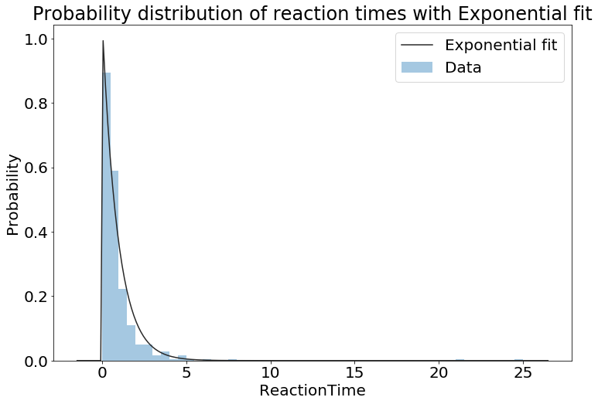
Task 1
Qn 1 – Interpreting Distributions
Gaussian – It's symmetrical with single peak. Data has finite mean and variance. The likelihood of the sample point is maximized at the mean
(b) Exponential – It's right-skewed with long, flat right tails. Data points are more likely to be sampled near smaller values than larger values. Data is usually associated with a constant failure rate.
(c) Weibull – It's either right-skewed or approximately symmetric. It can be resemabling either normal or exponential distribution. The advantage of Weibull is that it can fit skewed data better.
Qn 2 – Probability distribution of reaction times
Plot:
What distribution does it fit and what is the significance?
It fit the exponential distribution. The probability decreases as reaction time increases. Therefore, shorter reaction time is more likely to occur than longer reaction time.
Qn 3 – Average Reaction times
Over entire dataset: 0.93s
Over entire dataset per location:
highway: 1.48000s,
urban-street:0.92865s

Slide 4
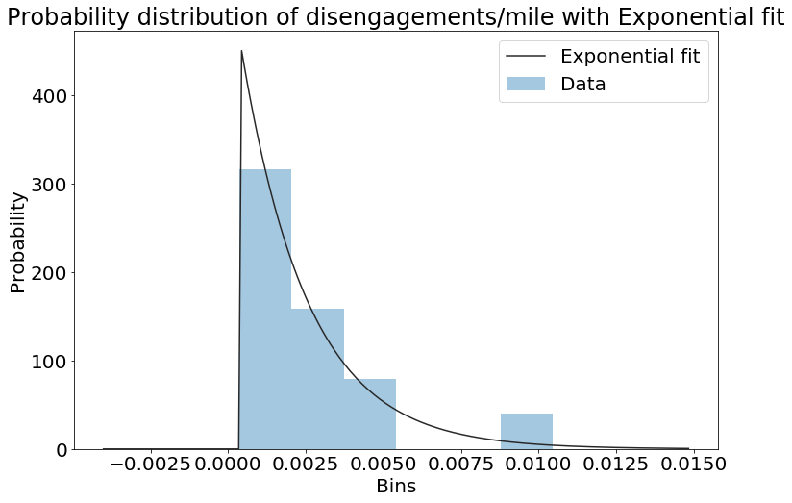
Task 1
Qn 4 – Hypothesis Testing
State the Null and Alternate Hypothesis
Null Hypothesis: Mean reaction time for humans in AV cars are not different from non-AV cars.
Alternative Hypothesis: Mean reaction time for humans in AV cars are different from non-AV cars.
Statistic Value = -2.0986, P value=0.0363
Outcome of the hypothesis test
Since the p value = 0.036 < 0.05, we reject the null hypothesis and conclude that there is significant different between the mean reaction time for humans in non-AV cars and human in AV cars.
Qn 5 – Probability distribution of disengagements/mile
Plot:
What distribution does it fit and what is the significance?
It fit the exponential distribution. Probability decreases as disengagement/mile with monthly granularity increases.

Slide 5
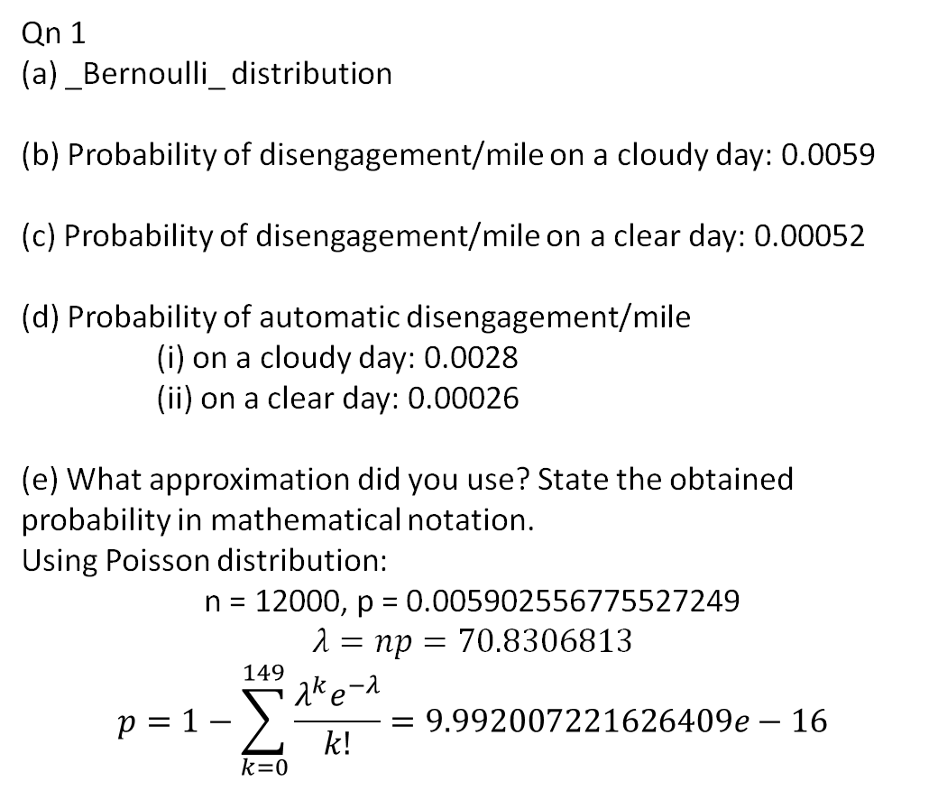
Task 2
Qn 1
(a) _Bernoulli_ distribution
(b) Probability of disengagement/mile on a cloudy day: 0.0059
(c) Probability of disengagement/mile on a clear day: 0.00052
(d) Probability of automatic disengagement/mile
(i) on a cloudy day: 0.0028
(ii) on a clear day: 0.00026
(e) What approximation did you use? State the obtained probability in mathematical notation.
Using Poisson distribution:
n = 12000, p = 0.005902556775527249
$$λ=np=70.8306813$$
$$p=1−\sum_{k=0}^{149}{\frac{{λ^{k}e}^{−λ}}{k!}}=9.992007221626409e−16$$
Qn 2 – Hypothesis Testing Concepts
(a) It represent the distribution of the sample means.
(b) Yes, if the null hypothesis is defined correctly. If the obtained p-value is smaller than alpha, we reject the null and accept the alternative. There is only 2 hypothesis available to us (null/alternative), the result will be one of the two.

Slide 6
Task 2
Qn 3 – Z-test
State the Null and Alternate Hypothesis
Statistic Value = 38.1986
P-value= 0
Outcome of the hypothesis test: Reject H0, accept Ha
Conclusion: Since p value is smaller than 0.05, we reject the null and conclude that the AV has more disengagements (automatic and manual) on cloudy days than clear days.
Qn 4 – Conditional Probability
(Write both the probability expression and the computed probability value)
(a) P(reaction time > 0.6 | weather = cloudy & type = automatic) = 0.47355
(b) P(reaction time > 0.9 | weather = clear & type = automatic) = 0.28125
Qn 5 – Conditional Probability and Total Probability
(Write both the probability expression and the computed probability value)
P(reaction time > 0.6 | weather = cloudy & type = automatic) * P(weather = cloudy & type = automatic) + P(reaction time > 0.9 | weather = clear & type = automatic) * P(weather = clear & type = automatic) / total_miles = 6.63e-07

Slide 7
Task 2
Qn 6 – Comparing AVs to human drivers
Since 6.63e-07 < 2x10-6, we can conclude that human drivers has higher accident rate per mile than AV. This means AV is safer than human drivers and is similar to the current stage of AV reported on news.
Qn 7 – KS Test
State the Null and Alternate Hypothesis
H0: Distribution of disengagement reaction time when the weather is cloudy and distribution of disengagement reaction time when the weather is clear are the same.
Ha: distribution of disengagement reaction time when the weather is cloudy and distribution of disengagement reaction time when the weather is clear are different
Statistic Value = 0.056
P value = 0.95
Outcome of the hypothesis test: Fail to reject the null hypothesis, accept the null hypothesis
Conclusion: Since P value = 0.95 > 0.1, we fail to reject the null, and conclude that the distribution of reaction time in cloudy and clear day are the same.

Slide 8
Task 3
Qn 3 – Conditional Probability Tables for NB classifier
Class | Urban-Street | Highway
Controller | 0 | 1
Perception System | 0 | 1
Computer System | 0.9324 | 0.0675
Class | Cloudy | Clear
Controller | 0.997 | 0.003
Perception System | 1 | 0
Computer System | 0.3966 | 0.6034
Class | Auto | Manual
Controller | 0.133 | 0.867
Perception System | 0.8194 | 0.1806
Computer System | 0.481 | 0.519
Qn 4 – NB Classifier Accuracy: 0.82439
Qn 5 – NB Cross Validation Accuracy: 0.8127

Slide 9
Task 3
Qn 6 – Is your NB model doing better than chance? Explain.
Yes as the average accuracy is over 80% which is greater than 1/3.
Qn 7 – Assumptions in NB in this context of AV safety analysis
A day's weather, car's location and type of disengagement are independent. Type of disengagement might not be independent of the other two since one would suspect driver might pull the trigger more often on bad weather (with bad visibility) and highway (higher speed).
Qn 8 – Possible improvements to increase classification accuracy
We will need a larger dataset since a lot of the probability in the naive bayes model are 0. If p(a|b) = 0, then no matter what p(a|c), p(a|d) is, the product of them will be 0. Also we can use a better classifier like SVM instead.

Slide 10
Insights on AV safety
List some insights on AV safety that you have gained by performing data analysis on the CA DMV dataset.
AV has been improved greatly over years.
AV accident rate is lower than human accident rate per mile according to this dataset.
Would you ride in an AV based on the data you have analyzed?
Yes.

