Slide 1
Mini-Project 2 Checkpoint 1 ECE/CS 498DS Spring 2020
Archit Patke (apatke), Haoran Qiu(haoranq4), Haoming Lu (hl36), Zhonghao Pan(zp3)

Slide 2
Task 1 - Question 0
Why do biologists need multiple samples to identify microbes with significantly altered abundance?
In statistical analysis, sample size is an important consideration. Larger sample sizes provide more accurate mean values, identify outliers that could skew the data in a smaller sample and provide a smaller margin of error.
2. Number of samples analyzed: 764
3. Number of microbes identified: 149

Slide 3
Task 1 – Question 1
Q | C | L | P
good | Low | Long | 0.919
bad | Low | Long | 0.081
good | low | Short | 0.957
Bad | Low | Short | 0.043
Good | High | Long | 0.034
Bad | High | Long | 0.966
Good | High | Short | 0.936
Bad | High | Short | 0.064
P(Q|C,L)
a. Factorization of joint probability distribution:
P(Q, LT, C, CM, ST) = P(Q|LT, C) P(LT) P(C|S, CM) P(S) P(CM)
b. Number of parameters needed to define conditional probability distribution: 11
c. Conditional probability tables:
C | ST | CM | P
low | cold | Nurse | 0.956
high | cold | Nurse | 0.044
low | cold | patient | 0.923
high | cold | patient | 0.077
low | cool | Nurse | 0.912
high | cool | Nurse | 0.088
low | cool | patient | 0.162
high | cool | patient | 0.838
ST | P
Cold | 0.8982
Cool | 0.1018
CM | P
nurse | 0.8976
patient | 0.1024
LT | P
Long | 0.2044
short | 0.7956
P(C|ST,CM)

Slide 4
Task 1 – Question 1 (continued)
Q | T | CM | LT | P
Good | Cold | Nurse | long | 0.88
bad | Cold | Nurse | long | 0.12
Good | Cold | Nurse | Short | 0.956
bad | Cold | Nurse | Short | 0.044
Good | Cold | Patient | long | 0.851
bad | Cold | Patient | long | 0.149
Good | Cold | Patient | Short | 0.956
bad | Cold | Patient | Short | 0.044
Good | cool | Nurse | long | 0.841
bad | cool | Nurse | long | 0.159
Good | cool | Nurse | Short | 0.955
bad | cool | Nurse | Short | 0.045
Good | cool | Patient | long | 0.177
bad | cool | Patient | long | 0.823
Good | cool | Patient | Short | 0.939
bad | cool | Patient | Short | 0.061
d. Table of P(Quality|Storage Temp, Collection Method, Lab Time):
e. Total number of samples dropped:65

Slide 5
Task 1 – Question 2
1. Number of samples removed:
HE0: 585
HE1: 572
2. What are the benefits and drawbacks to using relative abundance data? Is there information that we lose when the normalization is performed?
Normalizing data allows input variables to have the same treatment in the model and the coefficients of a model are not scaled with respect to the scale of the inputs. Some machine learning algorithms require the input data to be normalized in order to converge to a good result. It also benefits seeking for relationship among two sets of data.However, the drawback is that we lost the original values (true data).

Slide 6
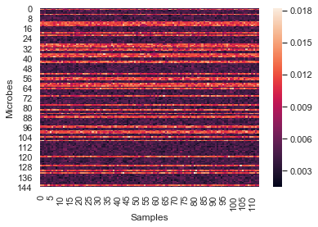
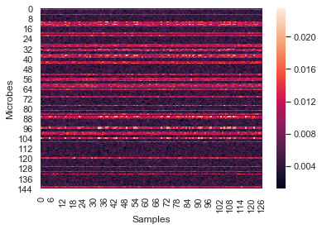
Task 1 – Question 3
Heatmaps (HE0 on left HE1 on right):
Summarize your observations
Samples within HE0 and within HE1 have similar microbe distributions. Compared to HE0, samples in HE1 have similar distribution patterns but darker (denser) amount of microbes. A type of microbe have similar relative abundance in HE0 and HE1.

Slide 7
Task 1 – Question 3 (continued)
Which aspects of the data are the heatmaps good at highlighting? What types of things are heatmaps less suitable for?
Heatmaps are graphical representations of data that utilize color-coded systems. The primary purpose of Heatmaps is to better visualize the volume of events within a dataset and assist in directing viewers towards areas on data visualizations that matter most. But they are not used for showing the real/true values. They are not used for showing the proportions of events (such as pie charts). They are not used for showing distribution of events.

Slide 8
Task 2 – Question 1
b. What is the null hypothesis of the KS test in our context? Use one microbe as an example to explain your answer.
For 'Acidobacteria_Acidobacteria_Gp1_Telmatobacter_Telmatobacter': H0 is that the distribution of 'Acidobacteria_Acidobacteria_Gp1_Telmatobacter_Telmatobacter' in samples of RelativeAbundance HE0 is the same as that of in samples of RelativeAbundance HE1
c. Count the number of microbes with significantly altered expression at alpha=0.1, 0.05, 0.01, 0.005 and 0.001 level? Summarize your answers in a table below:
Alpha | Number
0.1 | 32
0.05 | 25
0.01 | 15
0.005 | 12
0.001 | 9

Slide 9
Task 2 – Question 2
a. What does a p-value of 0.05 represent in our context?
P-value is the probability of obtaining results as extreme as the observed results of a statistical hypothesis test, assuming that the null hypothesis is correct.. Here, it means that the probability of the distribution of microbes in HE0 sample and that of HE1 sample are different at least as extreme as the results actually observed during the KS test, assuming that the two distribution are the same, is less than 0.05.
b. If the null hypothesis is true, what distribution will the p-values follow?
Uniform
c. If no microbe’s abundance was altered, how many significant p-values does one expect to see at alpha=0.1, 0.05, 0.01, 0.005 and 0.001 level? Compare your answers with your results in Task 2.1.c. Show the comparison in a table below:
If no microbe’s abundance was altered, the number would be
Smaller than 2.1c)
Alpha | Number | 2.1C)
0.1 | 11.5 | 32
0.05 | 5.75 | 25
0.01 | 1.15 | 15
0.005 | 0.575 | 12
0.001 | 0.115 | 9

Slide 10
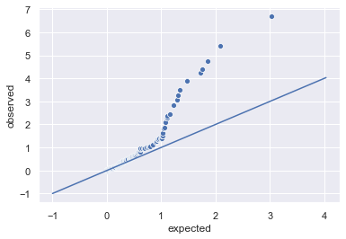
Task 2 – Question 2 (continued)
d. Q-Q plot:

Slide 11
Task 2 – Question 2 (continued)
e.i. How does taking the -log10() of the p-values help you visualize the p-value distribution?
Since p values are small, taking log helps make smaller number larger.
e.ii. What can you conclude from the Q-Q plot?
Data relationship is not linear between expected and observed (it doesn't align with the x=y line), which means that expected and observed are not the same.

