Slide 1
Frisbee Physics Simulation
Charles George
Advisor: Brian Postow
03/05/05

Slide 2
Road Map
Changes in project since design presentation
Game Programming
Input Output
Physics,
  Players
  Frisbees
Future Work
Conclusions

Slide 3
Project Changes
Original:
  Full Ultimate Frisbee Simulation
  focus on AI and Physics modeling
  A full playable, 7 on 7 game of ultimate
  Written entirely in C++ using Direct X
A change was needed
  Too much, not enough experience in field
The project became
  Simplified Frisbee Golf simulation
  Focus on physics, and writing expandable code

Slide 4
Road Map
Changes in project since design presentation
Game Programming
Input Output
Physics,
  Players
  Frisbees
Future Work, conclusions

Slide 5
Output
All Graphics done in Direct Draw
2D
Polygons, drawn using Direct Draw to gain access to surface memory
Back Buffered, one surface flipping chain
Separated from game logic

Slide 6
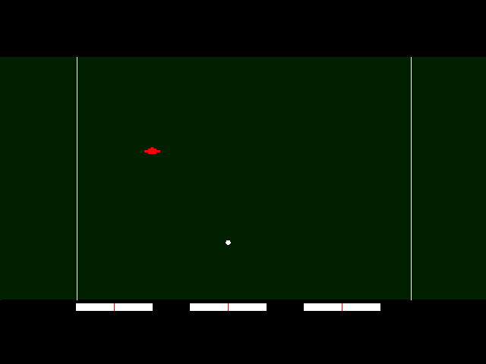
Screen Shot

Slide 7



Game Programming
Game input
processed
Input handled,
Physics calculated,
World updated
Game world
redrawn

Slide 8
Input
Designed for expansion
Basic idea:
  Tokens created, based on Direct Input
    In the future, AI also
  Each token sent to appropriate player object
    In my version, can be only one
  All Player objects calculate their appropriate movement from tokens
Allows for modularity and expandability

Slide 9
Roadmap
Changes in project since design presentation
Game Programming
Input Output
Physics,
  Players
  Frisbees
Future Work
Conclusions

Slide 10
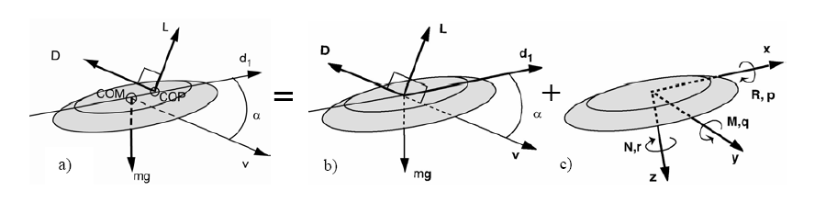

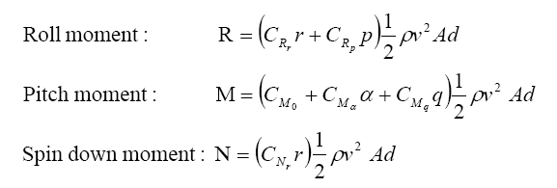
Frisbee Physics 101

Slide 11
Player Physics
Based on Acceleration, Velocity vectors for movement
Bounding Boxes for collision
  Two bounding boxes, one for Frisbees, one for other players
  Collision detection is 2D, with 3D checks built in

Slide 12
Changes in project since design presentation
Game Programming
Input Output
Physics,
  Players
  Frisbees
Future Work
Conclusions

Slide 13
Future work
Future Work
- Make it understand Ultimate Rules
  Implement AI
  Improve Graphics, add sound
Conclusions
  Took on many tasks
  Great learning experience

Slide 14
Questions?

Slide 15
Explanations of constants
Variables
v: velocity
a: angle of attack
Constants
ρ: air density
A: area of disk
C_{x}: experimental constants
d: diameter of disc
m: mass of disc
g: gravity
Vectors
v: velocity
mg: force of gravity
D: drag, opposite of v
L: Opposite of gravity

