Slide 1


Chilly Dog MCU Group Members Grant Franklin Martin Rennaker Yarentzy Magallanes Sponsor Skyelar Head TA Sambandh Dhal

Slide 2
Project Overview
Problem statement
A car parked outside on a sunny, 95-degree day can reach temperatures of up to 117 degrees Fahrenheit in just 30 minutes.
Approximately 100 dogs die in vehicles from heat exhaustion according to the AVMA.
Solution
Provide ideal cabin conditions to allow your pet to safely stay unattended in a vehicle.
Notes:
***The chilly dog is a battery powered car A/C system. that can cool the inside of your vehicle without relying on the motor of your car or its battery.

Slide 3
Subsystem Overview
16 Bit PIC (PIC24FJ128GA204)
Turns on/off load using a Relay
Outputs data to console through UART
Accepts input from user
Outputs AC Voltages
Read temperature data

Slide 4
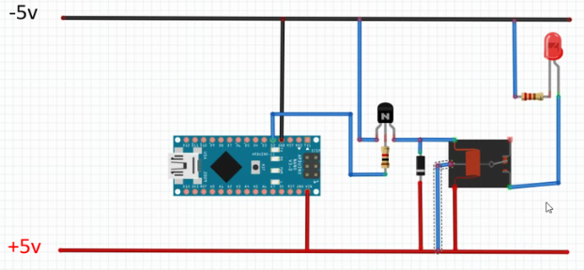
Relay
Songle SRD
Electromagnetic Relay
Nominal Coil Voltage 5V
Max current: 10A
Max voltage: 125 - 250 VAC
Notes:
Here is a little information about my relay. It is currently powering a small load of a LED but can reach up to 10A with 125- 250VAC. Here is the schematic that includes a diode to protect the micro-controller from voltage spikes among other things.

Slide 5
UART Communication Protocol
Redirect print function for debugging
Can send and receive data

Slide 6
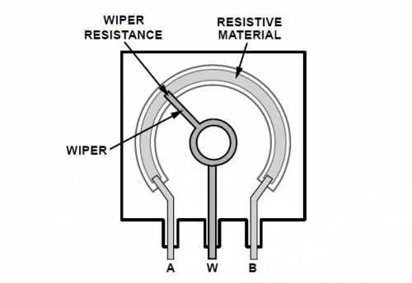
AC Input
Using a POT to control the speed of toggling LED
Notes:
Finally the final product of my subsystem will be to display the battery percentage of the VAC and I have configured this POT as an AC input and the LED as an AC output

Slide 7
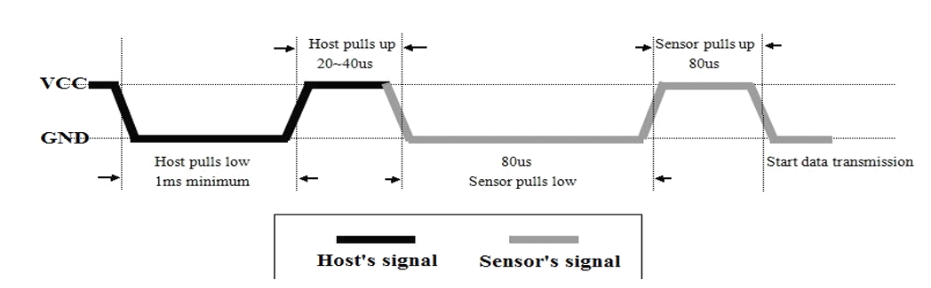
Temperature Sensor
DHT22
Data: high for 16us output 0
High for 70us output 1
Validation Completed on Arduino
Notes:
Walk through code
16 bits of humidity data
16bits of temperature data
8 bits of the sum of these for validation.
I have completed the validation of the temperature sensor on the Arduino. Now you may ask why did you use an Arduino for this when you said you were going to use a pic?
The temperature sensor expects an accurate host signal and I was unable to replicate the expected signal with an accuracy down to the micro second

Slide 8
Temperature Sensor
PIC is producing inaccurate delays
Attempted using timers (no response)
Low sampling rate on AD2
Oscilloscope validated hypothesis
Looking Forward
More research on Fast Internal Oscillator
Expected | 10us | 20us | 40us | 50us
Actual | 133us | 139us | 144us | 266us
Actual 2 | 133us | 141us | 146us | 265us
Notes:
I attempted using the delays with no luck and approached the problem using timers that would overflow at the configured time and no luck. Here you can see some of the delays that were set in the software and the actual measurements made on the oscilloscope. Looking forward I am going to have to conduct more research on the oscillator that I am using which is the fast internal Oscillator.

Slide 9
Looking Forward
Notes:
***You stop at the store just to run in for a second, and leave your pet in the car with the windows “cracked.” You’re just going to grab a couple of things, so it should all be fine. However, the lines in the store are long, you found a few extra things you needed Your pet should still be okay, though… he’s only been out there for about 20-30 minutes. Right?
Wrong.
***A car parked outside on a sunny, 95-degree Fahrenheit day can reach temperatures of up to 117 degrees Fahrenheit in just 30 minutes.
Your quick trip to the grocery store could be the determining factor between your pets life or death.
**approximatley 100 dogs die from heat exhaustion according to the American Veterinary Medical Association.
***We, the chilly dogs, have created a device to keep your cabin cool while you are away and assure the safety of your pet.
***The chilly dog is a battery powered car A/C system. that can cool the inside of your vehicle without relying on the motor of your car or its battery.
***Chilly Dog users will be able to adjust the desired output temperature using a phone application and even recive alerts when conditions become unfit for the pet.

