Slide 1
Simulation and minimal modeling
Workshop Autumn 2022
Eric Rouviere

Slide 2
Minimal modeling: a useful tool in theoretical work.
Idea
Build model
Simulate
Write a theory
1. “Highly expressed proteins evolve slowly” -D.A. Drummond (2005).
2. Under what conditions is this true?
3. Build a model of protein that can fold, unfold and function.
4. Evolve a population of these “proteins” under different evolutionary conditions in silico.
5. Propose a mathematical relationship between expression level and rate of evolution
6. Maybe you find that at higher mutation rates this does not hold and it explains the data from viruses.
Simulations of minimal models give you simple, interpretable “data” that provides a starting point for a mathematical theory.

Slide 3
But Biophysics students often don’t have experience in this pipelines. Most computation experience comes from:
“Data Science”
Scikit-learn
TensorFlow
PyTorch
Molecular Dynamics
Gromacs
Lammps
Amber

Slide 4
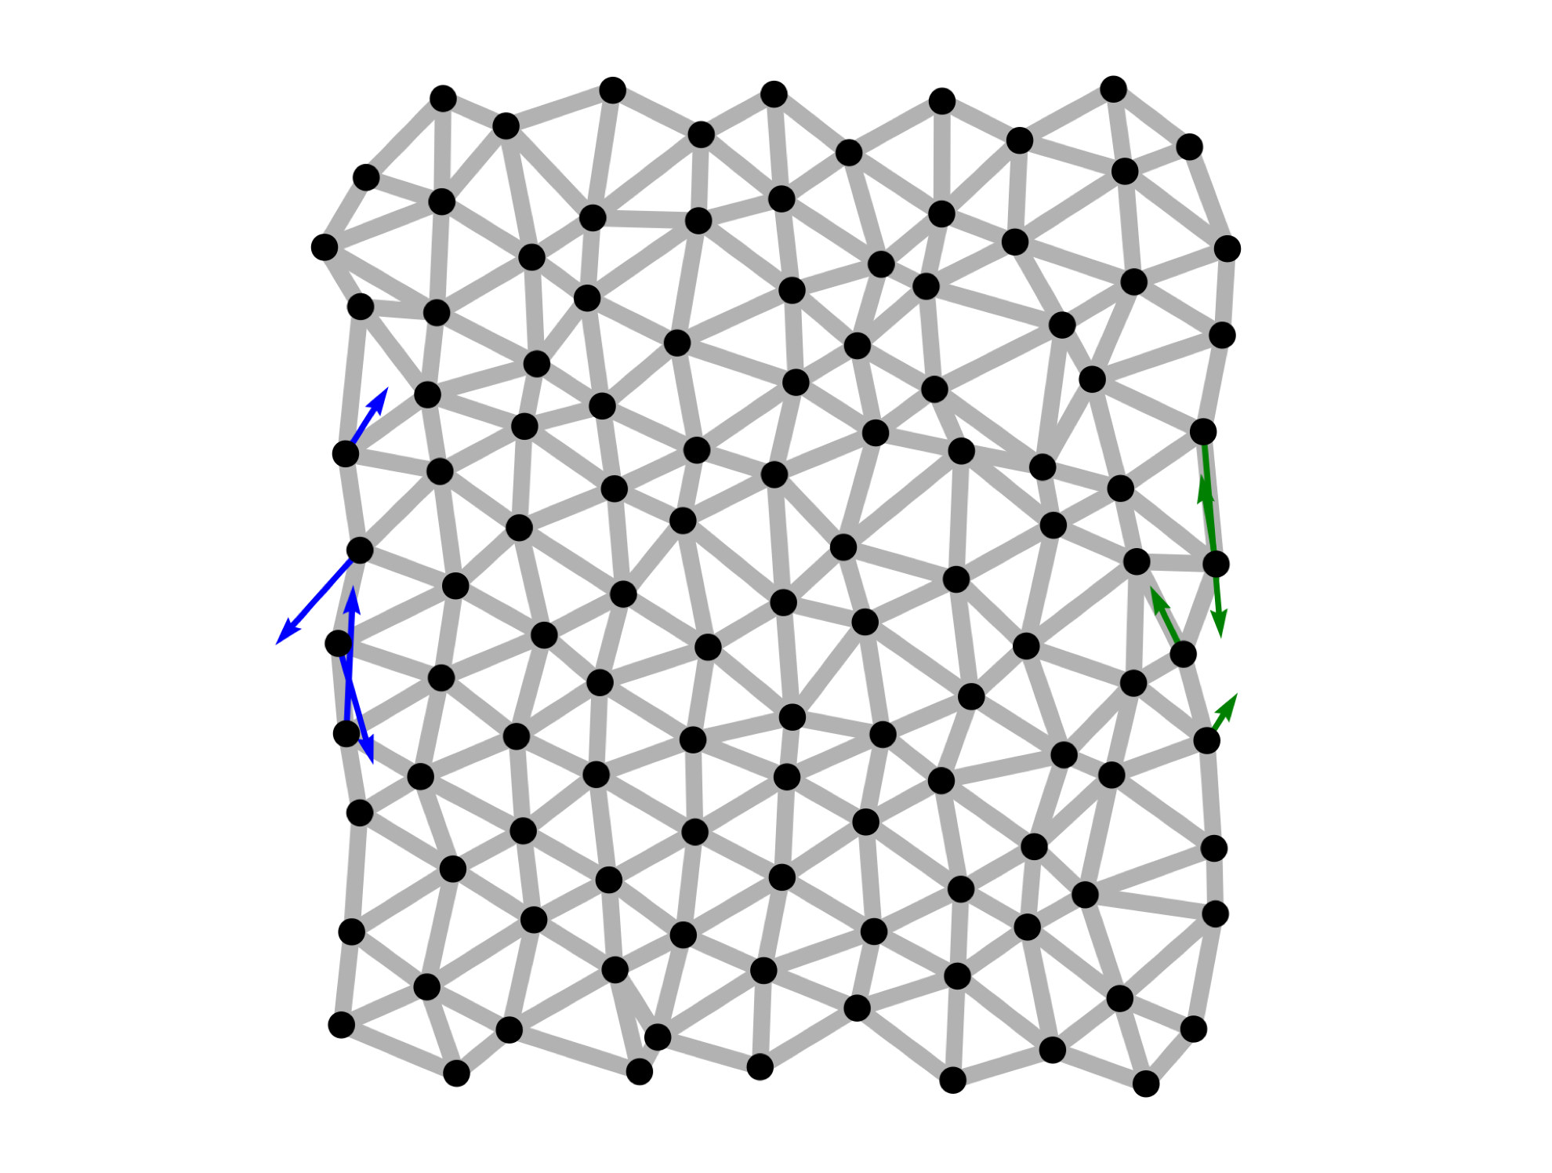
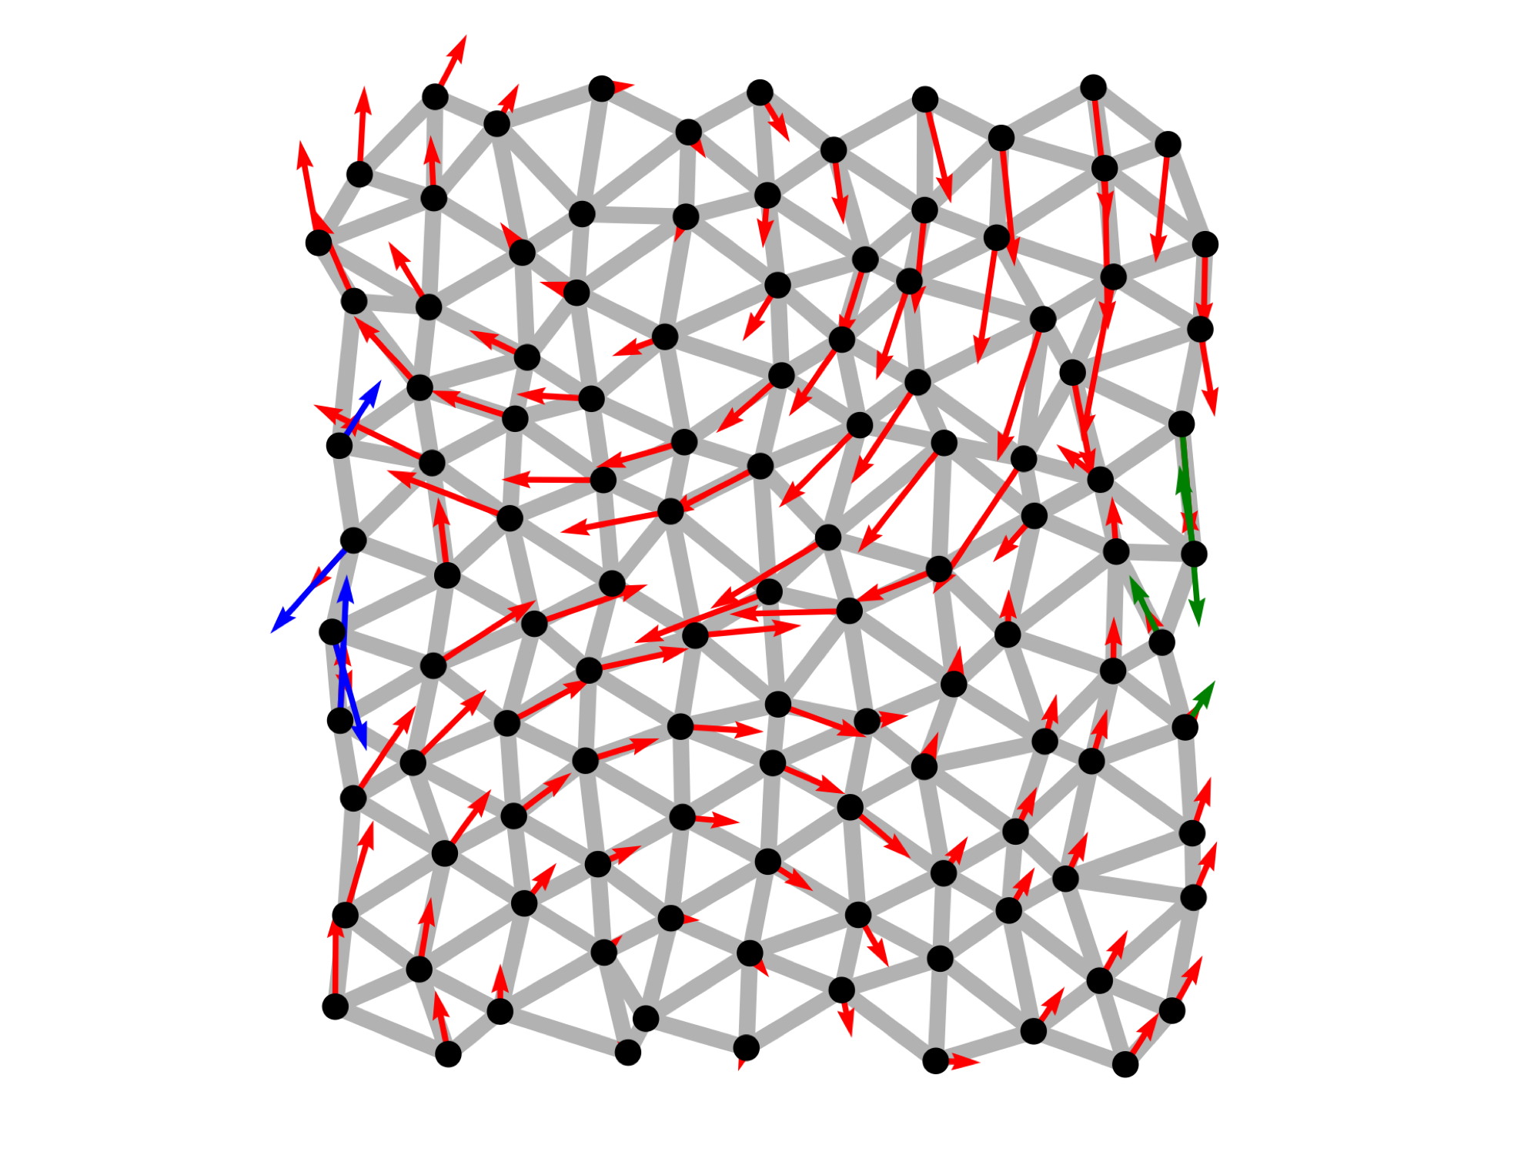
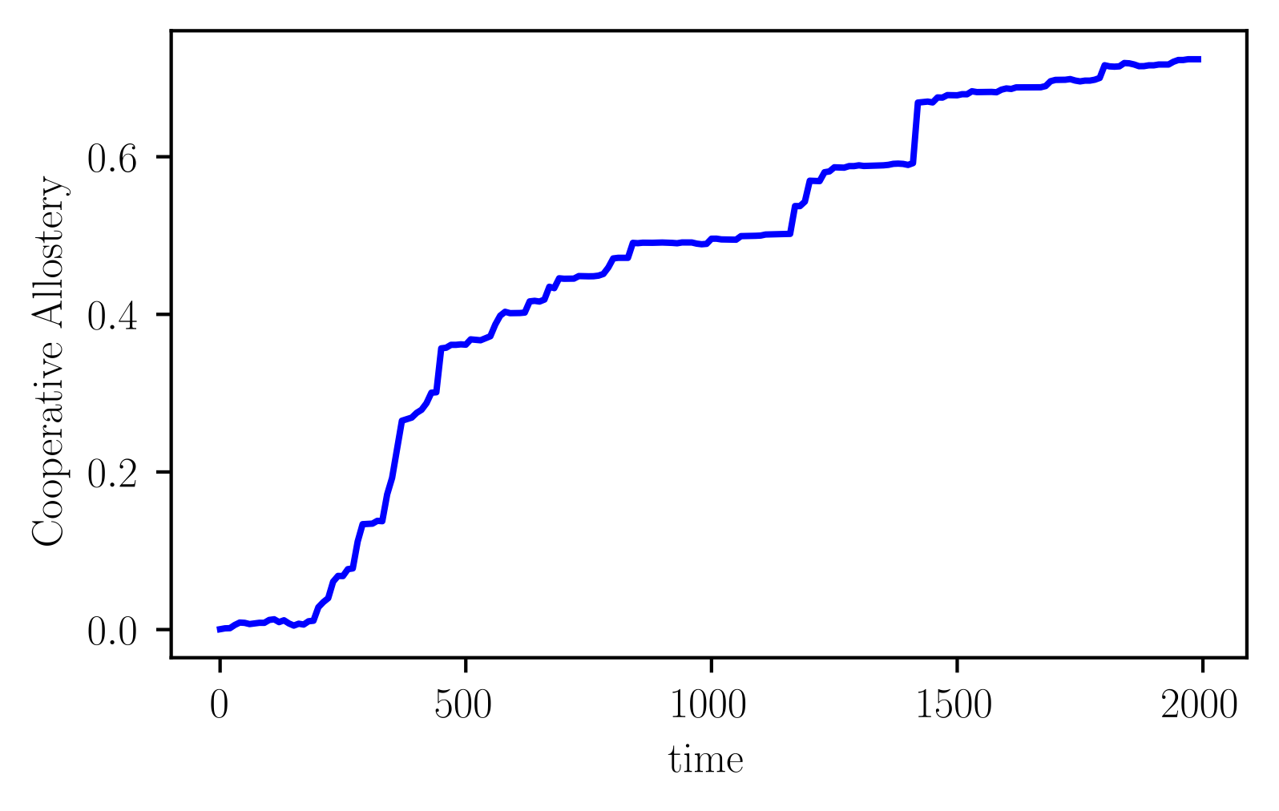
In this work shop we are going to:
Build a simple model of a protein (2d elastic network).
Measure the model’s “allostery” using linear response theory.
Simulate evolution, selecting for allostery using a Metropolis Monte Carlo algorithm.

Slide 5
Lets get started!

