Slide 1
Lab 3 teams
['Natalie ', 'Natasha ']
['Shize ', 'Julia ']
['JJ ', 'Steven ']
['Ashvin ', 'Andrew ']
['Katie ', 'Max ']
['Aaron ', 'Afra ']
['Abhigna ', 'Kelly ']
['Wonjin ', 'Tianyi ']
['Helen ', 'Annie ']
['Austin ', 'Serena ']
['Namya ', 'Jose ']
['Lillian ', 'Florence', 'Joshua ']

Slide 2
Events And Services

Slide 3
Roadmap
Static variables
The problem with blocking code
Events
Event-driven framework

Slide 4
Static variables

Slide 5


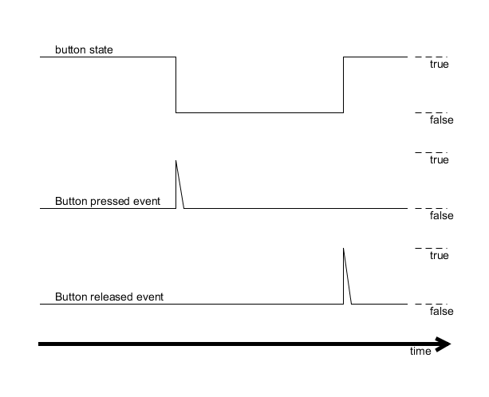
Events
Indicate changes in world
Instantaneous

Slide 6
An analogy
<- EVENT
State 1
State 2

Slide 7
Detecting events
You need TWO measurements (at least):
A current measurement
A record of a previous measurement

Slide 8
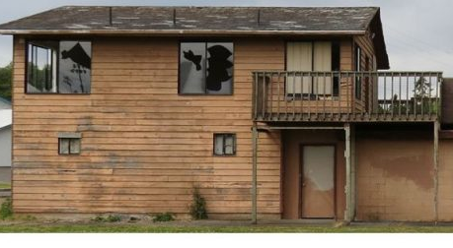
Detecting events

Slide 9
Detecting events

Slide 10
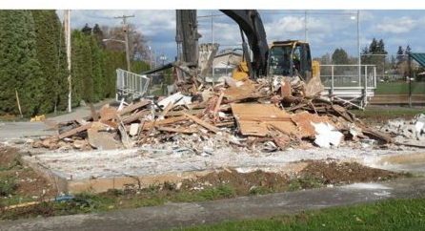
Detecting events

Slide 11
Services
Two types:
Continuous services detect events
Handler services react to events
(but can also generate events)
Allows robot to do multiple things “simultaneously”

Slide 12
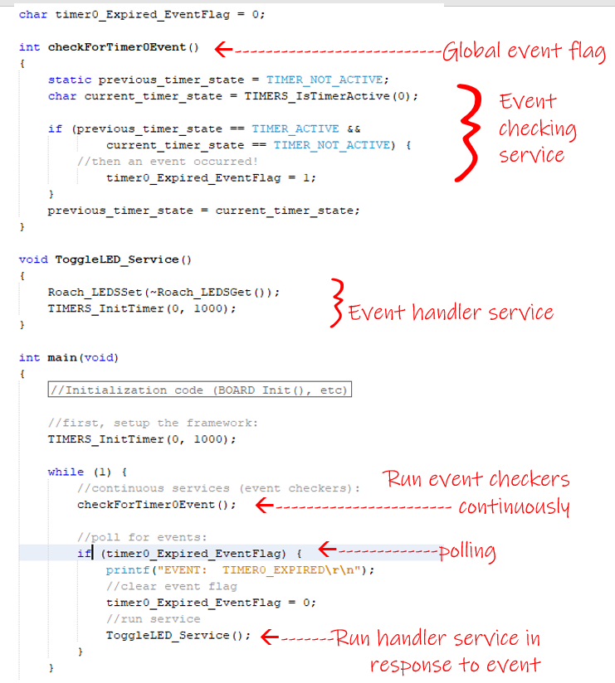

Slide 13
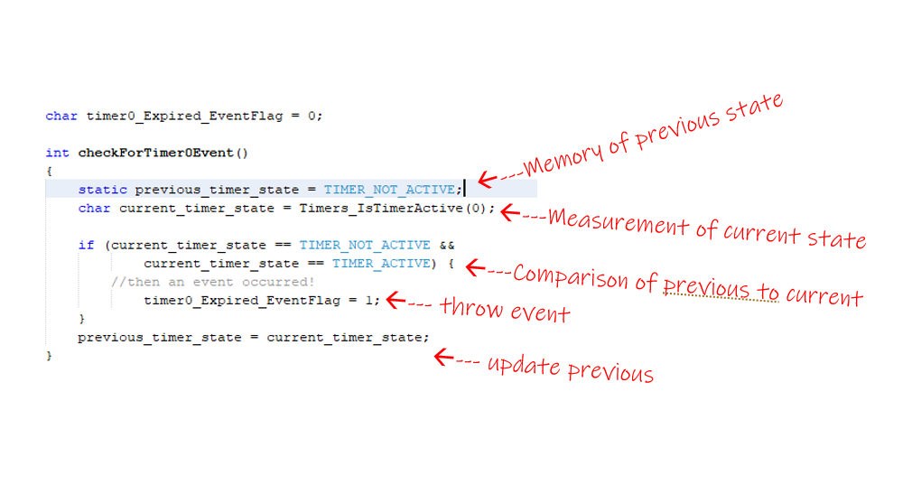
Detecting events

Slide 14
Questions?

