Slide 1
COSMOS ES 2: Extras and Common Mistakes

Slide 2
Roadmap
COSMOS Sites feedback
Common ES framework errors (so far)
New challenge – debouncing
New challenge – Improve ES framework

Slide 3
COSMOS Sites feedback
They’re not only for code! Record things like:
New concepts, technologies, approaches
Errors/ Questions / mysteries
Reflections
(what worked well, what didn’t, how could this be useful later?)

Slide 4
COSMOS Sites feedback
Don’t forget to invite me!
mnlichte@ucsc.edu
Put your name in the site name
And on the front page!
At the very least put it somewhere
For a couple of you:
Add some content please

Slide 5
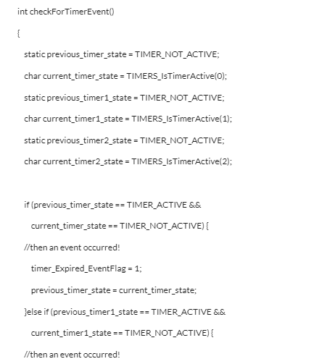
COSMOS Sites feedback
Please post your code/lab notes!
It’s how I track the class’s progress
Consider making a page for each lab
But don’t just paste in code,
it is hard to read! Instead, try:
https://tohtml.com/
Upload .c file
Google docs (?)

Slide 6
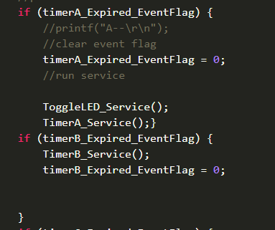
ES framework common mistakes
What could go wrong?

Slide 7
ES framework common mistakes

Slide 8

ES framework common mistakes
What could go wrong?

Slide 9
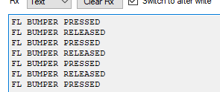
Debouncing

Slide 10
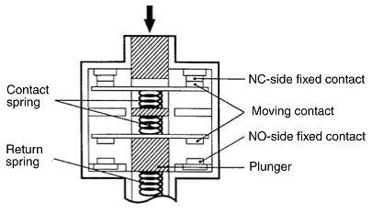
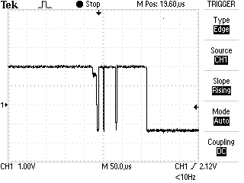
Switch bounce

Slide 11
New Challenge: Debouncing
Write a bump event checker that prevents “bouncing” events.

Slide 12
New Challenge: Improve ES framework

Slide 13
Questions?

