Slide 1
COSMOS 2019 State Machines

Slide 2
Roadmap
Lab 3 review
New C tricks:
Switch/case
rand()
State Machines
States vs events
State machines as models
State Machine Activities
Lab 4

Slide 3
Event-Driven Programming

Slide 4
Event-Driven Programming
So far, you’ve used code that:
runs once, at startup
Runs forever in a while loop
But some code should run only at specific times:
Periodic sensor monitoring
React to warnings
Take advantage of opportunities
Respond to requests

Slide 5
Asynchronous vs Synchronous
Synchronous:
Code runs at periodic intervals
Asynchronous:
Run when an event occurs
Receives an event from another process
Event is “consumed”

Slide 6
Reactive Architecture
Events:
Generated by event checkers
Pieces of code (or hardware)
r, generated by services
Are fed to services
Services:
Pieces of code that react to events
Services “consume” the events

Slide 7
Ingredients of an Event Checker
Must remember previous measurement
Cannot detect change from 1 measurement
Needs persistent memory (static)
We call this memory the checker’s “state”
Must compare previous state to current measurement
That’s what a change is, right?
If current measurement != previous measurement:
Make previous = current
Generate an event

Slide 8
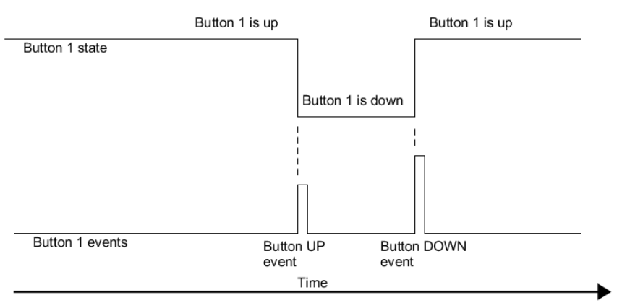
Event checker:

Slide 9
Ingredients of a Service
When an event occurs:
Call service, pass in event
Service does some action
“consume” (ie, destroy) the event

Slide 10
Simple Reactive Architecture in C
Events are signaled with high-scope variables
Boolean flags?
Integers to signal one of several events?
Event Checkers set the high-scope variables
Main loop polls high-scope variables
Calls appropriate service
then clears variable

Slide 11
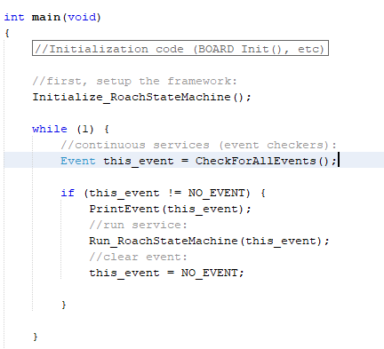
Simple Reactive Architecture in C

Slide 12
States and Events

Slide 13
States vs Events
State:
Temporary but not instantaneous property of a system
For example: Sleeping, Awake, Dead
Events:
Instantaneous
Can be internally caused changes in state:
For example: WAKE_UP, FALL_ASLEEP, DIE
Or momentary occurrences that don’t necessarily cause changes in state:
For example, WAKEUP_ALARM_RECEIVED
Or external causes of changes:
For example: BULLET_RECEIVED

Slide 14
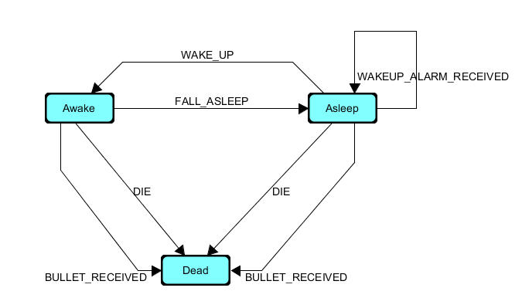
State Machine:
A set of states, linked by a set of transitions (generally events):

Slide 15
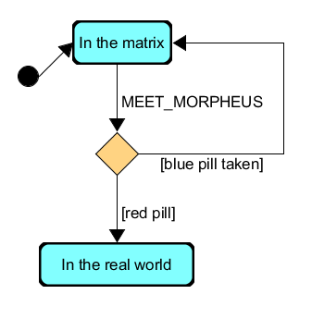
State Machine Diagrams
A way of drawing state machines
Standardized in Unified Modeling Language notation (UML)
States are bubbles
Starting state denoted by dot
Transitions are arrows
EVENTS are written on arrows
Can have / associated actions
Conditional transitions are diamonds
Take path of true [guard condition]

Slide 16
State Machines as Models
Model of the physical world:
Used to abstract (simplify) a complex system
Example: Button is up, button is down
Software Design Model
Used to plan, document, and build code
Or circuits, or machines
Example: Button event checker from last lecture
Easy to observe and debug (SO USEFUL)

Slide 17
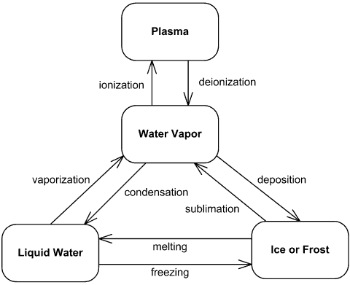
Physical Models
https://www.uml-diagrams.org/examples

Slide 18
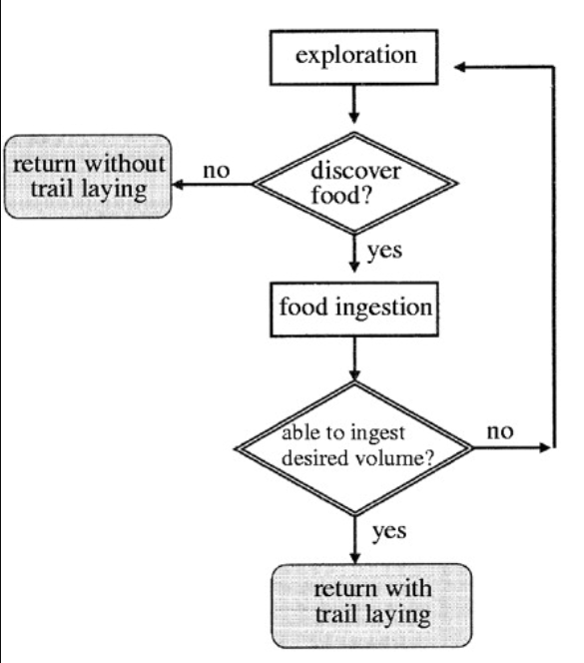
Behavioral Models
The principles of collective animal behaviour
D.J.T Sumpter Phil. Trans. R. Soc. B 29 January 2006

Slide 19
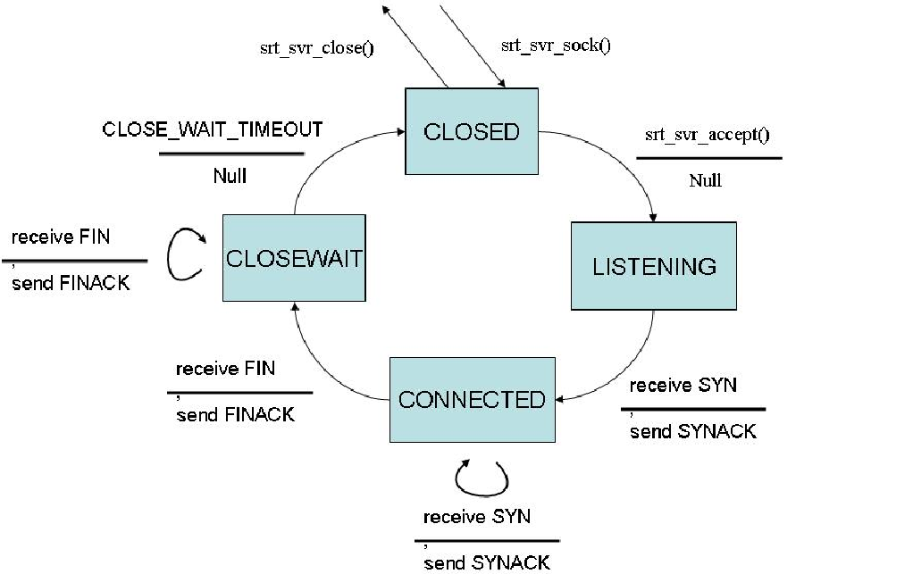
Server Design Models
http://www.cs.dartmouth.edu/~campbell/cs60/srt.html

Slide 20
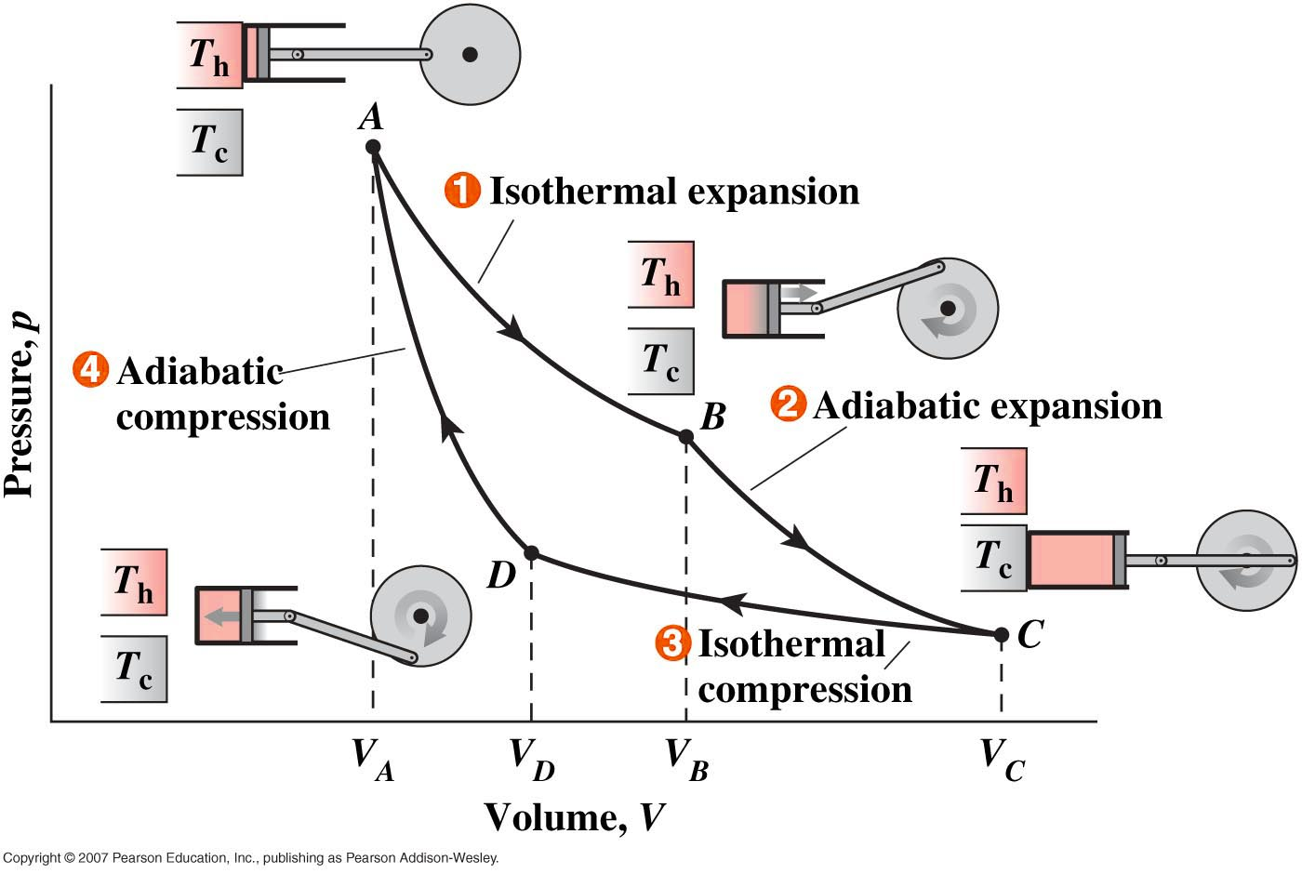
Physical Design Models

Slide 21
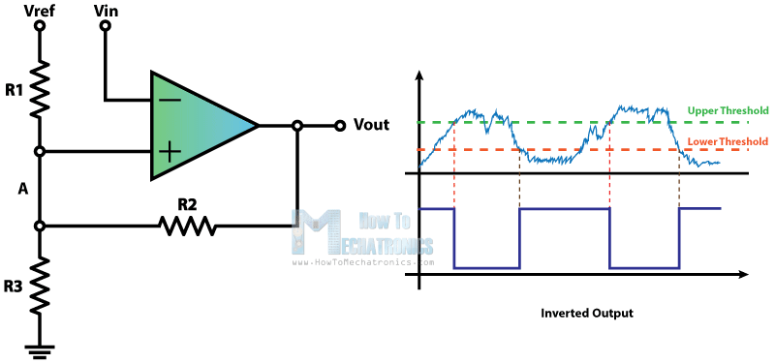
Electrical Design Models

Slide 22
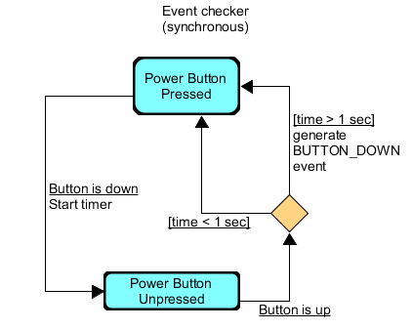
Synchronous SMs:
All event checkers are synchronous SMs
Event checkers need memory!
Run periodically
In a timer ISR
In your main loop
Transitions are NOT events
Instead, they are conditions
(observations of some other system’s state)

Slide 23
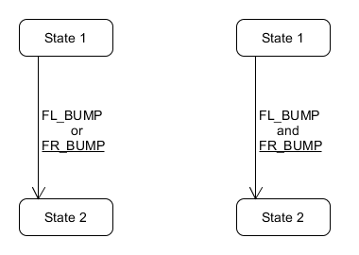
Question: Are either of these legit?

Slide 24
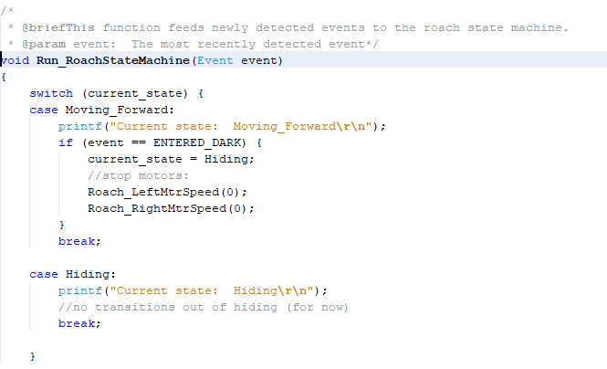
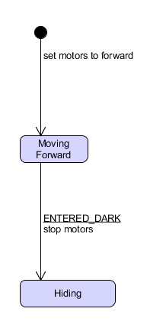
State Machines in C:

Slide 25
State Machines Activities:
Activity 1:
As a class, Model alarm Clock as SM
Activity 2:
In groups of ~5, Design a state machine for an oven on imaginary hardware:
4 buttons, 8 events
You may name the buttons whatever you like
1 screen to display whatever you, the designers, would like
User must be able to set temperature, cook time, cook mode
User must be able to stop cooking at any time

Slide 26
Lab 4 hints
One state at a time!
Test as you go!
To get a random number between 0 and 1000, do:
“ rand() % 1001 “
Don’t forget “break;”
For the SM design portion:
Stop coding while you design the SM!

Slide 27
Lab 4 teams
['Natalie ', 'Max ']
['Florence', 'Helen ']
['Wonjin ', 'Afra ']
['Austin ', 'Abhigna ']
['Jose ', 'Ashvin ']
['JJ ', 'Natasha ']
['Lillian ', 'Andrew ']
['Julia ', 'Serena ']
['Namya ', 'Kelly ']
['Shize ', 'Annie ']
['Steven ', 'Joshua ']
['Aaron ', 'Tianyi ', 'Katie ']

Slide 28
State Machine Activity
Activity 1:
As a class, Model alarm Clock as SM
Activity 2:
In groups of ~5, Design a state machine for an oven on imaginary hardware:
4 buttons, 8 events
You may name the buttons whatever you like
1 screen to display whatever you, the designers, would like
User must be able to set temperature, cook time, cook mode
User must be able to stop cooking at any time

Slide 29
COSMOS Timeline
This week:
Monday: State machine workshop, start lab 4
Tuesday: Robot Quest
Wednesday, Thursday: Lab 4
Friday: Pick Group Projects
Week 3:
Monday – Thursday: Group Project Work
Friday: Finalize posters (?)
Week 4:
Integrate group projects

