Slide 1
COSMOS 2019 State Machines II Oven SM Designs Lab4

Slide 2
Roadmap
COSMOS Cluster 6 timeline
Oven State Machine presentations
Lab 4 Notes and corrections
Back to the lab!

Slide 3
Oven SM Presentations
Say who you are
Describe your interface
What does the display show?
What do the buttons do?
Overview of state machine
How did your group arrive at this design?
How did you communicate ideas?
How did you resolve disagreements?
Why did you choose this design?
Pros, cons

Slide 4
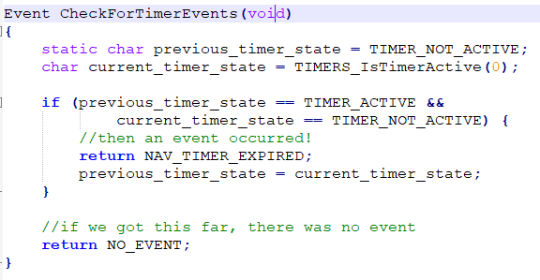
Lab 4 corrections
Original version of .zip file had broken Timer event checker!
New version of .X folder is on website
Added example of how to use NAV_TIMER

Slide 5
Lab 4 notes
Only edit Roach_State_Machine.c
But still read SM_main.c and Roach_Events.*
User NAV_TIMER to generate NAV_TIMER_EXPIRED events
Don’t forget “break;” in your switch/case

Slide 6
COSMOS Timeline
This week:
Wednesday (today): Lab 4
Thursday: Lab 4, project overview
Friday: Pick Group Projects, start project design
Week 3:
Monday – Thursday: Group Project Work
Friday: Finalize posters (?)
Week 4:
Integrate group projects

