Slide 1


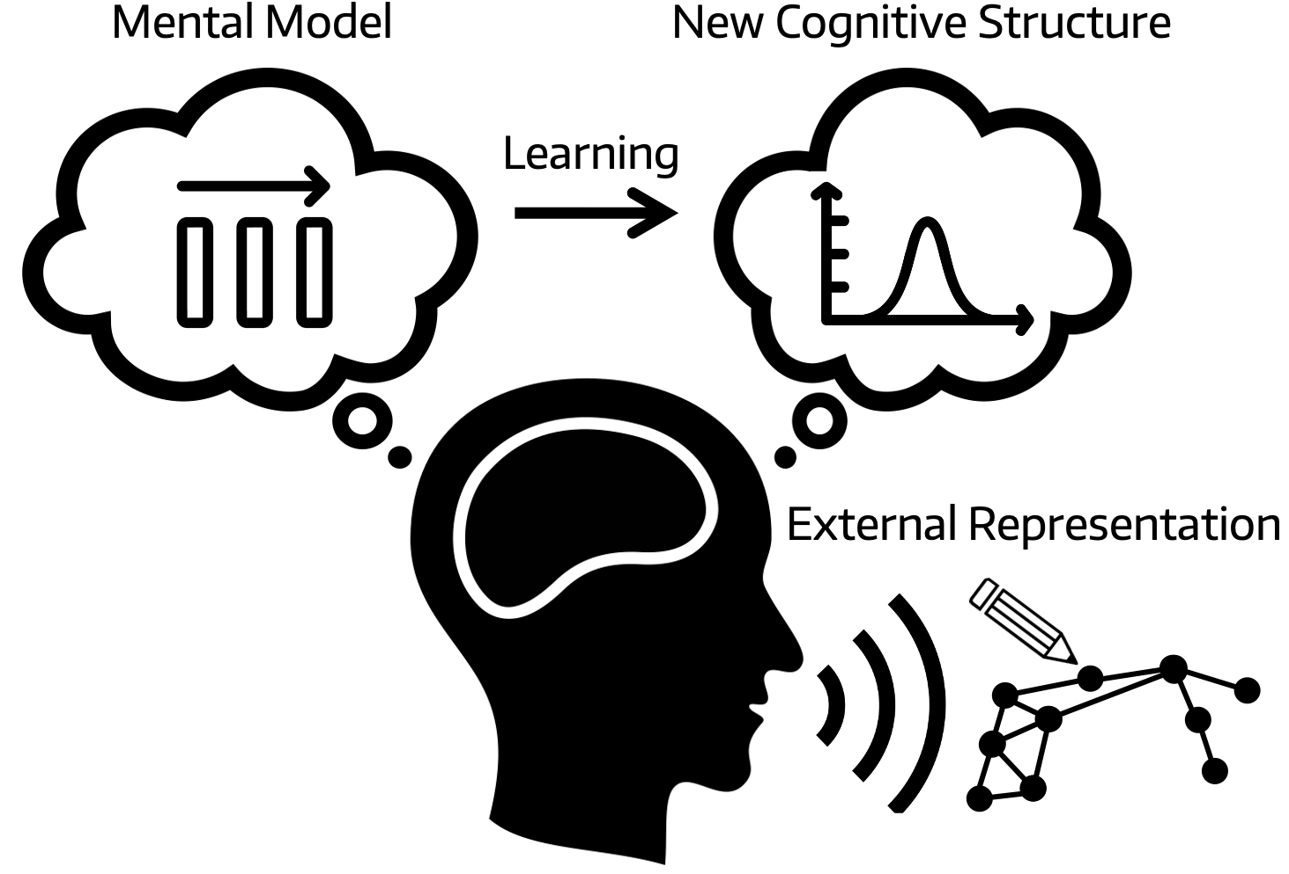
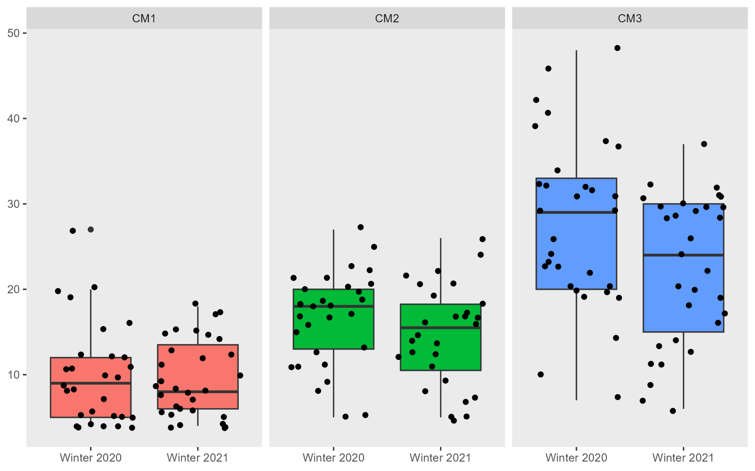
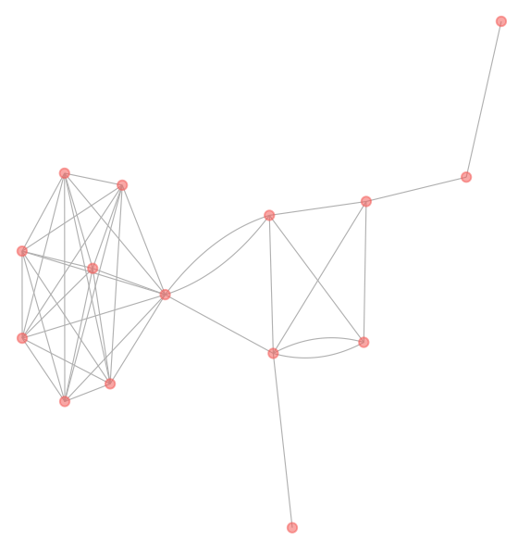
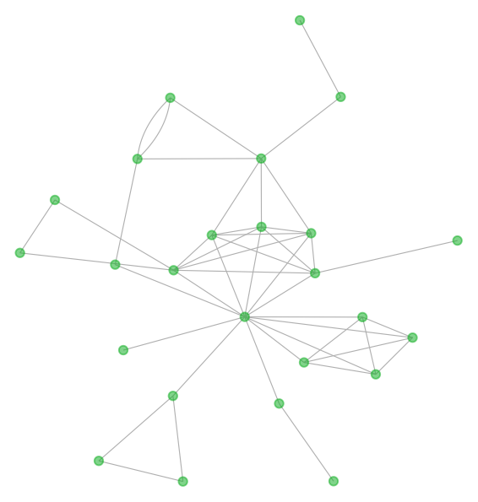
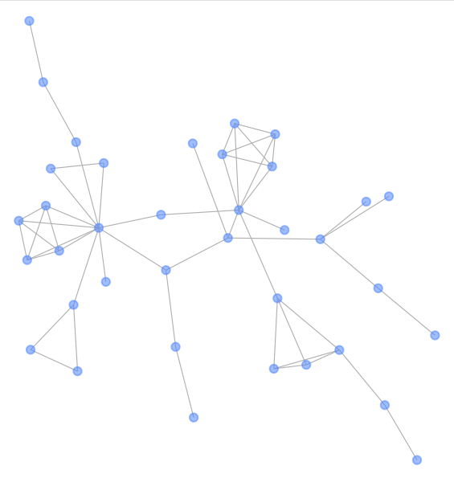
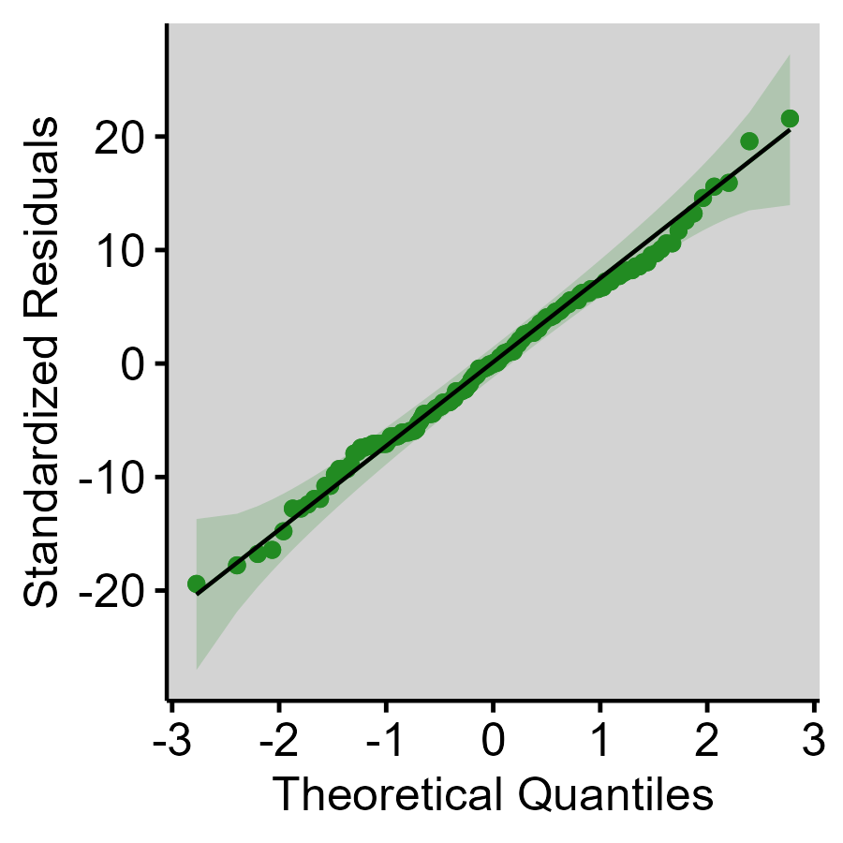
Concept Models Show the Impact of the COVID-19 Disruption on Students’ Cognitive Structures in a Statistics Course
Eric Yoon-Jae Shin, Corbitt, S., Gabriel, E.J., Nguyen, L., Bunyakiat, A., Nelson, D., Long, T.M., Trujillo, C.M. (2023)
University of Washington Undergraduate Research Symposium. May 19, 2023. Seattle, WA.
INTRODUCTION
RESULTS
DISCUSSION
Students added concepts to their models at a significantly slower rate
Findings
The disruption had an influence on the changes in the student concept models
Lower rates of added concepts occurred during the COVID disruption quarter
The results provide an estimate of the negative impact the disruption had on student learning
Limitations
The sample size of 180 models limits the strength of the findings.
A variety of different factors that could have been analyzed as predictors of the model changes
Background
Concept models are a useful method for instructors to assess learning ¹ ²
Changes in models may indicate the students’ cognitive structure ¹ ²
The connection of ideas in a model indicate student progress in the course ¹ ³
Problem Statement
Little is known about the impact of the COVID-19 disruption on cognitive restructuring during STEM learning
REFERENCES
¹Dauer, J. T., Momsen, J. L., Speth, E. B., Makohon-Moore, S. C. & Long, T. M. Analyzing change in students’ gene-to-evolution models in college-level introductory biology. Journal of Research in Science Teaching vol. 50 639–659 (2013).
²Clariana, R. B. Deriving Individual and Group Knowledge Structure from Network Diagrams and from Essays. Computer-Based Diagnostics and Systematic Analysis of Knowledge 117–130 (2010) doi:10.1007/978-1-4419-5662-0_7.
³Steyvers, M. & Tenenbaum, J. B. The Large-Scale Structure of Semantic Networks: Statistical Analyses and a Model of Semantic Growth. Cognitive Science vol. 29 41–78 (2005).
Distribution of the Concepts
Summary and Variance Tables
What Factors Best Explain the Changes in Student-Made Models about Statistics?
 | Estimate | Std. Error | t value | Pr (>|t|)
Intercept | 11.08 | 1.074 | 10.32 | 8.10E-20
Winter 2021 (COVID19) | -2.637 | 1.065 | -2.476 | 0.01425
Model CM2 | 5.849 | 1.316 | 4.446 | 1.55E-05
CM3 | 15.34 | 1.294 | 11.86 | 3.29E-24
ACKNOWLEDGEMENTS
METHODS
Student models (n = 180) were analyzed¹ from three assessments across two quarters of the same course and same instructor before and during the COVID-19 disruption.
The number of concepts in each model were calculated to build a linear model to compare. ¹ ³
The presented work was funded by the Initiatives to Develop Interdisciplinary Scholarship and Collaboration (IDISCO) student awards from the School of Interdisciplinary Arts and Sciences as well as the Scholarly Research and Creative Practice Award from the University of Washington Bothell.
This study was approved by the IRB #00010788 as part of the Student-made Models Analyzed on a Large Scale (SMALS) project.
 | Df | Sum Sq | Mean Sq | F value | Pr (>F)
Quarter | 1 | 344.5 | 344.5 | 6.752 | 1.02E-02
Model num. | 2 | 7320 | 3660 | 71.74 | 1.63E-23
Residuals | 176 | 8978 | 51.01 | NA | NA

