Slide 1
Programming your Bot
Design Hub workshop pt. 3

Slide 2
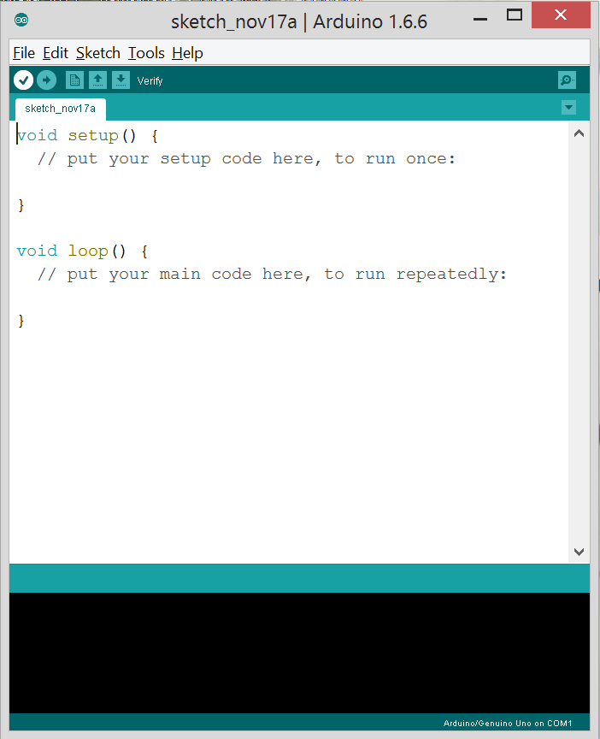
Getting the Arduino IDE
https://www.arduino.cc/en/Main/Software
IDE stands for Integrated Developer Environment

Slide 3
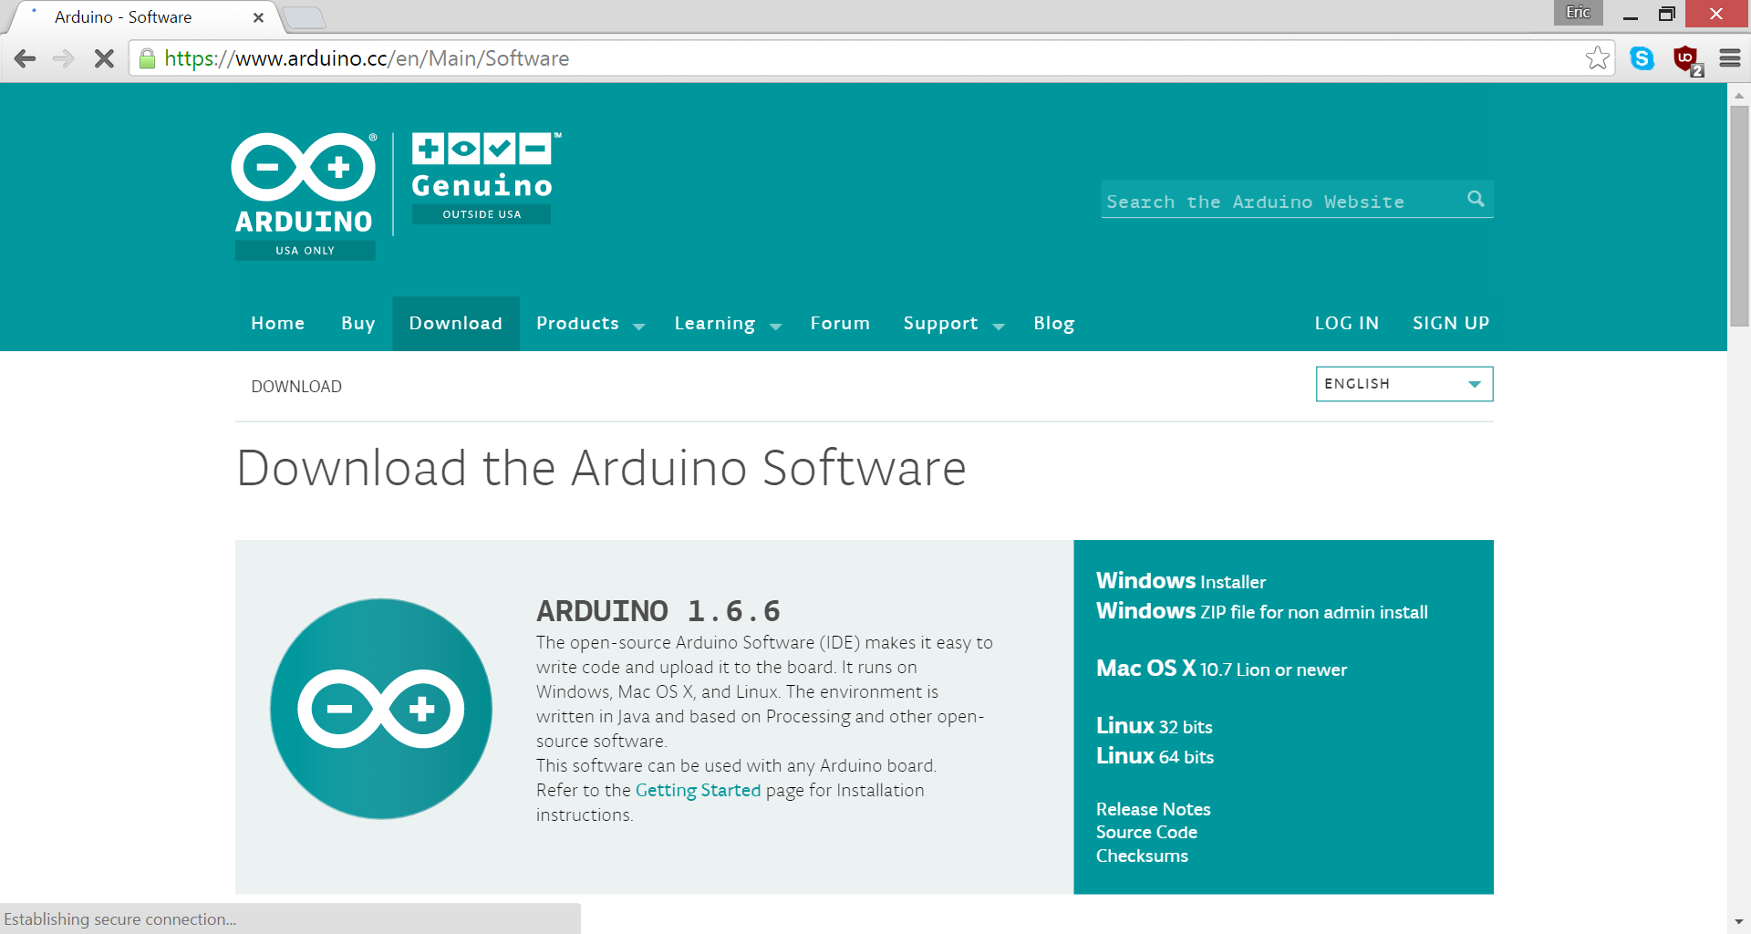

Slide 4
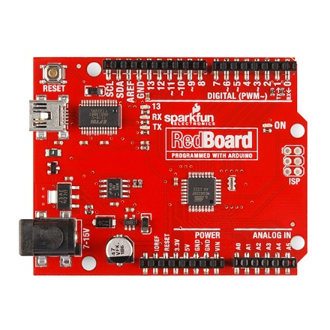
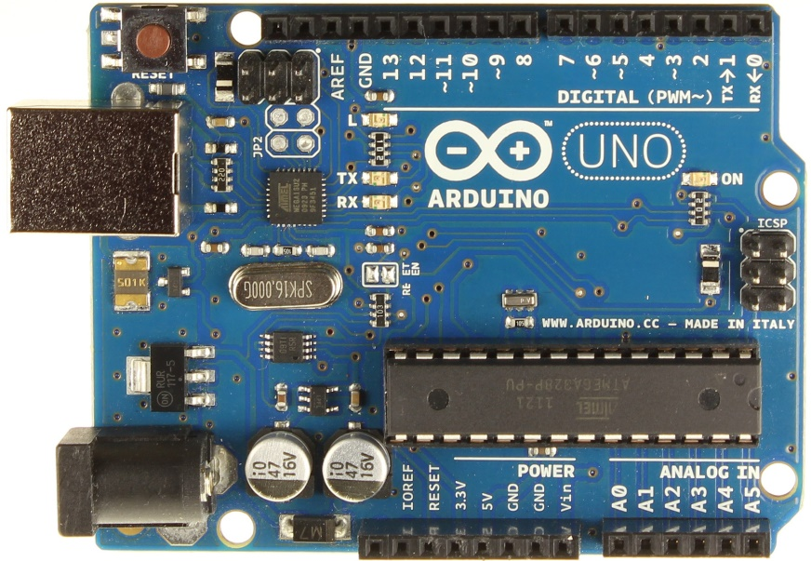
What is an Arduino
A microcontroller is a small computer on a single integrated circuit containing a processor core, memory, and programmable input/output peripherals.

Slide 5
How to get started
Arduino IDE supports C/C++ programming languages
Programs written on this IDE are called “sketches”
Click verify to check your sketch for errors
Click upload to upload your sketch onto your Arduino
If you see transparent text in formats like //asdf or is within /*asdf*/, it is a comment left by the author of the program that may explain what something does. Anything that has been commented out has no effect on the program.

Slide 6
How does this work?
This initializes the settings on the board for the program you uploaded.
These are the instructions that your Arduino will follow until it is instructed to stop, or is turned off.

Slide 7
Moving your Bot
motors.drive(a); turns motors on, a = speed of your motors, 0-255 , negative values move in backwards direction
motors.stop(); stops the motors
delay(b); b = duration in milliseconds of whatever is currently happening
motors.leftDrive(c); c = speed of left motor
motors.rightDrive(d); d = speed of right motor
You can use motors.left/rightDrive to control individual motors and turn your bot (e.g. driving in a circle)
These functions are case sensitive!
These commands are written within the brackets of void loop() {…}

Slide 8
IR Sensors
See PittRedBotLineFollowingDemo_v1
IR sensors send feedback (inputs) to the Arduino, which processes the information and translates it into movement that follows the lines (output).

Slide 9
Making noise
tone(buzzerPin, 587.33); //D5, or 587.33 Hz
delay(100); //delays for 100ms
noTone(buzzerPin); //ends the tone
How about making music?
How about making music and moving at the same time??

Slide 10
Sample programs
Check out Exp4_MakingSounds for an example on making noise and driving
Upload PittRedBotLineFollowingDemo_v1 for a program that will make your bot follow lines
Remember to verify and upload your program once you’re ready to test it out

Slide 11
Questions, comments, etc.

