Slide 1


Office 365 / Flow / Cognitive
Let’s Build an AI Image Management Portal in 30 Minutes Using Office 365, Microsoft Flow and Microsoft Cognitive Services
Eric Silver eric@techstargroup.com Microsoft Solution Architect TechStar Group

Slide 2

About this session
Demonstration on how to leverage Microsoft AI functionality to enhance an image library. We will show the use of Azure Cognitive Service Image processing algorithms to identify caption, tags, and descriptions. Microsoft Flow will be used to connect with Azure to process images uploaded to an image library.
.

Slide 3

What are we trying to solve?
Use Office 365 to build an intelligent and searchable image library

Slide 4
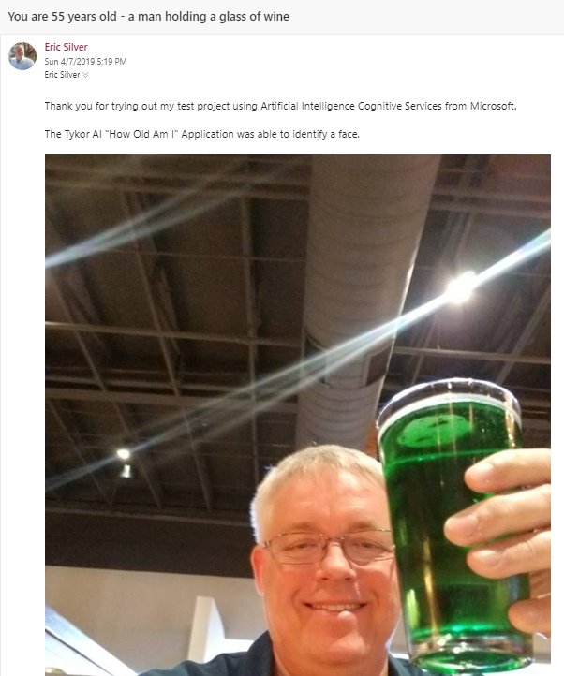
Test Cognitive Service Right now! Let’s see how old the Microsoft AI Face Recognitiion thinks you are?
Send an email with a selfie or a picture to:
howoldami@tykorusa.com

Slide 5
Demonstration Tykor USA Image Management System

Slide 6

First Ingredient Office 365
Image Storage

Slide 7
Second Ingredient: Microsoft Cognitive Services Artificial Intelligence

Slide 8
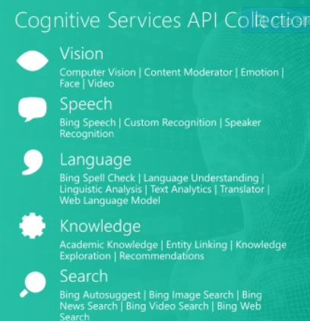

Slide 9

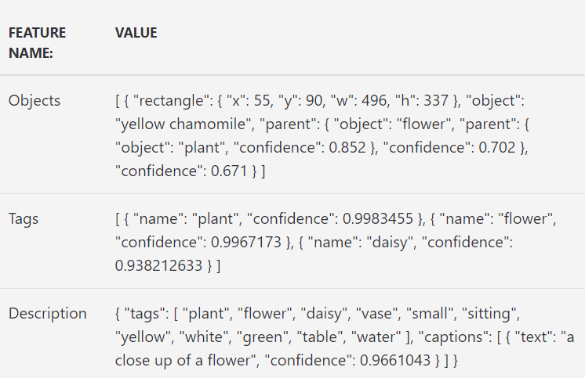
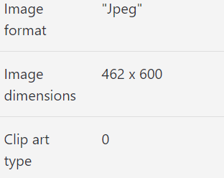
Sample Image Recognition

Slide 10
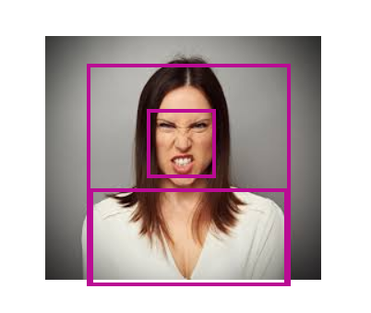
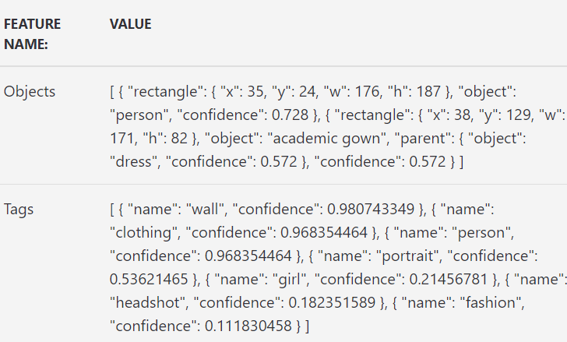
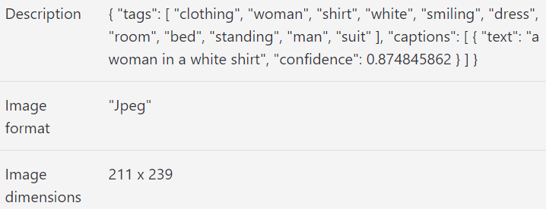
Another sample

Slide 11

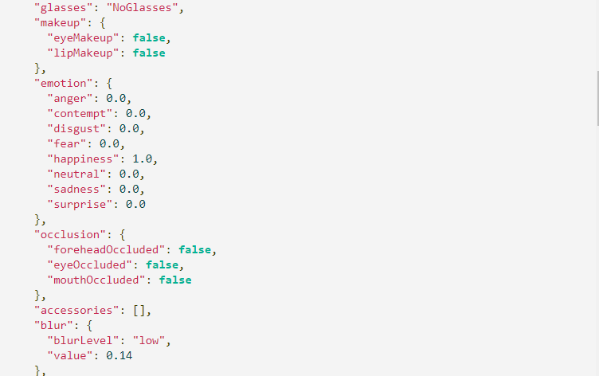
Face Recognition API

Slide 12
Third Ingredient Microsoft Flow
The binding agent in the recipe.

Slide 13
How was all of this built?
Code Review

Slide 14

Setup your Office 365 Site
.
Quick Steps Description
Create Document Library that will hold all of the images
Adding built in Content Type called Pictures
Add Tykor Image Content Type
Add Tykor People Content

Slide 15
Signup for Microsoft Cognitive Services
Runs in Microsoft Azure
Costs
Get free 200$ for first month to try
Quick Steps Description
Login into Azure
Create Computer Vision
Create Image Detection
Create Object Detection

Slide 16
Create Microsoft Flow
Quick Steps Description
Connect trigger Event to the document library
Extract Image Content
Submit Image to the various API we will be using
Extract information from the responses that we received from the Microsoft Cognitive Services
Update the item in the document list with the collected information

Slide 17
Questions?

Slide 18




Thank You
Eric Silver
+1 972 999-7876
eric@techstargroup.com
www.techstargoup.com

