Slide 1
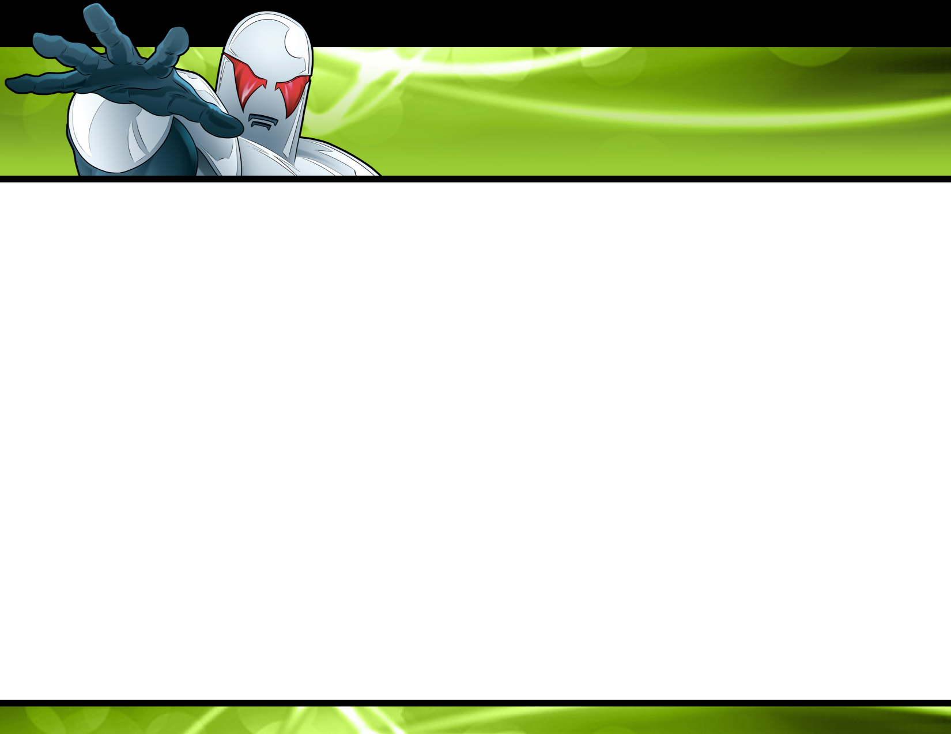
Marketing for Geeks
Developers involved with Marketing
Eric Sink
SourceGear
http://software.ericsink.com/

Slide 2
Why?
At many small software companies, people wear lots of hats.
At a Micro-ISV, one person wears ALL the hats.
Notes:
I want to get right into my topic and talk about developers involved with marketing.
The first question is “Why would we do this?” Why on earth would we want to have developers doing marketing? Why the heck would developers WANT to work in marketing?
First of all, sometimes this happens out of necessity. At many small software companies people wear a lot of hats.
If you’re a one-person company (which I call a Micro-ISV) you wear ALL the hats. You’re responsible for everything from coding to janitorial services, and that includes marketing.

Slide 3
Even at larger companies:
Many developers are already doing marketing whether they know it or not.
Notes:
Even at larger companies, many developers are involved in marketing whether they know it or not.
If this sounds strange, let me give you my definition of marketing, since I define it a bit more broadly than some folks do.

Slide 4
Product = DevTeam.Build(Something);
Marketing.TellEverybodyAbout(Product);
Notes:
Most programmers think of development and marketing like the pseudocode on this slide. Marketing is something that is done AFTER the product is built. As developers, we build the product, and then we hand it off to marketing and they do whatever it is that they do.
In other words, developers usually regard marketing as a post-processing step.
This attitude shows up in the way we talk.

Slide 5
“My product is almost in beta, so it’s time to start thinking about marketing.”
“The product isn’t the problem. We built a good product, then those marketing people screwed up.”
Notes:
In hallways and web forums, it is very common to hear quotes like these:
“My product is almost in beta, so it’s time to start thinking about marketing.”
“The product isn’t the problem. We built a good product, then those marketing people screwed up.”

Slide 6
Something = Somebody.DecideWhatToBuild();
Product = DevTeam.Build(Something);
Marketing.TellEverybodyAboutIt(Product);
Notes:
But a slightly more complete version of the algorithm looks like this.
Before we build something, we first have to decide what to build.

Slide 7
DecideWhatToBuild
New product ideas
New feature ideas
Assertion: Deciding what products or features to build is [at least in part] a marketing activity.
Notes:
I’m speaking at a very high level here.
I’m not talking about whether you have a spec or not or how detailed your spec is or how much it changes along the way. I’m talking about figuring out what product to build or what features to add in your next release.
Whether you’re doing agile or waterfall, most folks don’t set out to build a first-person shooter and end up with a word processor. ☺ In very broad brush strokes, everybody starts by deciding what to build.
My assertion is that this DecideWhatToBuild step is a marketing activity. Why? Because it has market implications.

Slide 8
Two Phases
Marketing has two phases
  1. Strategy (DecideWhatToBuild)
  (build the product)
  2. Communications (TellEverybodyAboutIt)
We tend to gloss over phase 1, even though it is the more important of the two.
Notes:
So I define marketing as something that happens in two phases. Strategy and Communications. Development is sandwiched in between.
Rather than being a post-processing step, marketing is how the whole process begins and ends.
But for most of us, when we think of marketing, we think of phase 2 and forget about phase 1.

Slide 9
Are developers involved in deciding what features to build?
Then developers are involved in marketing.
Even if they don’t think of it that way.
(TellEverybodyAboutIt too)
Notes:
At your company, are developers involved in deciding what features to build? If so, I claim that you have developers involved in marketing, even if they don’t think of it that way.
And of course, we still have to remember that in many companies, especially small ISVs, developers are involved in marketing much more explicitly. They’re getting “hands-on” with things like advertising and trade shows.
So, as developers, I claim that if we are to be involved in marketing, we should try to do it well.

Slide 10
Our Challenge
In general, we [geeks] are really bad at marketing.
Notes:
The problem is that in general, we don’t.

Slide 11
To be fair…
Almost everybody is really bad at marketing.
Notes:
Now to be fair, I should acknowledge that if we grade ourselves on the curve, things aren’t quite so bad.
Yes, we developers are bad at marketing, but the truth is that almost EVERYBODY is bad at marketing.

Slide 12
But I think we developers are worse than most.
Three reasons why…
Notes:
But I’m still arguing that we developers are worse than most, and today I want to talk specifically about three reasons why.

Slide 13
Three Problems
The Developer Mentality
  Pride in our craftsmanship
  The belief that we are normal
  Black/white thinking
Notes:
Our first problem is pride in our craftsmanship.
Second, we believe that we are normal.
Third, we tend to think of things in black-and-white terms.

Slide 14
Just to be clear…
“We”
“Preaching above myself”
Notes:
Now before I go any further I want to ask you to notice than when I speak of developer problems, I am mostly using the word “we”.
I am not standing up here trying to bring you to the point of advanced enlightenment that I have attained. I’m doing what folks in religion call “preaching above myself”. I may be up here in the pulpit, but I’m a sinner just like you, rotten to the core, and I’ll be confessing my depravity along the way.

Slide 15
Problem 1
Pride in our Craftsmanship
(aka “Disdain for everything but code”)
We think of marketing or sales as something that can subtract value if it is done poorly, not as something that can add value if it is done well.
Notes:
OK, let’s talk first about the problem of pride in our craftsmanship.
How could THAT be a problem? Well, strictly speaking, it’s not. Good developers care deeply about the quality of the stuff we create. That’s not the problem.
The problem is that this coin has two sides. One side is pride in our craftsmanship, and the other side is “disdain for everything but code”.
Let me say it this way: We think of marketing and sales as something that can subtract value if it is done poorly, not as something that can add value if it is done well.
Deep down inside, the only thing we really respect is the code.
As an example of this attitude, I’ll tell you a story from my own experience.

Slide 16
Story
Changing the ordering of the product list
Notes:
At SourceGear, almost of our sales are made on the web. People come to our online store. They see a list of products and bundles available to buy. They pick what they want, enter their payment information, and download the product.
A few years ago, I went to that list of products and changed it around. All I did was move the most expensive item to the top. Our revenue increased by about 30 percent.
Now as a developer, don’t you just think that’s ridiculous? I mean, it took me about 5 minutes to make this change, and I did it mostly on a whim. We made a heckuva lot of money from that 5 minutes of work, and something about that just seems wrong.
Obviously I was happy with the result, but I was also kind of pissed off. My thinking at the time was like this: We’ve got developers working right now on important features. If our revenue increases, it should be because those features offer more value to our customers, not because corporate purchasing agents tend to buy whatever is listed at the top of the page.

Slide 17
This is not the worst problem to have.
Craftsmanship
Notes:
Note that I am NOT telling this story as an example of great marketing or sales. I am mentioning it simply because my reaction offers an example of my code-centric attitude. I was upset about this because a part of me thinks that the only thing that should matter is the product.
I should admit now that this is NOT the worst problem we could have. Craftsmanship is a good thing. I happen to think it’s okay for a software company to have somewhat of a code-centric mentality.

Slide 18
JGMYPB
Which of these situations would you choose?
  Great product, lousy sales/marketing
  Lousy product, great sales/marketing
Overthinking in sales/marketing
Notes:
Which of these situations would you rather have? A Great product with lousy marketing and sales? Or a lousy product with great marketing and sales?
Note that I am resisting the temptation to cite a few examples from the latter category. ☺
Anyway, if you’re trying to create a dysfunctional software company, I think having a great product with lousy marketing and sales is the preferable disease to have. Sometimes I steer people in this direction if it looks like they are out of balance. When I see somebody spinning their wheels and stressing about marketing or sales, or trying to spend too much on advertising and such, I tell them to Just Go Make Your Product Better (JGMYPB).

Slide 19
Balance
The proper balance: Perhaps 70/30.
Notes:
But having things in the proper balance is the best way to go.
What’s the proper balance? I don’t know, maybe 70/30. I don’t have a lot of precision in that number.

Slide 20
Action Item
Don’t compromise on product.
But don’t treat sales/marketing as a waste of time.
We need to recognize that marketing and sales are worthwhile endeavors that can improve the success of a product.
Notes:
I’m just saying: Don’t compromise on product or craftsmanship, but respect the value of marketing. And sales.
These are worthwhile endeavors.

Slide 21
Confession
I am occasionally guilty of this attitude myself.
☺
Notes:
OK, now for my personal confession:
If our sales guy were here, he would be spewing his coffee. He often tells me that SourceGear has way too much of a code-centric mentality and that it’s mostly my fault.
And he’s mostly right. ☺

Slide 22
Problem 2
The [sadly mistaken] belief that we are normal
Notes:
OK. Problem 2: The SADLY MISTAKEN belief that we geeks are normal.
Consider the situation where we sit down in a meeting to DecideWhatToBuild.

Slide 23
DecideWhatToBuild
Bad Ideas Galore
The list of all my bad ideas for products and features would not fit on this slide in a 6pt font.
This in itself is not a problem.
But we spent money on some of these…
☹
Notes:
Typically, any developer in this kind of conversation will be a fountain of bad ideas. Lots and lots of ideas that are just awful.
I don’t want to tell you how many bad product ideas I have had in my career. Let’s just say there have been a lot of them.
Now having bad ideas is not a problem. The truth is that finding a product idea is a lot like photography. You take a thousand pictures to get five good ones. But things can get painful when you have a bad idea but still believe it’s a good one. Our company has spent a lot of good money on some of my bad ideas.

Slide 24
Product idea: Contact lenses for cats
Notes:
Just to illustrate, here’s an idea. I want to sell contact lenses for cats. I think in the area of feline veterinary medicine, there are big opportunities for optical care.
What do you think?
Now, even when you consider all the empirical evidence showing that pet owners will buy almost anything, any rational person can tell you that this product idea is idiotic:
Cats are WAY too fussy to wear contact lenses.
Cats don’t NEED contact lenses, because they all have better eyesight than humans.
And even if they didn’t, cats don’t need contact lenses because they don’t READ.
This is a profoundly stupid idea, but I’ve had software product ideas that are almost as dumb as this.
And so have you. ☺

Slide 25
It Goes Both Ways
We have an uncanny ability to
  Believe that bad ideas are good
    AND
  Believe that good ideas are bad.
SourceOffSite
Notes:
But that’s only half the problem. It goes both ways. Not only do we sometimes believe that bad ideas are good. We also tend to believe that good ideas are bad.
As an example, I’ll mention one of our products. It’s called SourceOffSite. Very simply, it’s a remote access solution for people who use Microsoft Visual SourceSafe.
SourceOffSite has been a reasonably successful product for us, but I can take no direct credit for it at all. SourceOffSite was conceived and built by other folks at SourceGear. I have never checked in a single line of code to the SOS tree. Neither the idea nor the implementation was mine.
In fact, when it was first suggested, I argued against it. I told them it was a lousy idea and it would never sell enough copies to be worth the trouble.

Slide 26
Total Revenue
$14,837,958.17
Notes:
As of last Wednesday around 2:00pm, after about nine years, the total revenue from SourceOffSite is $14,837,958.17.
Now I realize out here in Silicon Valley that’s not a very impressive number. That’s the kind of money you borrow from your brother to keep the lights on until you can get your series A.
But our company is in the middle of a cornfield in central Illinois. Things are different there. Everything’s a lot cheaper. I’ve been thinking about starting an offshore outsourcing firm. I figure all I need to do is setup Skype with a Beijing phone number and have all our developers work at night. ☺
Seriously, we’ve got 14M in revenue and counting, all from a product that I said was a bad idea. Obviously my product intuition is worth about the same as the stuff that comes out the south end of a northbound cow. ☺

Slide 27
I ♥ Technology
Why are we so bad at this?
Because we love technology for its own sake.
Normal people don’t.
Notes:
So why are we developers so bad at measuring product ideas?
Simple: Because we love technology for its own sake. Normal people don’t.

Slide 28
Product Idea
UI components for Erlang developers!
Notes:
Here’s a hypothetical product idea that’s a little bit more realistic. Let’s suppose that I want to create a suite of UI components for Erlang developers.
Everybody heard of Erlang? It’s a niche programming language with an emphasis on concurrent programming. Very cool stuff, but I’ll probably never learn it because I refuse to learn any language which isn’t trying to look like C. ☺
So anyway, that’s my product idea. I want to build a grid control and a charting package and a tree view, all written in Erlang and designed specifically for Erlang developers.

Slide 29
Getting There
Fall in love with a technology
Look for a product I can build with it
Go into “flat food mode”
Ship it!
Notes:
How did I come to this conclusion? I followed the same basic path that all geeks take when they look for an idea.
First, I fell in love with a technology. Erlang is awesome.
Second, I went looking for a product I could build with that technology.
Third, I went into “flat food mode”. That’s where I lock myself in a room and cut myself off from all contact with other people. Don’t bother me -- I’m busy coding. At mealtimes, just slide food under the door. Anything flat will do. Pizza, crackers. Stuff like that.
Eventually I open my door and step outside. I look around, see my shadow, and run back in for six more weeks of coding. ☺
Finally, I emerge with a brand new product ready to ship.

Slide 30
And invariably…
The initial customers LOVE it.
Notes:
And without a doubt, all of the initial customers are going to LOVE it.
There are 7 people on the planet who are using Erlang for desktop development. All 7 of them have a blog and are raving about how great my UI components are.

Slide 31
Validation!
We love technology.
We think everybody else [does|should] too.
The market tells us that we are right.
  Initially…
Notes:
This validates my idea! I suddenly wonder if my pickup truck is going to be big enough to carry all the money I’m going to be making. ☺
But as you can guess, my truck is more than sufficient. In fact, a tricycle with a nice basket would suffice. I’m not going to make much money at all. Here’s why.

Slide 32
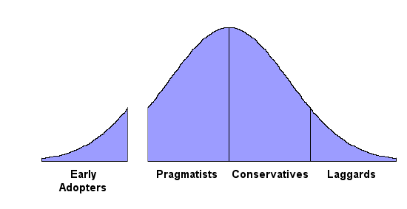
Getting Fooled
Notes:
This is the standard marketing adoption curve, complete with Geoffrey Moore’s chasm. You’ve probably all seen it before.
The problem is that the first people to try every product are the early adopters. And invariably, they love it. It doesn’t matter much what the idea is. If it’s well-done and new, there are early adopters somewhere who will tell you how great it is. I am quite certain I could find at least 7 people on earth who would buy my contact lenses for their cat.
Nonetheless, those early adopters have us fooled. We love technology for its own sake. The early adopters do too. So with every product idea we’ve got, there is an initial positive response from the early adopters, and that convinces us that our idea is great.
After that, things get difficult.

Slide 33
Early Adopters
Early Adopters are
  Easy to get
    They’ll try anything that’s new.
  Easy to lose
    Very shortly, your product won’t be new anymore.
Notes:
Those early adopters don’t stay. As customers, they’re easy to get and easy to lose. Our product doesn’t stay new for very long, so they don’t stay our customers for very long.

Slide 34
The Majority
Conservatives and Pragmatists are
  Hard to get
    They won’t try anything until they see somebody else doing it.
  Hard to lose
    They don’t like change.
Notes:
The real money is in selling to the thick part of that curve, the conservatives and pragmatists.
But those customers are hard to get, because they won’t try anything until they see one of theirs peers doing it first.
Fortunately, once you get them, they’re hard to lose, because they dislike change.
All good businesses are built by selling products to these people.

Slide 35
Geek Ideas
We tend to come up with ideas for
  Early adopters (fast start, short life)
Instead of
  The Majority (slow start, long life)
Notes:
However, as geeks, our love of technology for its own sake means that we tend to come up with ideas that work well for early adopters, not for the majority.
Our companies start fast and flame out fast.

Slide 36
Action Item
Stop thinking about how to use some technology we adore.
Start thinking about how to solve problems that normal people have.
Notes:
Our products would be more successful if we learned to stop thinking about technologies we adore and start thinking about problems that normal people have and how to solve them.

Slide 37
Confession
Hello, my name is Eric and I am a Technoholic.
Notes:
Confession: Hello, my name is Eric and I am a technoholic.
Seriously, I catch myself making this mistake around once a week. I have eventually come to admit that I will never be cured of this disease.
I just have to keep reminding myself:
Customers do not care what language my product is written in.
They don’t care about what library I used or how much fun I had learning a new technology or platform or tool.
They just want their problem solved, and many of them are seriously annoyed that they have to use a computer to do it.
The only way to overcome that annoyance and get their money is to create a product that is simply beautiful, and completely focused on what they want to do.

Slide 38
Problem 3
Black and White Thinking
Mindset proceeds from a world that is all binary
Marketing and sales are all about floats, not bools
  Will people buy this product?
  How many people will buy this product?
Notes:
OK. Problem 3: A black-and-white mentality.
Most of us developers think of everything in black and white terms.
Personally, I think this mentality proceeds from our training. When we are coding, we work in a binary world. The smallest unit of storage in a computer is the bit. A bit is either on or off. Never in between.
The problem is that marketing and sales are a world of gray. It’s a world of floats, not bools.
It is almost NEVER correct to ask, “Will people buy this product?”
Rather, we need to ask, “HOW MANY people will buy this product?”

Slide 39
Competition
All or nothing
Winner takes all
Notes:
This black and white mentality affects the way we think about competition.
We tend to believe that in every market segment, one player will win it all.

Slide 40
The monopolies in personal computing don’t help our thinking much
  Microsoft, Intel
Traditional markets don’t work this way
  (Soft drinks, mobile phones, cars)
But even in the software industry, lots of market segments are still very fragmented
Notes:
Now it doesn’t help much that in our particular industry, this line of thinking has a whole lot of truth in it.
Microsoft actually does have complete dominance of several market segments, including operating systems and office suites.
But traditional markets don’t work this way at all. Look at stuff like soft drinks or cars. Nobody has a monopoly. Every market has a strong #1 and a somewhat smaller #2. And numbers 3 through 5 all have solid revenue as well.
That’s the kind of thinking that make sense. Even in the software industry, there are still lots of market segments which remain fragmented.

Slide 41
Story
Students at the UIUC job fair
Notes:
Last year I was at a job fair at the University of Illinois Computer Science department, recruiting students to come work at SourceGear. About half a dozen times I had the following conversation:
The student would ask, “So what does SourceGear do?”
I said, “We sell version control tools.”
Suddenly, the student’s face would turn into a painful and contorted expression, as if they had eaten some bad shrimp.
“Version control? Doesn’t everybody just use CVS?”
“Sure, lots of people use CVS. But even still, there are dozens of companies selling commercial products in this market.”
“But why would anyone buy them when they could just use CVS?”
“Because even though CVS is great, it’s not the right tool for everyone. You know this happens in all software, not just version control. Nowadays there is a decent open source implementation of everything. Last year people spent over a hundred billion dollars on stuff they could have gotten for free. Why do you suppose they did that?”
“I don’t know. Why would anybody buy Windows or Office when Linux and OpenOffice.org are free?”
☺
Hey, I’m a fan of open source myself, but the black and white mentality just doesn’t fit the facts.

Slide 42
Avoid Competition:
Build a product that nobody wants
Notes:
Things get really bad for us when we bring that mentality into our DecideWhatToBuild discussions. If we assume that one player is going to win every market, we are very likely to assume that whoever got their first will be the winner. The means we will tend to look for product ideas which have no competition.
If we refuse to build any product or feature where we would have to face competition, then we are very likely to end up building a product that nobody wants.
I chose my Erlang UI component suite because I love Erlang, but also because nobody else has one. It’s a wide open opportunity with no competition.
But you know why nobody is selling a component suite specifically for Erlang developers? Because nobody wants one. By avoiding competition, I have avoided customers.

Slide 43
Compete!
Look at your competition
Pick one attribute
Be the best at one thing
Notes:
Good products don’t happen by avoiding competition.
They happen by competing the smart way.
Look at the competition.
Pick one attribute and be the best at that one thing.

Slide 44
Action Item
Banish “yes or no” questions from our DecideWhatToBuild conversations.
Notes:
Our action item here is a very practical suggestion: Do not allow the yes/no mentality in marketing discussions.
Next time you gather a group to talk about DecideWhatToBuild, put a bowl in the middle of the table. Every time somebody asks a yes/no question or makes a yes/no statement about the market segment, they have to throw a dollar into the bowl.
“I don’t think we should use C# because people won’t be willing to download the framework.” That’s a dollar.
“Do people have video cards with enough RAM for those textures?” That’s a dollar.
The first time you do this, it probably won’t go very well, but look on the bright side: By the end of the meeting, you’ll have enough money in the bowl to take everybody out for sushi! ☺

Slide 45
Closing
Geeks in marketing
Notes:
In closing, let me just say this: Despite everything I’ve said here, I think developers can be good at marketing. But marketing is like anything else we do. We’re going to be good at it only if we take it seriously and work hard at it.
Speaking from my own experience, it’s worth the effort. I’m a coder at heart, and I always will be. I started out in my career with the belief that marketing was for bozos who simply don’t get it. Over the years I have studied and practiced in this area and I have found marketing to be an enjoyable part of my job.
If you’re in marketing at a software company, I encourage you to consider getting developers involved. The relationship between your group and the dev team will improve. And your marketing efforts just might get better, just from the additional perspective.
To any developer, I would say that if you have the interest and the opportunity to get involved in marketing, do it.
And I hope you find the things I have said to be helpful. Thank you.

