Slide 1

UNCLE MANDO’S CAR SEARCH
Presented By Julian Grado and Eric Solorio

Slide 2

A Car Search Website

Slide 3
ABOUT
Customers can search for cars that are available in dealerships.
Customers have data connected to the dealers, and services they have received
Site also display a car’s dealership and country it is in
Headquarters Employees can add/update to the database as well

Slide 4

USER DIAGRAM

Slide 6

Main Case Description
Register
User can create an account on the car search site
Login
user is greeted to log in and access website’s components
Business Register
Accesses business login and puts user with HQ
Business Login
User can create new orders, find new dealerships, and make new man
Search
User can search through the database of the multitude of cars that we have
HQ
The headquarters can create an account to make new orders, new manufacturers, and new dealerships

Slide 7

E/R Diagram

Slide 9

DATABASE SCHEMA

Slide 10
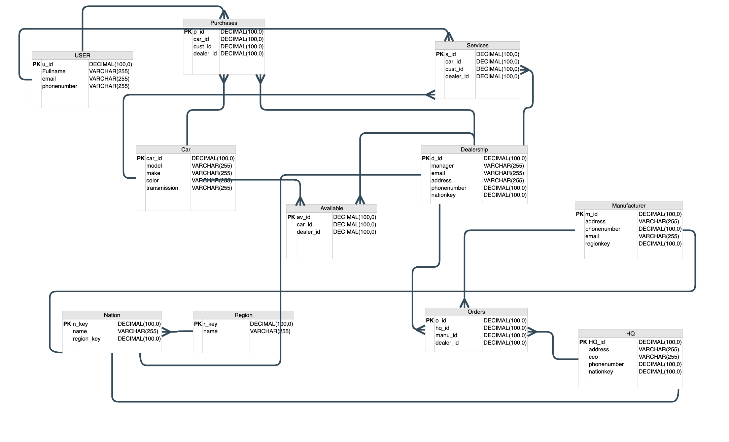

Slide 11





Implementation
Google Sheets - Database
Python – Back End
Flask – Web Development
JavaScript
HTML
CSS
SQLite
41,297 Lines of RAW ORIGINAL DATA

Slide 12
OUR GITHUB:
https://github.com/ericsolorio/CarSearchDatabase

Slide 13

THANK YOU

