Slide 1
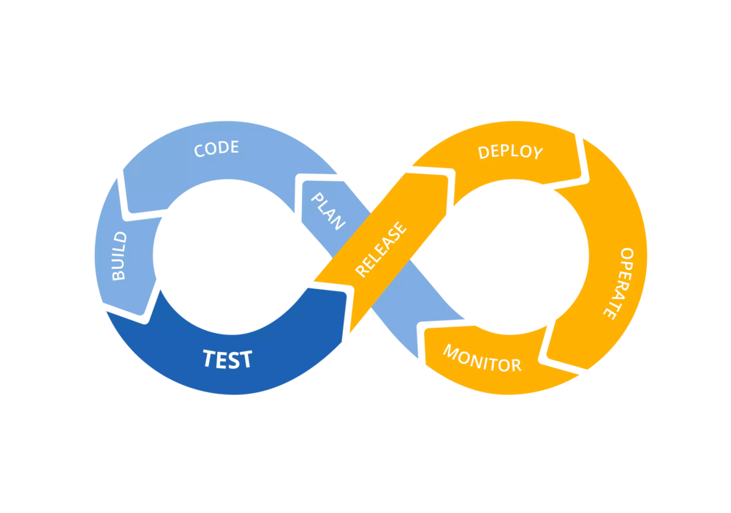
Continuous Integration and Delivery (CI/CD)

Slide 2

WHAT IS CI/CD ?
The practice of automating the integration of code changes from multiple contributors into a single software project
Continuous integration leads to continuous deployment allowing us to deliver software more rapidly
Notes:
This is the Jenkins Dashboard.

Slide 3
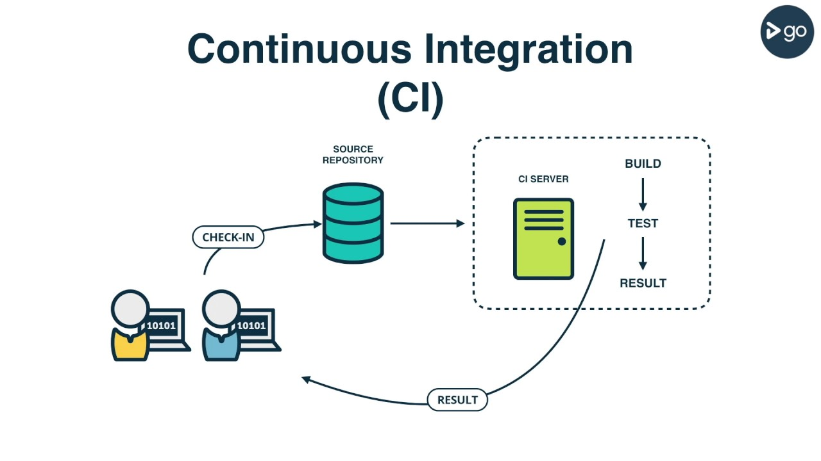

Slide 4

Open Source Continuous Integration Server

Slide 5
WHAT IS JENKINS?
Monitors executions of repeated jobs
Used primarily for continuously building and testing software projects, i.e. “Continuous Integration” or “CI”
Previously known as “Hudson”
http://jenkins-ci.org

Slide 6





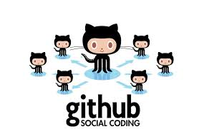







WHO USES JENKINS?

Slide 7
WHY USE JENKINS?
Immediate feedback on broken builds
No building from dev machines and manually copying files
Automated deployment
Automated test execution and feedback

Slide 8
PLUG-INS
Over 600 plug-ins available for customization
Examples:
  JIRA
  Ant
  Maven
  JUnit
  Javadoc
  SSH
  MSBuild
  NUnit
  PowerShell
  Email Notifications
https://wiki.jenkins-ci.org/display/JENKINS/Plugins

Slide 9
QUESTIONS?

Slide 10
INSTALLATION
Prerequisites :
Create a VM with Vmware/Virtualbox using image centos
Logged to your machine as root (or user with sudo privileges)
Installing Jenkins :
1. Java is a java application, so you need to install java
$ sudo yum install java-1.8.0-openjdk-devel
2. Enable Jenkins repository
$ curl --silent --location http://pkg.jenkins-ci.org/redhat-stable/jenkins.repo | sudo tee /etc/yum.repos.d/jenkins.repo
$ sudo rpm --import https://jenkins-ci.org/redhat/jenkins-ci.org.key

Slide 11
INSTALLATION
3. Install and start Jenkins
$ sudo yum install jenkins
$ sudo systemctl start jenkins
$ sudo systemctl status jenkins
$ sudo systemctl enable jenkins
4. Allow Jenkins port to be accessible from outsite the VM
$ sudo firewall-cmd --permanent --zone=public --add-port=8080/tcp
$ sudo firewall-cmd –reload
5. Open http://your_ip_or_domain:8080 and setup your jenkins
You can find more at link below :
https://linuxize.com/post/how-to-install-jenkins-on-centos-7/

Slide 12
JENKINS PIPELINE
A continuous delivery pipeline is an automated expression of your process for getting software from version control right through to your users and customers

Slide 13
Jenkinsfile (Declarative Pipeline)
pipeline {
agent any
stages {
stage('Build') {
steps {
sh 'makemvn -B -DskipTests clean package'
}
}
stage('Test'){
steps {
sh 'mvn test'
}
post {
always {
junit 'target/surefire-reports/*.xml'
}
}
}
stage(‘Deliver') {
steps {
sh './jenkins/scripts/deliver.sh'
}
}
}
}

Slide 14
QUESTIONS?

Slide 15
EXAMPLE 1
Build a java app with maven
1. Clone https://github.com/jenkins-docs/simple-java-maven-app to your local machine
2. Open your jenkins and create pipeline project

Slide 16
TAKS 1

Slide 17
TAKS 2

Slide 18
TAKS 3

Slide 19
QUESTIONS?

