Slide 1



Pre-Stack Kirchhoff Time Migration on Hadoop and Spark
Yang Chen, Tang Jie, Gao Heng, Wu Gangshan
Nanjing University
Notes:
Hello, everyone! My name is yangchen, I come from Nanjing University. Today, I want to share with you my work----pre-stack kirchhoff time migration on Hadoop and spark.

Slide 2
Outline(cooperate with Sinopec)
Introduction
Kirchhoff on Hadoop
Kirchhoff on Spark
Conclusion
Notes:
I will introduce my work from several aspects. First is the introduction of the background knowledge. Second is the Kirchhoff algorithm on Hadoop and Spark respectively. Lastly, I will conclude my work in concise.

Slide 3
Introduction
Kirchhoff on Hadoop
Kirchhoff on Spark
Conclusion

Slide 4
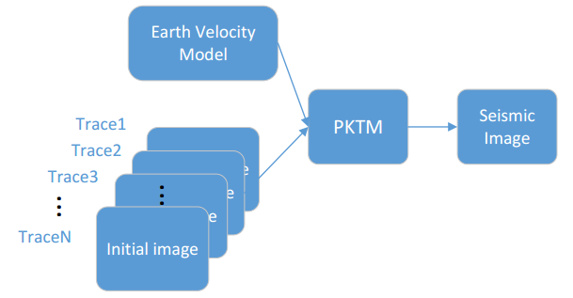
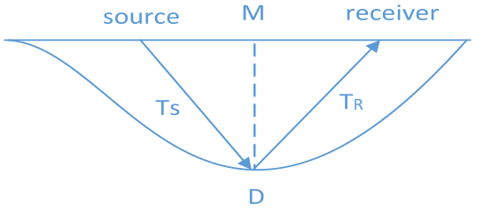
Kirchhoff Algorithm
Pre-Stack Kirchhoff Time Migration is one of the most popular migration technique in seismic imaging area because of its simplicity, efficiency, feasibility and target-orientated property.
Data Model
Spread Model
Notes:
The Kirchhoff algorithm is one of the most popular migration technique in seismic imaging area. It has simplicity, efficiency, feasibility and target-orientated property.
The data model of kirchhoff shows in the picture. We can see that the input data splits into traces. A trace data is the format data in seismic. Then, we can see the spead model in the next picture. D is the scanner point. A ware transfers from source to D and reflect to receiver. Receivers can collect the data about underground layers.

Slide 5
Kirchhoff Algorithm
Looking
down from the sky
ground
shot points
scanner points
trace
data
How to get output trace?
output trace
ground
the point on output trace
flying time
aggregate input traces in
influence ellipse

Slide 6
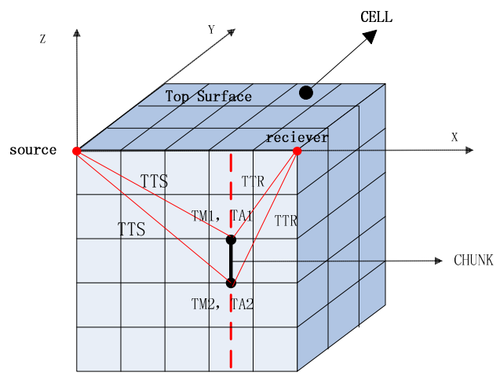
Kirchhoff Algorithm
big data

Slide 7

Kirchhoff Algorithm
Kirchhoff migration uses the Huygens-Fresnel principle to collapse all possible contributions to an image sample.
Flow Chart
Notes:
Kirchhoff algorithm uses the huygens-fresnel principle to collapse all possible contributions to an image sample. Now, I show the flow chart of the Kirchhoff algorithm. From the figure, there is a cycle to handle input traces.

Slide 8
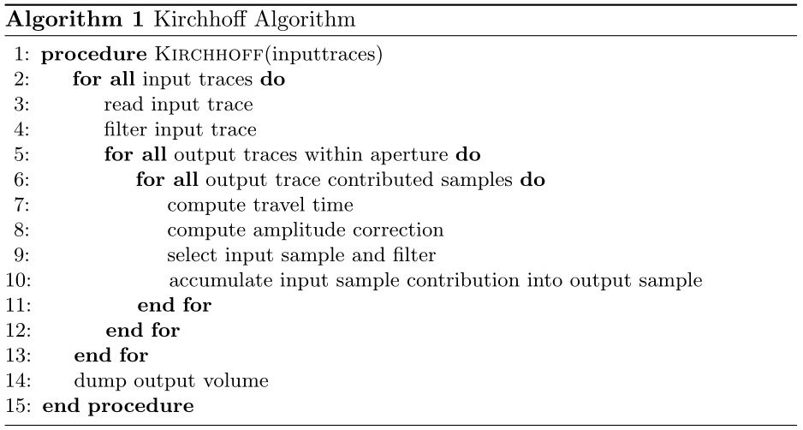
Kirchhoff Algorithm
pseudo-code
Notes:
The total pseudo-code show as the Algorithm1. It is a trebling cycle. So the cpu version wastes a lot of time.

Slide 9
Motivation
Disadvantage:
CPU:
trebling cycle, waste time, big data
GPU:
run fast(thousands of threads), but big data(enough gpu memory), no fault tolerance
Advantage:
Hadoop & Spark:
big data
distribute computing
fault tolerance

Slide 10
Introduction
Kirchhoff on Hadoop
Kirchhoff on Spark
Conclusion

Slide 11


Kirchhoff on Hadoop
According to the official, number of mappers should be 10-100.
one map task corresponds to a core.
We should not split trace data into two parts.
How to split input data?
We use multi-threads to compute data in map task.
if Hyper-Threading is on,
set 2*(threads - 2),
else (threads - 2)
Optimize computing with a matrix operations replace double cycles.
Map task computing？
The output traces should sort by id.
So, we use the partition function to sort output trace into several group.
Then use distribute algorithm to sort each group.
Finally, write them to HDFS in turns.
S_{i} is a input file.
M is the memory of mapper.
r_{n} is the number of reduce tasks.
k is the parameter.
Partition & Sort？

Slide 12
Kirchhoff on Hadoop
Framework
Notes:
Now, I introduce the kirchhoff algorithm on Hadoop. Here is the picture of framework. We use the split function to decide the size of input split and use the hash function to determine which map result transfer to which reduce task.

Slide 13
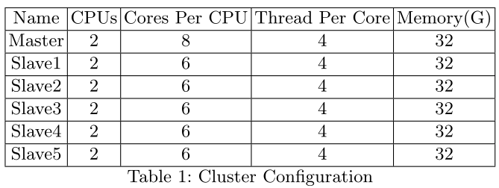
Hadoop Experiments
Configuration:
Notes:
Here is the configuration of the hadoop experiments. I use 32G memory and 12 cpu cores.

Slide 14
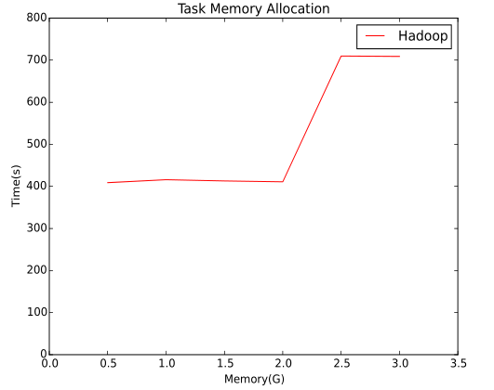
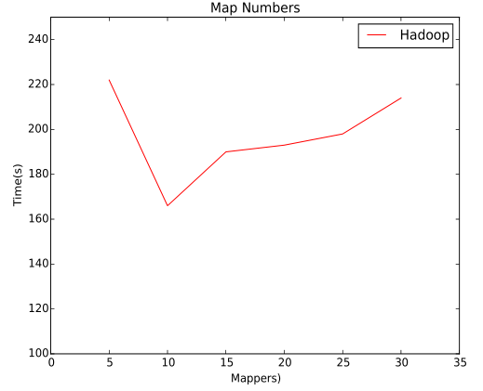
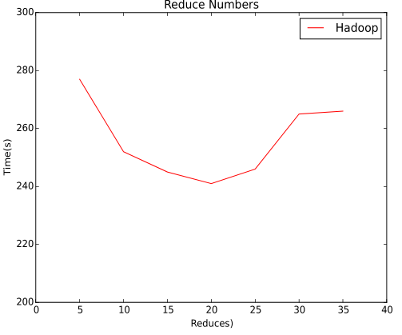
Hadoop Experiments
Secondly, we test how the number of mappers affects the performance.
When the number is small, it can not make full use of the system resources.
When the number is large, it needs more rounds to parallel execute map tasks.
Firstly, we test how the memory of a mapper’s container affects the performance.
When the memory exceeds to a threshold, the number of map tasks which run parallel reduces and the execution time becomes longer.
Finally, we test how number of reduce tasks affects the performance.
When the number is small, it takes a lot of time to aggregate output traces.
When the number is large, it holds the resources in the cluster to affect the parallel of map tasks.
Notes:
we first test how memory of mapper affects the performance of the program. We can see that when the memory exceeds over some threshold, the number of mappers reduces, and the execution time becomes longer.
Secondly, we test how the number of mappers affects the performance. we can see that the executing time is smallest when the mapper’s number adapts to the cluster’s resources.
Lastly, we test how reduce task numbers affects the performance. when the number of reduce tasks match the number and output pairs of mappers, it gets the best performance.

Slide 15
Introduction
Kirchhoff on Hadoop
Kirchhoff on Spark
Conclusion

Slide 16


Kirchhoff on Spark
RDD is a memory dataset in Spark, it can preserve data in memory.
Spark provides many operations on RDD, such as partition.
How to split input data?
In Spark, regardless of map task or reduce task, it is the transformation on RDD.
Each partition of RDD compute in parallel.
Also use multi-threads.
RDD
RDD computing？
each RDD use partition
Each RDD partition corresponds to a reduce task.
Partition & Sort？

Slide 17
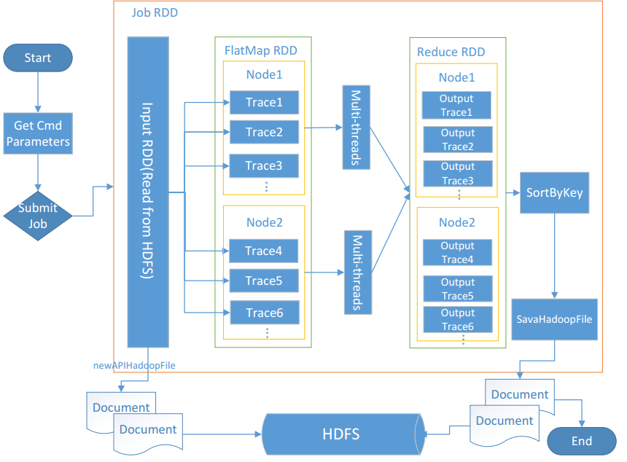
Kirchhoff on Spark
Framework
Notes:
Now, I introduce the kirchhoff algorithm on Spark. Here is the picture of framework. We use the partition function to decide the size of RDD partitions and use the mapping function to determine which map result transfer to which reduce task.

Slide 18
Experiments
Configuration:
Notes:
The configuration of the spark experiments is the same as hadoop.

Slide 19
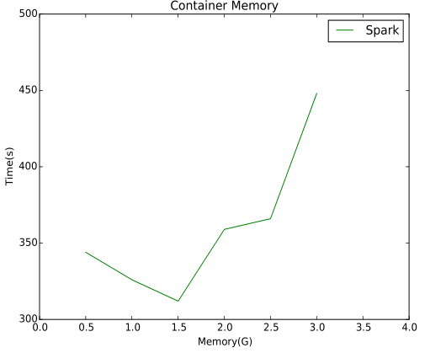
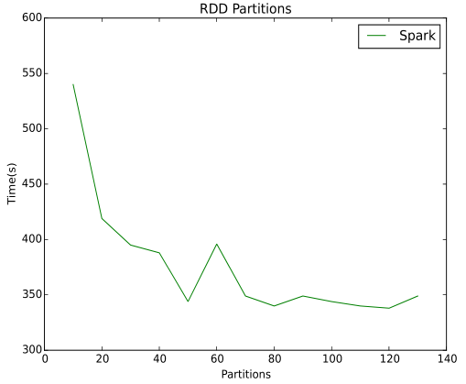
Spark Experiments
Firstly, we change the memory of container to evaluate the performance.
If the memory is small, there will be more partitions to execute.(rob resources)
Else, parallel tasks reduces.
Secondly, we test RDD partitions to find the best partition.
When RDD partitions grow, it make the cluster run busy to handle them, so the curve tend to be stable.
Notes:
First, we change the configuration of the container’s memory to evaluate the performance of the program. if the memory of a container exceeds to a proper value, the execution time grows longer.
Second, we test the RDD partitions about the input traces, find the best partitions. when RDD partitions grows, the cluster run busy to handle RDDs with the same amount of time.

Slide 20
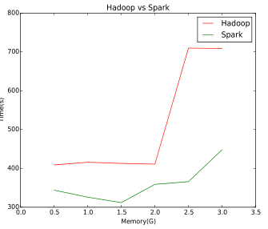
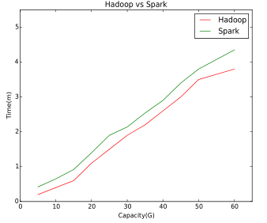
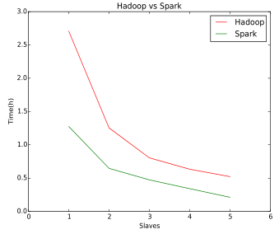
Comparison
Notes:
Finally, we compare experiments on Hadoop and spark. Firstly, we compare the yarn container memory. Secondly, we compare the reading and writing time of Hadoop and Spark I/O capacity. Lastly, we compare the running time of Kirchhoff application on Hadoop and Spark framework.

Slide 21
Introduction
Kirchhoff on Hadoop
Kirchhoff on Spark
Conclusion

Slide 22
Conclusion
Contributions：
use distribute algorithm to handle seismic data
implement expansion capability
Future Work:
improve I/O speed
Infiniband on HDFS in Hadoop
Tachyon on HDFS in Spark
alter resource scheduler
alter the source code of Yarn resource scheduler
Notes:
I found hdfs has a low efficiency of I/O, so we can improve the reading and writing ability using Infiniband with hdfs, or use tachyon with hdfs in spark.

Slide 23

Notes:
Thank you for listening.

Slide 24
Hadoop
Hadoop is an Apache open source distributed computing framework for the cluster is stored in inexpensive hardware.
The core design of Apache Hadoop is MapReduce and HDFS.
Notes:
Now, I introduce Hadoop. The core design is MapReduce and Hdfs. First is the MapReduce framework. Second is the hdfs architecture.

Slide 25
Hadoop
Version 1
1.Job & Task Scheduling
2.Resource Management
Task Computation
Platform + Application Framework
Notes:
Hadoop has two generation. This is version 1. JobTracker is responsible for job and task scheduling and resource management. while tasktracker takes charge for task computation. The architecture combines platform and application framework.

Slide 26
Hadoop
Version 2
Resource
Management
Platform
Resource
Monitoring & Enforcement
Job & Task Scheduling
Application Framework
Notes:
However, in the version 2, jobtracker split into resource manager and applicatin master, while tasktracker corresponds to nodemanager. Their duty does not change. But the new generation split architecture into platform and application framework.

Slide 27
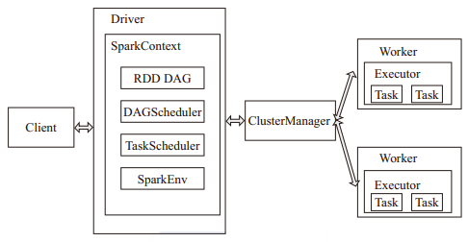
Spark
Spark is a MapReduce-like cluster computing framework, Spark enables memory distributed data sets. It introduces the concept of Resilient Distributed Dataset(RDD).
Notes:
Spark is a MapReduce-like cluster computing framework. The core design is RDD. The framework shows in the figure.

Slide 28
RDD
An RDD is a read-only collection of objects partitioned across a set of machines that can be rebuilt if a partition is lost.
Notes:
An RDD is a read-only collection of objects. RDD provides narrow dependency and wide dependency. narrow dependency represents each partition of the parent RDD is used by at most one partition of the child RDD. while wide dependency where multiple child partitions may depend on it.

Slide 29


Kirchhoff on Hadoop
Start
1
A container corresponds to a map
.
Acquire Cluster
task
,
each map task uses multi
environment
-
read
threads to handle input traces and
use a HashMap to preserve the
<
output traces produced by input
key
,
value
>
traces
.
HDFS
2
Another trick is each
.
Input
thread use a buffer to keep shot
Data
(
Splits
)
data
,
program
this will accelerate the
.
Each node has many map tasks
3
,
.
Mapping
aggregate all the map output
traces with the same key
,
decrease the intermediate result
Container
Container
Container
Container
.
One trick is to write these output
result to HDFS
,
just write the
filename and file offset to the
reduce task
.
4
.
write
Combining
Use a hash function to map the
output pairs to the reduce task
,
Node
Node
Node
Node
ensure that the keys in every
reduce task are in the right order
.
5
.
Partitioning
(
Shuffle
)
read
HDFS
6
.
Reducing
7
.
Outputting
8
.
Image Output
End
Notes:
This is the flow chart of Kirchhoff on hadoop correspond to the figure above. We can see the important points about all steps.

Slide 30
Kirchhoff on Spark
Notes:
Here is the flow chart of Kirchhoff on spark correspond to the figure above. We can see the key points about all steps.

