Slide 1
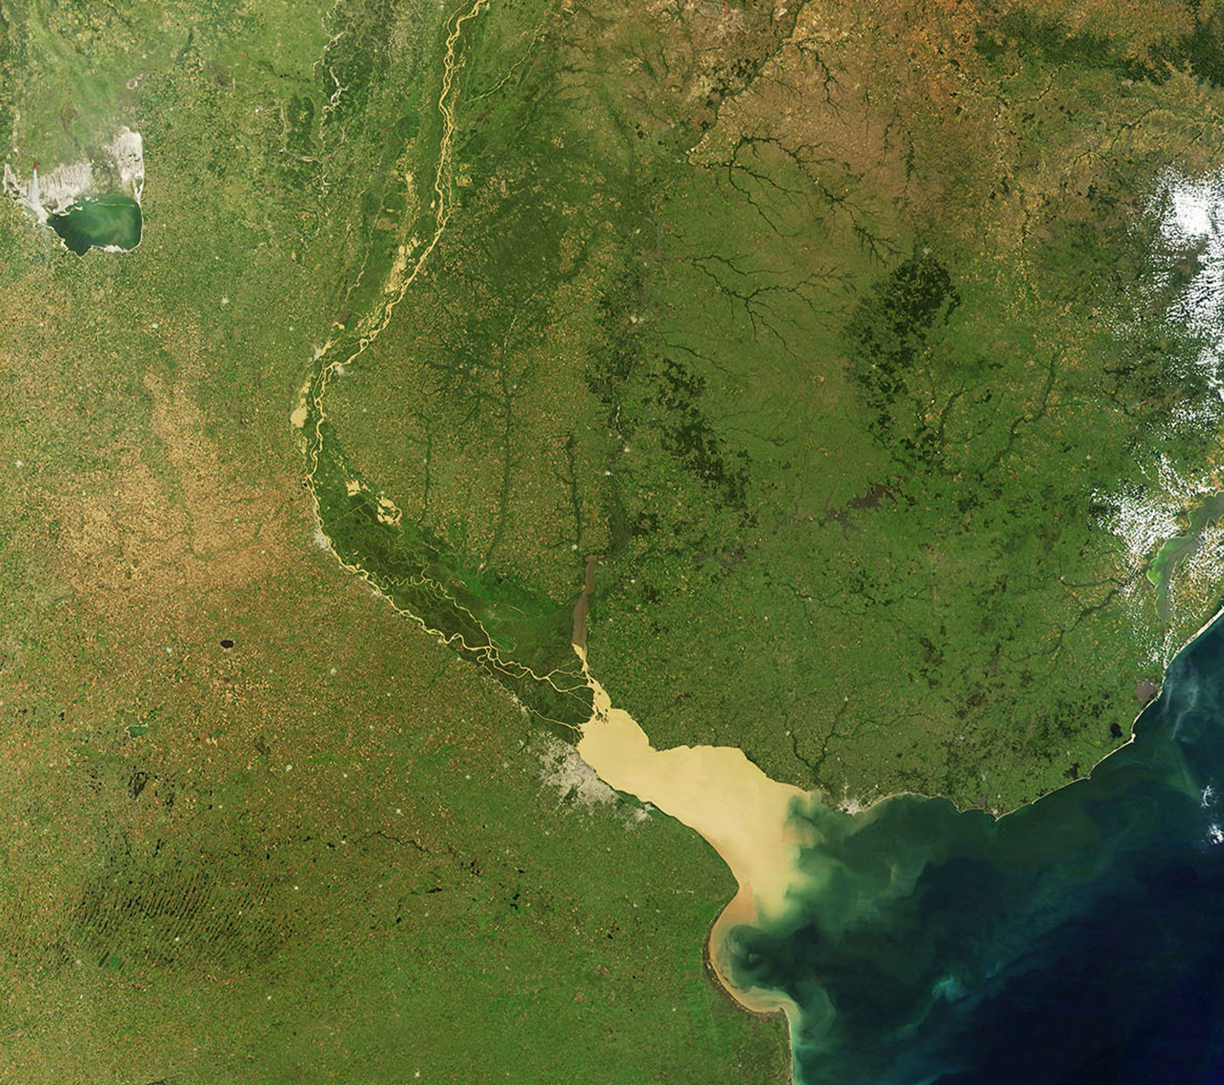

Early diagenetic alterations of sterol biomarkers during particle settling and burial in polluted and pristine areas of the Rio de la Plata Basin
Speranza, E.D., Colombo, M., Skorupka, C.N., Colombo, J.C.
Laboratorio de Química Ambiental y Biogeoquímica, FCNyM, UNLP
Notes:
Presentation No authors details, just the institution

Slide 2
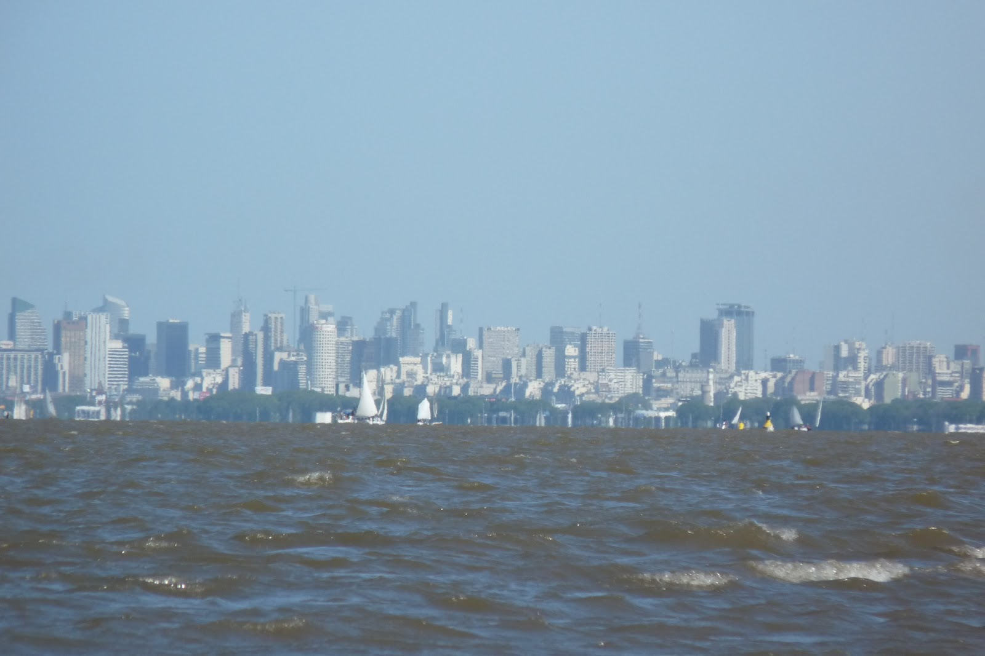
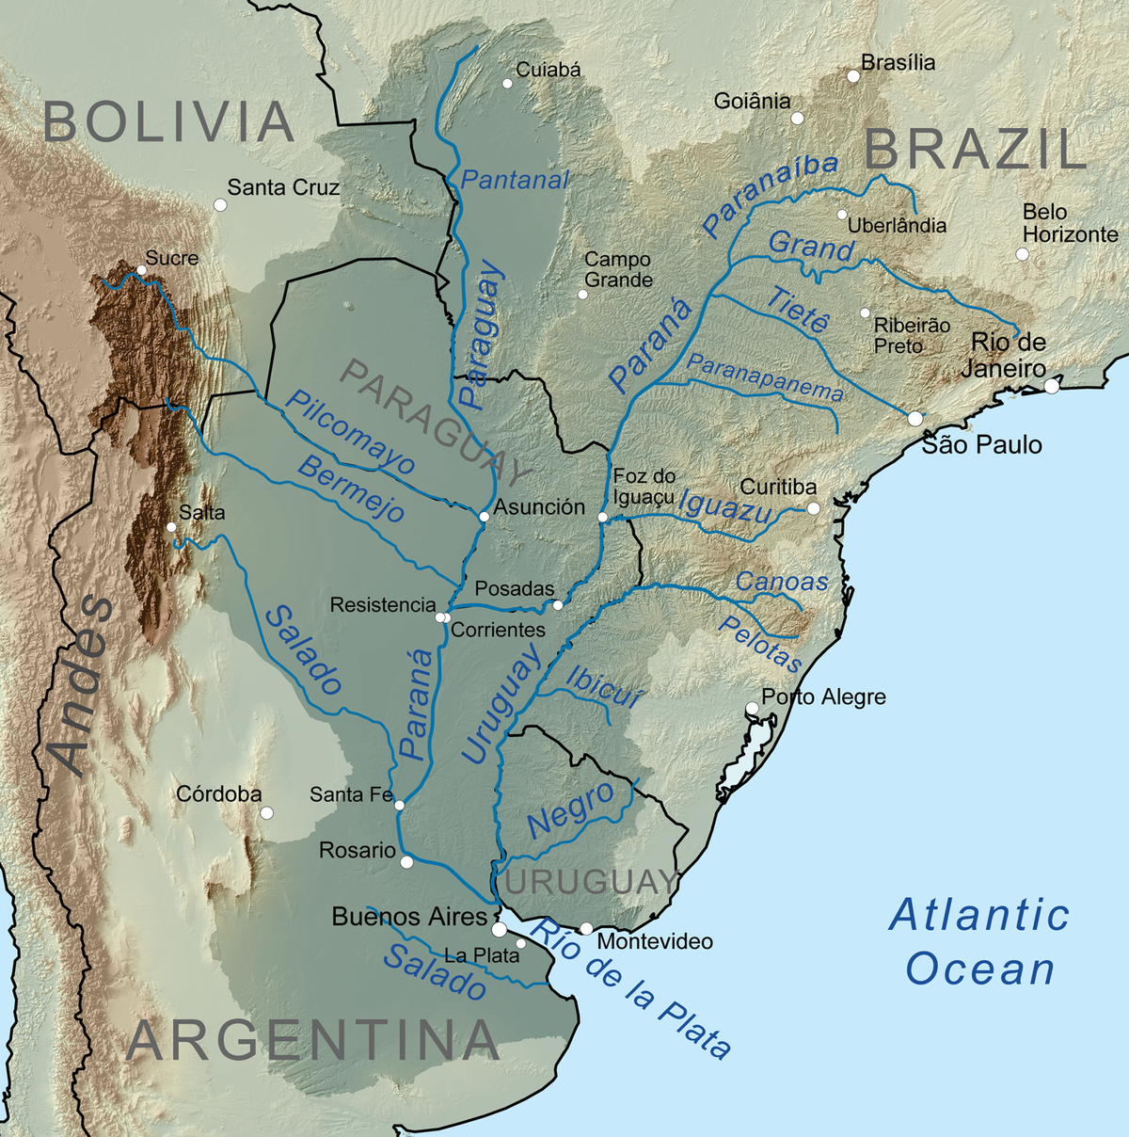
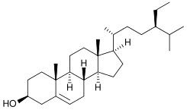
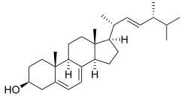
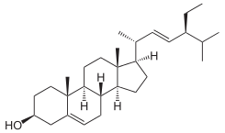
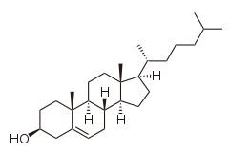
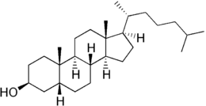
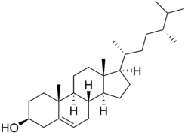
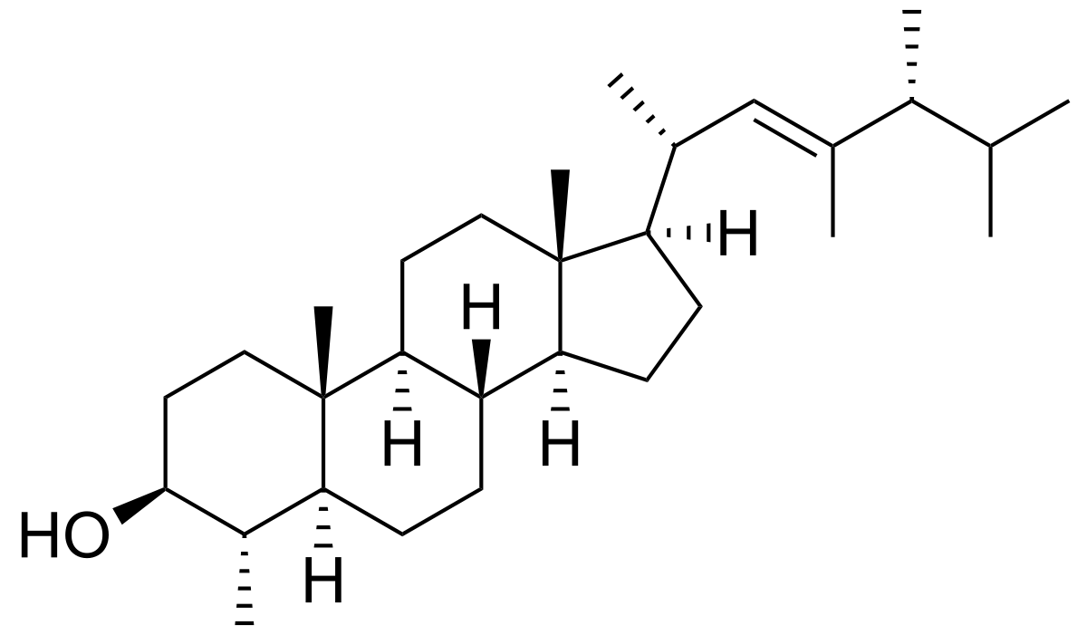
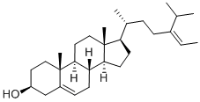
Background
Buenos Aires city metropolitan area
~16x10⁶ people
Heavily polluted
Huge sewer discharge
(~2x10⁶ m³/day)
Sterols
Biomarkers: Organic matter source and degradation
Fecal sterols (e.g. coprostanol)
Area
~3x10⁶ km²
Rio de la Plata basin
Discharge
~27,000m³/s
Settling material
Represent fresh inputs of OM
Particularly relevant in turbid environments
Particulate load ~100x10⁶ tons/year
Notes:
The Rio de la Plata basin is among the biggest river systems of the world, in terms of darinage area and river flow, and it transports a huge particulate load to the Atlantic Ocean. (Alternatively: “Extending from Brasil and Bolivia to Argentina, the Rio de la Plata basin...”)
In the Rio de la Plata estuary , the metropolitan area of Buenos Aires is inhabited by 16 million people and is heavily polluted with hydrocarbons, POPs and metals. The main Buenos Aires sewage outfall has a flow of more 2 millions m3/day. These effluents had been discharged untreated until the installation of a WWTP in 2015.
Due to their abundance, resistance and diversity sterols are widely used as biomarkers in aquatic environments. The reltive source specificty of sterols make them useful to ascertain the sources of organic matter. Some of them are synthesized in the gut of humans and other animals, becoming tracers of fecal pollution.
For the study of sterol biogeochemical dynamics in the turbid Rio de la Plata basin, the settling material is particularly relevant since it represent fresh inputs of organic matter to the system.

Slide 3
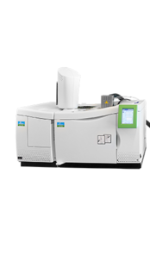
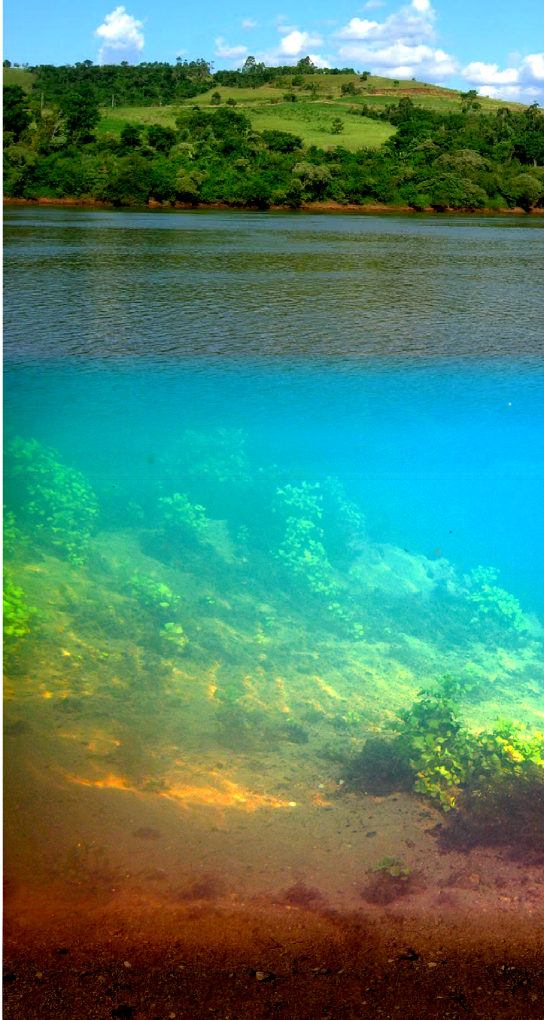
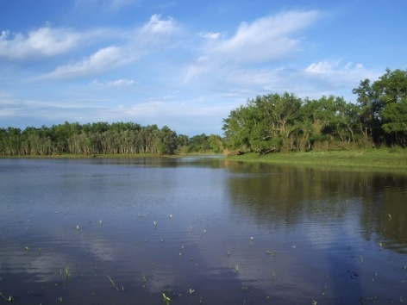
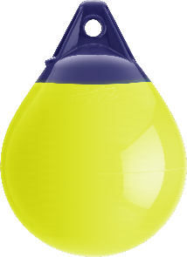
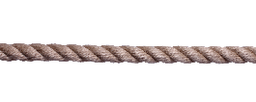
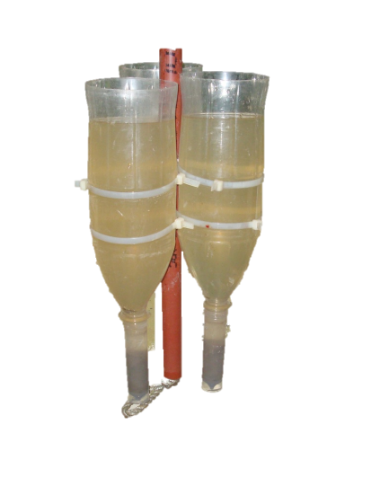
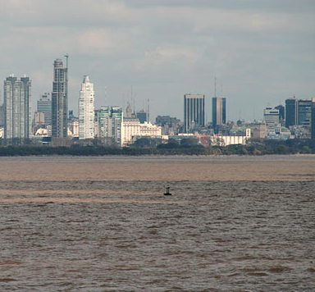
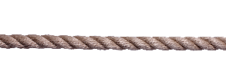
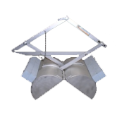

Methods
N (Uruguay river)
GC-MS analysis
Sediment trap
Lipid extraction & purification
BA (Buenos Aires
Rio de la Plata estuary)
Surface sediment

Slide 4
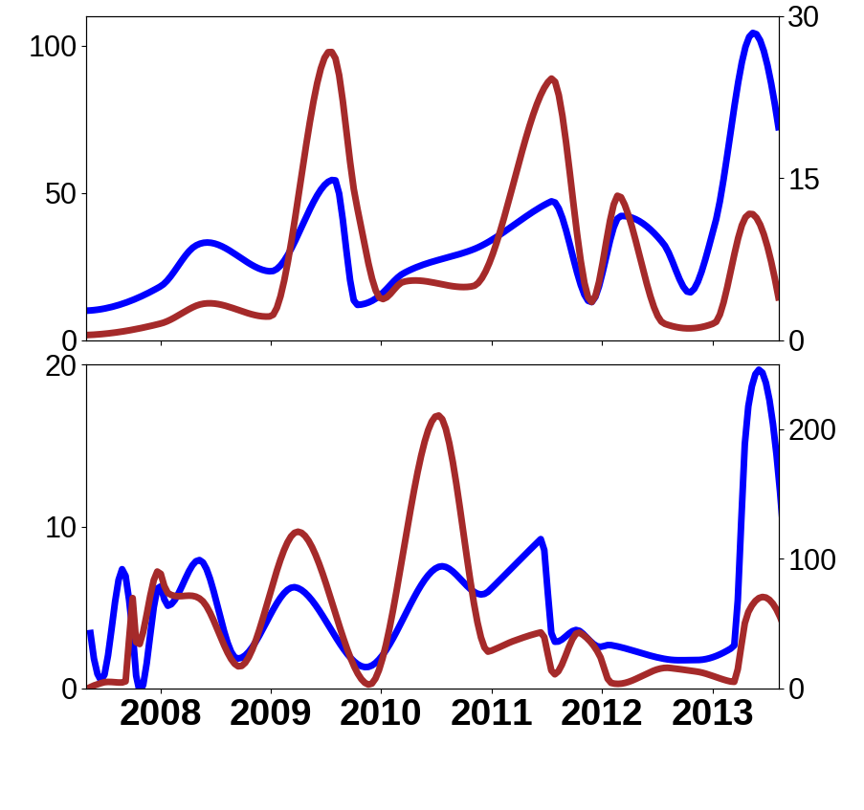
Results: Temporal variation
BA
Sterol content follows seasonal variation of river flow and particle flux
Particle flux (mg/cm².day)
Sterol content (mg/g)
N
Spring-Summer
Wet and warm
Flux / Sterols
Autumn-Winter
Dry and cold

Slide 5
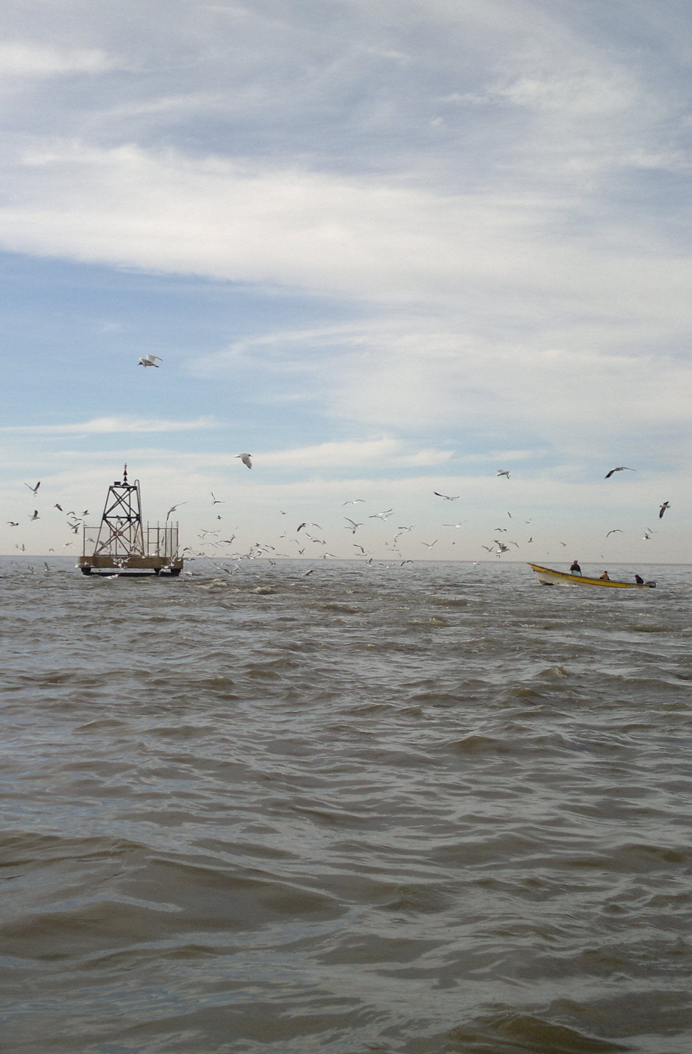
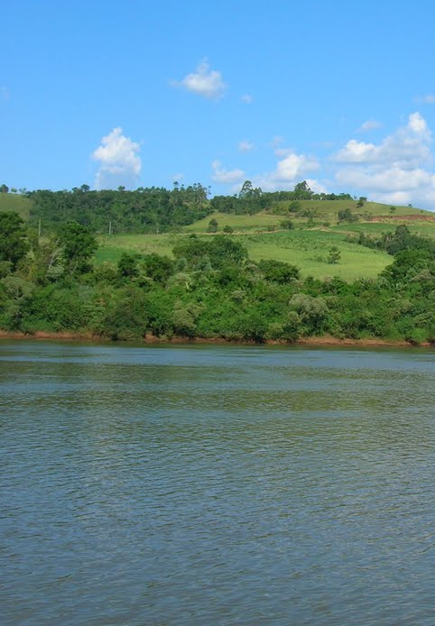
Results: Settling particles sterols
BA
N
Total sterols:
7140 µg/g
Total sterols:
41 µg/g
170 X
Fecal sterols
Cholesterol
Other sterols
Plant sterols
Much higher organic matter input at BA
Contrasting sterol composition
3.6 mg/g coprostanol at BA (≈ sewage sludge)
Anthropogenic
Natural

Slide 6
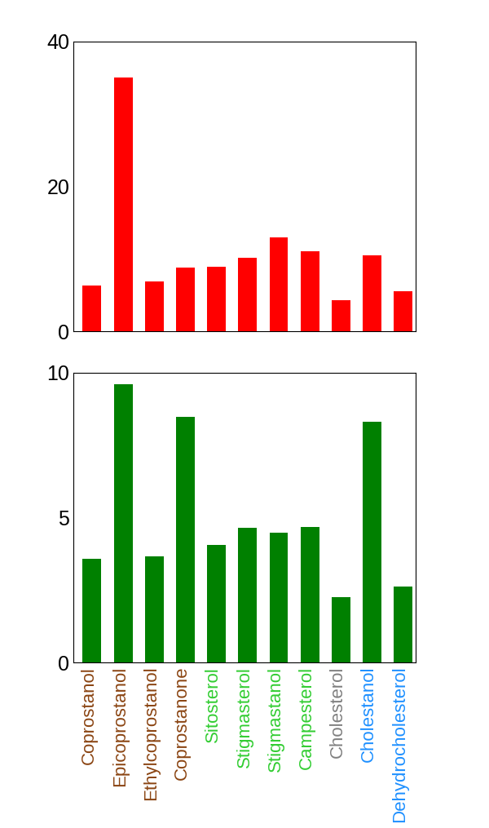
Results: Sterols settling down
Sterol vertical flux:
BA
116 ± 168
mg/cm².year
Higher vertical fluxes of sterols at BA
Anoxic conditions in BA sediments results in higher sterol preservation
Accumulation efficiency (%)
N
0.070 ± 0.13
mg/cm².year

Slide 7
Results: Sediment sterols
BA
N
Total sterols:
708 µg/g
Total sterols:
1.9 µg/g
370 X
Fecal sterols
Cholesterol
Other sterols
Plant sterols
Sterol composition similar to settling particles, with 10-20 times lower concentrations

Slide 8
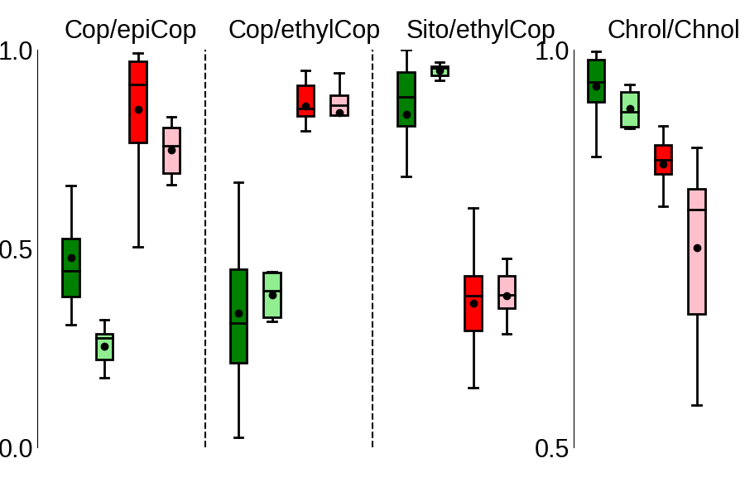
Results: Sterols ratios
Sterols ratios were used to evaluate organic matter sources and degradation
BA
Settling material
BA
Sediments
N
Settling material
N
Sediments
Low degradation of fecal sterols at BA
Fecal sterols mainly from herbivores at N
Low fecal pollution at N
Prevailing anoxic conditions at BA

Slide 9

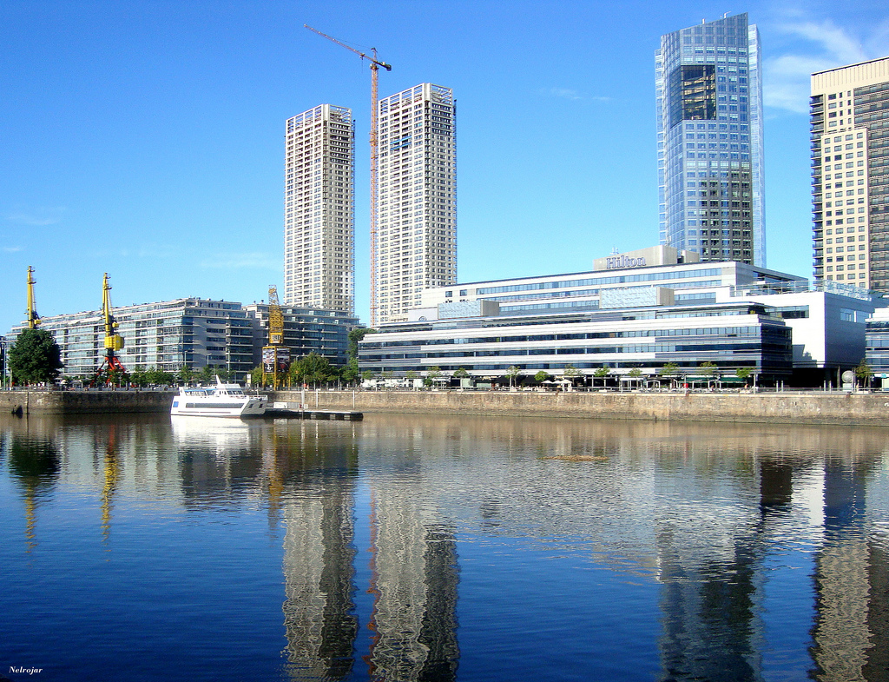
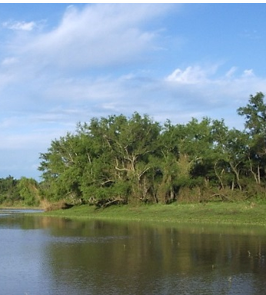




Conclusions
BA
N
Massive sewage pollution!
Settling material
Land plants input
μg/g
Sterol content
μg/g
X 170
Accumulation efficiencies (%)
7-40
10-14
5
6-10
2-6
3
2
2-6
Oxic
Sediments
Anoxic

