Slide 1
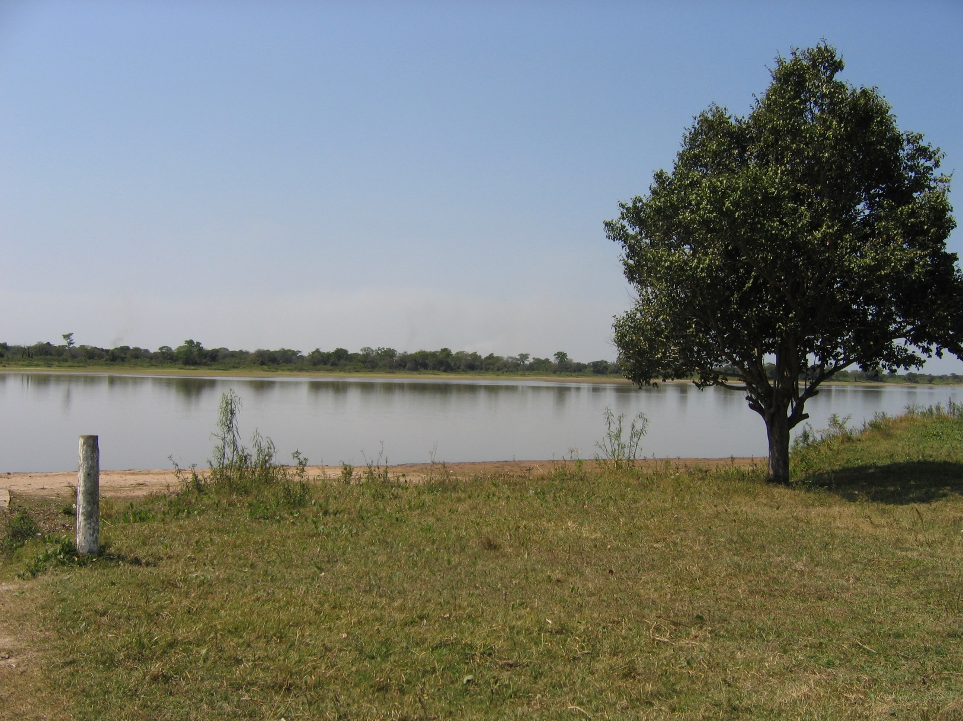
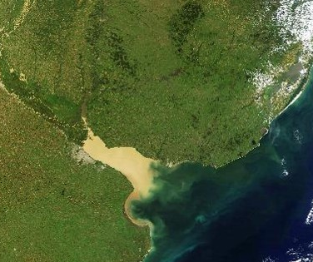

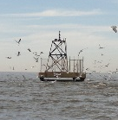
Vegetal detritus
─S34
Buenos Aires City
W58
I
Anthropogenic detritus

Slide 2
Vegetal detritus
─S34
Buenos Aires City
W58
I
Anthropogenic detritus

