Slide 1
LCM AUTOMATION SCRIPT - CLI / PYTHON2.7
Domain : Charging
Pulkit Garg – Intern, Ericsson-Global, Chennai Area
Ericsson Internal
2019-11-4

Slide 2
AGENDA
PURPOSE
AFTER SCRIPT DEPLOYMENT – WORKFLOW
INTERNALS- WORKFLOW
DELIVERABLES
OTHER FEATURES
DEMO

Slide 3
PURPOSE
To automate updating of a given Maven-Artifact’s version throughout Gerrit projects under Charging domain, recursively.
WHY ?
There are total 72 Gerrit projects (repositories) in charging. Earlier, every project was fetched manually and scanned for any dependency upon a particular artifact (other project) which recently got a step-down/step-up in version as part of LCM activity. (I/F matrix update)
The respective modifications to artifact’s dependency version for each such dependent project were commited manually.
Notes:
This post installation script is now removed since we now won’t be having the need to mention the physical path of the servicelogics in the audit log.

Slide 4
AFTER SCRIPT DEPLOYMENT - WORKFLOW
MavenBox :
Supervised
Automation
environment
Git Enterprise repositories
Bulk fetch repositories
Build-master Node
Submit
separate commits for each repository
Gerrit Code Review
JENKINS Automation

Slide 5
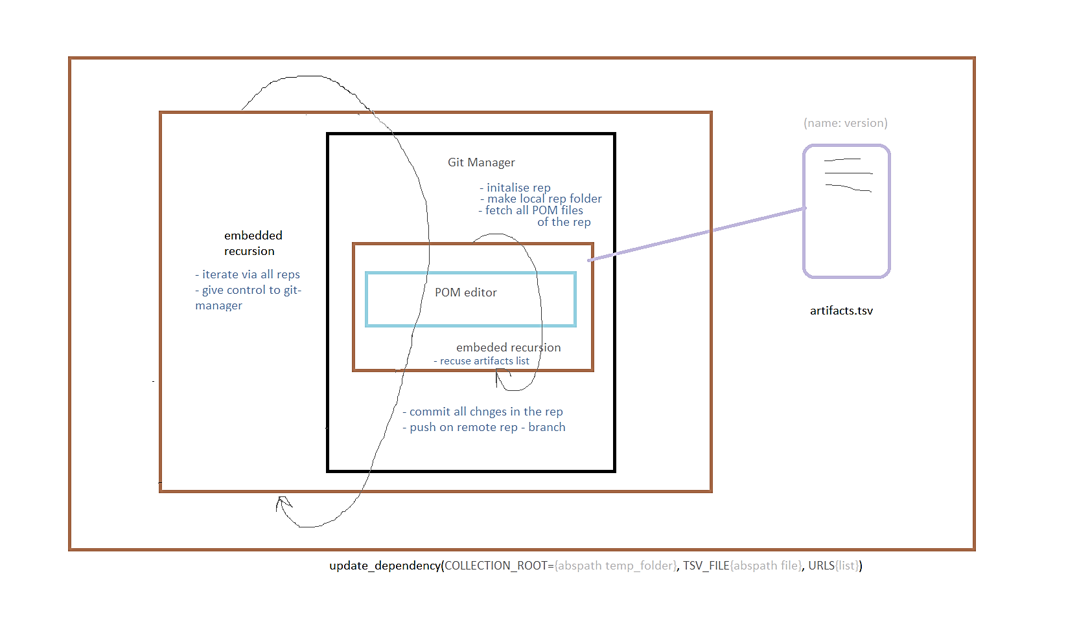
INTERNALS – WORKFLOW

Slide 6
DELIVERABLES
Interactive Command-line script interface
CSV sample format for artifacts
Python2.7 API package : MavenBox
Executable Builds for multiple OS platforms.

Slide 7
OTHER FEATURES
Prompts (Y/N) under Condition as follows:
In case of any merge conflicts (ie. Two or more commits are being made concurrently upon same dependency version tag in a particular POM file within a single gerrit project ).
In case of subjected artifact’s previous-version found being hardcoded inside submodule’s POM file (ie. To avoid triggering of any compatibility issues that breaks functionality ).
Option to again start script upon locally-fetched gerrit repositories which were downloaded by previous run. WARN: this feature is more readily prone to merge conflicts. Use-cases are as follows
If facing bandwidth latency
If under unit testing / development mode

Slide 8
OTHER FEATURES
Option to add Reviewers (ie. GERRIT EMAIL IDs) for final commits being made to one or more gerrit repositories.
Dumps CLI – interactive log into a temp-file path as provided for logging purposes.
Setup custom commit-message Line for gerrit commits

Slide 9
DEMO
We are going to show contents of CLI-dump logging file obtained via a sample artifacts.csv and, five Charging Gerrit repositories.
We are going to add reviewers to our commits
We are going to show some featured test-cases.

Slide 10
THANK YOU

