Slide 1
M.T.S.
Multiprotocol Test Suite
Technical presentation
MTS
Fabien Henry
fabien.henry@ericsson.com

Slide 2

MTS
Table of contents
Basics
Input files
Interfaces
Protocol
Core
Logging
Statistics
Documentation
Master/slaves
Capture/Genscript
Conclusion

Slide 3
MTS
Basics : features
Multi-protocol tester specially designed for IMS architecture :
* IMS protocols (SIP, RTP, DIAMETER, HTTP protocols) +
* EPC architecture (GTP protocol) +
* PSTN/PNLM architecture on IP network (SIGTRAN protocol) (in progress)
* Application protocols (iptv, mail, sms, aaa, signaling, media, alarm/notif, nat, …) +
* Basic transport ones (TCP, UDP, SCTP, TLS)
Functional, non-regression or protocol tests => ‘Sequential’ mode
Load, performance endurance stress tests => ‘Parallel’ mode (master/slave)
Simulates equipment => client, server or both sides
System supervision => capture mode (like wireshark)
Definition of tests case in XML files : test and scenarios input files
Graphical (very convivial) or command line (for test automation) user interfaces
Easy to use : logging management and rich statistics presentation.
Pure software solution (standard IP network card) => support only IP based protocol
Written in java => supports many famous platforms : Windows and Linux supported
Open Source product since begin 2012 with GPLV3 license => free to use²²

Slide 4
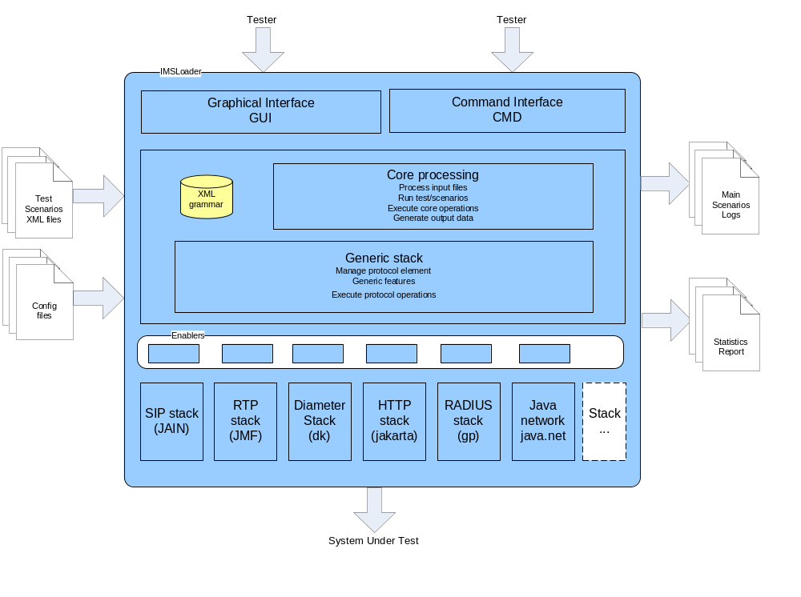
MTS
Basics : architecture

Slide 5
MTS
Input files : test description
Described in XML syntax
Used directly in the tool with the user interfaces
A test begins with a <test> tag => tests suite
A test is defined as a testcase list
Each testcase (<testcase> tag) is composed of a list of scenarios => call-flow chart
For each scenario (<scenario> tag), the content is a reference to the XML scenario file which is relative to the test location or absolute => call-flow entity
For all tags, you have “name” and “description” attributes
Changes in the test file need a test reload from the user
XML syntax :
<test>/N*<testcase{state, number}>/N*<scenario>

Slide 6
MTS
Input files : scenario description
Described in XML syntax
A scenario file begins with the <scenario> tag
Consists in a list of operations which are run sequentially in the time
When an operation failed (often a timeout on message receipt), the scenario running is stopped and return a failure to the testcase
Protocol operations (this is the main goal of the tool)
Core operations
For all operations, you could defined 3 common attributes : “name”, “description” and “state”
Changes in scenario file are taken into account immediately (without any reload)
XML syntax :
<scenario>/N*<operation>

Slide 7
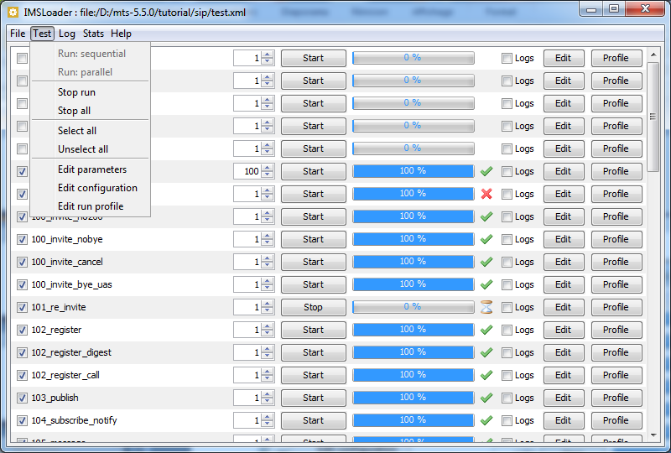
MTS
Interfaces : GUI overview

Slide 8
MTS
Interfaces : GUI features
Useful for scripts writing, testing and debugging
Open, close, reload, edit the test file => menu “File”
Show the list of testcases in the main windows
Run a testcase manually one or many times => “Run” button
Run a part of a test sequentially mode (only selected ones)
Run a part of a test in parallel mode (simultaneously) at a given load (testcase by sec) => menu “Test”
1) a selector checkbox (“state” XML attribute)
2) a testcase name (“name” XML attribute)
3) a number textbox with spins to enter the number of iterations to run (“number” XML attribute)
4) a “Start” button to start the testcase manually
5) a gauge to display the progress of the testcase running
6) a status icon of the testcase (OK, failed, interrupted)
7) a checkbox called “logs” to display the scenarios logs
8) an “Edit” button to edit the scenarios in your favourite editor (defined at installation and configurable)

Slide 9
MTS
Protocol : operations
Based on message elements : data message format (text / binary)
* <sendMessagePPP> => to send a message
* <receiveMessagePPP> => to wait until a message is received with filtering features
Uses a way of transport : a channel element (connection)
* <openChannelPPP> => to open a transport channel
* <closeChannelPPP> => to close a transport channel
Listens dynamically to a host/port : listenpoint element
* <createListenpointPPP> => to create a listenpoint
* <removeListenpointPPP> => to remove a listenpoint
Capture network traffic on a interface : probe element
<createProbePPP> => to create a capture probe
<removeProbePPP> => to remove a capture probe
=> Standardized XML grammar (easy to learn)

Slide 10
MTS
Protocol : internal routing mechanism
Using the ‘destScenario’ attribute when sending the message : the same message (identified by the route.MESSAGE_ID formula) is dispatched to this scenario
Using the transaction element (for response only) : the answer is dispatched to the scenario who has sent the corresponding request (identified by the route.TRANSACTION_ID); this is configurable with route.DEFAULT_RESPONSE parameter.
Using the session element (for subsequent message only) : the subsequent message is dispatched to the scenario who has processed the corresponding initial message (identified by the route.SESSION_ID); this is configurable with route.DEFAULT_SUBSEQUENT parameter.
Finally using the SCENARIO_NAME parameter : the message is dispatched to the scenario which has the ‘routing’ attribute equals to the result the SCENARIO_NAME calculation. If more than one then perform a round-robin algorithm.

Slide 11
MTS
Protocol : generic stack features
Generic stack features available for all protocols
Generic information on messages like “type”, “result”, “request” flag, transport information (listenpoint channel) ...
Support of transactional protocol : transaction = a request and many response messages
Manages automatically the retransmission of requests if no responses after a timeout (useful for un reliable transport as UDP)
Perform retransmission filtering : not dispatch to the scenario
Support of session protocol : session = an initial messages and many subsequent requests

Slide 12
MTS
Protocol : supported main protocols (1/2)
Protocol | Stack | Transport | IO block | Trans action | Session | Listen point | Channel | Capture / Genscript
IMS / EPS
SIP jain | Jain SIP stack | UDP,TCP, SCTP,TLS,RFC | N | Yes | Yes | Yes | No | No
SIP light | Java.net | UDP,TCP, SCTP,TLS,RFC | B/N | Yes | Yes | Yes | No | Yes/Yes UDP only
DIAMETER | DK open source | TCP, SCTP | N | Yes | Yes | No | No | Yes/Yes
RTP jmf | JMF stack | UDP | N | No | No | No | Yes | No
RTP light | Java.net | UDP | B/N | No | No | Yes | No | Yes/Yes
RTP flow | Java.net | UDP | B/N | No | No | Yes | No | Yes
HTTP | Jakarta | TCP, TLS | B/N | Yes | No | No | Yes | No
GTP V2, V1, Prime | Java.net | TCP, SCTP | B/N | Yes | No | Yes | Yes | No
Transport
UDP | Java.net | UDP | B/N | No | No | Yes | No | No
TCP | Java.net | TCP | B/N | No | No | Yes | Yes | No
SCTP | DK open source | SCTP (Linux only) | B | No | No | Yes | Yes | No
TLS | Java.net | TCP | B | No | No | Yes | Yes | No

Slide 13
MTS
Protocol : supported application protocols (2/2)
Protocol | Stack | Transport | IO block | Trans action | Session | Listen point | Channel | Capture / Genscript
Application
RADIUS | GP open source | UDP | B | Yes | No | No | Yes | No
RTSP | Java.net | TCP,UDP | B/N | Yes | No | Yes | Yes | No
SMTP | Java.net | TCP | B/N | Yes | No | Yes | Yes | No
IMAP | Java.net | TCP | B/N | Yes | No | Yes | Yes | No
POP | Java.net | TCP | B/N | Yes | No | Yes | Yes | No
SMPP | Java.net | TCP | B/N | Yes | No | Yes | Yes | No
UCP | Java.net | TCP | B/N | Yes | No | Yes | Yes | No
SIGTRAN (1) | Java.net | TCP,SCTP | B/N | Yes | No | No | No | No
H248 (text) | Java.net | UDP, SCTP | B/N | Yes | No | Yes | No | No
MGCP | Java.net | UDP, SCTP | B/N | Yes | No | Yes | No | No
MSRP | Java.net | TCP, TLS | B/N | Yes | No | Yes | Yes | No
SNMP | Snmp4j Mibble | UDP | B/N | Yes | No | Yes | No | No
STUN | Java.net GP util | UDP | B/N | Yes | No | Yes | No | No
ETHERNET | libpcap + jpcap | IP | N | No | No | No | No | Yes
supports only M3UA, BICC, ISUP, SCCP layers and not ASN1 ones (like CAP, MAP, TCAP, …)

Slide 14
MTS
Protocol : benchmark
Short summary of the main load figures on a Dell 5400 computer (2x4 core RAM 4Gb):
1) SIP : 300 CAPS out + 300 CAPS in, 90000 calls (SIP only)
2) SIP/RTP: 1200 calls (SIP/RTP send only)
3) SIP UA: 90000 subscribers (for 3 Gb of RAM)
4) Diameter: 5000 transaction/s
5) HTTP: 4400 transaction/s
To have more information about performance figures, please look at the benchmark document.

Slide 15
MTS
Core : main operations
<parameter> : set an internal parameter with a specific operation type; eg with a setFromMessage operation, you could analyze a received message
<test> : perform a basic test with a given condition type and put the test in the failed status
<and>/<or>/<not> : Define complex condition by using logical operator combining many <test> operations.
<if> : make a conditional branching with a complex condition
<switch> : make a conditional branching with equals condition
<label>/<goto> : jump to a label in the scenario running
<while> : perform a loop in the scenario running
<system> : run an external system command
<pause> : perform a wait in the scenario running
<semaphore> : synchronizes 2 scenarios with “wait” (blocking) and “notify” (releasing) actions. DEPRECATED : use <parameter operation=“system.semaphoreXXXX”/> instead of.
<exit> : stops the scenario execution and returns optionally a failure
<finally> : force the execution of a block even when there is a failure
<try> : escape errors on a sequence of operations

Slide 16
MTS
Logging : features
Useful for functional, non-regression, protocol testing
2 scopes for logging messages: scenario and application
3 storage locations: on files or into memory (GUI only) or no location (logs disabled)
4 levels : the minimum level is configurable
=> DEBUG(0)/INFO(1)/WARN(2)/ERROR(3)
5 topics : for filtering
=>CALLFLOW/PROTOCOL/CORE/PARAMETER/USER
<log> operation : the user defines its own logging information

Slide 17
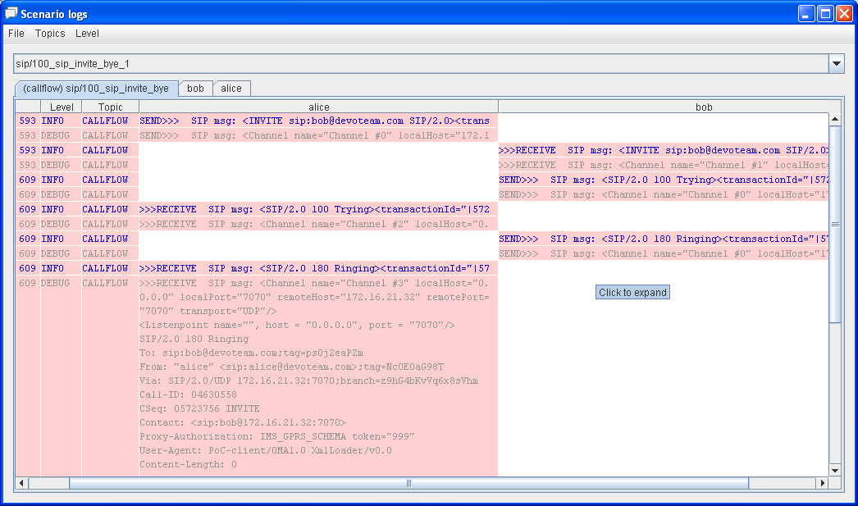
MTS
Logging : example

Slide 18
MTS
Statistics : features
Used for load, endurance, stress testing
A real-time statistics panel (GUI only)
Generation of an HTML report statistics on user demand and automatically at the test end.
Many predefined statistics counters organized in sections :
=>Request/Response/Transaction/Session/RtpflowTransport/Protocol/
Test/Testcase/Scenario/Operation/ Config/User
<stats> operation : the user defines his own stat counter
Counters organized as a tree to have more and more accurate information
Temporal graph or value histogram or the same into the CSV format too

Slide 19
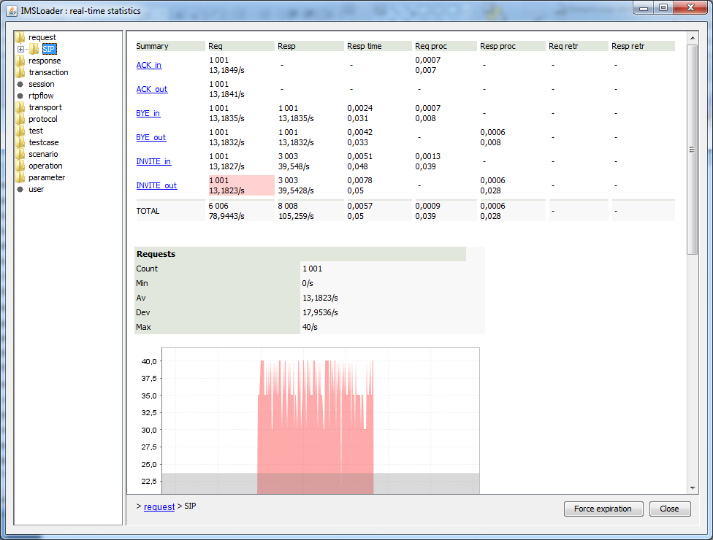
MTS
Statistics : real-time examples

Slide 20
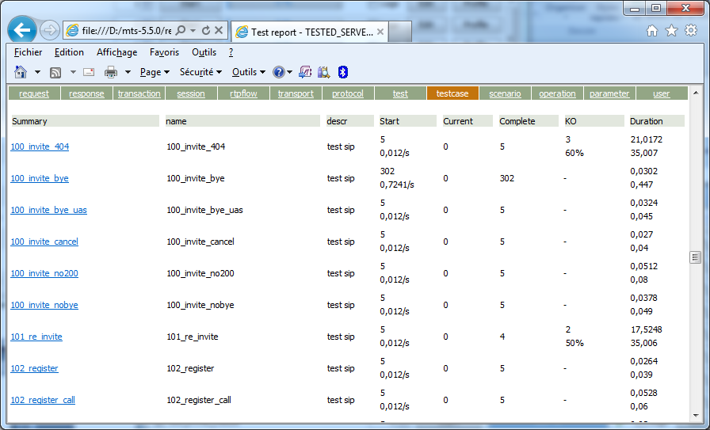
MTS
Statistics : HTML report examples

Slide 21
MTS
Interfaces : command line (CMD)
Useful to run script automatically or with high performance
Opens, runs the test and generates the statistics report
Command startCmd.xxx usage :
Usage: startCmd.xxx
    <testFile> => the test description file (mandatory)
    -seq[uential]|-par[allel]|<testcaseName> |<testcaseNumber>|-rand[om]
    => the running mode (mandatory)
Changes some editable parameters (-param option) or config values (-config) on the command-line
Able to configure logging and statistic features with specific options on the command-line
Some features are activated by key pressing (stop and generate report)

Slide 22
MTS
Documentation : tutorial & user manual & support
Tutorial : a complete a list of testcases given as examples
* SIP call-flows (rfc 3261) and a lot of SIP extensions (INVITE, REGISTER, REGISTER_MD5, PRACK, UPDATE, PUBLISH, MESSAGE, SUBSCRIBE, NOTIFY, REFER, INFO, …)
* SIP agent (PROXY, B2B, REGISTRAR, FORKING)
* DIAMETER messages (rfc 3588) and all IMS interface
(Cx, Dx, Rx, E2, E4, Rq, Gqp, …)
=> Learn the product or the protocols (pedagogic interest)
=> Start some new testcases as a starting point and just customize them (no blank page : => no worry for the tester)
User manual : a detailed description of MTS features
Technical presentation & demos : this one
Provided with the product in the tool main directory
Support on the product at : mailto:support.mts@ericsson.com
WEB Site : http://mts.arm-tool.com

Slide 23
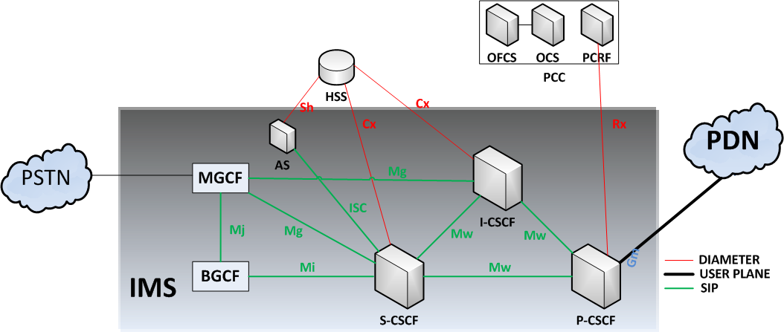
MTS
Protocol : IMS interfaces
Implements the main protocol : SIP, DIAMETER, RTP
Simulates all main features : CSCF, HSS, AS, UA, MRF, PCRF, PCEF, OCS, ...

Slide 24
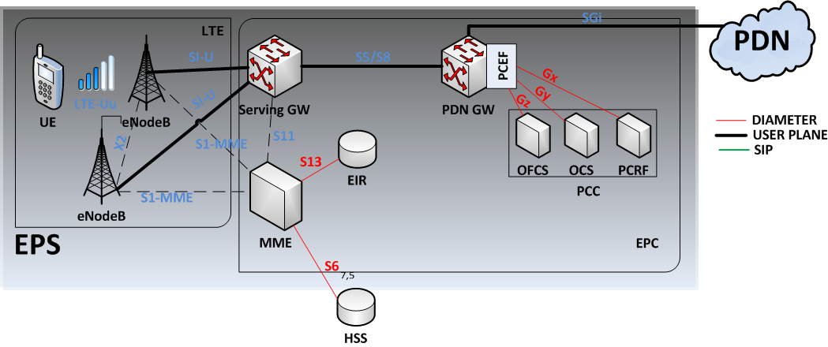
MTS
Protocol : EPS/LTE architecture
Implements the main protocol : GTPV2-C, GTP-U, DIAMETER
Simulates all main features : eNodeB, MME, Serving GW, PDN GW

Slide 25
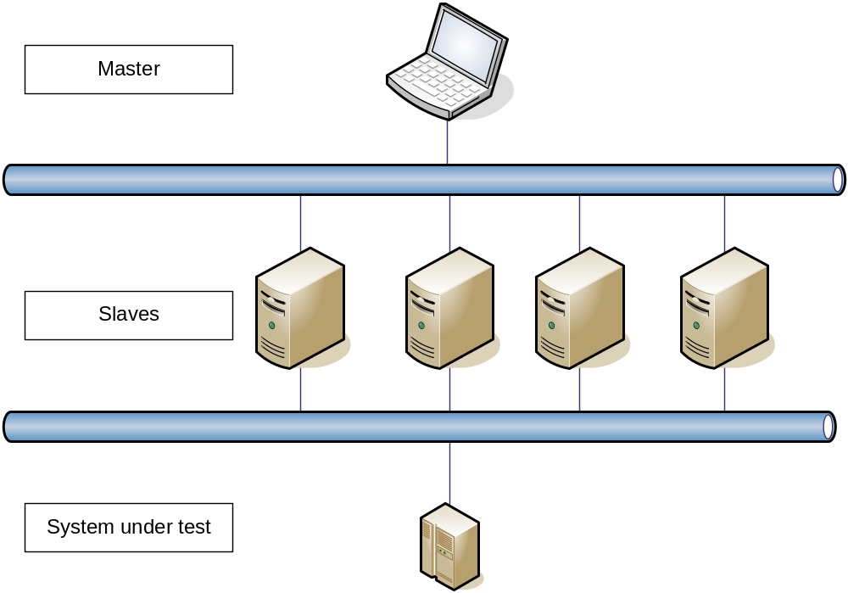
MTS
Master/slaves : architecture

Slide 26
MTS
Master/slaves : features
Master function : GUI user interface to launch and monitor the running of many tests on remote hosts
Slave function : command line process to run a test on the host on master demand
Communication between master and slaves uses RMI protocol
Input => Master XML file with a list of tests and remote URL to reach the slave hosts
Runs the selected tests sequentially or in simultaneously mode (parallel)
Output => Tests progress and status, statistics HTML report

Slide 27
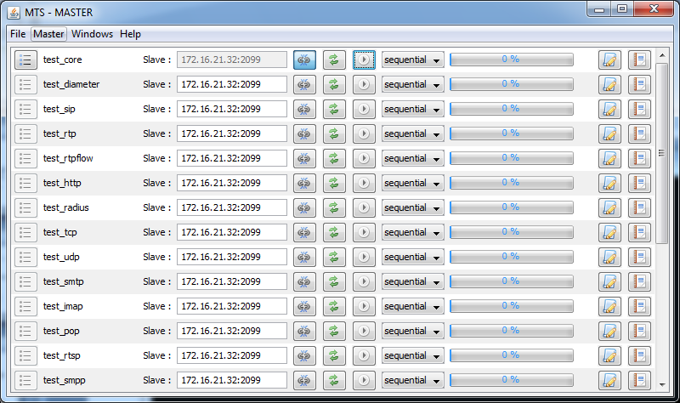
MTS
Master/slaves : GUI

Slide 28
MTS
Capture mode
For supervision of production equipment
No message generated by tool : complete passive behaviour
Check the messages on the network, detect the bad one and react by statistic counter, logs information, mail sending or SNMP trapping
Capture network traffic on a interface : probe element
<createProbePPP> => to create a capture probe
<removeProbePPP> => to remove a capture probe
Of course all core operations available for getting information on a capture message (setFromMessage) and for testing it (<test> operation)
Available on SIP (all transports), DIAMETER, RTP, RTPFLOW protocols
Example provided in the tutorial for each of them

Slide 29
MTS
Genscript module
Generate automatically the XML scripts from a network capture (wireshark pcap format)
Possibility to make a filter on messages contained into the capture file : based on a list of URL to simulate (<protocol>:<host>:<port> format)
The user provides a capture file and a test file to get the result
Create the scenario XML file (name is the port provided in URL)
Generate <sendMessagePPP> and <receiveMessagePP> operations
If port is not the default one, also generate <createListenpointPPP> and <removeListenpointPPP> operations
Add the scenario into the test file at the testcase level (name is the capture file name); if testcase does not exist, then create it.
Available on SIP (UDP only), DIAMETER, RTP, RTPFLOW protocols
Example provided in the tutorial into <install_dir>/tutorial/genscript
Usage: genScript.xxx
    <URL list> => the list of URL to simulate (mandatory)
    <captureFile> => the network capture file .pcap (mandatory)
    <testFile> => the test description file .xml (mandatory)

Slide 30
MTS
Conclusion : last version story and future (2/2)
V5.0.x : T1 2011 => RTPFLOW improvement (for PSTN), Passive mode (capture) support Win 7, SUN JRE 7
V5.1.x : T2 2011 => STUN
V5.2.x : T3 2011 => SIGTRAN (none AP layer)
V5.3.x : T4 2011 => DIAMETER improvement + genScript module
V5.4.x : T1 2012 => MGCP + Remove license control
V5.5.x : T1 2012 => Open Source version + new unified GUI
V5.6.x : T3 2012 => DIAMETER improvement + TCP/UDP socket parameters support + importSipp module + GTP (experimental)
V5.7.x : T4 2012 => GTP protocol V1, V2, Prime
V5.8.x : T2 2013 => SIGTRAN AP layers support, testcase multi-instances, binary to/from number operations

Slide 31
MTS
Conclusion : new features pipe and priorities
P.1 : Support AP layers in SIGTRAN protocol suite using an external asn.1 encoder
P.1 : Manage many instances of the same testcase, add an instances attribute on the <runProfile> object to control the testcase population
P.2 : Improve genScript result for DIAMETER (write the code and the name)
P.2 : For DIAMETER take the vendorID into account to make link between code and name for AVP (MANTIS 000xxxxx)
P.3 : Develop a light DIAMETER stack without Capability Exchange
P.3 : Implement the capture and genScript for HTTP (change in the HTTP stack in required)

Slide 32
MTS
Conclusion : benefits
Rich : supports of all IMS protocols (SIP, RTP, DIAMETER, HTTP), others application ones (Radius, HTTP, SMTP, RTSP) and transport ones (TCP, UDP, SCTP, TLS)
Customizable : easy to change the call flows or messages (XML input file) => no hard development needed
Simple to use : to define the test scripts => reuse the tutorial scripts and just customize and configure them; quickly run what you want to test (no blank page syndrome)
Easy to test : No script to develop to reproduce a network capture (for SIP, DIAMETER, RTP protocol only) using the genscript module
Multi-purpose : functional, load testing, server-side simulation or supervision.
Convivial : easy to use with its graphical user interface to run and tune the scripts : useful logging and statistics features
High-performance: about 5000 trans/s in DIAMETER and 400 CAPS in SIP
Software : No specific hardware (except for PSTN with Asterisk)
Universal : Run on all the famous platforms (Windows Linux supported, Solaris tested) because java-written code
Extensible : Possible development of a new protocol (20 to 40 days)
Scalable : provided by the master/slave features

Slide 33

MTS
Conclusion : contacts
AUSTRIA
BELGIUM
CZECH REPUBLIC
DENMARK
FRANCE
LUXEMBOURG
MOROCCO
MIDDLE EAST
NETHERLANDS
NORWAY
POLAND
SPAIN
SWEDEN
SWITZERLAND
UNITED KINGDOM
CONTACT
Fabien HENRY
+ 33(0) 2 96 48 73 87
fabien.henry@ericsson.com
FRANCE
www.ericsson.com
Thank you
for your attention
Authors
Date of release
© DEVOTEAM GROUP
This document is not to be copied or reproduced in any way without Devoteam express permission. Copies of this document must be accompanied by title, date and this copyright notice.
File Info

