Slide 1

MTS
Multiprotocol Test Suite
Solution overview

Slide 2
OBJECTIVE
INDUSTRIALIZE the test activity
MTS one single tool for a complete test coverage.
Reduce the time and efforts required for performing new or non-regression tests campaigns
Improve the quality and the coverage of the tests campaigns.
Generate costs and time savings for the projects using MTS
Notes:
11/08/262012-02-03
11/08/262012-02-03
2012-02-03

Slide 3
Key Features
MTS: the solution to integrate, test and optimize your IP telecom system
Tool rationalization
Easy to use (XML syntax)
Easy to adapt to customer specifics
Multi-protocol support : SIP, RTP, RTCP, SQL, Diameter, Radius, HTTP/SOAP, SMTP, TCP/UDP/SCTP, etc.
GUI: easy to use & helpful for scenario tuning
Hardware agnostic: written in Java (open-source)
Built-in reports for log management and statistics
Master/Slave configuration available to manage several instances from one place.
PedagogIC tool for training exercises
Notes:
11/08/262012-02-03
11/08/262012-02-03
2012-02-03

Slide 4
Areas of application
MTS is a Key tool in the following domains
IMS : MTS can replace / simulate or interface with any of the IMS core bricks.
  Business application testing : MTS gives the possibility to test the intranet and internet applications
LTE : for core network simulation. MTS replace, simulate radio and charging modules
Test automation : Launch in one click a full non-regression campaign
Load testing : End-to-end load testing and equipment testing
QoS testing : MOS calculation based on E-model
Probes interfacing : MTS sends SNMP trapes to passive probes used to monitor the network
Notes:
11/08/262012-02-03
11/08/262012-02-03
2012-02-03

Slide 5
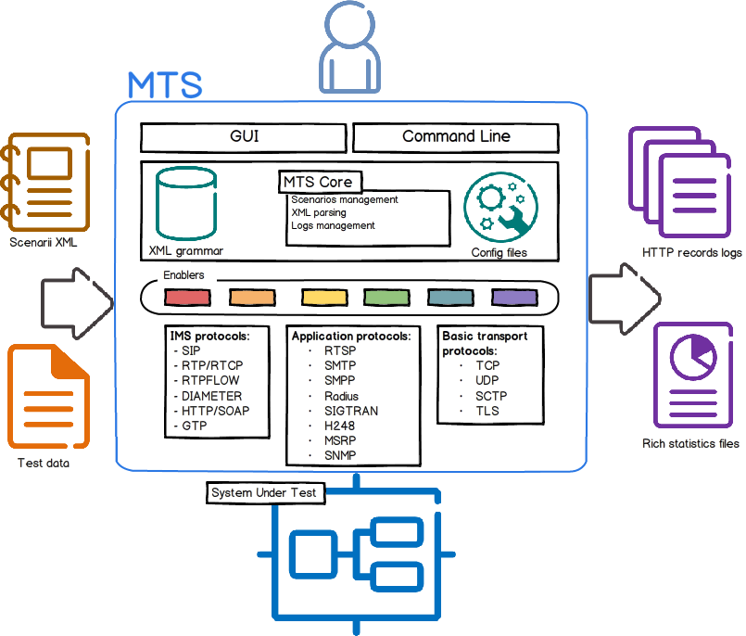
How it WORKS
User Interfaces : graphical user interface and command line interface
INPUT FILES : Test scenarios and test data
OUPUT FILES : log files and statistic reports (HTML format)
System Under Test
Notes:
11/08/262012-02-03
11/08/262012-02-03
2012-02-03

Slide 6












MAIN REFERENCES
LTE : VoLTE Load test (User Agent simulator)
SIP : Telephony AS performance
Diameter : HSS CX interface
SIP/RTP : SBC test (pinholing)
HTTPS/Radius/SMTP/IMAP/POP : billing
SOAP/IMAP: Voice Mail System
VoIP testing (Tunisia)
PCRF simulator
HTTP/SOAP : SOAP server
TCP : TCP answer machine
TCP/HTTP : Anonymous server
IMS integration testing tool
VoLTE : User Agent simulator
AGW integration test
SIGTRAN
SIP/Diameter Performance
PSTN test
SIP/Diameter : Test Lab
for engineering school
Integration tool for the whole platform (IMS, FTTH, LTE)

