Slide 1
IT Automation – CA1 – automated Public cloud using AWS
By Eric Strong
x00169645@mytudublin.ie

Slide 2
Solution overview
AWS – Highly Available, Highly scalable, Web Server
Using CloudFormation Infrastructure as Code
Using Blue Green Deployments
Using Ansible for Configuration Management

Slide 3
Solution overview
Solving Problem 1: Test and production - Different Environments – Blue Green Deployments
Solving Problem 2: Project deadlines have been missed due to the unavailability of Environments - IAC
Solving Problem 3: Spending time performing repetitive maintenance tasks - Ansible

Slide 4
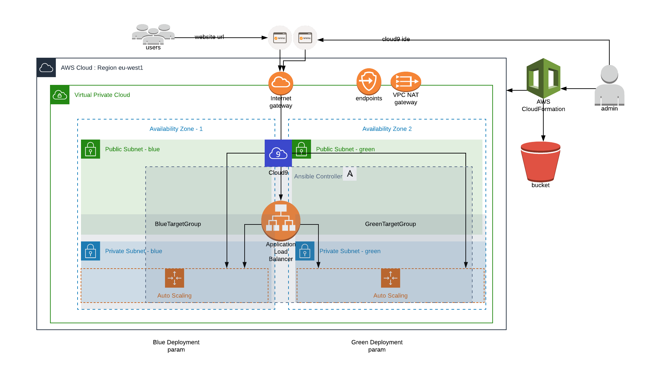
AWS Diagram

Slide 5
AWS Technology
Virtual Private Network (VPC)
VPC endpoints
NAT gateway
Elastic IP
Internet gateway
Routing tables
Routes
Multiple Availability Zones
Public and Private subnets
Security groups
Application load balancer
EC2 Autoscaling groups
Launch configuration
Cloud9 IDE
Target groups
Nat gateway
Service endpoint
Ansible
AWS Code Commit repos
Cloudformation template with parameters, mappings, conditions, outputs
AWS CLI

Slide 6
Solution Extras
AWS CLI
Cloud9
Meets the requirements
Automated – dynamic inventory

Slide 7
Demo
By Eric Strong
x00169645@mytudublin.ie

Slide 8
Solution Improvements
Multi AZ - Database
Terraform
AWS Elastic Beanstalk
Hybrid Cloud

Slide 9
IT Automation – CA1 – automated Public cloud using AWS
By Eric Strong
x00169645@mytudublin.ie

