Slide 1

Large-Scale Reconfigurable Digital Neuromorphic Architecture
Eric Ke-Haur, Taur
UCSD Summer Intern Research Program
Notes:
Fancy name of FPGA based Artificial Neural Network Inference

Slide 2
Core of the Project
Data from previous Layer
X1
W1
n1
Input RAM
Processor
Weight RAM
X2
W2
n2
X3
W3
n3
Xn
Wn
nn
Emulate layer of the network
Read Weight info from Weight RAM
Load input from Input Ram
Process data as perceptron
Output
RAM
Data to
next Layer
Notes:
The core of the project emulates the layer of the network.
It loads data (weight or input) and then process the data to obtain the output.

Slide 3
Project Hierarchy
Top Module
Clock
Core
FSM Location
Xilinx IPs
Block RAM
RAMs
Diff. Clock
Floating Point
Matmul
FIFO
UART
Comms Location
FIFOs
Notes:
Project consists of two main components.

Slide 4

Submodule Read/Write Memory
Sysclock
Sysclock
FSM
clk_out
Common Clock Source
USB
Interface
reset
din_rxFIFO [7:0]
BLOCK RAM
dout_txFIFO [7:0]
UART
wr_en_rxFIFO
RxFIFO
TxFIFO
empty_txFIFO
full_rxFIFO
rd_en_txFIFO
Notes:
This is the RTL schematic of the top layer.
Data sent from USB transforms to parallel data and is then sent to the FIFO for processing.

Slide 5
Topology of Read/Write Process
COMMAND
ADDRESS
WAIT FOR DATA
TO REACH OUTPUT
RAISE USB
WR FLAG
POP IF NOT EMPTY
POP IF NOT EMPTY
RST
IDLE
VER
CMD
RD
0
RD
1
IDLE
HOLD DATA
WITH REG
ADDRESS
WRITE DATA TO RAM
DATA
POP IF NOT EMPTY
POP IF NOT EMPTY
WR
0
WR
1
Notes:
This is the topology of the FSM of a RAM read/write process. FIFO pop data in sequence. The interpretation of data is dependent of the order of popping the data.

Slide 6
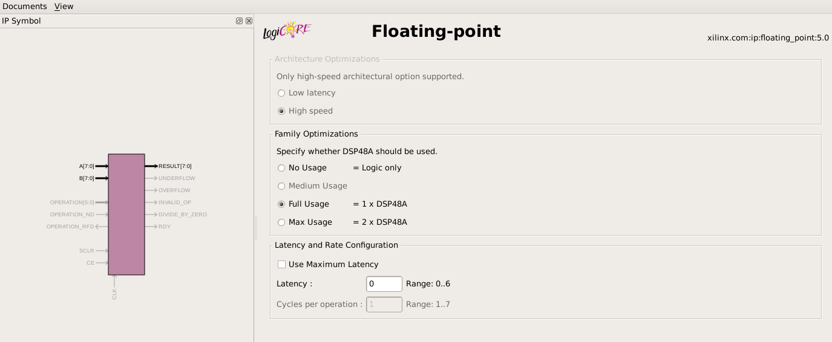
Submodule Dot Product Module/Process
X1
Floating Point
Multiplication
Xilinx IP Generator
W1
Floating Point
Addition
X2
Floating Point
Multiplication
W2
Sign
Exponent
1
Fraction
Notes:
Sub-module matmul contains two dot product operations in parallel, which consists of floating point IPs as shown in figure above.
To make timing less of an issue, the entire sub-module is totally combinational, which is resource demanding and slow in speed.

Slide 7
Information Transfer Packet
Write Packet (Input/Weight)
Input Data RAM
Command
4 bits
Column
4 bits
Row
16 bits
Value
8 bits
00
Width 4 * 8 bit
Weight Data RAM
01
Width 4 * 8 bit
00
Width 4 * 8 bit
…
…
01
Width 4 * 8 bit
Read Packet (Input/Weight/Output)
…
…
Command
4 bits
Column
4 bits
Row
16 bits
Pad 0s
8 bits
Output Data RAM
00
Width 4 * 8 bit
Matmul Packet
01
Width 4 * 8 bit
Command
4 bits
Pad 0s
28 bits
…
…
Notes:
These packets are essential to tell the FSM what to perform in upcoming states.
For the write packet, it is like pre-loading data into the RAM before any process.
For the read packet, we can ensure that the data written to that specific address is neither corrupt nor wrong.

Slide 8
Simple Implementation
X1 | X2 | X3 | X4
X5 | X6 | X7 | X8
X9 | X10 | X11 | X12
X13 | X14 | X15 | X16
W1 | W2 | W3 | W4
W5 | W6 | W7 | W8
W9 | W10 | W11 | W12
W13 | W14 | W15 | W16
W17 | W18 | W19 | W20
W21 | W22 | W23 | W24
W25 | W26 | W27
W29 | W30 | W33 | W32
…
W57 | W58 | W59 | W60
W61 | W62 | W63 | W64
Output 1
Output 2
Output 3
Output 4
X1 | X2 | X3 | X4
X5 | X6 | X7 | X8
X9 | X10 | X11 | X12
X13 | X14 | X15 | X16
16
inputs
64
weights
1
W1
1
Dot Product
Operation
+
+
ACC
REG
2
W2
2
3
W3
3
Dot Product
Operation
…
…
16
W16
4
Notes:
The implementation of a single core consists of 16 inputs and 4 outputs, implying that the weight RAM is 64 rows in depth.
Also we completed a network for NMIST classification with 784 inputs, 100 hidden units and 10 outputs

Slide 9
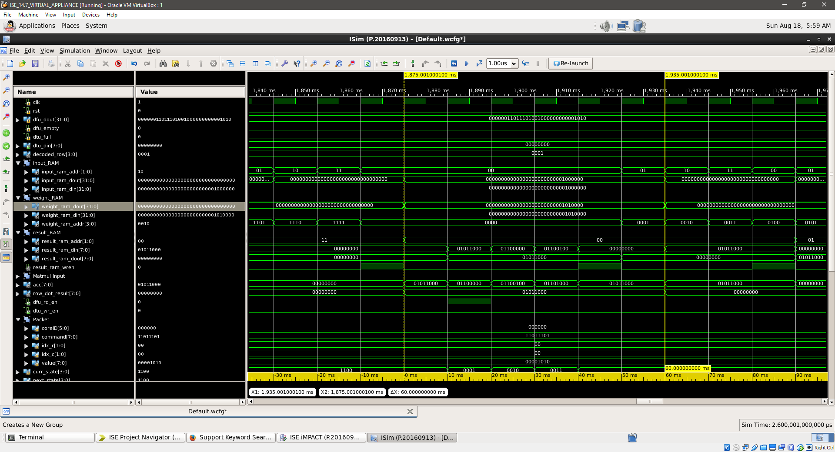
Simple Implementation Simulation
Notes:
The simulation of the project looked something like this. We can look at the output ram data out signal to double check if the data is correct in simulation

Slide 10
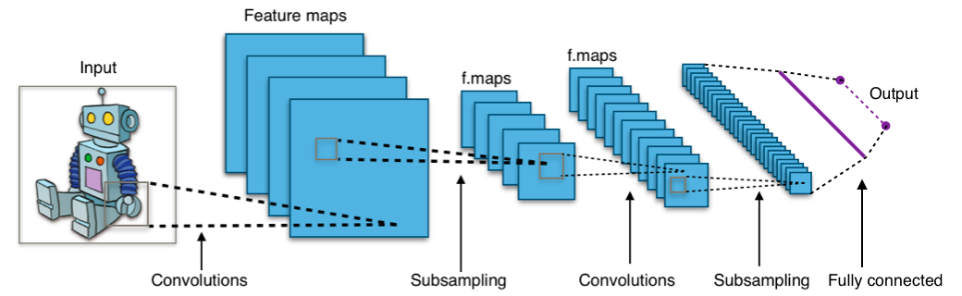
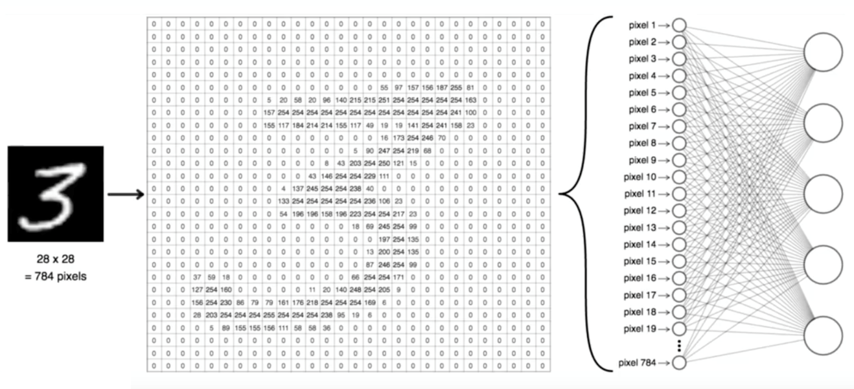
Future Extensions
Large Scale ANNs
Convolution Nets
Notes:
This project is pretty extensive. The architecture can also fit to conv nets and conventional ANNs.

Slide 11
Acknowledgments

