Slide 1
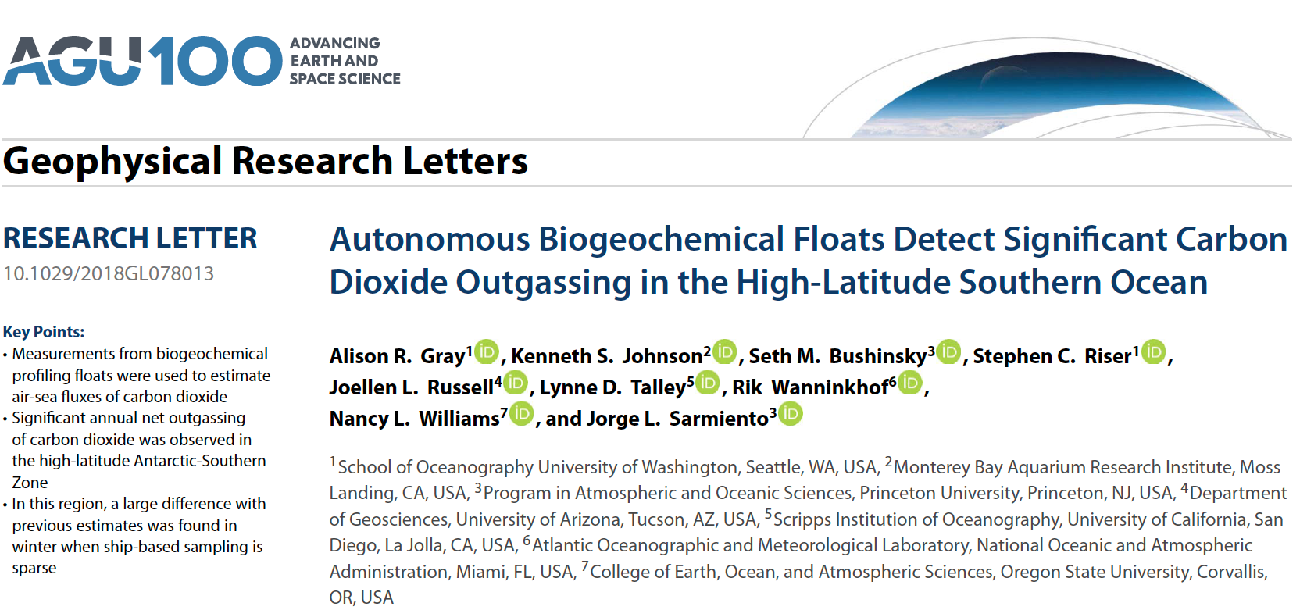

Slide 2
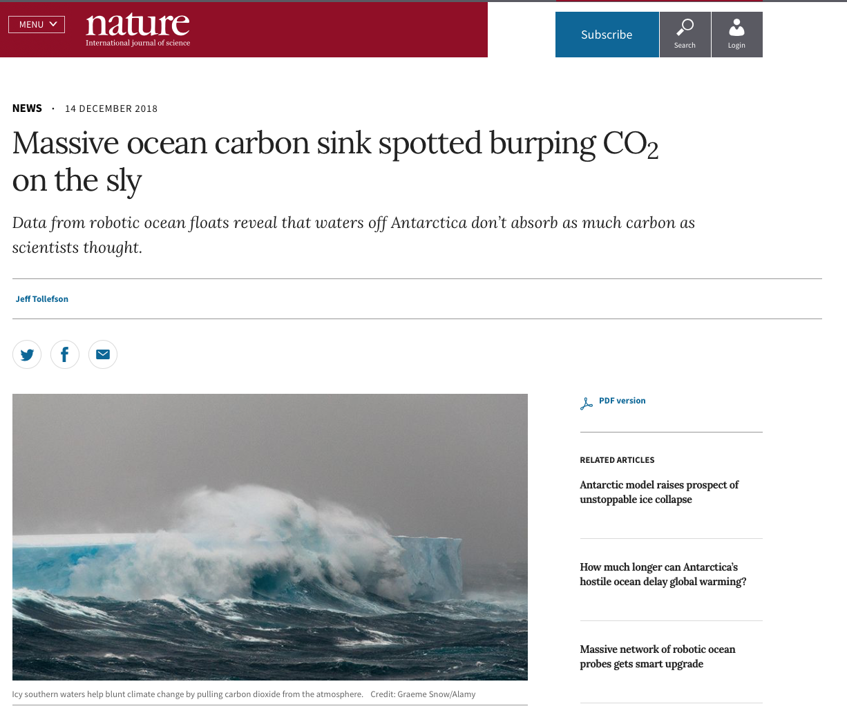

Slide 3
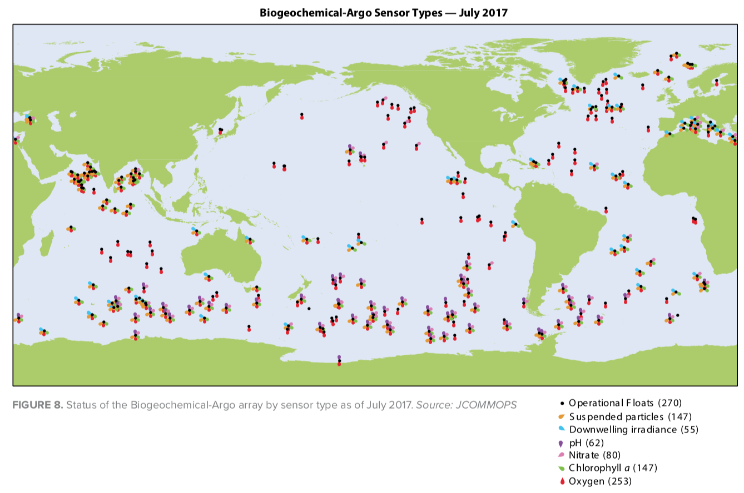
So what? / Why is this important?
-Global oceans take up a large portion of the anthropogenic carbon from the atmosphere (~1/3 of all emissions)
-Southern Oceans comprise a major uptake region of the global oceans (~1/3 of total global uptake)
-Remote, and therefore sparsely sampled (although this is changing)
-Information about the Southern Ocean carbon uptake comes from observations (ship-based, moorings, and BGC floats), BGC ocean models (e.g., OFAM), and a combination (reanalysis/data-assimilation products, e.g. SOSE)
-The present state and evolution of the Southern Ocean carbon sink will play a large role in determining the evolution of the atmospheric carbon content in the near future

Slide 4
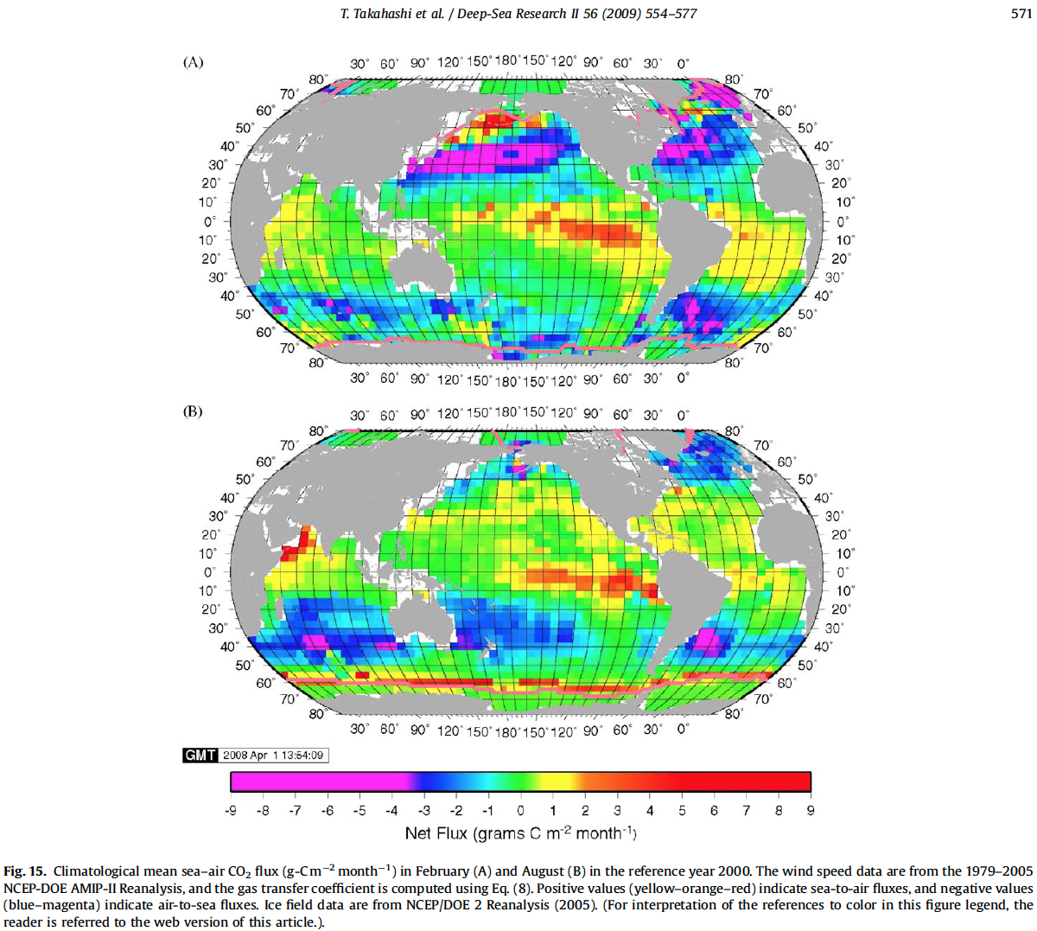
Background (1)
Takahashi et al., 2009
Based on 3 million shipboard msments from 1970-2007
+ = OUT of ocean

Slide 5
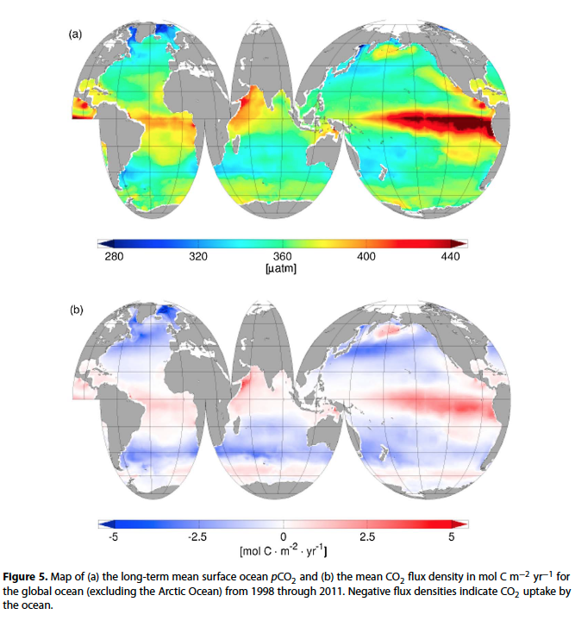
Background (2)
Landschuetzer et al., 2014
Obs from SOCATv2
(Surf. Ocean C Atlas, vs. 2)
Neural network ->
extrapolation

Slide 6
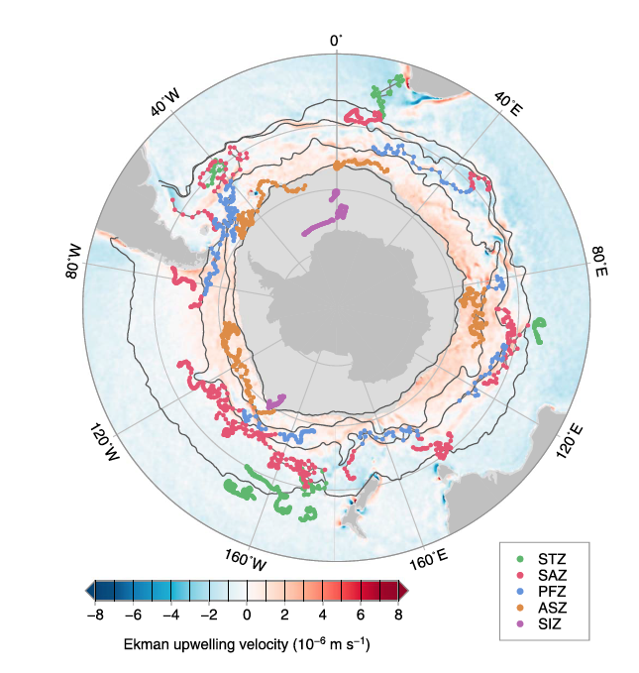
Gray et al., 2018
Float drifts
(2014-2017)

Slide 7
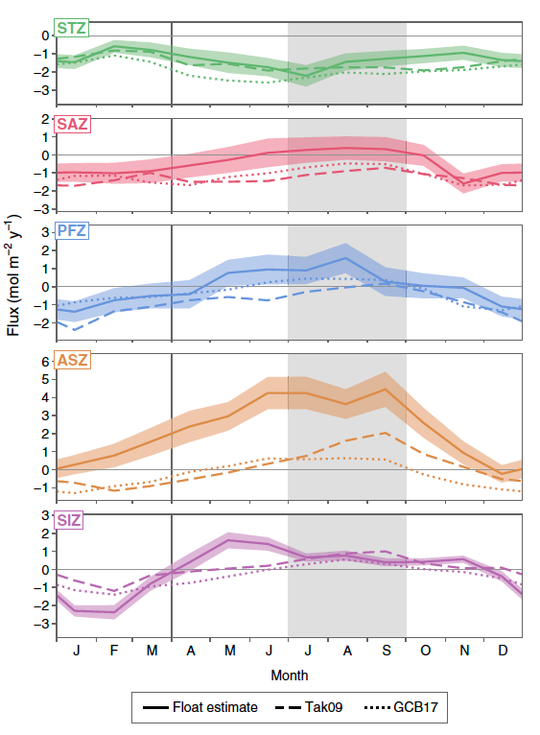
Gray et al., 2018
-in general, this study finds higher (more positive, aka out of the ocean) fluxes in fall/winter for SAZ, PFZ, and ASZ than previous studies
-especially much larger outgassing in ASZ in JAS (compared to Tak09 and GCB17)
-Tak09 = Takahashi et al., 2009
-climatology
-GCB17 = Global Carbon Budget (Le Qur et al.), 2017
-S.O. based on Landschtzer et al. , 2014
-neural network mapping of observations
+ = OUT of ocean

Slide 8
Gray et al., 2018
-in general, this study finds higher (more positive, aka out of the ocean) fluxes in fall/winter for SAZ, PFZ, and ASZ than previous studies
-especially much larger outgassing in ASZ in JAS (compared to Tak09 and GCB17)
-Tak09 = Takahashi et al., 2009
-climatology
-GCB17 = Global Carbon Budget (Le Qur et al.), 2017
-S.O. based on Landschtzer et al. , 2014
-neural network mapping of observations
+ = OUT of ocean

Slide 9
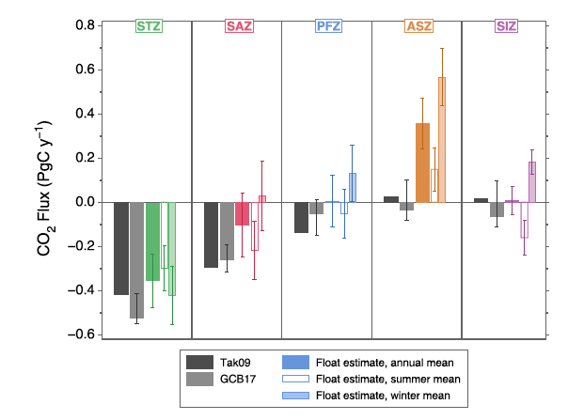
Gray et al., 2018
-same info, different plot
+ = OUT of ocean

Slide 10
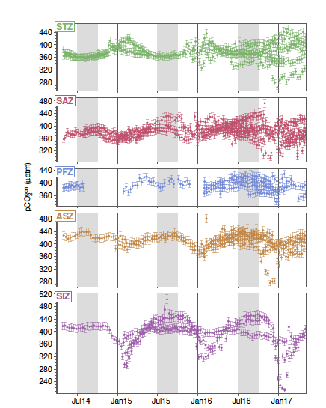
Gray et al., 2018
(sup.)
SSpCO2 in the different regions
(to compare to other data sets)

Slide 11
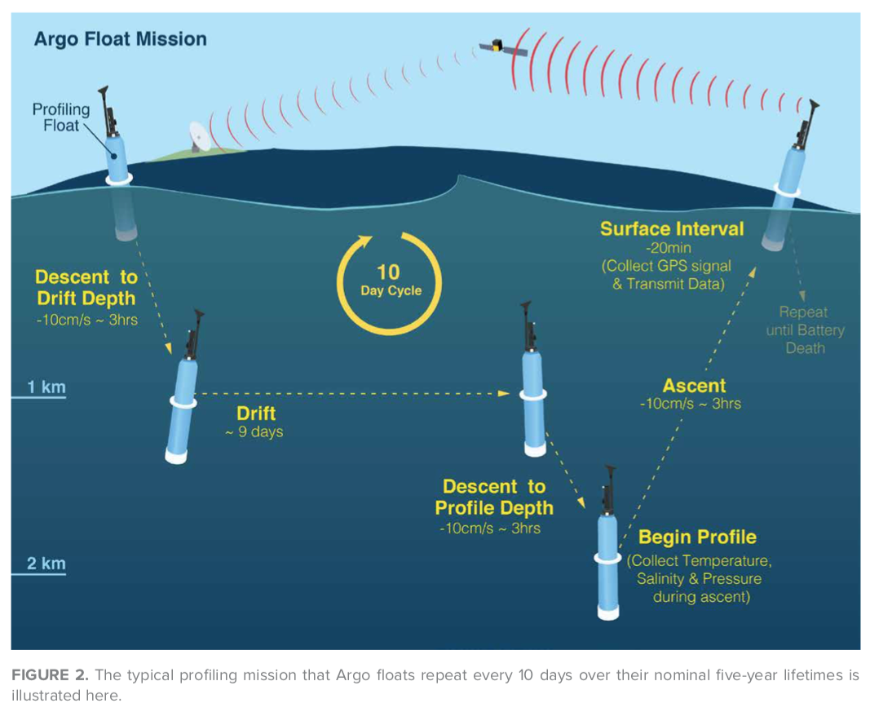
Methodology:
F = k K₀ (pCO₂^{ocn} − pCO₂^{atm}) pH, T and S from BGC Argo floats
TA from LIAR (Carter et al., 2018)/GLODAP
pCO₂^{ocn} was determined from above 2 quantities (CO2_sys)
wind speed (ERA-interim reanalysis from ECMWF)
pCO₂^{atm} from Cape Grimm Observatory
Figure (and BGC Argo map in prev. slide) from WHOI’s special issue of Oceanography on the Argo program:
https://www2.whoi.edu/staff/sjayne/wp-content/uploads/sites/43/2018/07/The-Argo-Program.pdf

Slide 12
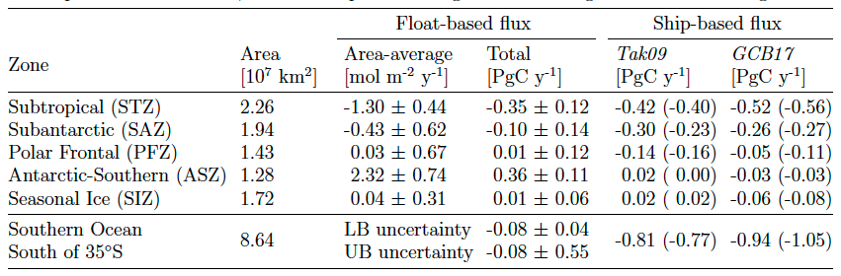
Results
CO2 uptake of −0.08 Pg C/year for the entire Southern Ocean south of 35∘S (Table S2)
Compared to previous studies:
the float-based Southern Ocean CO2 flux estimate is considerably different fromship-based estimates that give a mean uptake of −0.8 (Tak09) or −0.9 (GCB17) Pg C/year when sampled at the same locations at the floats

Slide 13
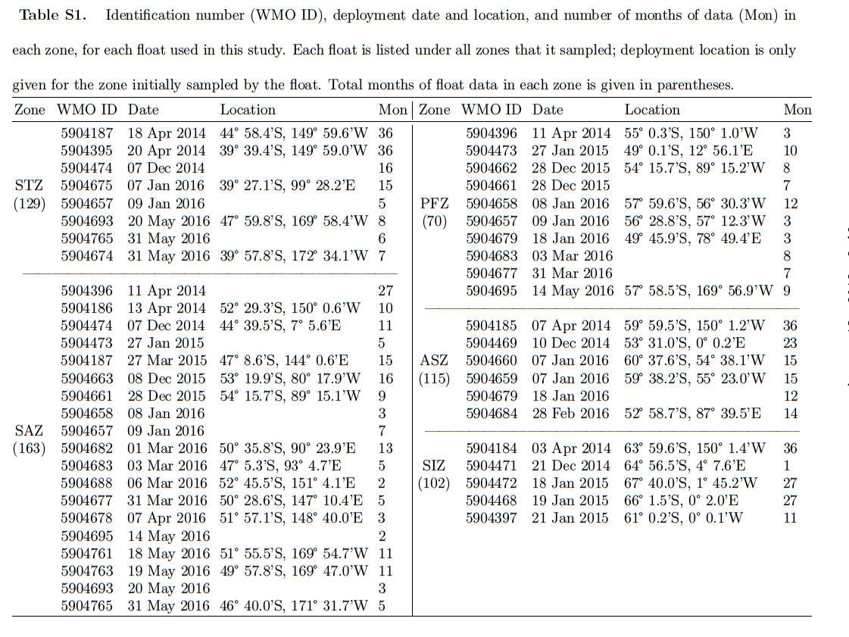

Slide 14
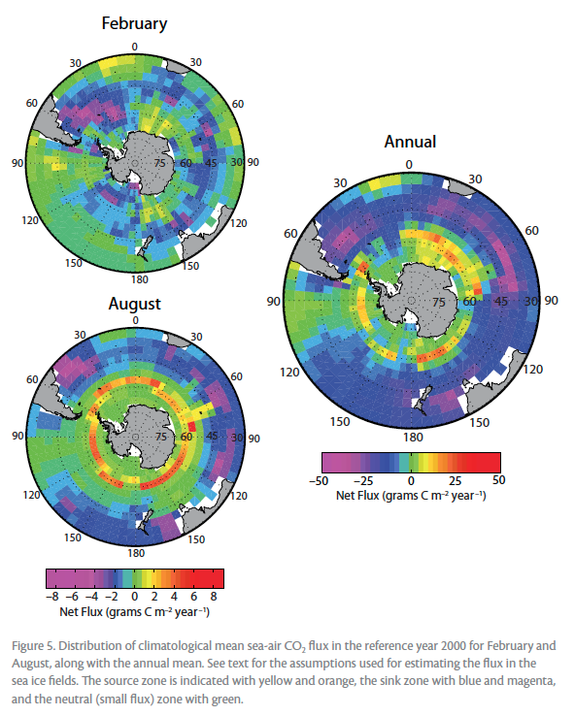
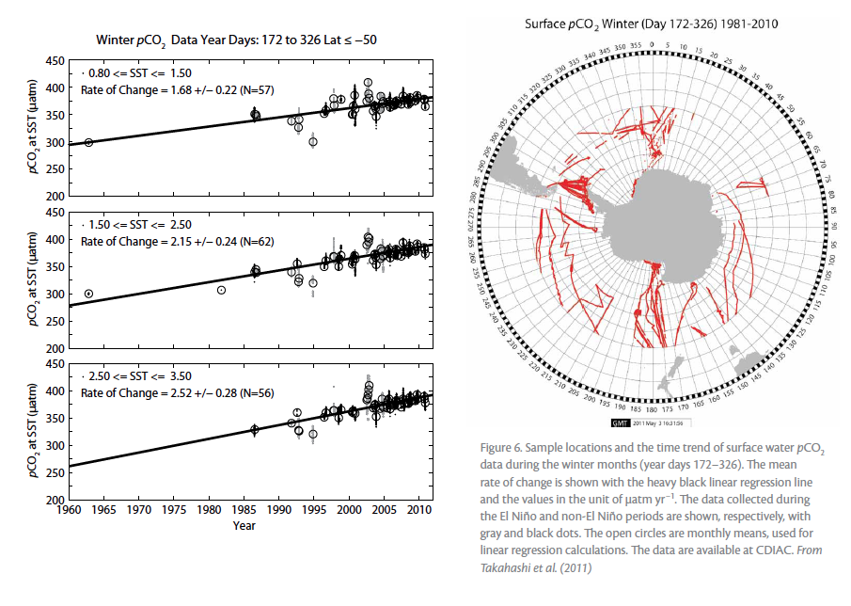
Takahashi et al., The Changing Carbon Cycle in the Southern Ocean. 2012
Trends in winter
(for different SST classes)
+ = OUT of ocean
Takahashi et al., 2009 is a monthly/annual data set on a global (4*5 deg.) grid of 2000 climatology
Contains surf. pCO2, C-flux, delta-pCO2, SST, SSS
Also avail.: 2005 climatology of above + pH, TCO2, TALK, omega_arag and calc

Slide 15
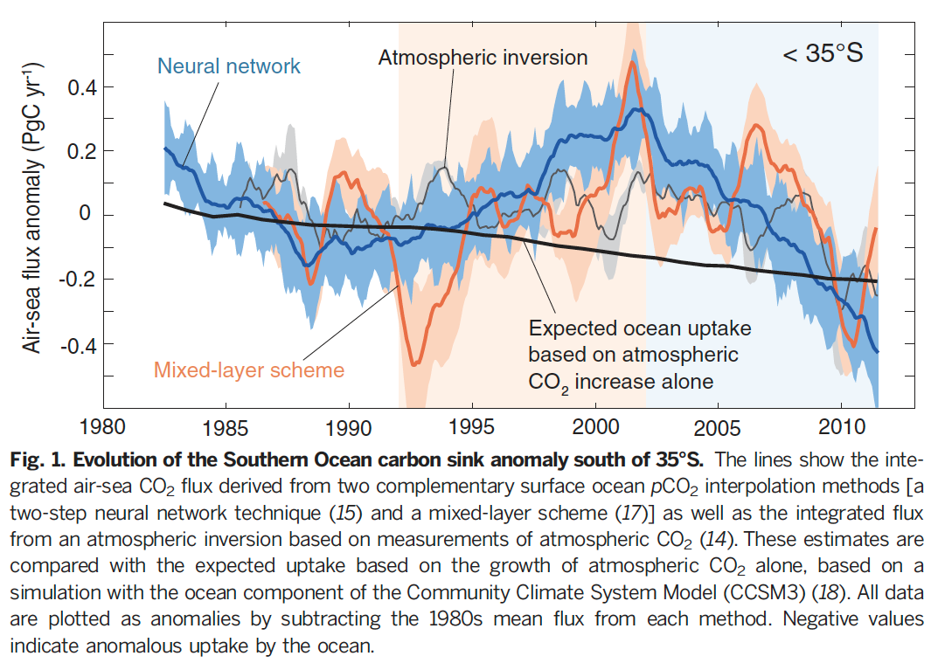
From Landschtzer et al.; The reinvigoration of the Southern Ocean carbon sink. 2015

Slide 16
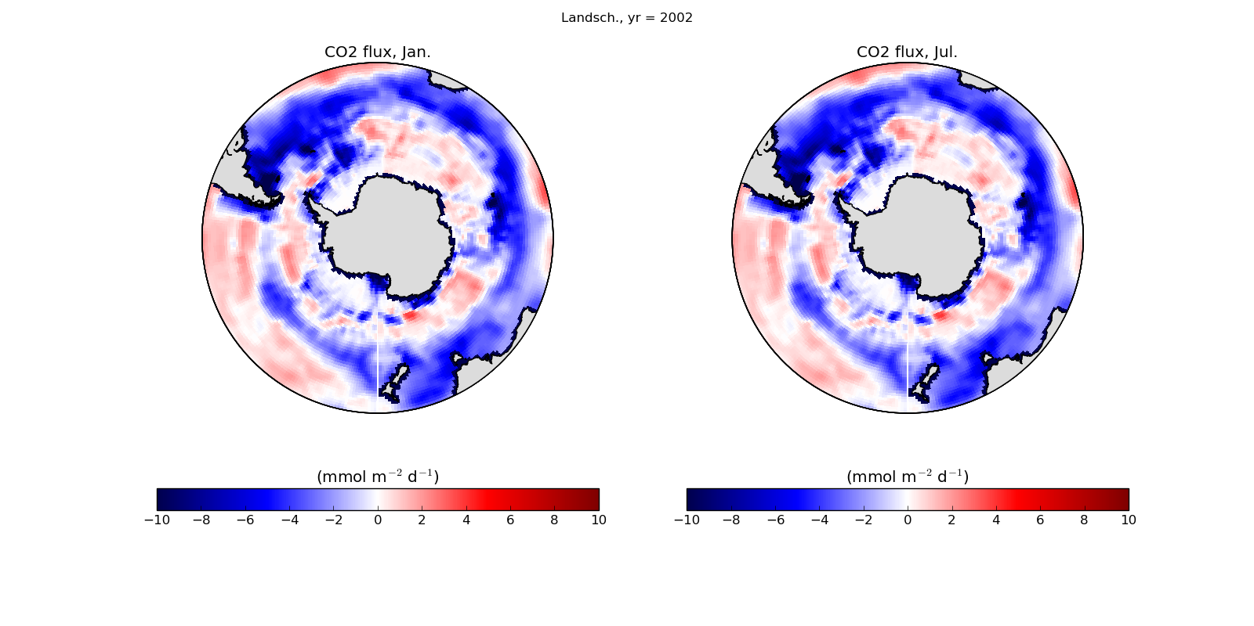
+ = out of ocean
Landschuetzer data set:
Has global gridded monthly data for 1985-2015
(BGC including CO2flx, pCO2, delta-pCO2)

Slide 17
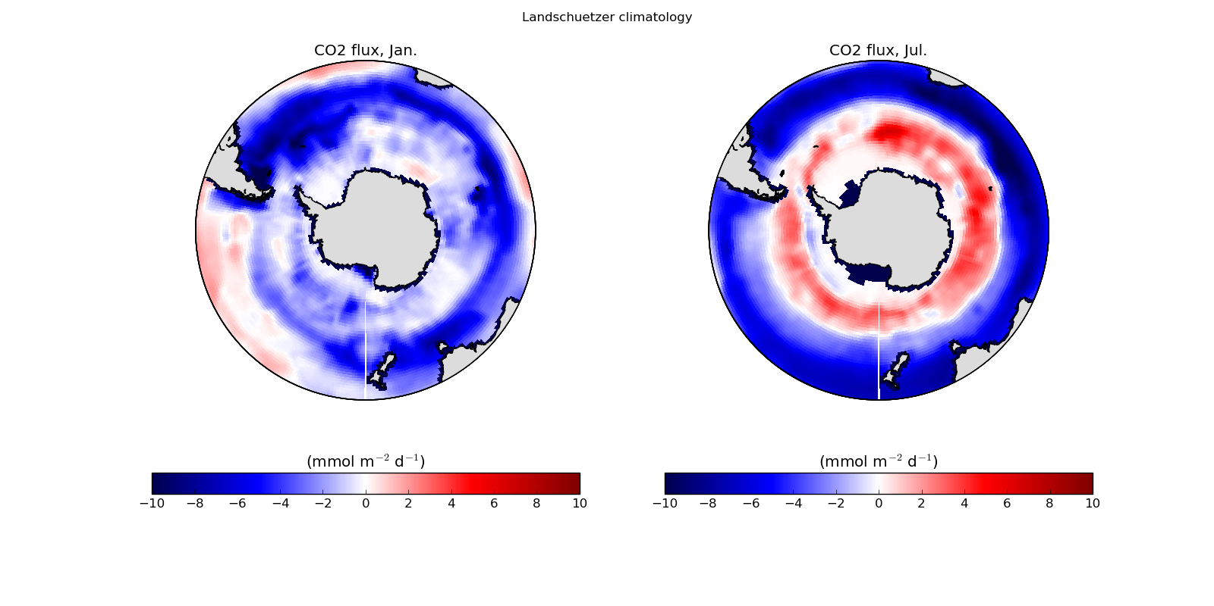
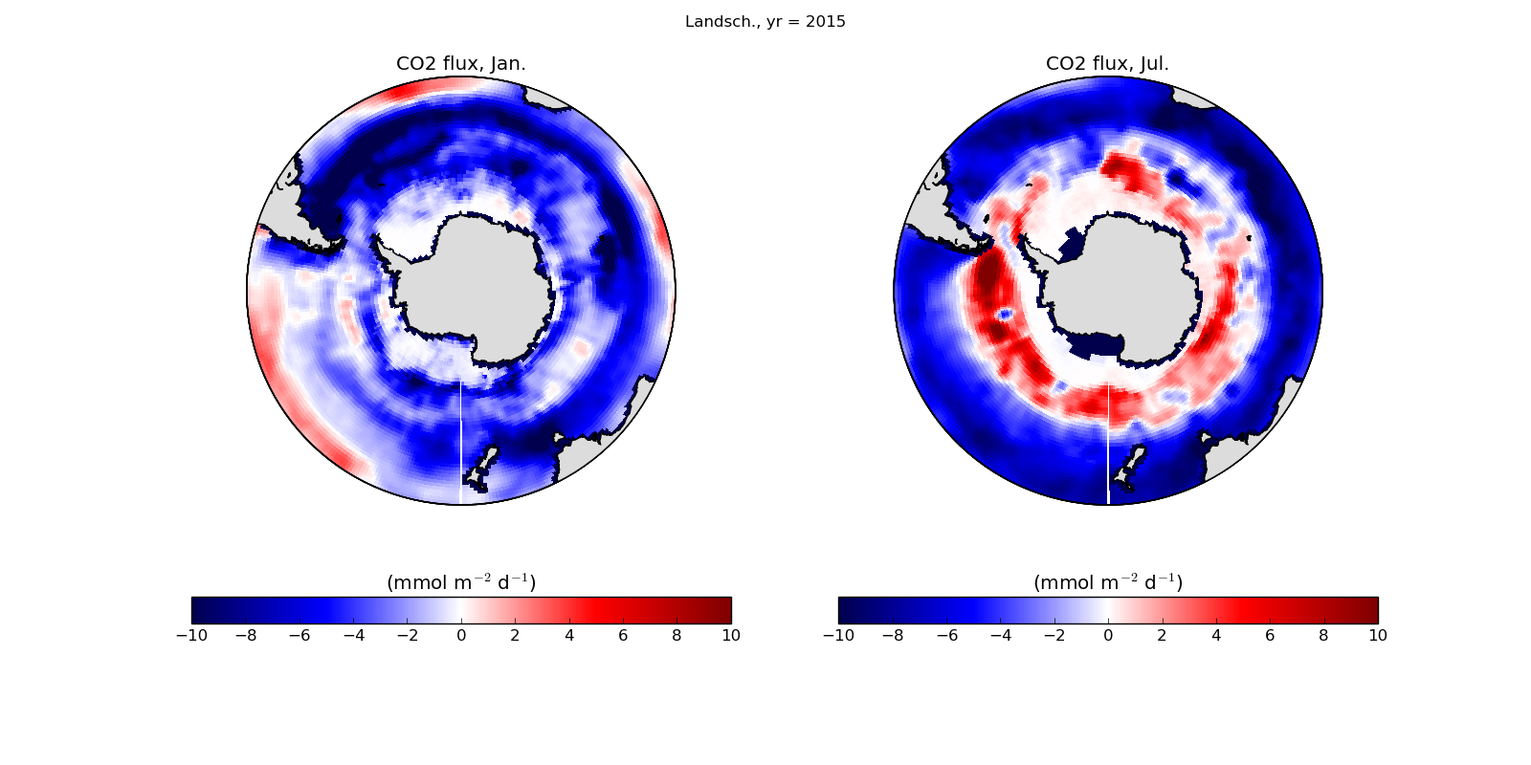
+ = out of ocean

Slide 18
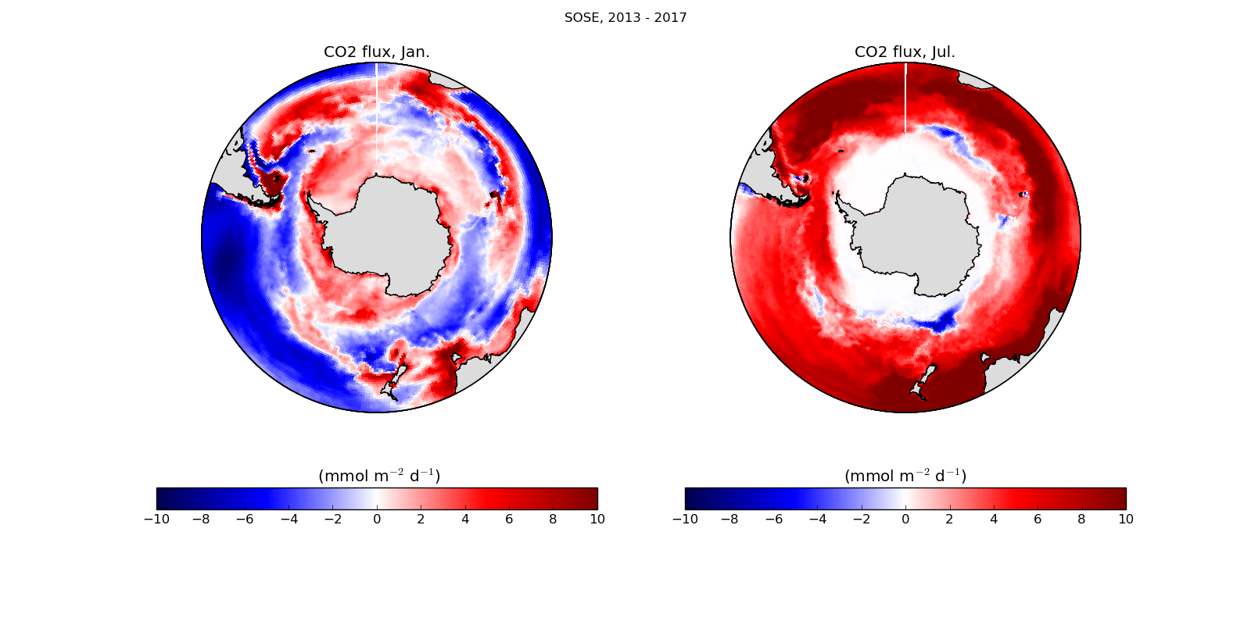
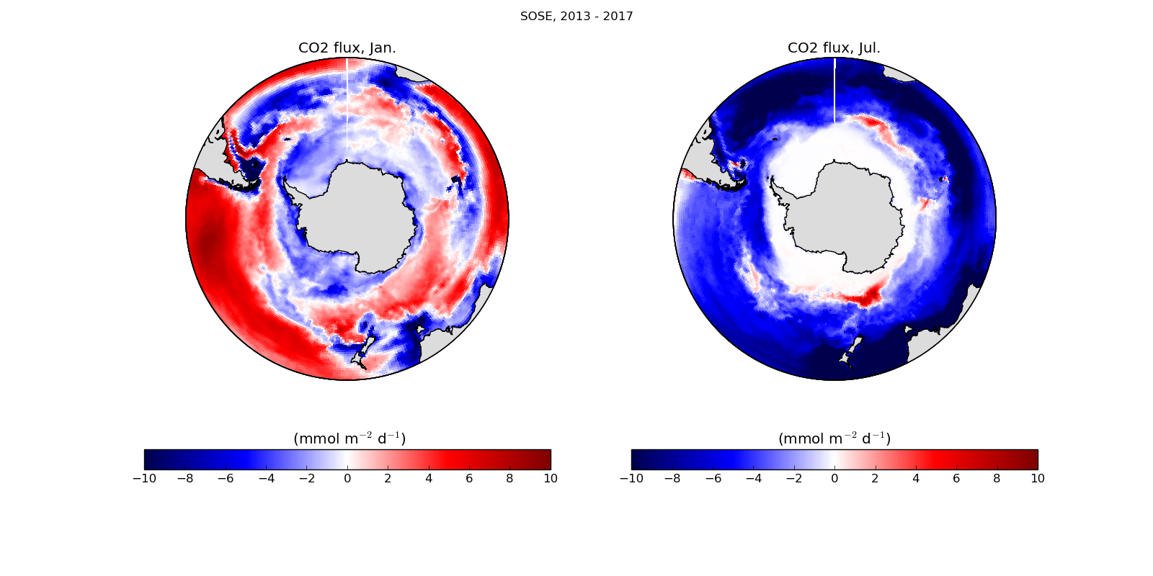
+ = out of ocean
Southern Ocean State Estimate:
Has gridded monthly/annual data for S.O. for 2008-2012 and 2013-2017
(SST, SSS, MLD and BGC including CO2flx, pCO2, NO3, Fe, Phyto-lrg/sml, NPP, DIC, Alk, pH)
-most variables available throughout water column

Slide 19
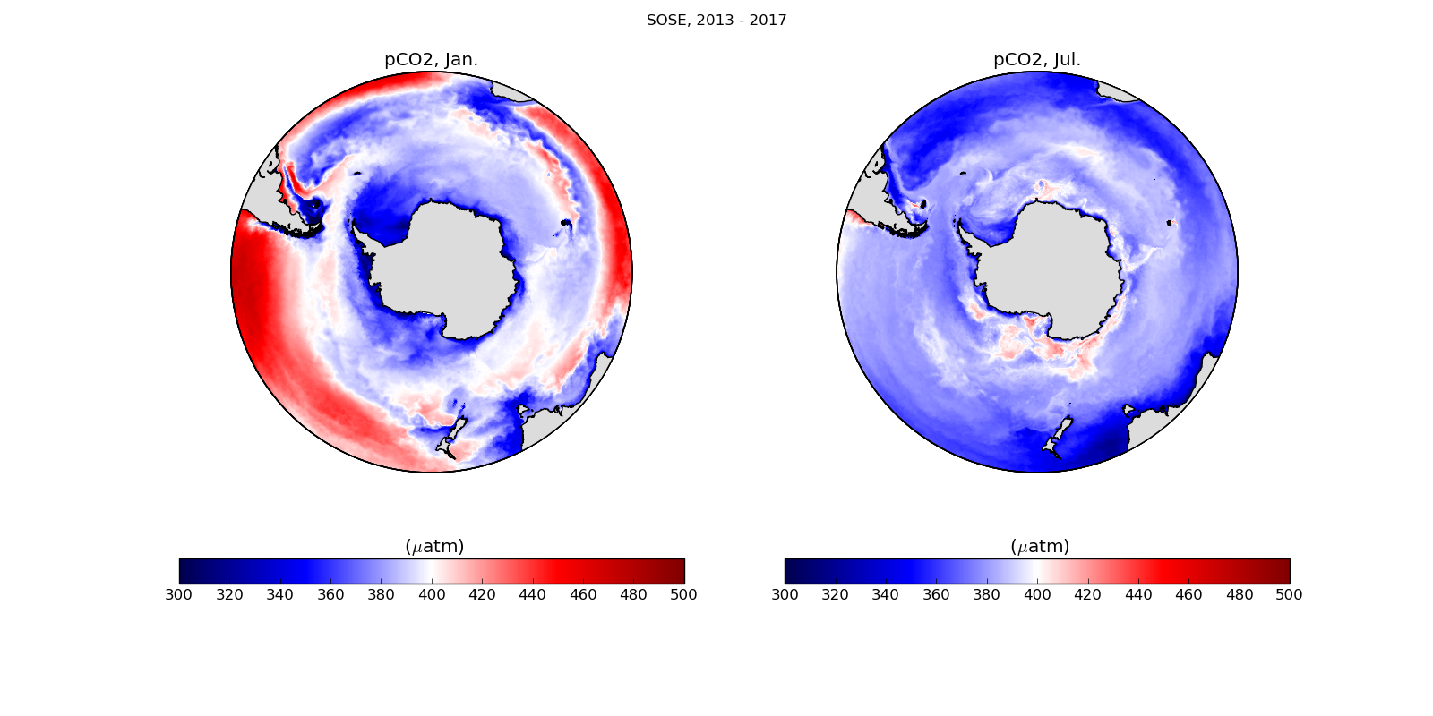

Slide 20
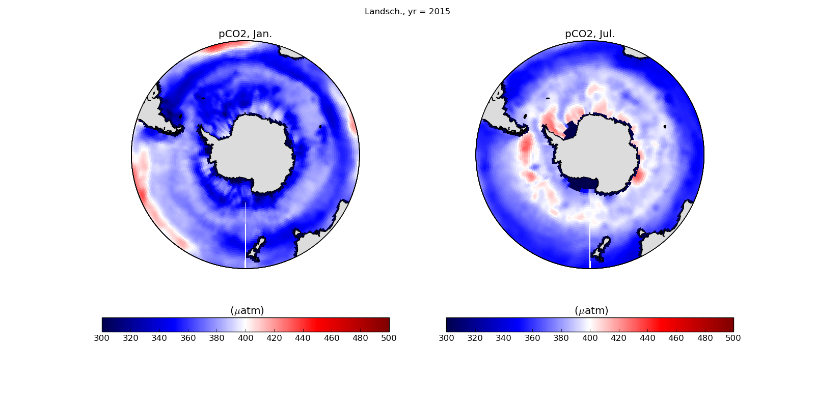

Slide 21
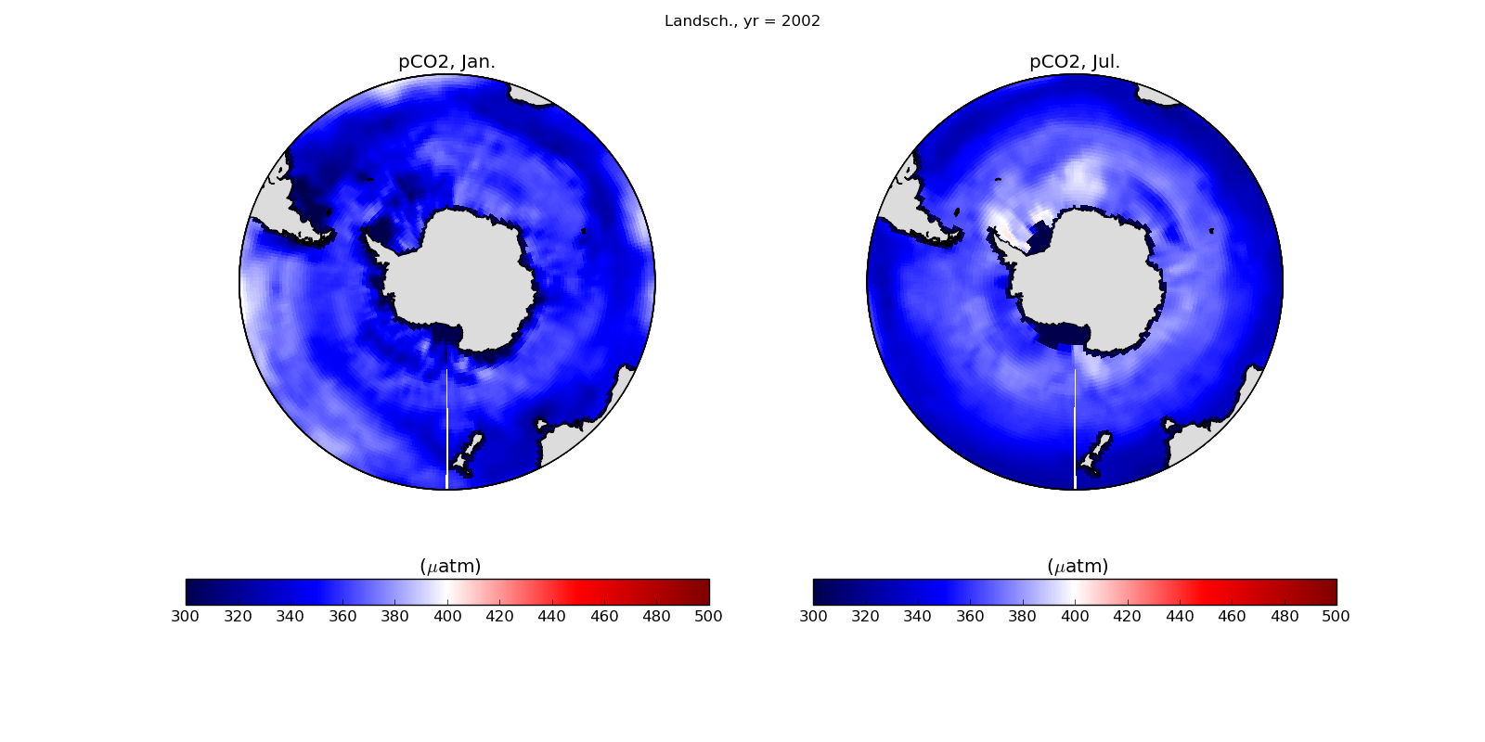

Slide 22
References:
-Gray et al.; Autonomous Biogeochemical Floats Detect Significant Carbon Dioxide Outgassing in the High-Latitude Southern Ocean. 2018
-Landschtzer et al.; Recent variability of the global ocean carbon sink. 2014
-Landschtzer et al.; The reinvigoration of the Southern Ocean carbon sink. 2015
-Landschtzer et al.; Decadal variations and trends of the global ocean carbon sink. 2016
-Le Qur et al.; Global Carbon Budget 2017. 2018
-Takahashi et al.; ClimatologicalmeananddecadalchangeinsurfaceoceanpCO2, and net sea–air CO2 flux over the global oceans. 2009
-Takahashi et al.; The Changing Carbon Cycle in the Southern Ocean. 2012
-Verdi and Mazloff: A data assimilating model for estimating Southern Ocean biogeochemistry. 2017
Data sites:
http://www.ldeo.columbia.edu/res/pi/CO2 Takahashi CO2 data (global : 2000)
https://www.nodc.noaa.gov/archive/arc0105/0160558/3.3/data/0-data/
Landschtzer CO2 data (global : 1985-2015)
http://sose.ucsd.edu/sose.html Verdi and Mazloff, 2017 SOSE BGC data (S.O. : 2008-2017)
https://cdiac.ess-dive.lbl.gov/ftp/ CO2sys (and lots more)

Slide 23
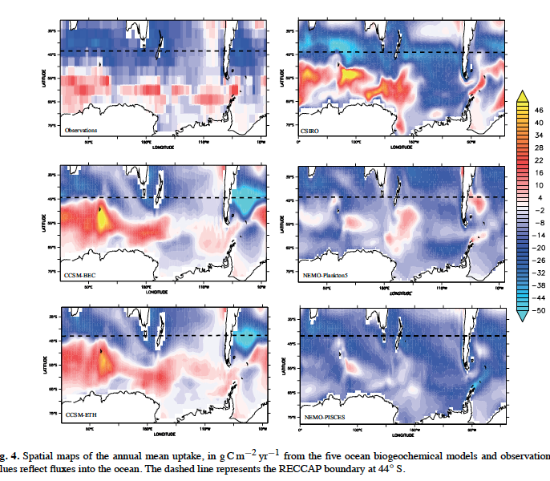
Lenton 2013
sea-air CO2 fluxes, 1990-2009
Obs, and model-intercomparison
Outgassing of CO2 off coast of E. Antarctica (centered around 55-60S, 50-100E) in 3/5 models and in obs.

Slide 24
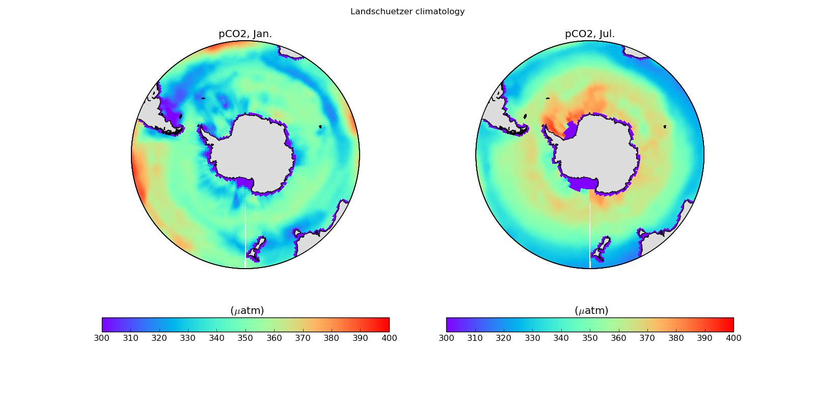
(for period 1985-2015)

