Slide 1
Voter Rank
By Eric Perez

Slide 2
Idea
A ranked-choice voting system (RCV) is an electoral system in which voters rank candidates by preference on their ballots. If a candidate wins a majority of first-preference votes, he or she is declared the winner. If no candidate wins a majority of first-preference votes, the candidate with the fewest first-preference votes is eliminated. First-preference votes cast for the failed candidate are eliminated, lifting the second-preference choices indicated on those ballots. A new tally is conducted to determine whether any candidate has won a majority of the adjusted votes. The process is repeated until a candidate wins an outright majority.

Slide 3
Why my Project
I felt like an online voting system is what is needed during pandemic times.

Slide 4
Initial Needs
Create an interface that will allow you to view registration status.
Create a site that will allow you to register to vote.
Create a site that will allow you to check the status.
Create a great shell/interface
Login/Register available

Slide 5
High Level Requirements
Complete the voting section as Voter.
Create a ranked choice election.
Input votes.
Display results in percentages.
Complete the admin section as Administrator.

Slide 6
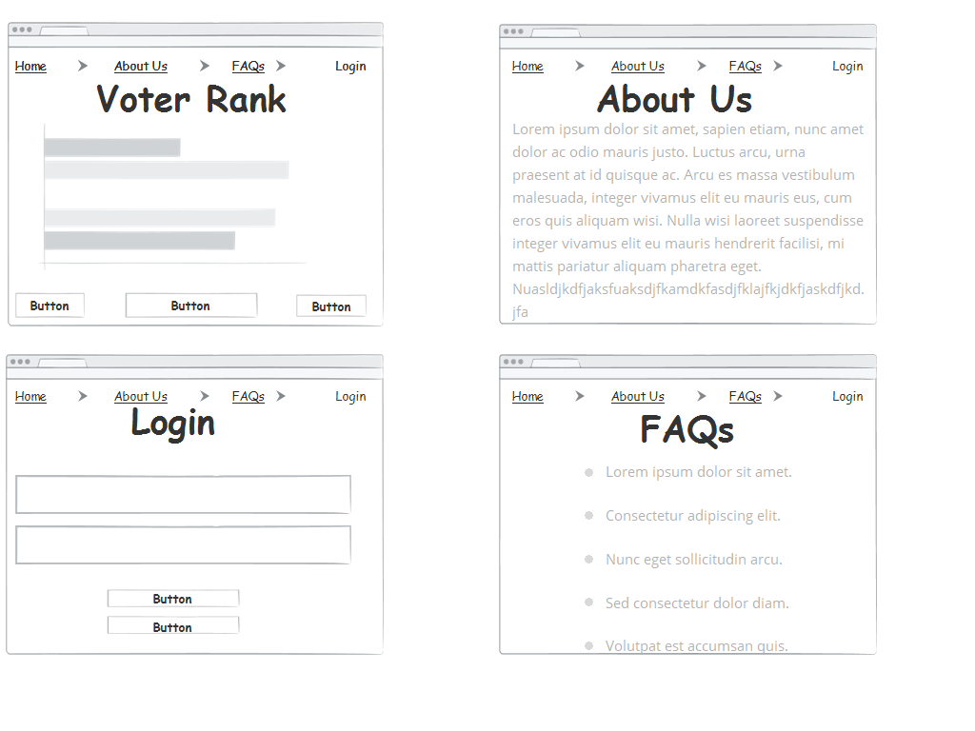
Wireframes / Mockups

Slide 7
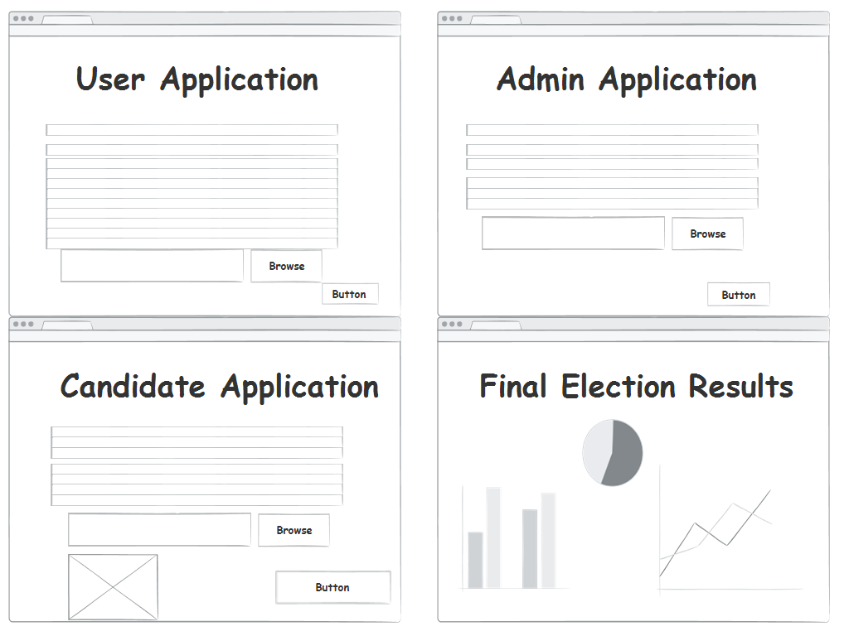
Wireframes / Mockups

Slide 8
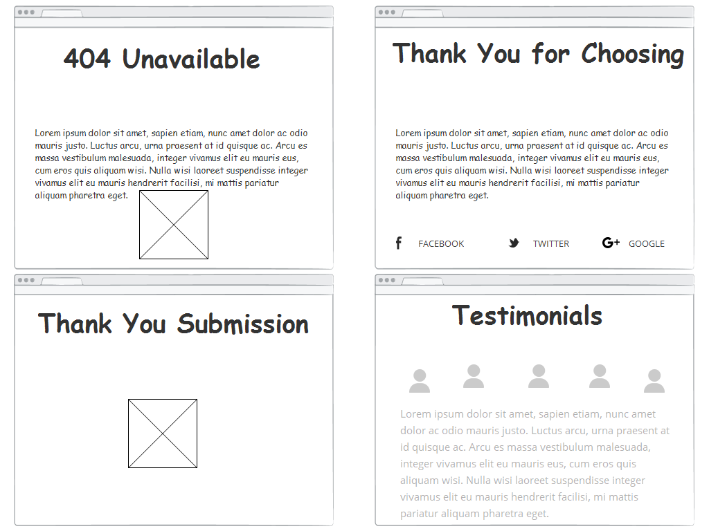
Wireframes / Mockups

Slide 9
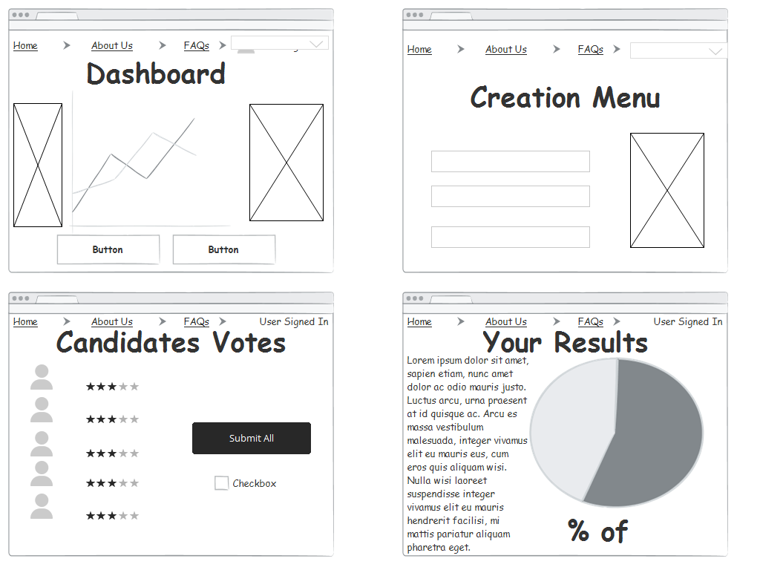
Wireframes / Mockups

Slide 10
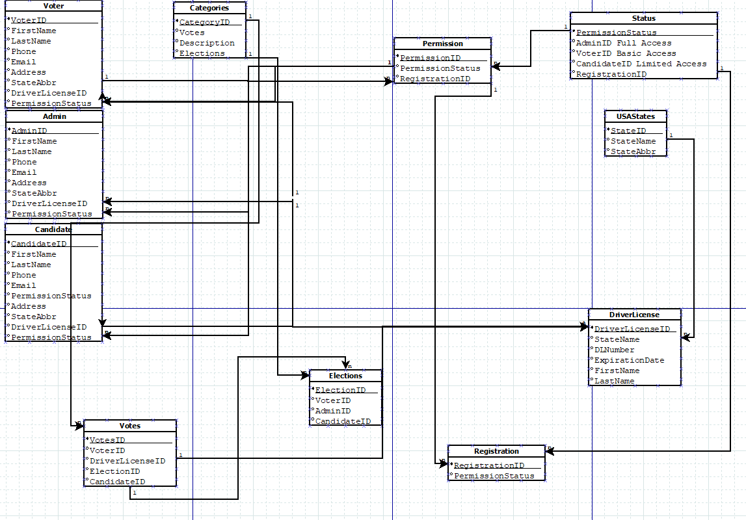
ER Diagram

Slide 11
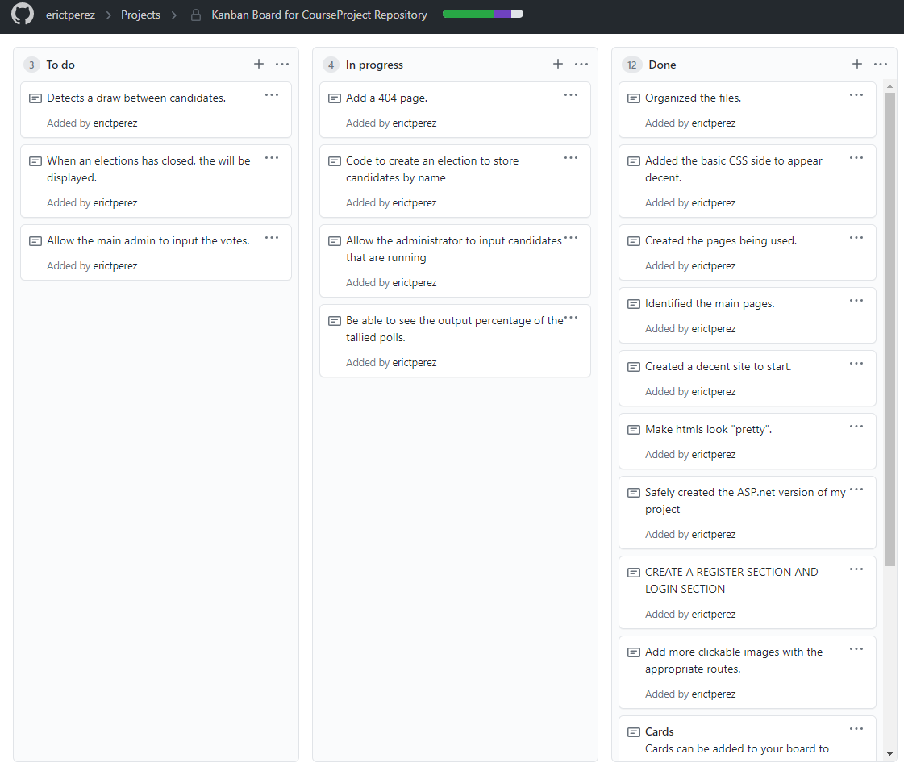
Kanban Board via GitHub

Slide 12
Demo of ASP.net
https://localhost:44350/

