Slide 1
Voter Rank
By Eric Perez

Slide 2
Initial Needs
Create an interface that will allow you to view registration status.
Create a site that will allow you to register to vote.
Create a site that will allow you to check the status.

Slide 3
High Level Requirements
Complete the voting section as Voter.
Complete the admin section as Administrator.

Slide 4
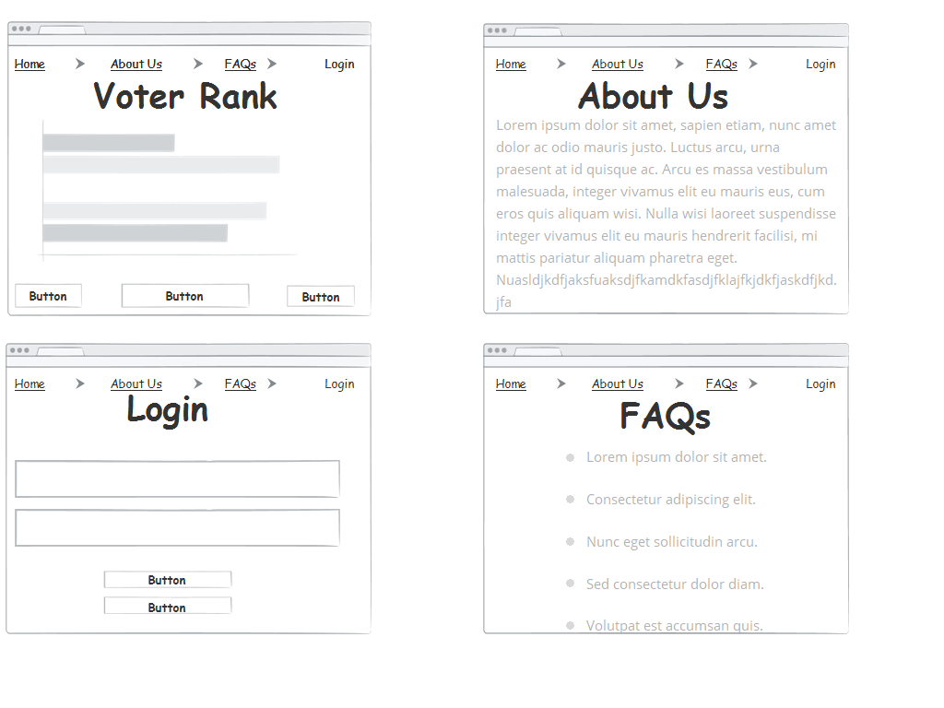
Wireframes / Mockups

Slide 5
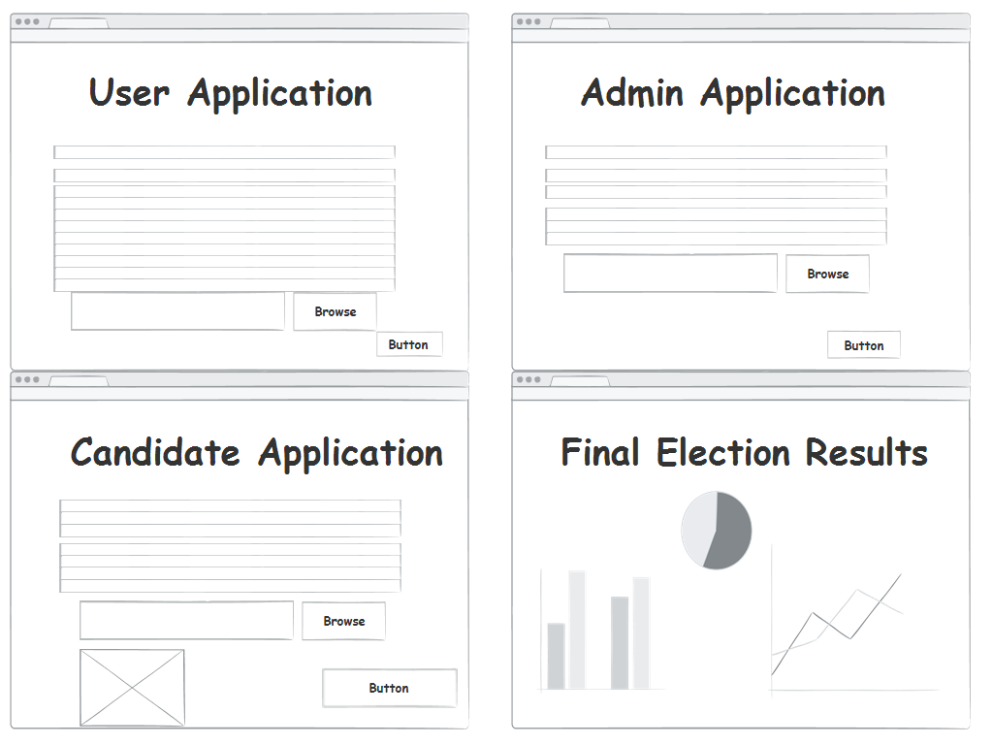
Wireframes / Mockups

Slide 6
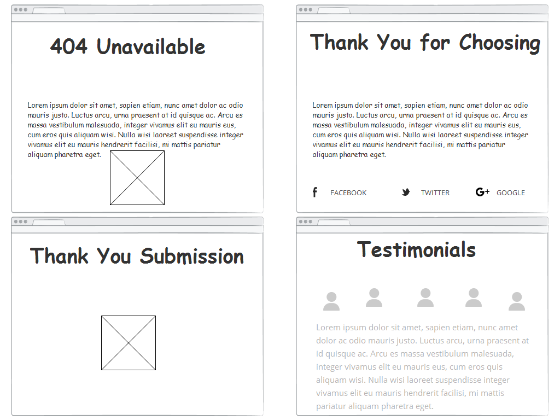
Wireframes / Mockups

Slide 7
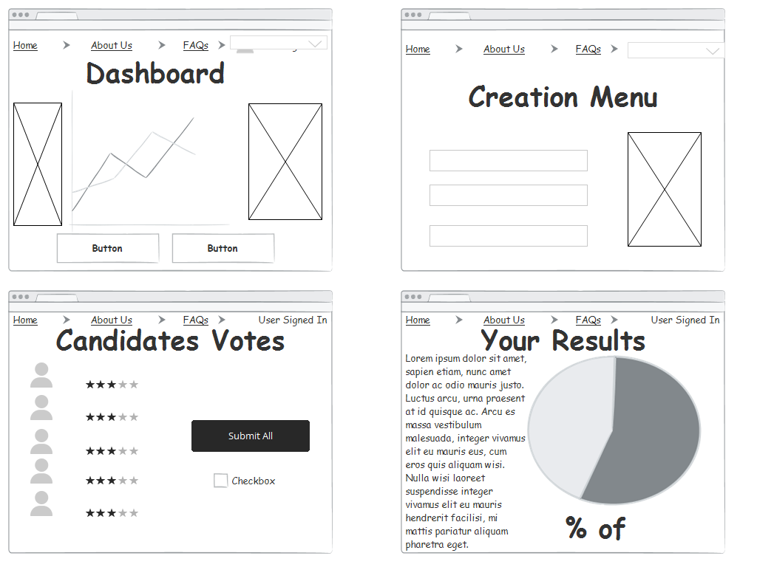
Wireframes / Mockups

Slide 8
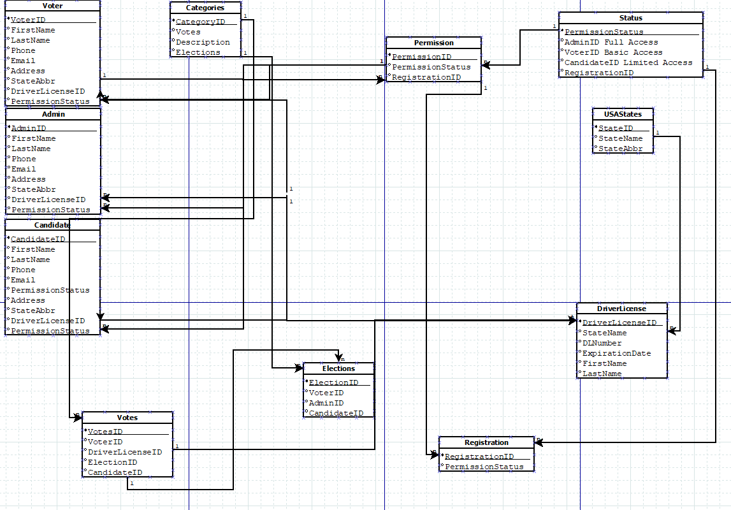
ER Diagram

Slide 9
Demo of ASP.net
https://localhost:44350/

