Slide 1
AIGC 5500 | ADVANCED DEEP LEARNING | MIDTERM PROJECT
Does built-in structure help spam detection?
A CNN, an LSTM, and a Transformer against a bag-of-embeddings baseline
Baseline
CNN
LSTM
Transformer
Team MVPs
Daniel Alejandro Castillo Martín, Abhi Manishkumar Patel, Eric Ly, Bryan Jacome, Nouroz Ali
Professor: Hossein Pourmodheji | Humber Polytechnic | November 2026
https://github.com/erictsaily/AIGC5500-Midterm-Project
Notes:
Hi, I'm Daniel Castillo, presenting for Team MVPs in AIGC 5500. Our question is simple: when you classify spam, does it help to build structure into the model? We compared a CNN, an LSTM and a Transformer against a deliberately simple baseline. I'll show you what we found, and what we would not claim from it.

Slide 2
THE QUESTION
Which built-in structure helps classify spam?
Baseline
CNN
LSTM
Transformer
No structure
Local patterns
Sequential state
Direct lookup
Averages word embeddings: knows which words appear
Sliding windows of 3, 5, and 7 words
Reads word by word, keeps one state
Any word attends to any other word
Does any structure beat a model with none, and why?
Evidence: four models with three seeds each | one ablation per family | a second dataset | inference cost
AIGC 5500 Midterm Project | Team MVPs
2 / 21
Notes:
The task is binary: is an email spam, or ham, meaning normal mail? [Point to the cards from left to right.] Each model makes a different bet. The baseline makes none: it averages word embeddings, so it only knows which words show up. The CNN bets on local patterns, windows of three, five and seven words. The LSTM bets on order, reading one word at a time with a single running state. And the Transformer bets on direct lookup, where any word can attend to any other.
[Point to the green box.] So, does any of that structure beat a model with none, and why? We ran four models with three seeds each, one ablation per family, a second dataset, and a cost check. The punchline up front: for spam, which words appear carries almost all the signal.

Slide 3
DATA | DANIEL CASTILLO
Enron spam, audited before splitting
Source
31,716 train + 2,000 test emails
Partition | Emails | Ham | Spam
Train | 22,524 | 11,681 (51.9%) | 10,843 (48.1%)
Validation | 5,632 | 2,921 (51.9%) | 2,711 (48.1%)
Test | 1,981 | Held out, scored once at the end
Removed before splitting
51 empty | 3,137 duplicates
372 train-test overlaps | 19 test duplicates
Every decision uses validation
Vocabulary, checkpoints, and model choice never see the test split
Split
Stratified 80/20 of development data, seed 42
Source: notebooks/01_data_preparation.ipynb, sections 2.1 to 2.6 (dataset: SetFit/enron_spam on Hugging Face)
AIGC 5500 Midterm Project | Team MVPs
3 / 21
Notes:
Our main dataset is the Enron spam corpus, the SetFit version on Hugging Face. It ships with 31,716 training emails and 2,000 test emails. [Point to the left column.] Before touching any model, we audited it. We dropped 51 empty emails and 3,137 duplicates. We also found 372 training emails that appear word for word in the test set. Left in, they would have leaked the answers and inflated the test score. The test set also had 19 duplicates of its own.
[Point to the table.] Then we made a stratified 80/20 split with seed 42: 22,524 emails for training, 5,632 for validation and 1,981 for test. The classes are close to balanced, about 52 percent ham and 48 percent spam. [Point to the green box.] And this was our rule all the way through: the vocabulary, the checkpoints and every model choice used validation only. The test set was scored once, at the very end.

Slide 4
IDENTICAL CONDITIONS
Same inputs, budget, and selection rule for every model
Input
Training
Model size
Lowercased words and punctuation
10,000-token vocabulary from training text only
256-token limit: 32.2% of emails cut, 49.6% of tokens dropped
AdamW, learning rate 0.001, weight decay 0.01
Gradient clip 1.0, batch 64, 10 epochs
Best epoch by validation spam F1
Seeds 42, 123, 2026 for every run
No hyperparameter search for any model
Model | Parameters
Baseline | 640,130
CNN | 736,902
LSTM | 739,586
Transformer | 723,586
Largest / smallest = 1.16
Every model has the same 640,000-weight embedding table
Source: src/config.py, src/text.py, and the parameter counts printed in notebooks 02 to 05
AIGC 5500 Midterm Project | Team MVPs
4 / 21
Notes:
A comparison is only fair if everyone plays by the same rules. [Point to Input.] All four models see the same input: lowercased words and punctuation, a 10,000-token vocabulary built from training data only, and a cap of 256 tokens per email. That cap is a real trade-off. It cuts 32.2 percent of training emails and drops 49.6 percent of the tokens, and I'll come back to it.
[Point to Training.] Training is identical too: AdamW, learning rate 0.001, weight decay 0.01, clipping at 1, batches of 64, and 10 epochs. Each run keeps the epoch with the best validation spam F1, meaning F1 with spam as the positive class, and everything uses seeds 42, 123 and 2026. What did we tune? Nothing, for any model. The only check was two learning rates for the LSTM on one seed, and it picked the shared 0.001.
[Point to Model size.] Sizes are close, from about 640 to 740 thousand parameters, a ratio of 1.16, well inside the factor of two the brief allows.

Slide 5
BASELINE | NOUROZ ALI
Baseline: an average of word embeddings
Token IDs
up to 256 per email
Embedding
64-d, learned
Masked mean
over real tokens only
Linear
2 scores: ham, spam
Equivalent to a learned spam score per word, averaged
Knows which words appear, not their order
Same data, budget, seeds, and tuning (none) as the deep models
640,130
parameters
trained from scratch, no pretrained weights
Source: src/baseline_model.py, notebooks/02_baseline_experiment.ipynb
AIGC 5500 Midterm Project | Team MVPs
5 / 21
Notes:
First, the baseline, which Nouroz built. [Follow the boxes left to right.] It's simple on purpose. Each word becomes a 64-dimensional embedding, we average them over the real words, ignoring padding, and a linear layer gives two scores, ham and spam. A nice way to think about it: a linear layer after an average is the same as giving every word its own learned spam score and averaging those. So it knows which words appear, and nothing about their order. It uses the same data, budget, seeds and tuning as the deep models, with 640,130 parameters, all trained from scratch.

Slide 6
CONVOLUTIONAL | BRYAN JACOME
CNN: phrase detectors with max-pooling
Ablation: all widths = 1
Token IDs
up to 256 per email
Embedding
64-d, learned
Conv1d + ReLU
widths 3, 5, 7
100 filters each
Global max-pool
padding masked
Dropout + Linear
p = 0.1, 300 to 2
Shared weights: a filter finds its phrase anywhere
Max-pool asks: did this phrase appear at all?
Three widths catch phrases of different lengths
736,902
parameters
trained from scratch, no pretrained weights
Source: src/cnn_model.py, notebooks/03_cnn_experiment.ipynb
AIGC 5500 Midterm Project | Team MVPs
6 / 21
Notes:
Next, Bryan's CNN: the course idea of a small window with shared weights sliding along the input. [Point to the Conv1d box.] After the same embedding, three parallel 1D convolutions with widths 3, 5 and 7 each have 100 filters. Each filter is a phrase detector, and because weights are shared, it finds its phrase anywhere. Global max-pooling then asks: did this phrase appear at all? Padding is masked so it never wins the max, and the 300 features go through dropout and a linear layer. If multi-word cues matter, this model should catch them. It has 736,902 parameters, and the red box shows the ablation: every width set to one.

Slide 7
RECURRENT | DANIEL CASTILLO
LSTM: one sequential state, read word by word
Ablation: forget-gate bias +1
Token IDs
up to 256 per email
Embedding
64-d, learned
Packed LSTM
128 units, 1 layer
unidirectional
Final hidden state
the email summary
Dropout + Linear
p = 0.1, 128 to 2
Gates decide what the cell state keeps or forgets
Padding never enters the state (verified in the notebook)
The classifier sees only the final state
739,586
parameters
trained from scratch, no pretrained weights
Source: src/lstm_model.py, notebooks/04_lstm_experiment.ipynb
AIGC 5500 Midterm Project | Team MVPs
7 / 21
Notes:
Then the recurrent model, my LSTM. It reads the email one token at a time, with 128 hidden units in one single-direction layer. Sequences are packed, so the state never sees padding, and we checked in the notebook that extra padding doesn't change the output. The final hidden state is the email's summary, followed by dropout and a linear layer.
From the course, the gates decide what the cell state keeps or forgets, which helps gradients survive long sequences. But here's the catch, so keep it in mind: the classifier only sees that final state. Everything has to squeeze through it. It has 739,586 parameters, and the ablation changes the starting forget-gate bias.

Slide 8
ATTENTION | ABHI PATEL
Transformer: every word can look up every other
Ablation: remove positions
Token IDs
up to 256 per email
Token + position
64-d each, learned, summed
2 encoder layers
pre-norm, 4 heads
FF 128, GELU
Masked mean
over real tokens only
Linear
64 to 2
Direct lookup in one step: no state, no window
Positions are added because attention alone is order-blind
Padding mask in attention and in pooling
723,586
parameters
trained from scratch, no pretrained weights
Source: src/transformer_model.py, notebooks/05_transformer_experiment.ipynb
AIGC 5500 Midterm Project | Team MVPs
8 / 21
Notes:
And the attention model, Abhi's Transformer. [Point to the red dashed box.] We add a learned position embedding to each token, because self-attention on its own is order-blind. It sees a set of words, not a sequence. Then come two pre-norm encoder layers, each with four attention heads, a 128-unit feed-forward block with GELU, residual connections and dropout. A padding mask keeps attention and pooling away from the padded positions, and we average over the real tokens before the classifier.
The key idea is direct lookup. Any word can pull information from any other word in a single step, with no running state and no fixed window. It has 723,586 parameters, and the ablation simply removes the position embeddings.

Slide 9
RESULTS | ENRON
Baseline leads on both splits; the LSTM trails
Model | Validation spam F1 (selection) |  |  |  | Test spam F1 (scored once)
 | seed 42 | seed 123 | seed 2026 | mean ± SD | seed 42 | seed 123 | seed 2026 | mean ± SD
Baseline | 0.9888 | 0.9882 | 0.9890 | 0.9887 ± 0.0004 | 0.9890 | 0.9910 | 0.9900 | 0.9900 ± 0.0010
CNN | 0.9874 | 0.9868 | 0.9871 | 0.9871 ± 0.0003 | 0.9889 | 0.9885 | 0.9889 | 0.9888 ± 0.0002
LSTM | 0.9834 | 0.9853 | 0.9810 | 0.9832 ± 0.0022 | 0.9854 | 0.9820 | 0.9780 | 0.9818 ± 0.0037
Transformer | 0.9882 | 0.9851 | 0.9854 | 0.9862 ± 0.0017 | 0.9849 | 0.9859 | 0.9868 | 0.9859 ± 0.0010
Mean test errors (of 1,981 emails): Baseline 20 | CNN 22 | Transformer 28 | LSTM 36
Spam F1 (spam = positive class). Mean ± sample SD over three seeds; best in each column in bold. Source: results/enron/*/validation_per_seed.csv and test_per_seed.csv
AIGC 5500 Midterm Project | Team MVPs
9 / 21
Notes:
Okay, here are the Enron results, every seed, in spam F1. [Point to the left block.] On the left is validation, which drove every decision. And here's the first surprise: the baseline has the highest mean, 0.9887, and it's the most stable too, with a standard deviation of just 0.0004. Then the CNN at 0.9871, the Transformer at 0.9862, and the LSTM last at 0.9832, with the widest spread, 0.0022.
[Point to the right block.] On the right is the single test run of the frozen models, and the picture doesn't change. The baseline leads again at 0.9900, then the CNN at 0.9888, the Transformer at 0.9859, and the LSTM at 0.9818.
[Point to the bar at the bottom.] These differences are small, so it helps to count emails. Out of 1,981 test emails, the baseline gets about 20 wrong on average, the CNN 22, the Transformer 28, and the LSTM 36.

Slide 10
EVIDENCE
Every number comes from notebook output
03_cnn_experiment.ipynb, section 4 (printed output)
LIVE: switch to the notebook (about 30 s)
CNN (full) seed 42 best epoch 6 val acc 0.9879 F1 0.9874 (82s)
CNN (full) seed 123 best epoch 6 val acc 0.9872 F1 0.9868 (82s)
CNN (full) seed 2026 best epoch 10 val acc 0.9876 F1 0.9871 (83s)
Ablation: kernel width 1 seed 42 best epoch 7 val acc 0.9893 F1 0.9890 (52s)
Ablation: kernel width 1 seed 123 best epoch 9 val acc 0.9897 F1 0.9894 (52s)
Ablation: kernel width 1 seed 2026 best epoch 10 val acc 0.9895 F1 0.9891 (52s)
Where each number is written
Baseline: notebook 02, sections 5 and 7
CNN: notebook 03, sections 4 and 7
LSTM: notebook 04, sections 5 and 6
Transformer: notebook 05, sections 4 and 7
Second dataset: notebook 06
Tables: built from the CSV files in results/
05_transformer_experiment.ipynb, section 4 (printed output)
Transformer (full) seed 42 best epoch 9 val acc 0.9886 F1 0.9882 (82s)
Transformer (full) seed 123 best epoch 8 val acc 0.9856 F1 0.9851 (82s)
Transformer (full) seed 2026 best epoch 10 val acc 0.9860 F1 0.9854 (82s)
Ablation: no positions seed 42 best epoch 8 val acc 0.9879 F1 0.9875 (82s)
Ablation: no positions seed 123 best epoch 10 val acc 0.9874 F1 0.9870 (82s)
Ablation: no positions seed 2026 best epoch 10 val acc 0.9863 F1 0.9859 (81s)
AIGC 5500 Midterm Project | Team MVPs
10 / 21
Notes:
These numbers come straight from our code. Each notebook writes its per-seed results to CSV files in the results folder, and our tables are built from those files. [Point to the dark boxes.] These are the printed lines from the CNN and Transformer notebooks. Let me show you the real thing.
[Switch to 03_cnn_experiment.ipynb, section 4.] Here's the CNN notebook. For each seed you can see the best epoch, the validation accuracy and the F1, and they match the table: 0.9874, 0.9868, 0.9871. [Scroll to section 7.] Section 7 is the test evaluation. It runs once, and there's a guard that refuses to run it again. [Open 04_lstm_experiment.ipynb, section 5, and point to the validation spam F1 column.] And here are my LSTM runs, the same three seeds, same numbers as the slide. [Return to the slides.]

Slide 11
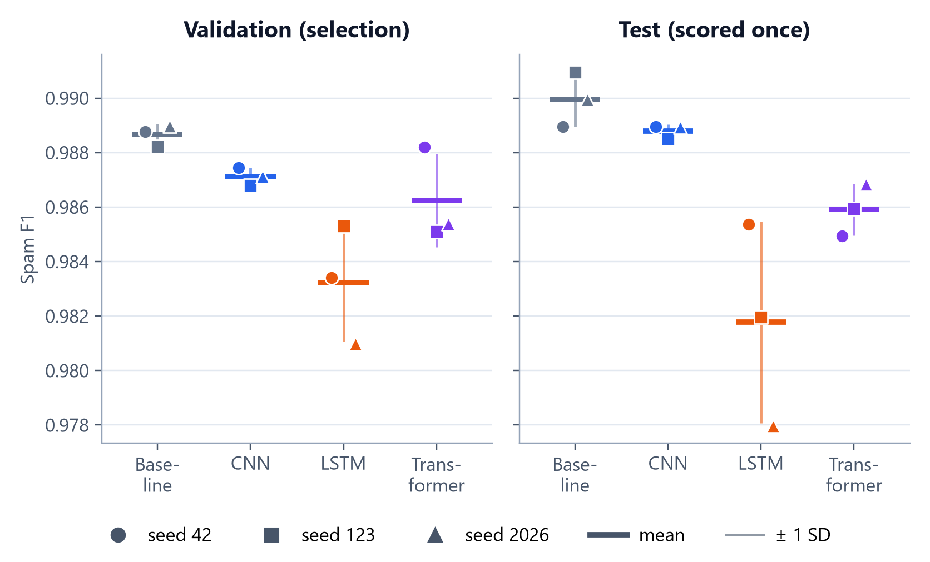
WHY THE FAMILIES DIFFER
Pooling models tie; the final-state LSTM is the outlier
Baseline, CNN, and Transformer pool evidence from every position: within 0.0024 on validation
Spam is largely lexical: which words appear
LSTM: a cue must survive up to 256 updates to reach the classifier, giving the lowest mean and widest spread
An explanation consistent with the evidence, not tested directly.
Source: same per-seed CSV files as the results table
AIGC 5500 Midterm Project | Team MVPs
11 / 21
Notes:
So why this order? [Point to the baseline, CNN and Transformer.] On validation, these three are within 0.0024 of each other, and what they share is pooling: the baseline and the Transformer average, the CNN takes a max. Either way, a spam cue anywhere in the email reaches the classifier in one step. That's enough here, because spam is largely lexical. Certain words showing up is strong evidence, wherever they are.
[Point to the LSTM.] The LSTM is the odd one out. Remember the catch: its classifier only sees the final state. So a clue in the first sentence has to survive up to 256 updates to count, and in training its gradient has to travel all the way back. That bottleneck fits what we see: the lowest mean, the widest spread, and, as you'll see shortly, a bigger gap on the second dataset. To be clear, this is an explanation that fits the evidence, not one we tested directly. The test would be to pool over all of the LSTM's hidden states instead of using only the last one.

Slide 12
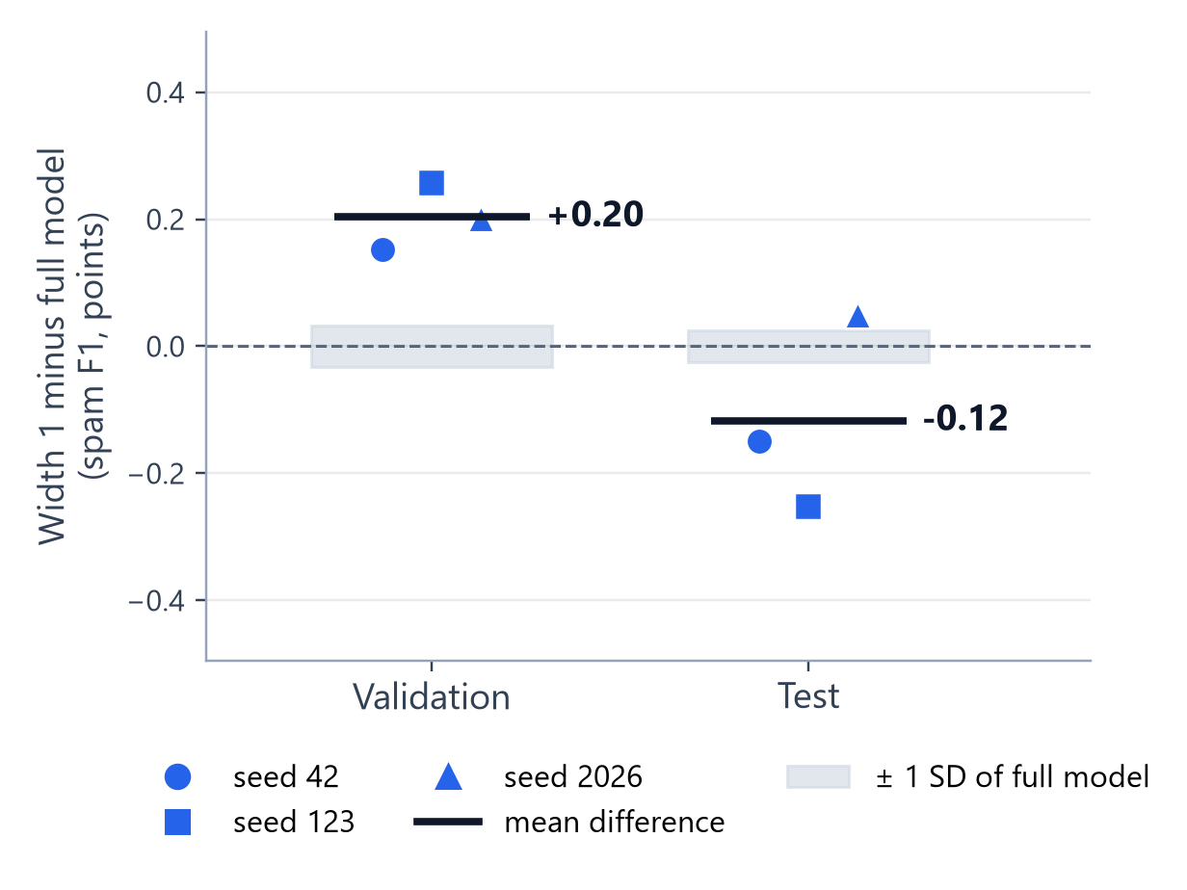
ABLATION 1 OF 3 | CNN | BRYAN JACOME
Width-1 kernels: higher on validation, within noise on test
Seed | Validation |  | Test
 | full | width 1 | full | width 1
42 | 0.9874 | 0.9890 | 0.9889 | 0.9874
123 | 0.9868 | 0.9894 | 0.9885 | 0.9860
2026 | 0.9871 | 0.9891 | 0.9889 | 0.9894
Mean ± SD | 0.9871 ± 0.0003 | 0.9892 ± 0.0002 | 0.9888 ± 0.0002 | 0.9876 ± 0.0017
Difference | +0.0020 |  | -0.0012
Multi-word windows did not help. Width 1: 660,102 parameters, about 37% less training time per run.
Spam F1; mean ± sample SD over seeds 42, 123, 2026. Shaded band: ± 1 SD of the full model across seeds. Source: results/enron/cnn/
AIGC 5500 Midterm Project | Team MVPs
12 / 21
Notes:
Now the ablations, each changing exactly one thing. I'll give differences in F1 points, where one point is 0.01. For the CNN, Bryan set every kernel width to one, so each filter sees a single word and the model becomes a bag of word detectors. The only side effect is fewer weights: 660,102 instead of 736,902.
The result surprised us. [Point to the validation columns.] On validation, width one is better on all three seeds, by 0.20 points, about six times the full model's seed spread. [Point to the test columns.] On test it dips 0.12 points, but that's mixed across seeds and within its own spread. So multi-word windows didn't help. The full model also peaked early, at epoch 6 on two seeds, which hints at overfitting. And width one trains faster, about 52 seconds per run instead of 82.

Slide 13
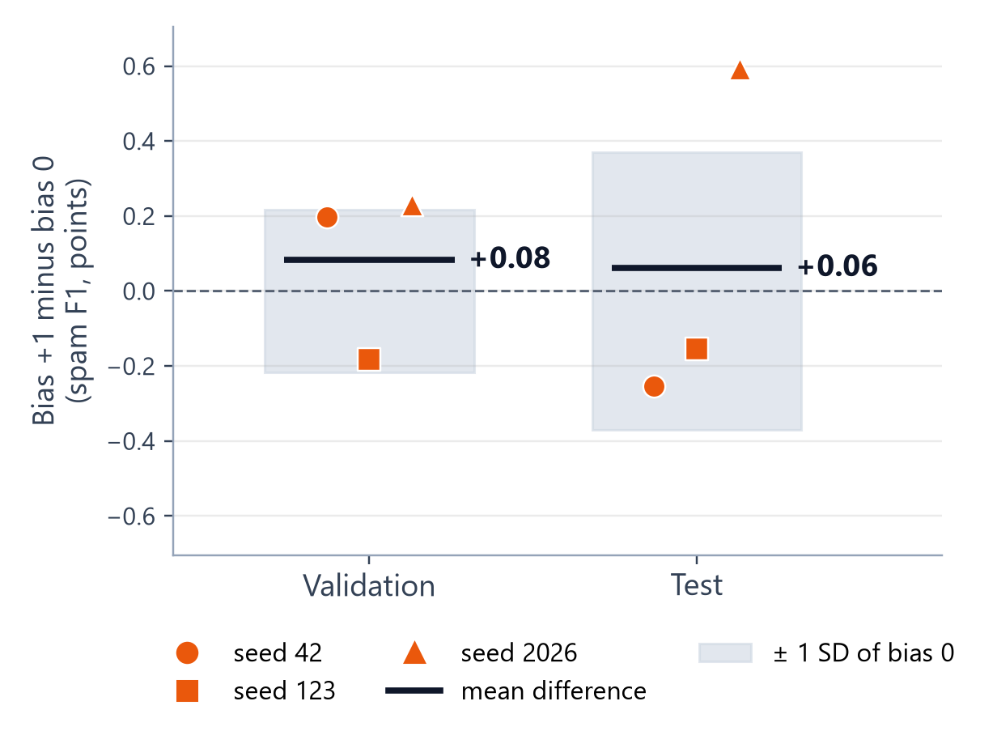
ABLATION 2 OF 3 | LSTM | DANIEL CASTILLO
Forget-gate bias +1: no reliable effect
Seed | Validation |  | Test
 | bias 0 | bias +1 | bias 0 | bias +1
42 | 0.9834 | 0.9854 | 0.9854 | 0.9828
123 | 0.9853 | 0.9835 | 0.9820 | 0.9804
2026 | 0.9810 | 0.9833 | 0.9780 | 0.9839
Mean ± SD | 0.9832 ± 0.0022 | 0.9841 ± 0.0012 | 0.9818 ± 0.0037 | 0.9824 ± 0.0018
Difference | +0.0008 |  | +0.0006
Mixed seeds on both splits. Spread across seeds halves, a hint only. Same 739,586 parameters.
Spam F1; mean ± sample SD over seeds 42, 123, 2026. Shaded band: ± 1 SD of the bias 0 model across seeds. Source: results/enron/lstm/
AIGC 5500 Midterm Project | Team MVPs
13 / 21
Notes:
For my LSTM, the ablation changes only the starting forget-gate bias, from 0 to plus 1. It's a common recommendation that nudges the cell to keep information early in training. The architecture and parameter count don't change at all.
[Point to the chart.] On validation, plus one helps two seeds and hurts one, an average gain of 0.08 points. On test, it helps one seed and hurts two, an average gain of 0.06 points. Both are well inside the normal seed-to-seed variation, so we can't claim an effect. The one thing that stands out is that the spread across seeds roughly halves, from 0.0022 to 0.0012 on validation. But with three seeds, that's a hint, not a finding. So making memory easier at the start didn't close the LSTM's gap.

Slide 14
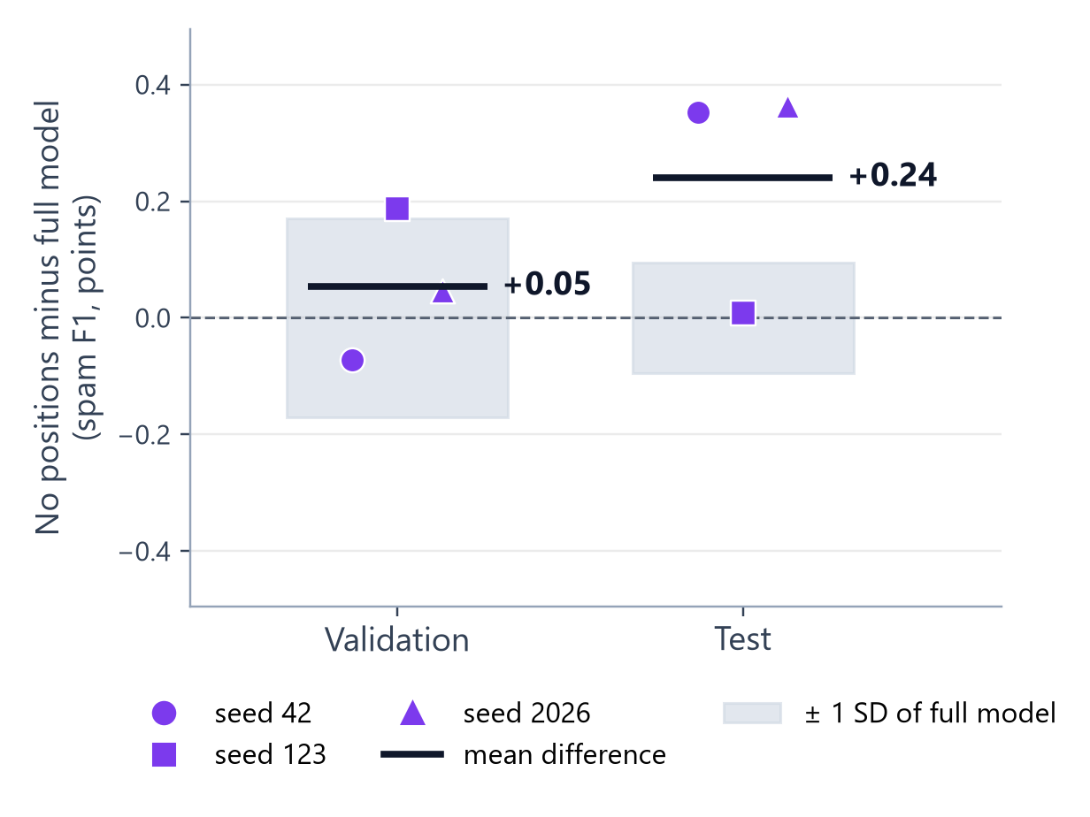
ABLATION 3 OF 3 | TRANSFORMER | ABHI PATEL
Removing positions: no measurable cost
Seed | Validation |  | Test
 | full | no positions | full | no positions
42 | 0.9882 | 0.9875 | 0.9849 | 0.9885
123 | 0.9851 | 0.9870 | 0.9859 | 0.9860
2026 | 0.9854 | 0.9859 | 0.9868 | 0.9905
Mean ± SD | 0.9862 ± 0.0017 | 0.9868 ± 0.0008 | 0.9859 ± 0.0010 | 0.9883 ± 0.0022
Difference | +0.0005 |  | +0.0024
Order information gave no benefit; the test gain of about 5 emails is close to the seed spread.
Spam F1; mean ± sample SD over seeds 42, 123, 2026. Shaded band: ± 1 SD of the full model across seeds. Source: results/enron/transformer/
AIGC 5500 Midterm Project | Team MVPs
14 / 21
Notes:
For the Transformer, Abhi removed the learned position embeddings and nothing else, which drops 16,384 parameters. Without positions, and with mean pooling, the model literally treats an email as an unordered bag of words.
[Point to the chart.] On validation the difference is plus 0.05 points, well inside the full model's spread of 0.17. On test, the no-position version is actually higher on all three seeds, by 0.24 points. That sounds like a lot, but it's about 5 emails out of 1,981, close to the seed spread. So we're careful: we're not saying removing positions helps. We're saying position information gave no measurable benefit here.

Slide 15
ABLATIONS TOGETHER
Removing word order did not measurably hurt
CNN
Width-1 kernels
Order-free windows
+0.0020 validation
Transformer
No positions
Order-free set of words
+0.0005 validation
Baseline
Averaged embeddings
Order-free by design
best on validation and test
The useful signal is which words appear, not how they are arranged
The LSTM ablation tests optimisation at initialisation, not order: its null result points to the final-state architecture.
AIGC 5500 Midterm Project | Team MVPs
15 / 21
Notes:
Put the ablations together and there's one story. [Point to the three cards.] Two of them take away the model's sense of word order, width-one kernels and no positions, and neither measurably hurt. Add the order-free baseline topping both validation and test, and that's three separate pieces of evidence pointing the same way. [Point to the green box.] For this task, which words appear matters far more than how they're arranged. The LSTM ablation asked a different question, about the start of training, and its null result points to the architecture, the final-state readout, as the real issue.

Slide 16
SECOND DATASET | ERIC LY
Kaggle ham/spam: a harder dataset, the same protocol
20,000 emails, 47% spam
Split 14,381 / 3,596 / 2,000
Own 10,000-token vocab
Same protocol, same seeds
Model | Validation spam F1 (selection) |  |  |  | Test spam F1 (scored once)
 | seed 42 | seed 123 | seed 2026 | mean ± SD | seed 42 | seed 123 | seed 2026 | mean ± SD
Baseline | 0.9656 | 0.9622 | 0.9638 | 0.9639 ± 0.0017 | 0.9628 | 0.9675 | 0.9662 | 0.9655 ± 0.0024
CNN | 0.9622 | 0.9558 | 0.9610 | 0.9597 ± 0.0034 | 0.9580 | 0.9512 | 0.9630 | 0.9574 ± 0.0059
LSTM | 0.9418 | 0.9392 | 0.9432 | 0.9414 ± 0.0020 | 0.9385 | 0.9372 | 0.9464 | 0.9407 ± 0.0050
Transformer | 0.9595 | 0.9591 | 0.9571 | 0.9586 ± 0.0013 | 0.9585 | 0.9652 | 0.9548 | 0.9595 ± 0.0052
Spam F1; mean ± sample SD over three seeds; best in each column in bold. Source: results/kaggle/*/ and notebooks/06_second_dataset_experiment.ipynb
AIGC 5500 Midterm Project | Team MVPs
16 / 21
Notes:
Of course, this could all be a quirk of Enron. So Eric reran all four models on a second dataset: a Kaggle collection of 20,000 labelled emails, about 47 percent spam. After the same cleaning that's 14,381 training, 3,596 validation and 2,000 test emails, with its own vocabulary. Same protocol, same seeds.
[Point to the Baseline row.] It's harder, which helps: the baseline reaches about 0.964 instead of 0.989, leaving room for differences. Again the baseline is best on validation, at 0.9639, then the CNN, the Transformer and the LSTM. On test it leads again, and the CNN and Transformer swap places by just 0.0021, well inside their seed spreads.

Slide 17
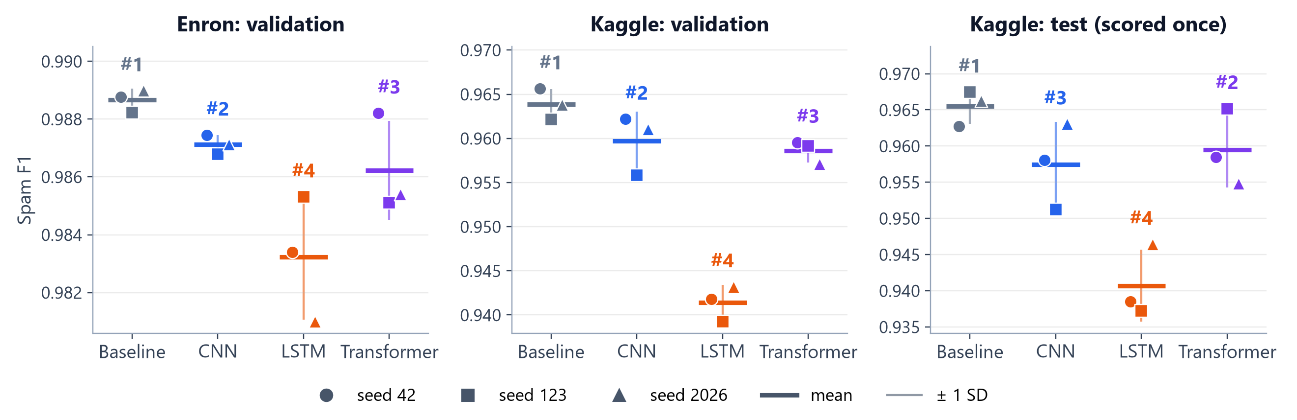
DOES IT HOLD?
Same validation ranking on both datasets; the LSTM gap widens
Ranking
Baseline, CNN, Transformer, LSTM on both validation sets
LSTM gap to baseline
0.54 points on Enron, 2.25 on Kaggle
Kaggle test
CNN and Transformer swap by 0.0021, inside the seed spread
Labels show the rank of each mean. Source: results/enron/ and results/kaggle/
AIGC 5500 Midterm Project | Team MVPs
17 / 21
Notes:
Here's the same thing as a picture. [Point to the rank labels.] On both validation sets the ranking is identical: baseline, CNN, Transformer, LSTM. The top three stay close, but look at the LSTM. Its gap to the baseline grows from 0.54 points on Enron to 2.25 on Kaggle, about four times bigger. So both main findings hold: no family beats the structure-free baseline, and the sequential model comes last every time. One caution: both datasets are English email spam, so this is robustness within one domain, not across tasks.

Slide 18
INFERENCE COST
Similar sizes; timings are not comparable across GPUs
Model | Parameters | ms per email (batch 64) | Peak GPU memory | Hardware
Baseline | 640,130 | 0.036 | 23.7 MB peak | RTX 3060 Laptop GPU
CNN | 736,902 | 0.098 | 72.5 MB peak | GTX 1050 Ti
LSTM | 739,586 | 0.120 | 43.2 MiB extra | RTX 3060 Laptop GPU
Transformer | 723,586 | 0.144 | 181.1 MB peak | Tesla T4
Not a ranking
Three GPUs and two procedures; the baseline and LSTM share a GPU, not a procedure
Valid within a family, same GPU
CNN width 1: 41% less time, 38% less memory. Transformer without positions: about the same.
Time per email = batch-of-64 time / 64. Peak: CUDA peak allocated incl. weights. Extra: peak above weights and inputs. Source: results/enron/*/inference_cost.csv
AIGC 5500 Midterm Project | Team MVPs
18 / 21
Notes:
Now, cost. [Point to the Parameters column.] Parameters are easy: all four models sit between 640 and 740 thousand. [Point to the Hardware column.] Time and memory need care, because each owner measured on their own GPU: a GTX 1050 Ti for the CNN, a Tesla T4 for the Transformer, and an RTX 3060 laptop for the LSTM and the baseline. Even those two share a GPU but not a procedure. So this is not a ranking.
For the record, per email in batches of 64: 0.036 milliseconds for the baseline, 0.098 for the CNN, 0.120 for the LSTM and 0.144 for the Transformer, with peak memory as shown in the table. [Point to the green box.] The fair comparison is within a family on one GPU: width-one kernels cut the CNN's time by 41 percent and its memory by 38 percent, while dropping positions left the Transformer about the same.

Slide 19
LIMITATIONS
What we would not claim
"The CNN is best"
The baseline beats it on validation and test; the top three are a few test emails apart
"Order never matters"
Two email datasets only, and the 256-token cut drops about half the tokens
"LSTMs are worse"
One configuration; two of three runs peaked at the final epoch, 10
"Small gaps are real"
Three seeds; gaps below about 0.002 are within noise
"Each model at its best"
Equal but minimal tuning; Enron is near the ceiling (baseline test 0.990)
AIGC 5500 Midterm Project | Team MVPs
19 / 21
Notes:
This brings me to what we would not claim. [Point to each claim as you go.] First, that the CNN is the best model for spam. The baseline beats it on validation and on test, and the top three are only a handful of test emails apart. Second, that word order never matters. We tested two email datasets, and the 256-token cut throws away about half the text.
Third, that LSTMs are worse in general. We tried one configuration, and two of its three runs peaked at the very last epoch, so a longer budget might narrow the gap. Fourth, that small gaps are real. With three seeds our spread estimates are rough, and gaps below about 0.002 are basically noise.
And finally, that we saw each model at its best. Everyone got the same minimal tuning, and Enron is near the ceiling: the baseline reaches 0.990 on test, right at the brief's 99 percent warning. That's exactly why the harder second dataset matters.

Slide 20
CONTRIBUTIONS AND REFERENCES
Who owned what, and what we did not write
Member | Owned piece | Ablation
Daniel Castillo | Data preparation, LSTM, baseline test | Forget-gate bias
Nouroz Ali | Baseline | -
Bryan Jacome | CNN | Kernel width 1
Abhi Patel | Transformer | No positions
Eric Ly | Second dataset, Presentation, Report Preparation | -
References
Metsis, Androutsopoulos, & Paliouras (2006). Spam filtering with naive Bayes: which naive Bayes? CEAS.
SetFit (n.d.). enron_spam [Data set]. Hugging Face.
artofintelligence (n.d.). ham-spam [Data set]. Kaggle.
Kim (2014). Convolutional neural networks for sentence classification. EMNLP.
Hochreiter & Schmidhuber (1997). Long short-term memory. Neural Computation.
Jozefowicz, Zaremba, & Sutskever (2015). An empirical exploration of recurrent network architectures. ICML.
Vaswani et al. (2017). Attention is all you need. NeurIPS.
Xiong et al. (2020). On layer normalization in the Transformer architecture. ICML.
Loshchilov & Hutter (2019). Decoupled weight decay regularization. ICLR.
Paszke et al. (2019). PyTorch. NeurIPS; PyTorch documentation.
AI assistance: ChatGPT (notebook starter structure); Cursor AI agent (draft slides and script, reviewed by the team).
AIGC 5500 Midterm Project | Team MVPs
20 / 21
Notes:
Quickly, who did what. [Point to the table.] I did the shared data preparation, the LSTM with its ablation, and the baseline's final test run. Nouroz built and trained the baseline, Bryan the CNN and its ablation, Abhi the Transformer and its ablation, and Eric ran the second-dataset check. [Point to the references.] On the right are both datasets, the papers behind each model and ablation, and the AI tools we used, including help drafting these slides, which we reviewed ourselves.

Slide 21
ANTICIPATED QUESTIONS
Three questions a sceptic should ask
Is the baseline winning only because the deep models were under-trained or under-tuned?
The CNN peaked at epoch 6 on two seeds; the baseline at 9 or 10. Only the LSTM peaked at the end. Claim: at equal, minimal tuning.
Did the 256-token cut remove the signal that order-aware models need?
Cannot rule it out: about two thirds of emails fit whole, but long emails were never scored separately. Next test: a longer cap.
With gaps this small, which parts of the ranking are real?
Every LSTM seed is below every baseline seed on both datasets; width 1 beats the full CNN on every seed. The top-three order is not: the CNN and Transformer swap on the Kaggle test.
Repository: https://github.com/erictsaily/AIGC5500-Midterm-Project
AIGC 5500 Midterm Project | Team MVPs
21 / 21
Notes:
To finish, here are three questions I'd push on if I were the sceptical reader.
[Point to the first question.] One: is the baseline winning only because the deep models were under-trained or under-tuned? Look at where the runs peaked. The CNN peaked at epoch 6 on two seeds, so it wasn't short of training; it was starting to overfit. The baseline peaked at epoch 9 or 10, so the cap limited it just as much. Only the LSTM, peaking at the end in two of three runs, clearly has more to gain. So our claim is deliberately narrow: at equal, minimal tuning, structure didn't help.
[Point to the second question.] Two: we cut every email at 256 tokens. Did that remove the very signal the order-aware models needed? We can't rule it out. About two thirds of training emails fit entirely inside the cap, but we never scored the long emails separately. The direct test is to rerun the two order ablations with a longer cap, and that's the first experiment we'd add.
[Point to the third question.] Three: with gaps this small, which parts of the ranking are real? Two results hold seed by seed: every LSTM seed is below every baseline seed on both datasets, and every width-one CNN seed beats every full CNN seed on validation. The order of the top three is not solid, since the CNN and Transformer swap on the Kaggle test. We scored the test set once, so we report that swap rather than tune it away.
[Pause.] That's our project. Thanks for watching.

