Slide 1

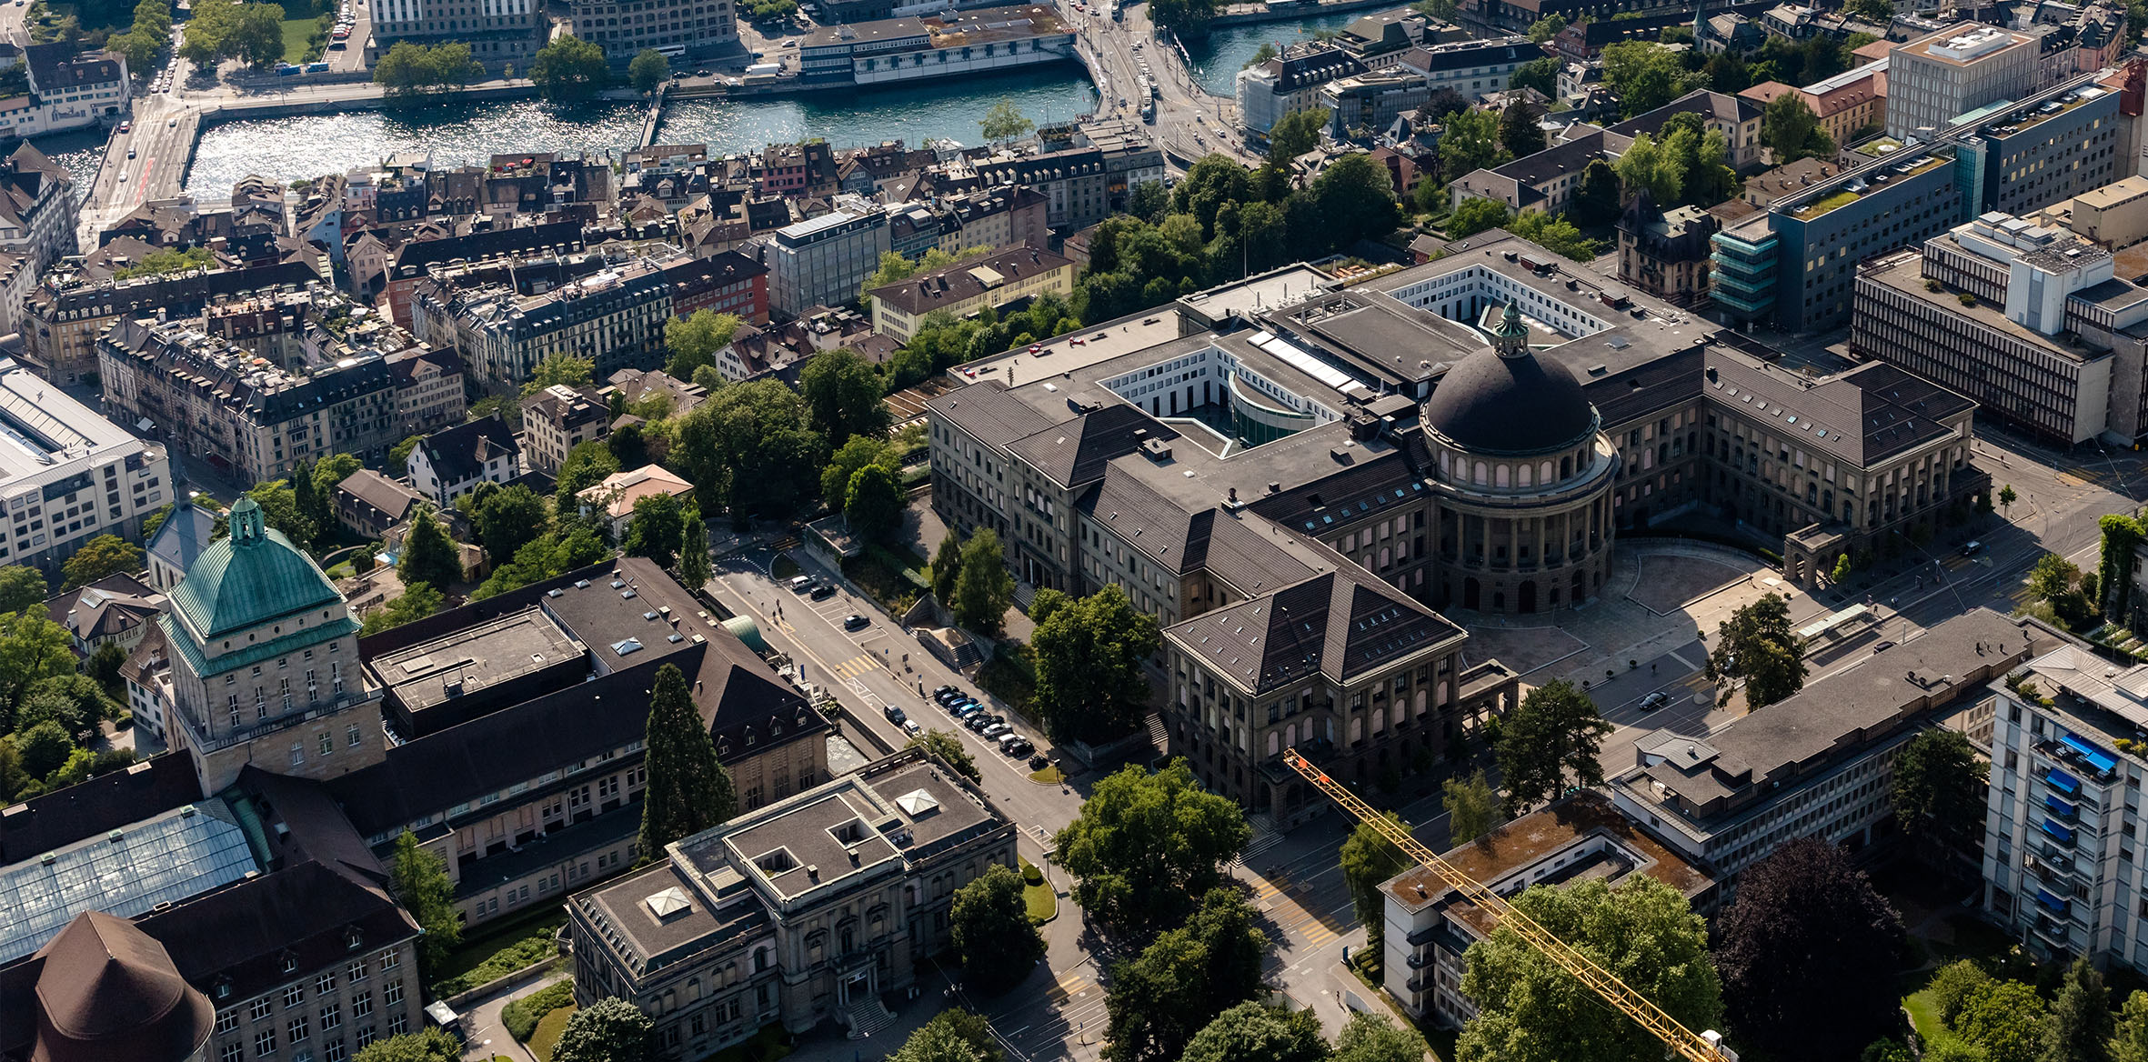
Semester Thesis
Professor Dr. Siegwart
Supervisors: Cornelius von Einem, David Hug
Nicolina Spiegelhalter
09.01.2023

Slide 2
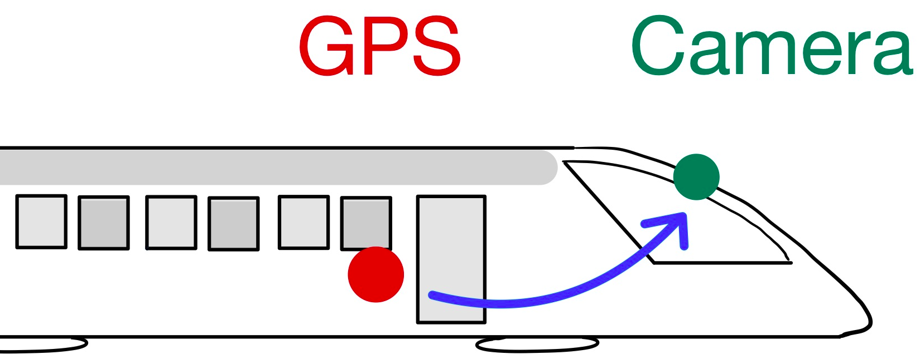
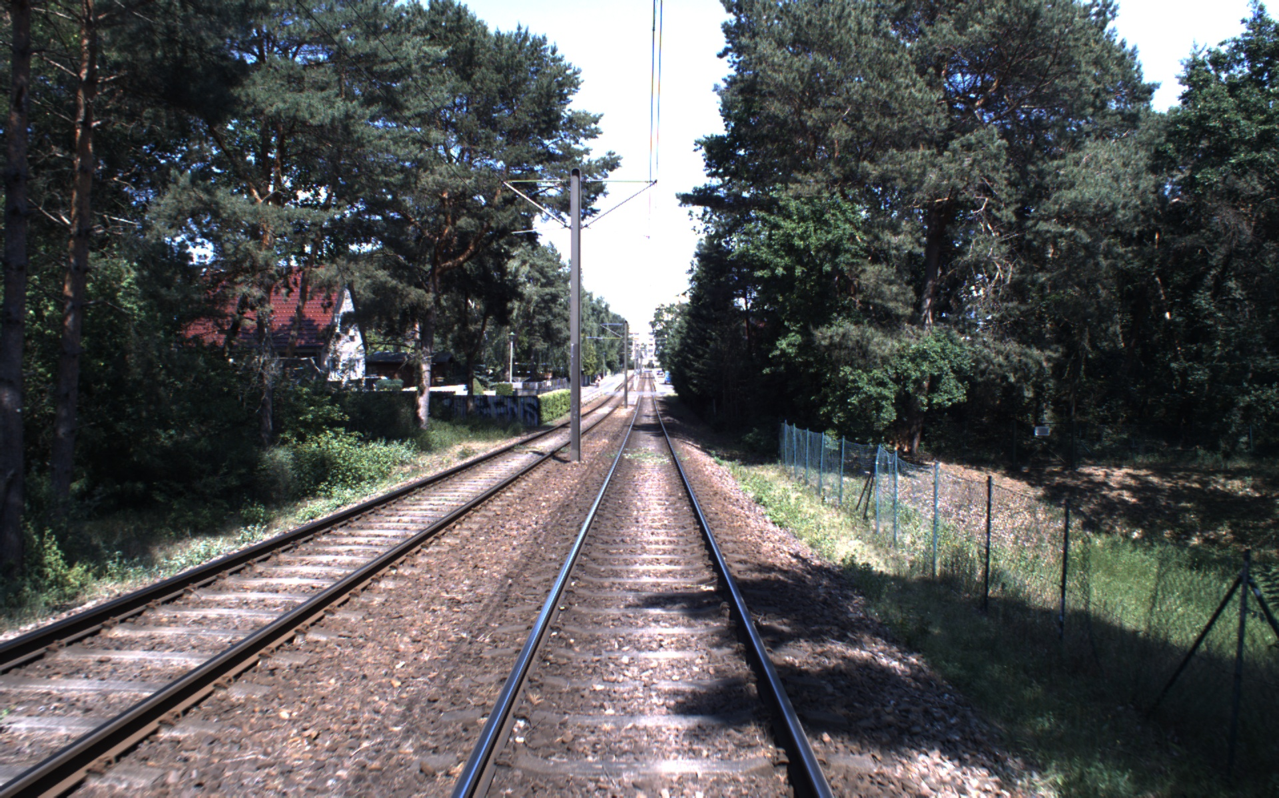

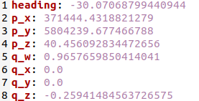
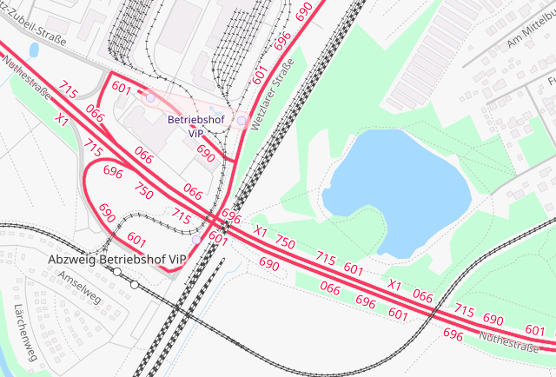
Goal of Semester Thesis
Online estimation of 6 DOF relative pose of camera to GPS, leveraging
  Visual information
  GPS and IMU measurements
  Map information
Img 1: Transformation between GPS and camera
Purpose:
  No additional prior calibration process
  Labeled data generation for existing datasets
    Finding ROI for obstacle detection
Img 2: Visual information
Img 3: GPS and IMU measurements of train pose
Img 4: Map information on railway tracks

Slide 3
Approach based on literature review
State of the art:
  Pose estimate with calibration aids ¹
  Solely rely on vanishing points if three are visible ²
Approach:
2)
Multistaged parameter estimation:
Leverage properties of vanishing point ³
Leverage detection of distinct landmarks ⁴
1)
Railway detection on straight tracks
An Inverse Projective Mapping-based Approach for Robust Rail Track extraction, Wang et al, 2015
Using vanishing points for camera calibration, Caprile, 1990
Vision-based track estimation and turnout detectio using recursive estimation, Ross, 2010
Geolocation estimation of target vehicles using image processing and geometric computation, Namazi, 2022

Slide 4
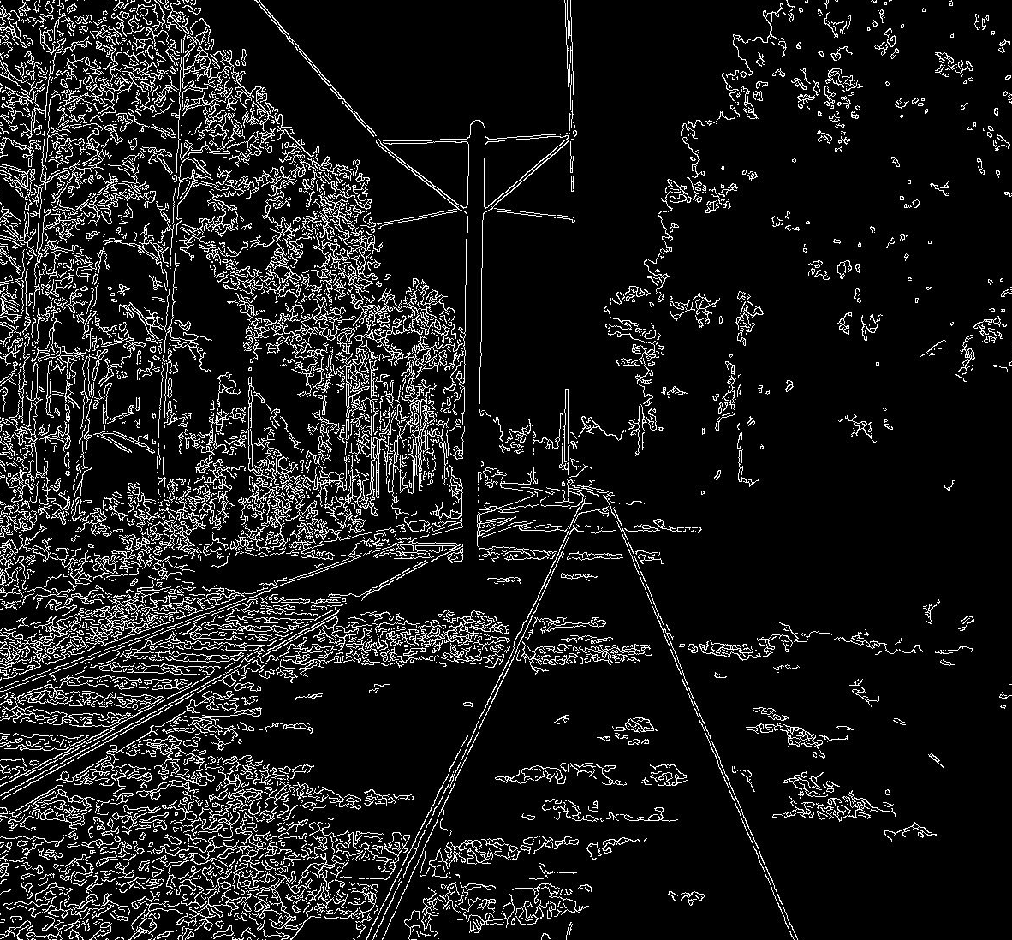
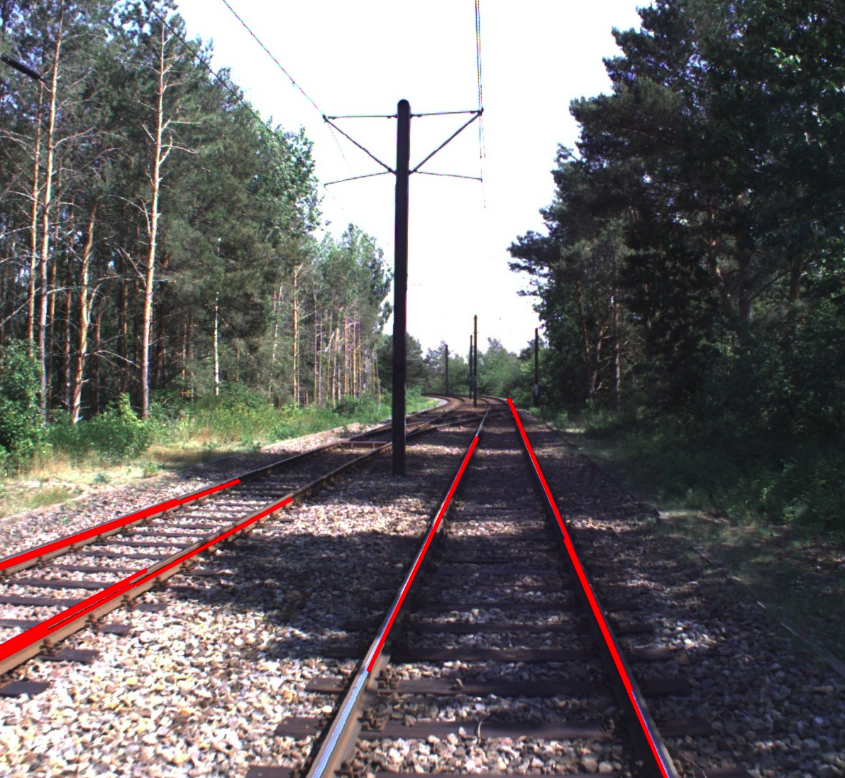
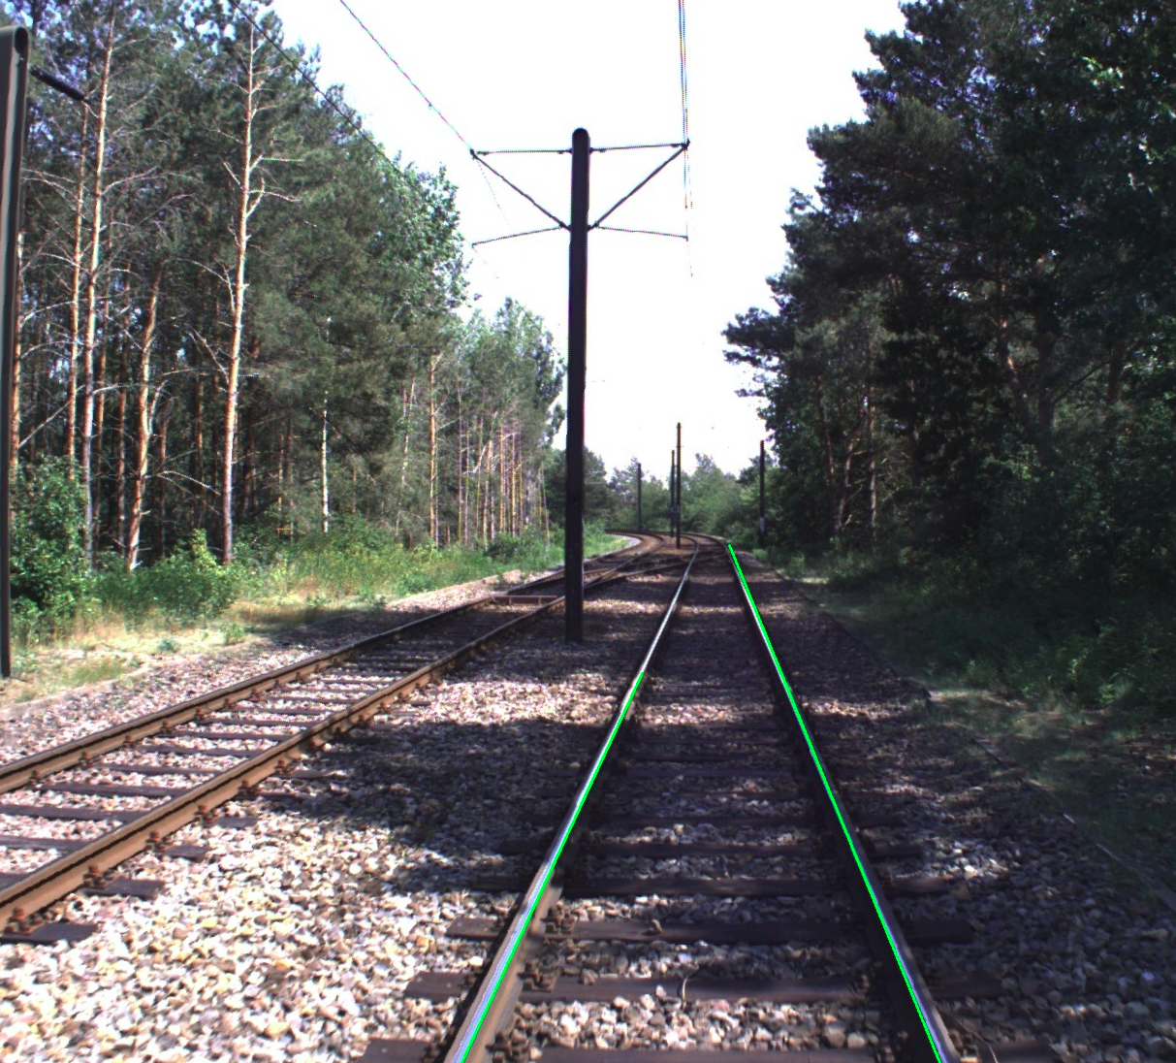
Railway detection
Canny Edge Detection
2) Probabilistic Hough Transform
3) Geometrical prior knowledge to filter for correct lines

Slide 5
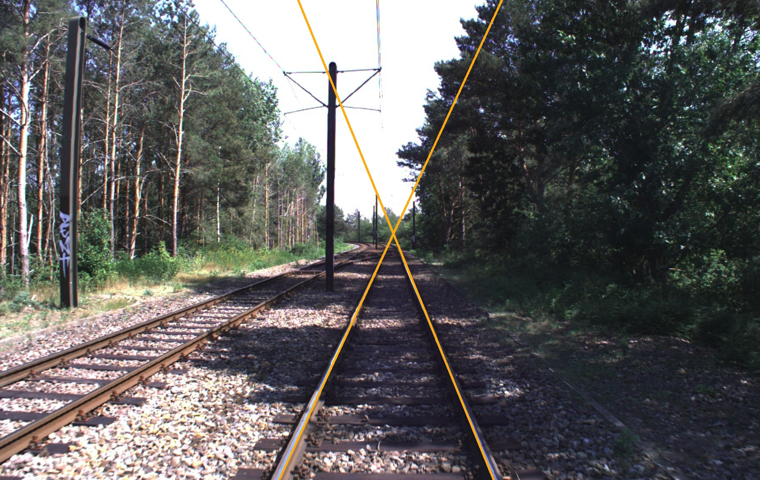
Vanishing point
Projective geometry:
  parallel lines in world converge to one point in image
  Three vanishing points – one per axis
Tracks converge to one horizontal vanishing point
Img 1: Vanishing point at crossection of railway tracks

Slide 6
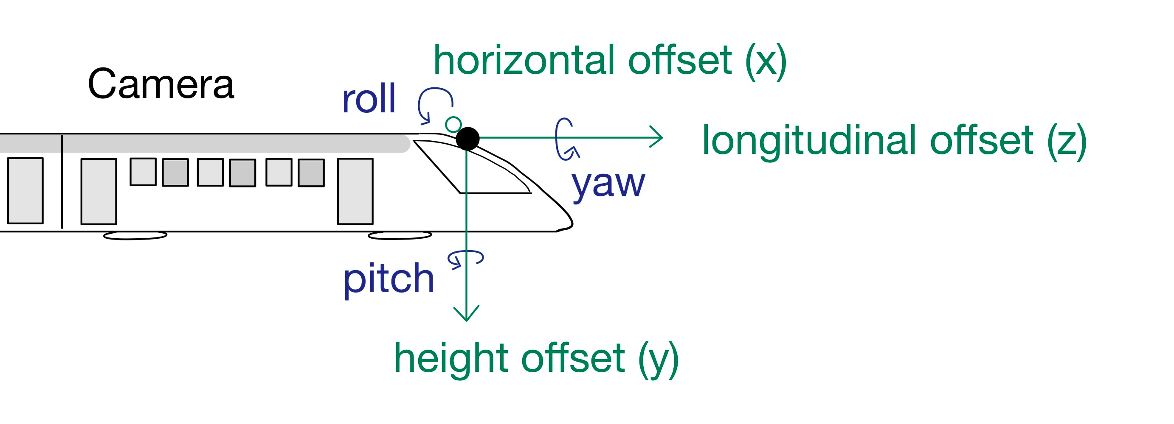
Order of Multistaged Parameter Estimation
Pitch
Yaw
Roll
Img 1: Axes label visualization for camera
Height offset
Horizontal offset
Longitudinal offset

Slide 7
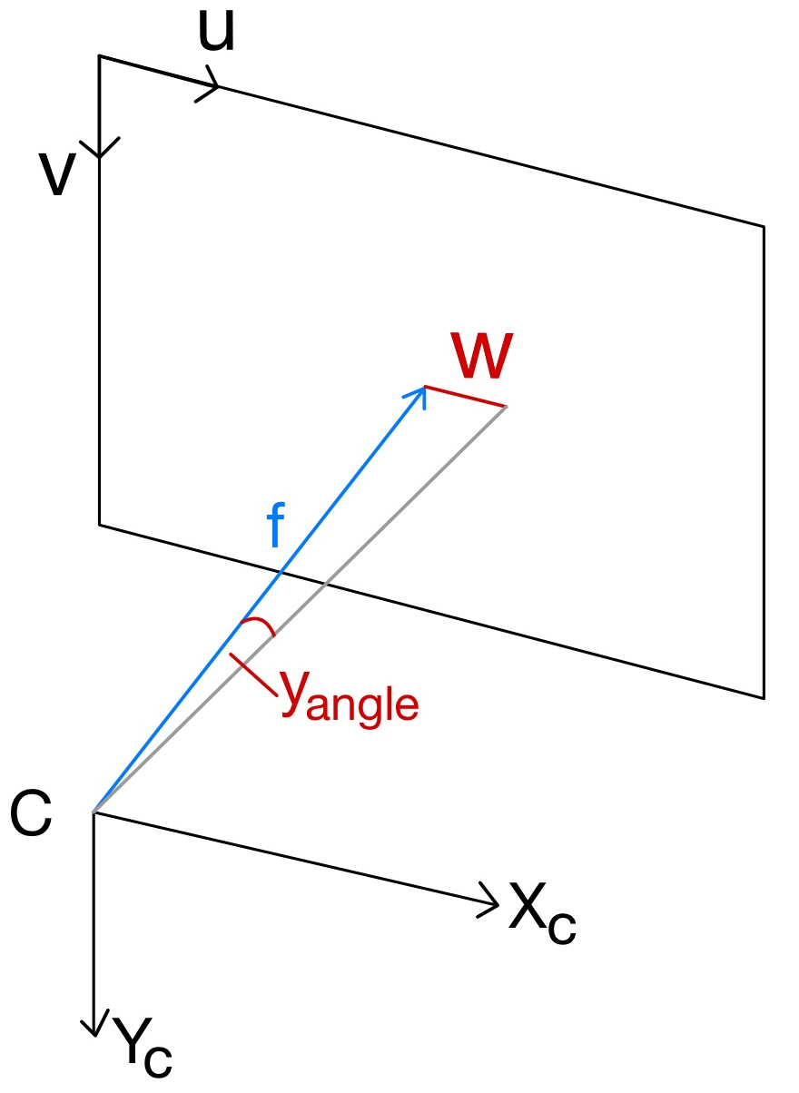
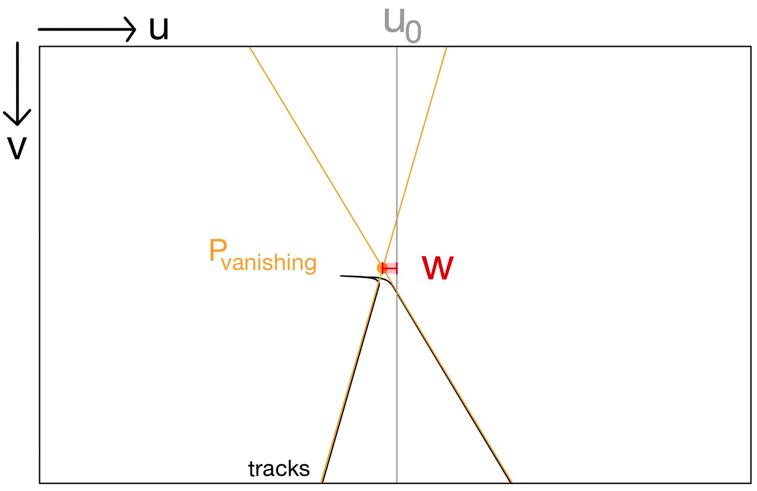
Pitch estimate
Leverage vanishing point
pitch
Img 1: Visualization of vanishing point and offset w
Img 2: Visualization of focal length f and offset w

Slide 8
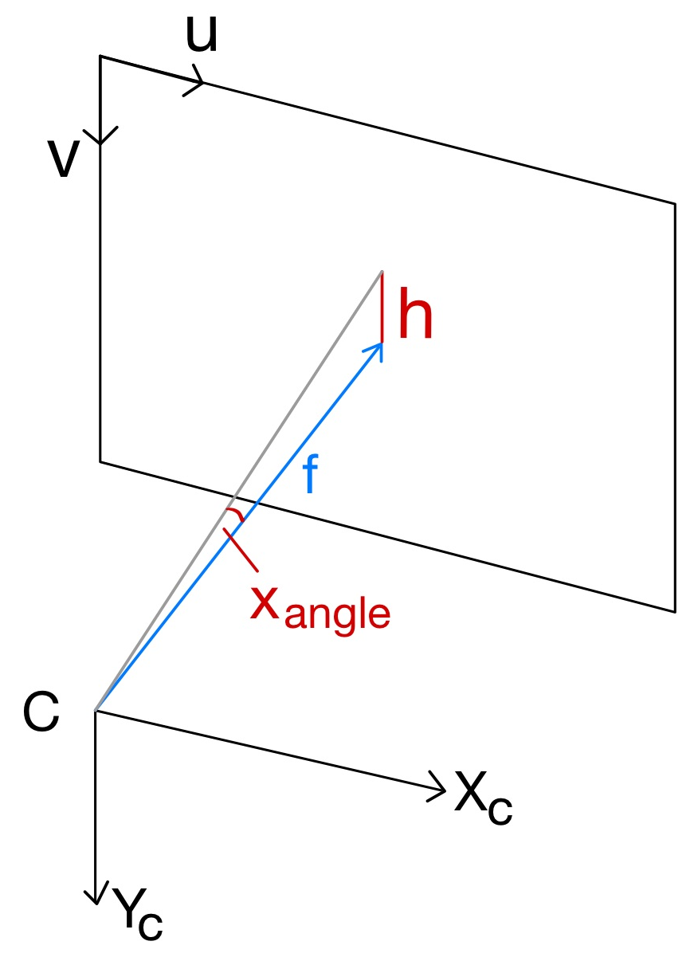
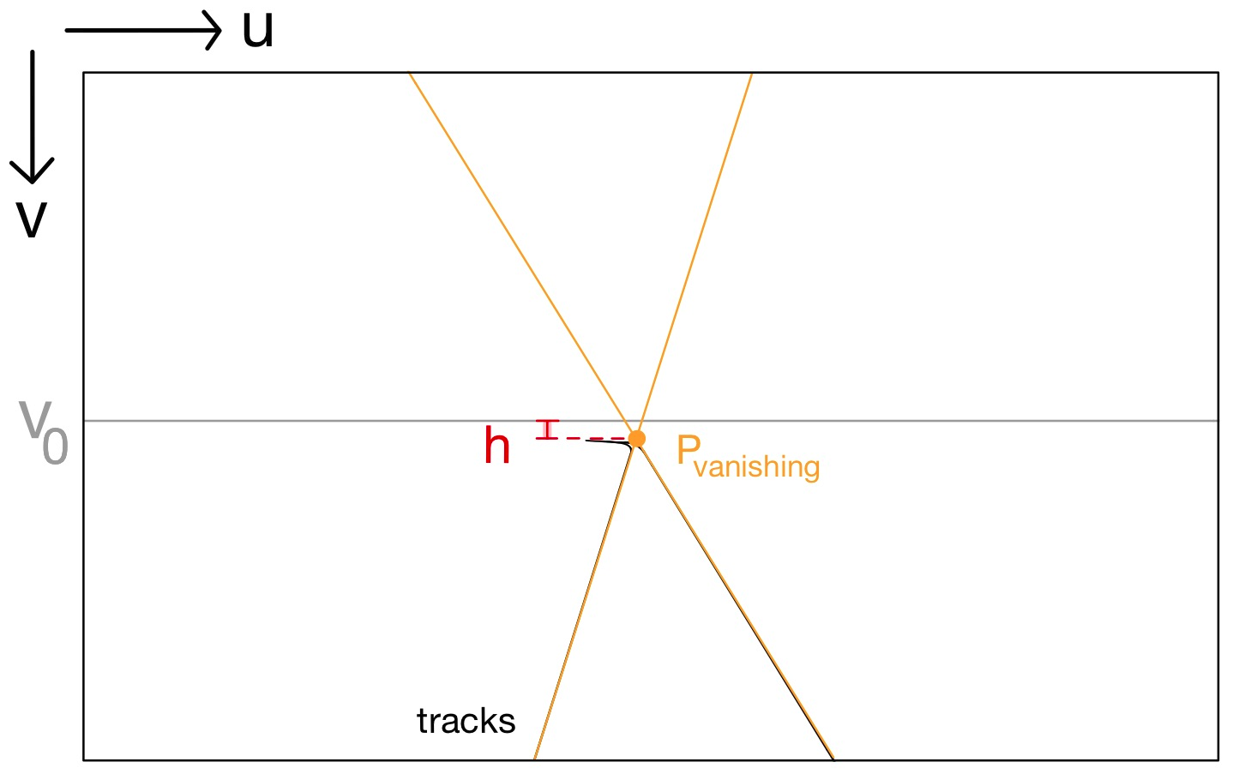
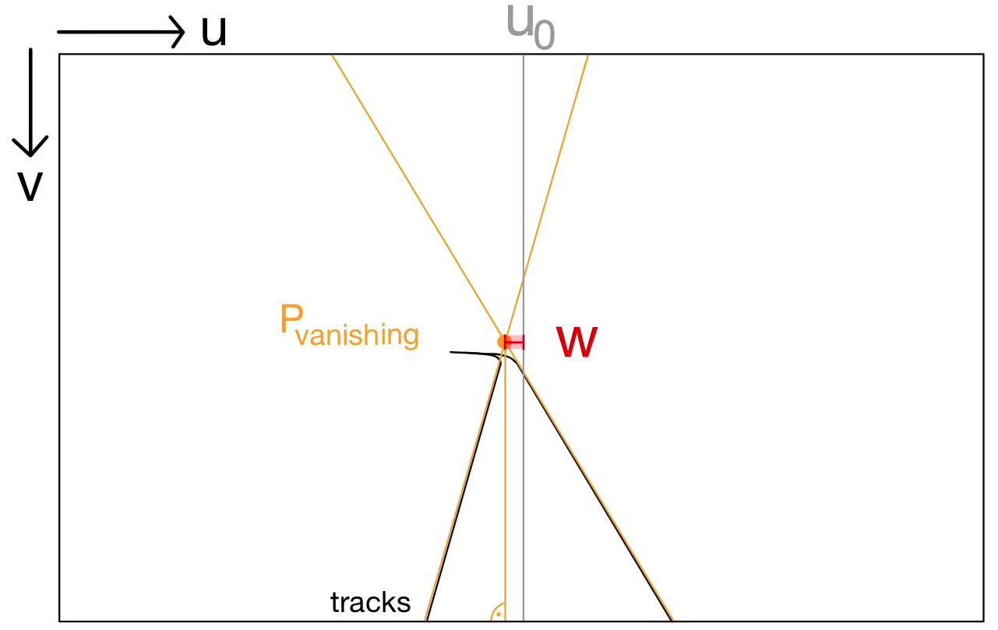
Roll estimate
Leverage vanishing point
roll
Img 1: Visualization of vanishing point and offset h
Img 2: Visualization of focal length f and offset h

Slide 9
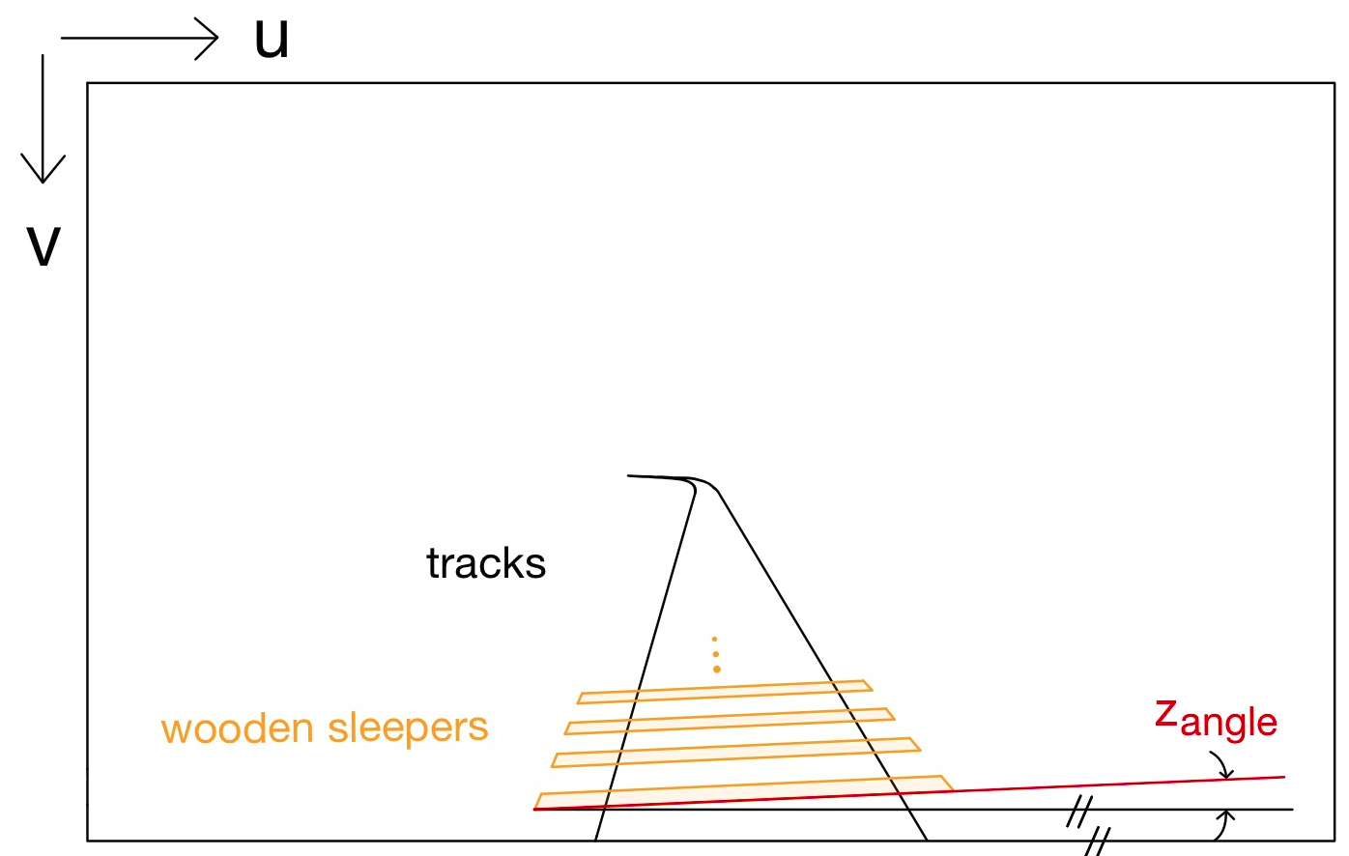
Yaw estimate
Visual detection of wooden sleepers
Compute the angle of their contours (in red)
yaw
Img 1: Visualization of wooden sleepers between the tracks

Slide 10
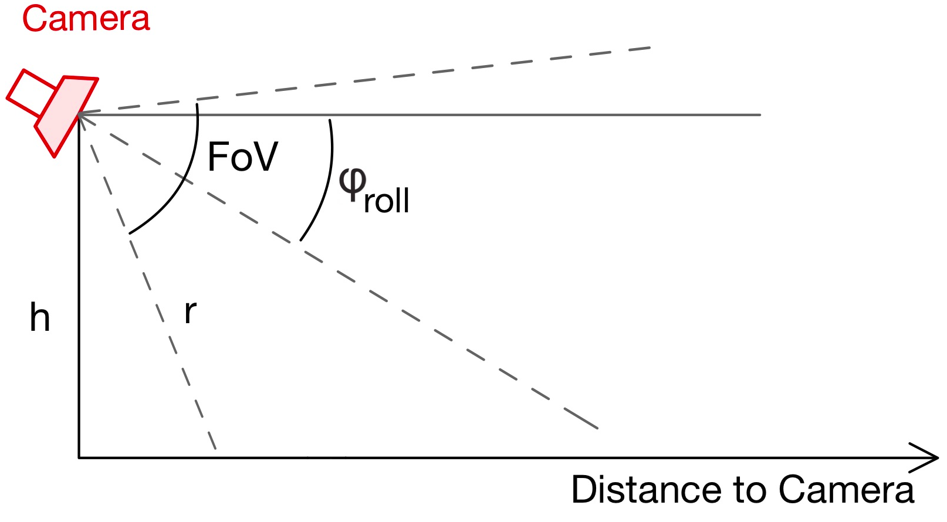
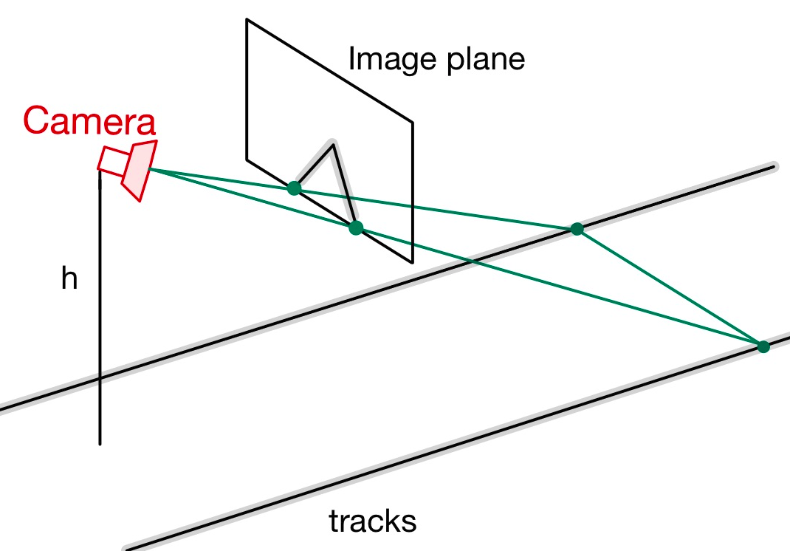
Height offset estimate
Leverage relation of perceived width of tracks to known real world width
Trigonometry to determine height
Img 1: Relation between parameters r, camera roll and height h
Img 2: Visualization of perceived width of tracks at bottom frame

Slide 11
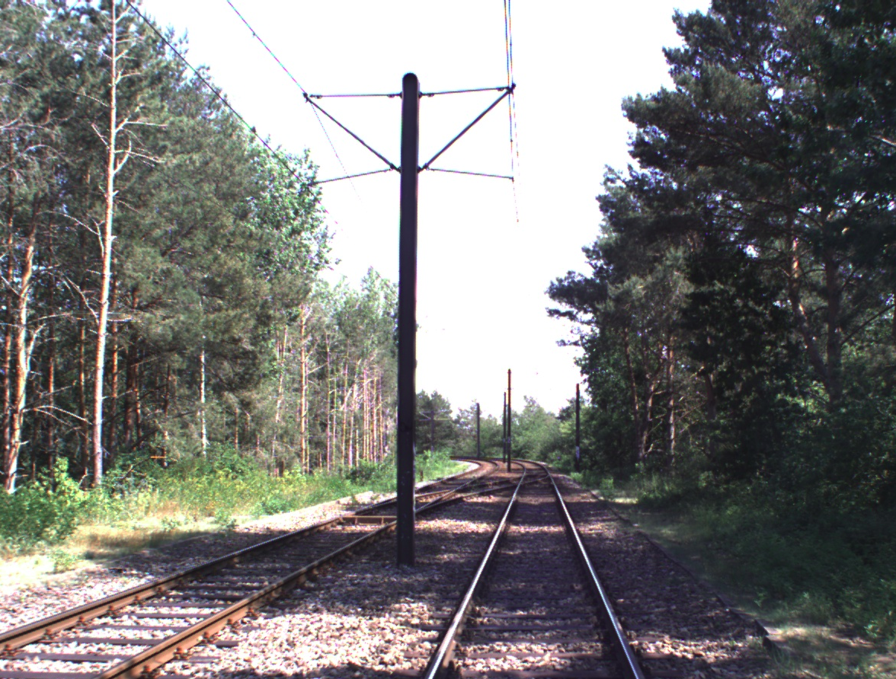
Horizontal and longitudinal offset process
Distinctive landmark detection: electricity pole
Compute depth of bottom pixel (orange)
Convert bottom pixel into GPS frame
Compare visual detection to known location
Img 1: Axes labels visualization
Img 2: Electricity poles visual in image with ground contact point highlighted

Slide 12
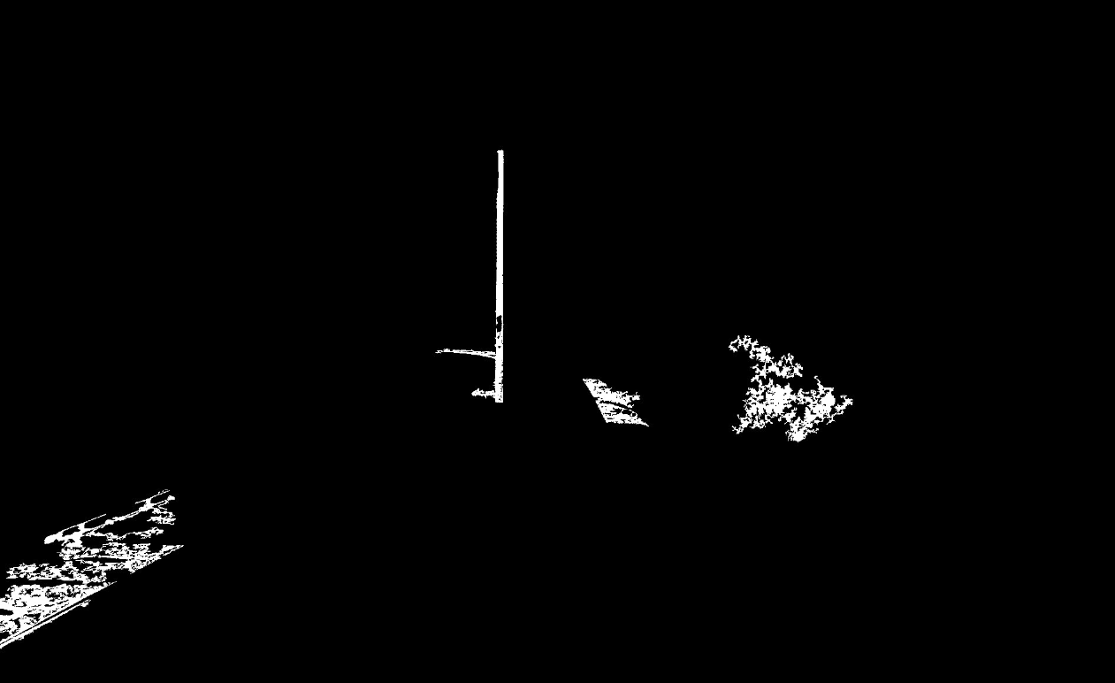
Pole detection
Image processing
  HSV color filters
  Component analysis for large areas
Identify pole as component with vertical line
Ground contact point: lowest pixel of pole
Img 1: Image after color-filtering and component analysis for larger areas

Slide 13
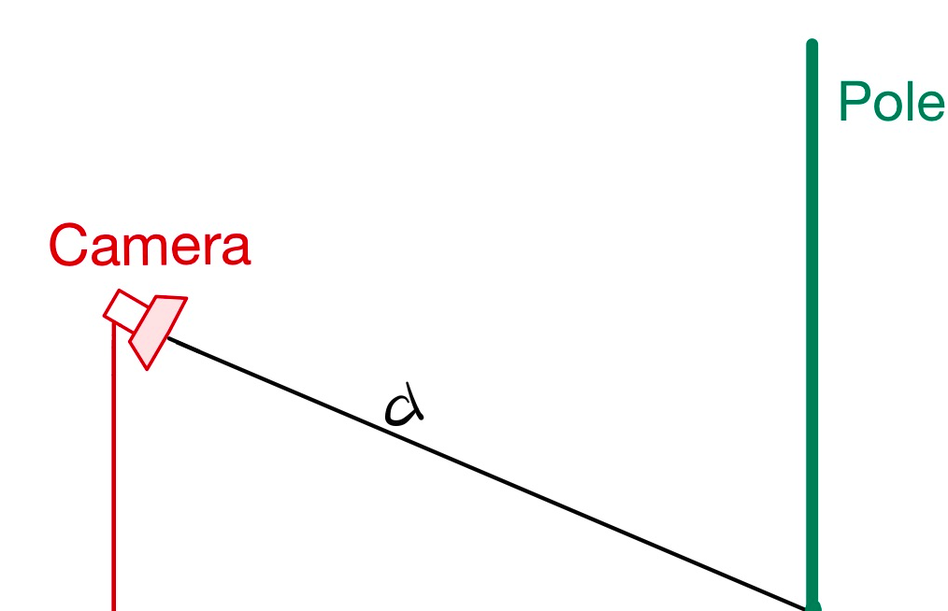
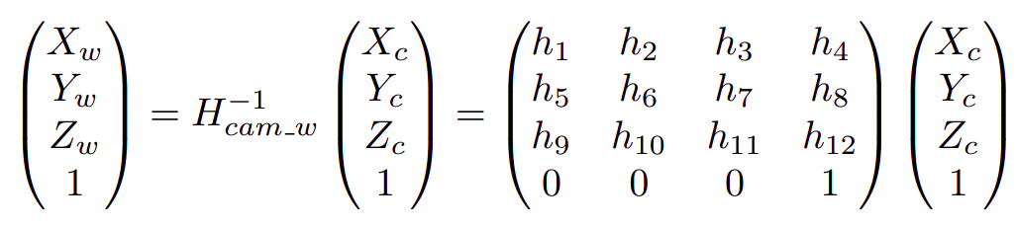
Depth computation¹
Extract equation from homogeneous transformation matrix
Z_{W} = floor elevation of ground contact point
Solve for depth Z_{C}
depth
Img 1: Geometry used to compute depth
Geolocation estimation of target vehicles using image processing and geometric computation, Namazi, 2022

Slide 14
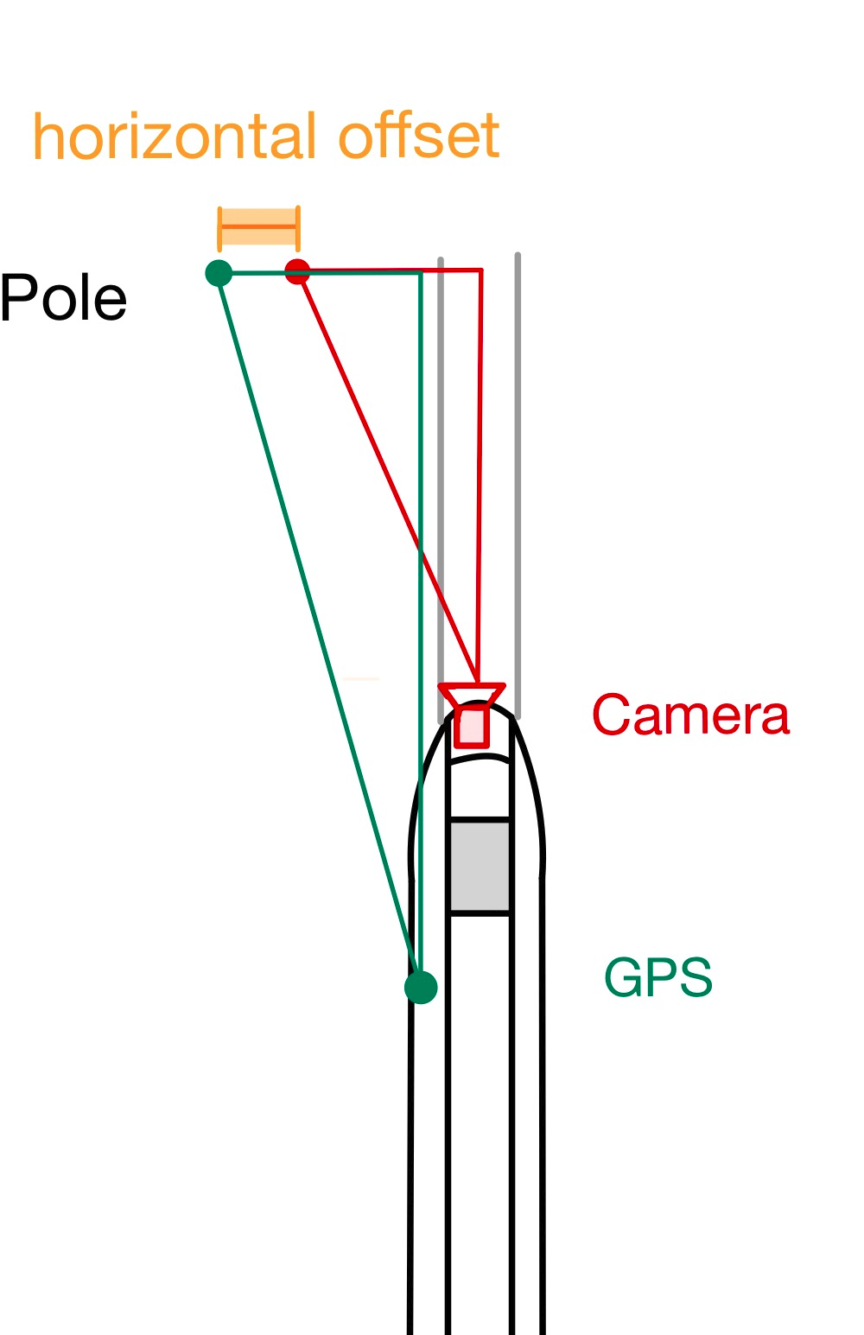
Horizontal offset
Conversion of bottom pixel into GPS frame
Horizontal difference of visual detection to known location
Img 1: Difference in pole perception by camera to known location

Slide 15
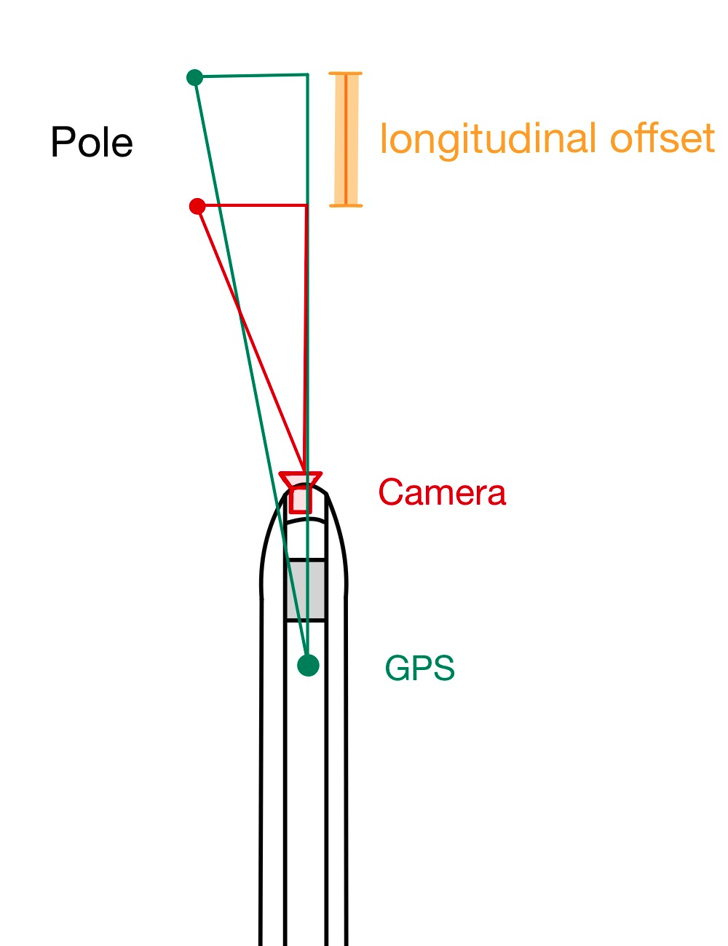
Longitudinal offset
After succesful pole detection and depth computation
Conversion of bottom pixel into GPS frame
Longitudinal difference of visual detection to known location
Img 1: Difference in pole perception by camera to known location

Slide 16
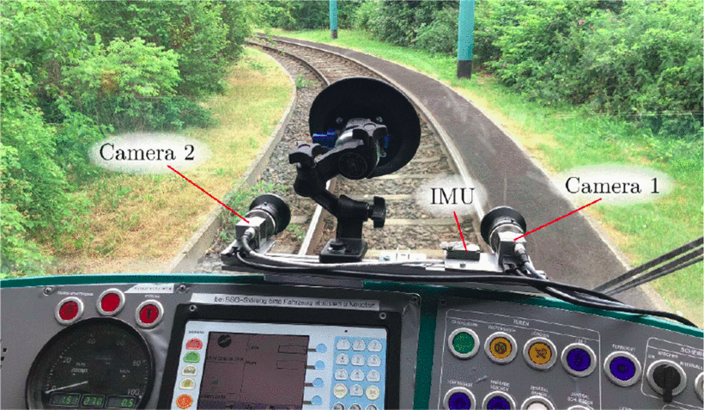
Results
Camera setup at front of train
Comparison of my translational and rotational estimates to prior knowledge
Img 1: Camera setups at the front of the train

Slide 17
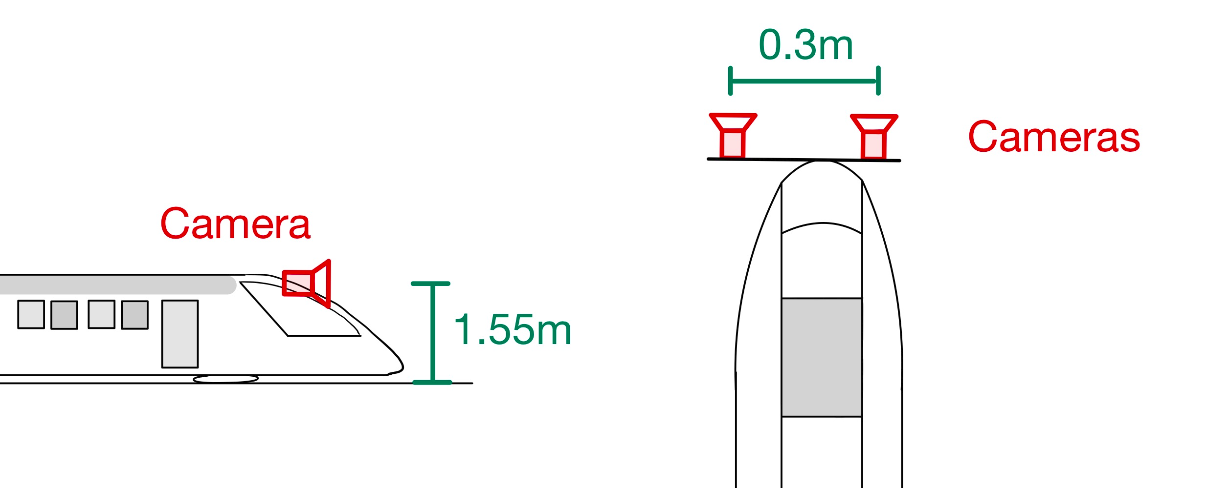
Results
Camera setup at front of train
Comparison of my translational estimates to prior knowledge
Img 1: a) Side view of camera setup in front of train b) Top view of camera setup
Estimate medians wrt GPS | Horizontal offset | Height | Longitudinal offset
Right camera | 1.34m | 1.47m | 12.81m
Left camera | 1.19m | 1.5m | 10.76m

Slide 18
Results
Camera setup at front of train
Comparison of my translational estimates to prior knowledge
Img 1: a) Side view of camera setup in front of train b) Top view of camera setup
Estimate medians wrt GPS | Horizontal offset | Height | Longitudinal offset
Right camera | 1.34m | 1.47m | 12.81m
Left camera | 1.19m | 1.5m | 10.76m
Distance between cameras from my estimates: 0.15m
Ground truth: 0.3m

Slide 19
Results
Camera setup at front of train
Comparison of my translational estimates to prior knowledge
Img 1: a) Side view of camera setup in front of train b) Top view of camera setup
Estimate medians wrt GPS | Horizontal offset | Height | Longitudinal offset
Right camera | 1.34m | 1.47m | 12.81m
Left camera | 1.19m | 1.5m | 10.76m
Ground truth: 1.55m

Slide 20
Results
Camera setup at front of train
Comparison of my translational estimates to prior knowledge
Img 1: a) Side view of camera setup in front of train b) Top view of camera setup
Estimate medians wrt GPS | Horizontal offset | Height | Longitudinal offset
Right camera | 1.34m | 1.47m | 12.81m
Left camera | 1.19m | 1.5m | 10.76m
Ground truth: should have same values

Slide 21
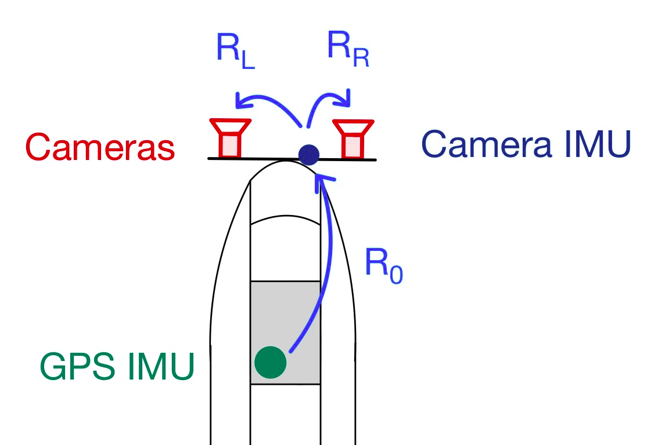
Results
Camera setup at front of train
Comparison of my rotational estimates to:
  values obtained by rotation from GPS IMU to camera via camera IMU
  Relative rotation between cameras
Img 1: Setup with GPS IMU and camera IMU
Estimate medians wrt GPS | Roll | Pitch | Yaw
Right camera | -90.0° | 89.49° | 0.42°
Left camera | -90.02° | 91.58° | -0.65°

Slide 22
Results
Camera setup at front of train
Comparison of my rotational estimates to:
  Euler angles from rotation from GPS IMU to camera
Img 1: Setup with GPS IMU and camera IMU
Estimate medians wrt GPS | Roll | Pitch | Yaw
Right camera | -90.0° | 89.49° | 0.42°
Left camera | -90.02° | 91.58° | -0.65°
Summed difference: 1.1°

Slide 23
Results
Camera setup at front of train
Comparison of my rotational estimates to:
  Euler angles from rotation from GPS IMU to camera
Img 1: Setup with GPS IMU and camera IMU
Estimate medians wrt GPS | Roll | Pitch | Yaw
Right camera | -90.0° | 89.49° | 0.42°
Left camera | -90.02° | 91.58° | -0.65°
Summed difference: 2.44°

Slide 24
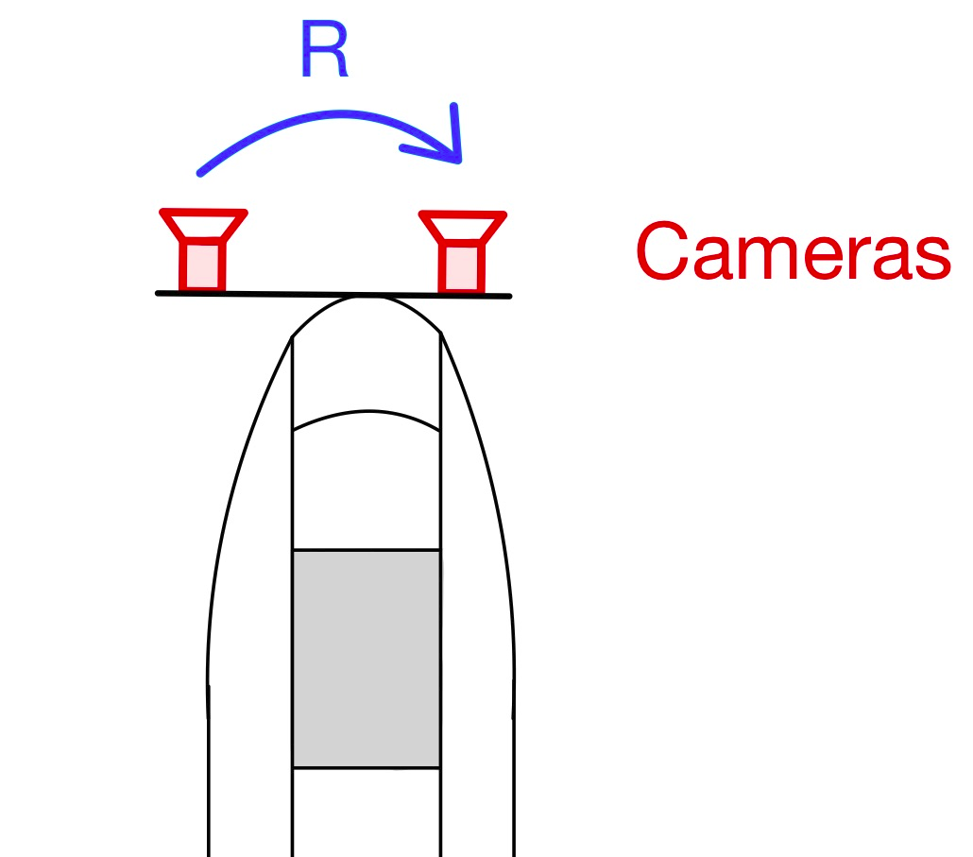
Results
Camera setup at front of train
Comparison of my rotational estimates to:
  Relative rotation between cameras
Img 1: Relative rotation between cameras
Estimate medians wrt GPS | Roll | Pitch | Yaw
Right camera | -90.0° | 89.49° | 0.42°
Left camera | -90.02° | 91.58° | -0.65°
Summed difference: 0.46°

Slide 25
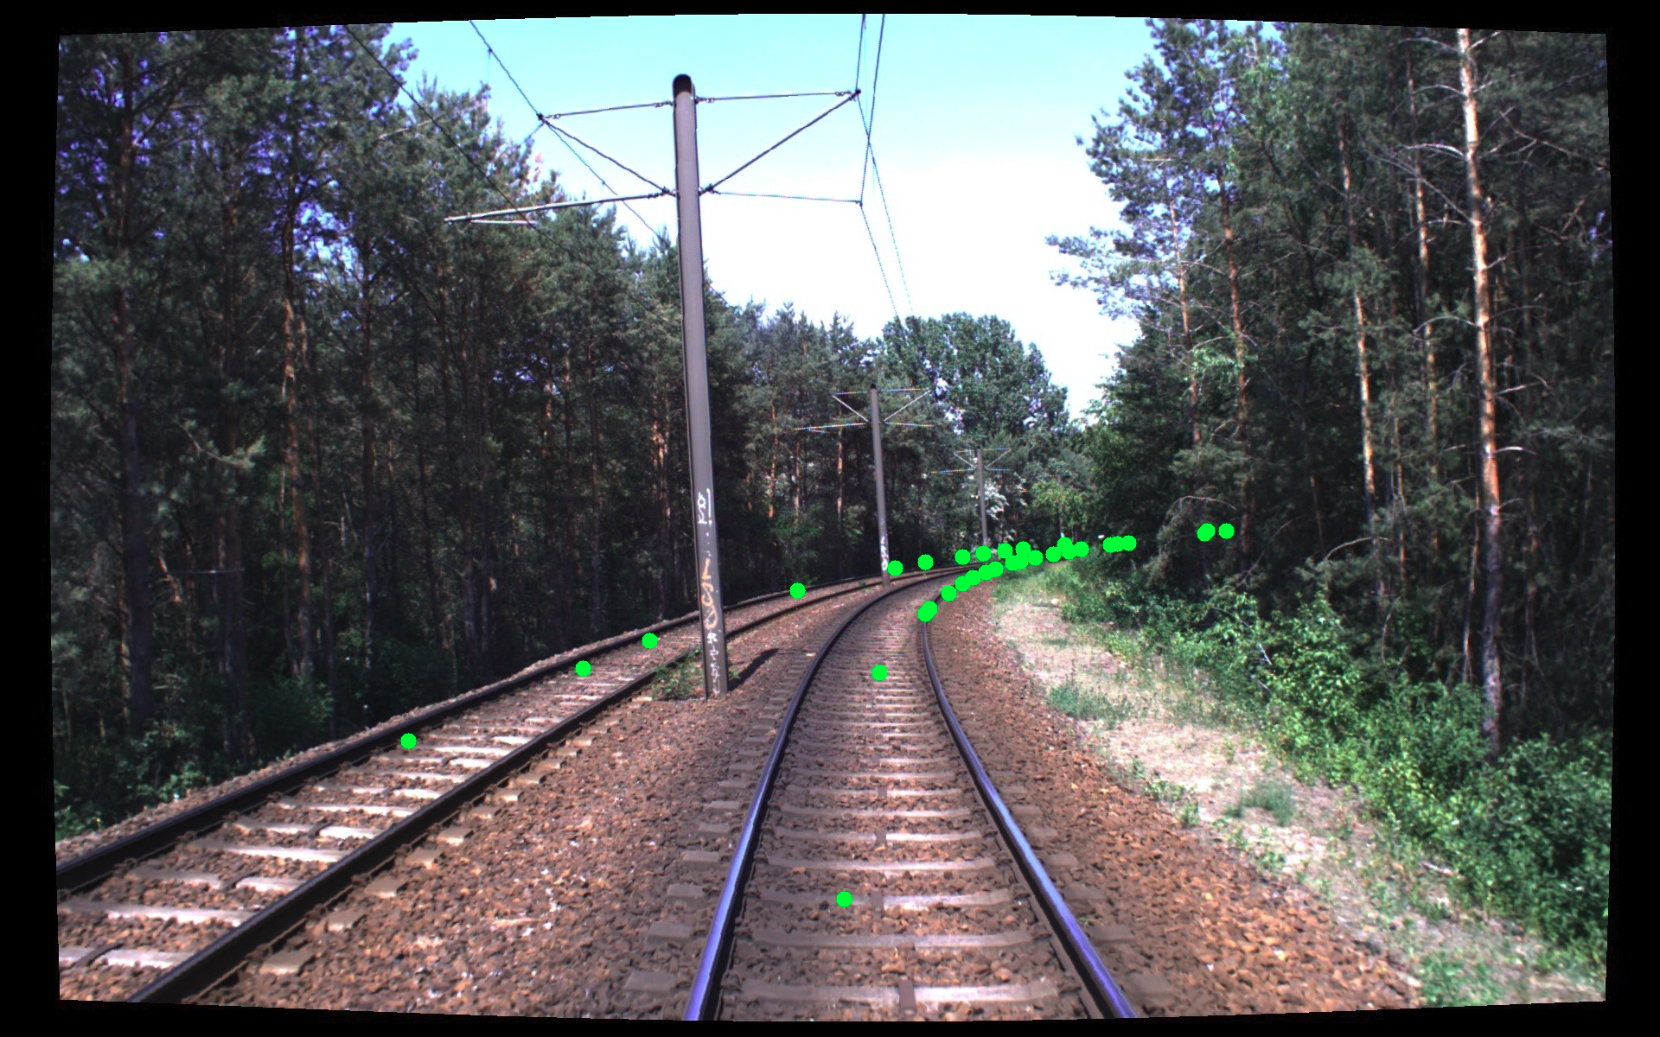
Results
Projection of railway track nodes from OpenStreetMap into image frames:
Left camera:
Right camera:

Slide 26
Results
Projection of railway track nodes from OpenStreetMap into image frames:
Left camera:
Right camera:

Slide 27
Conclusion
Importance of accurate angles
Dependencies have large impact
  Camera height
  Horizontal offset
  Longitudinal offset
Automate key frame selection with e.g. Schneider ¹
Visual-inertial Self-calibration on Informative Motion Segments, Schneider et al, 2017

Slide 28
Questions?
Nicolina Spiegelhalter
spiegeln@ethz.ch

Slide 29


Height estimate detail
Leveraging
  Camera pitch: -x-rotation
  opening angle of camera alpha = 46.4°
  normed width of tracks G= 1.435m
  perceived width of tracks in pixel w₀: 542 pixel
Combination of following equations¹ to find h:
Img 1: Relation between parameters r, camera roll and height h
r
r = (g² + h²)^{1/2}
Img 2: Visualization of perceived width of tracks at bottom frame
Source 1: Vision-Based Track Estimation and Turnout Detection Using Recursive Estimation, Ross 2010

Slide 30
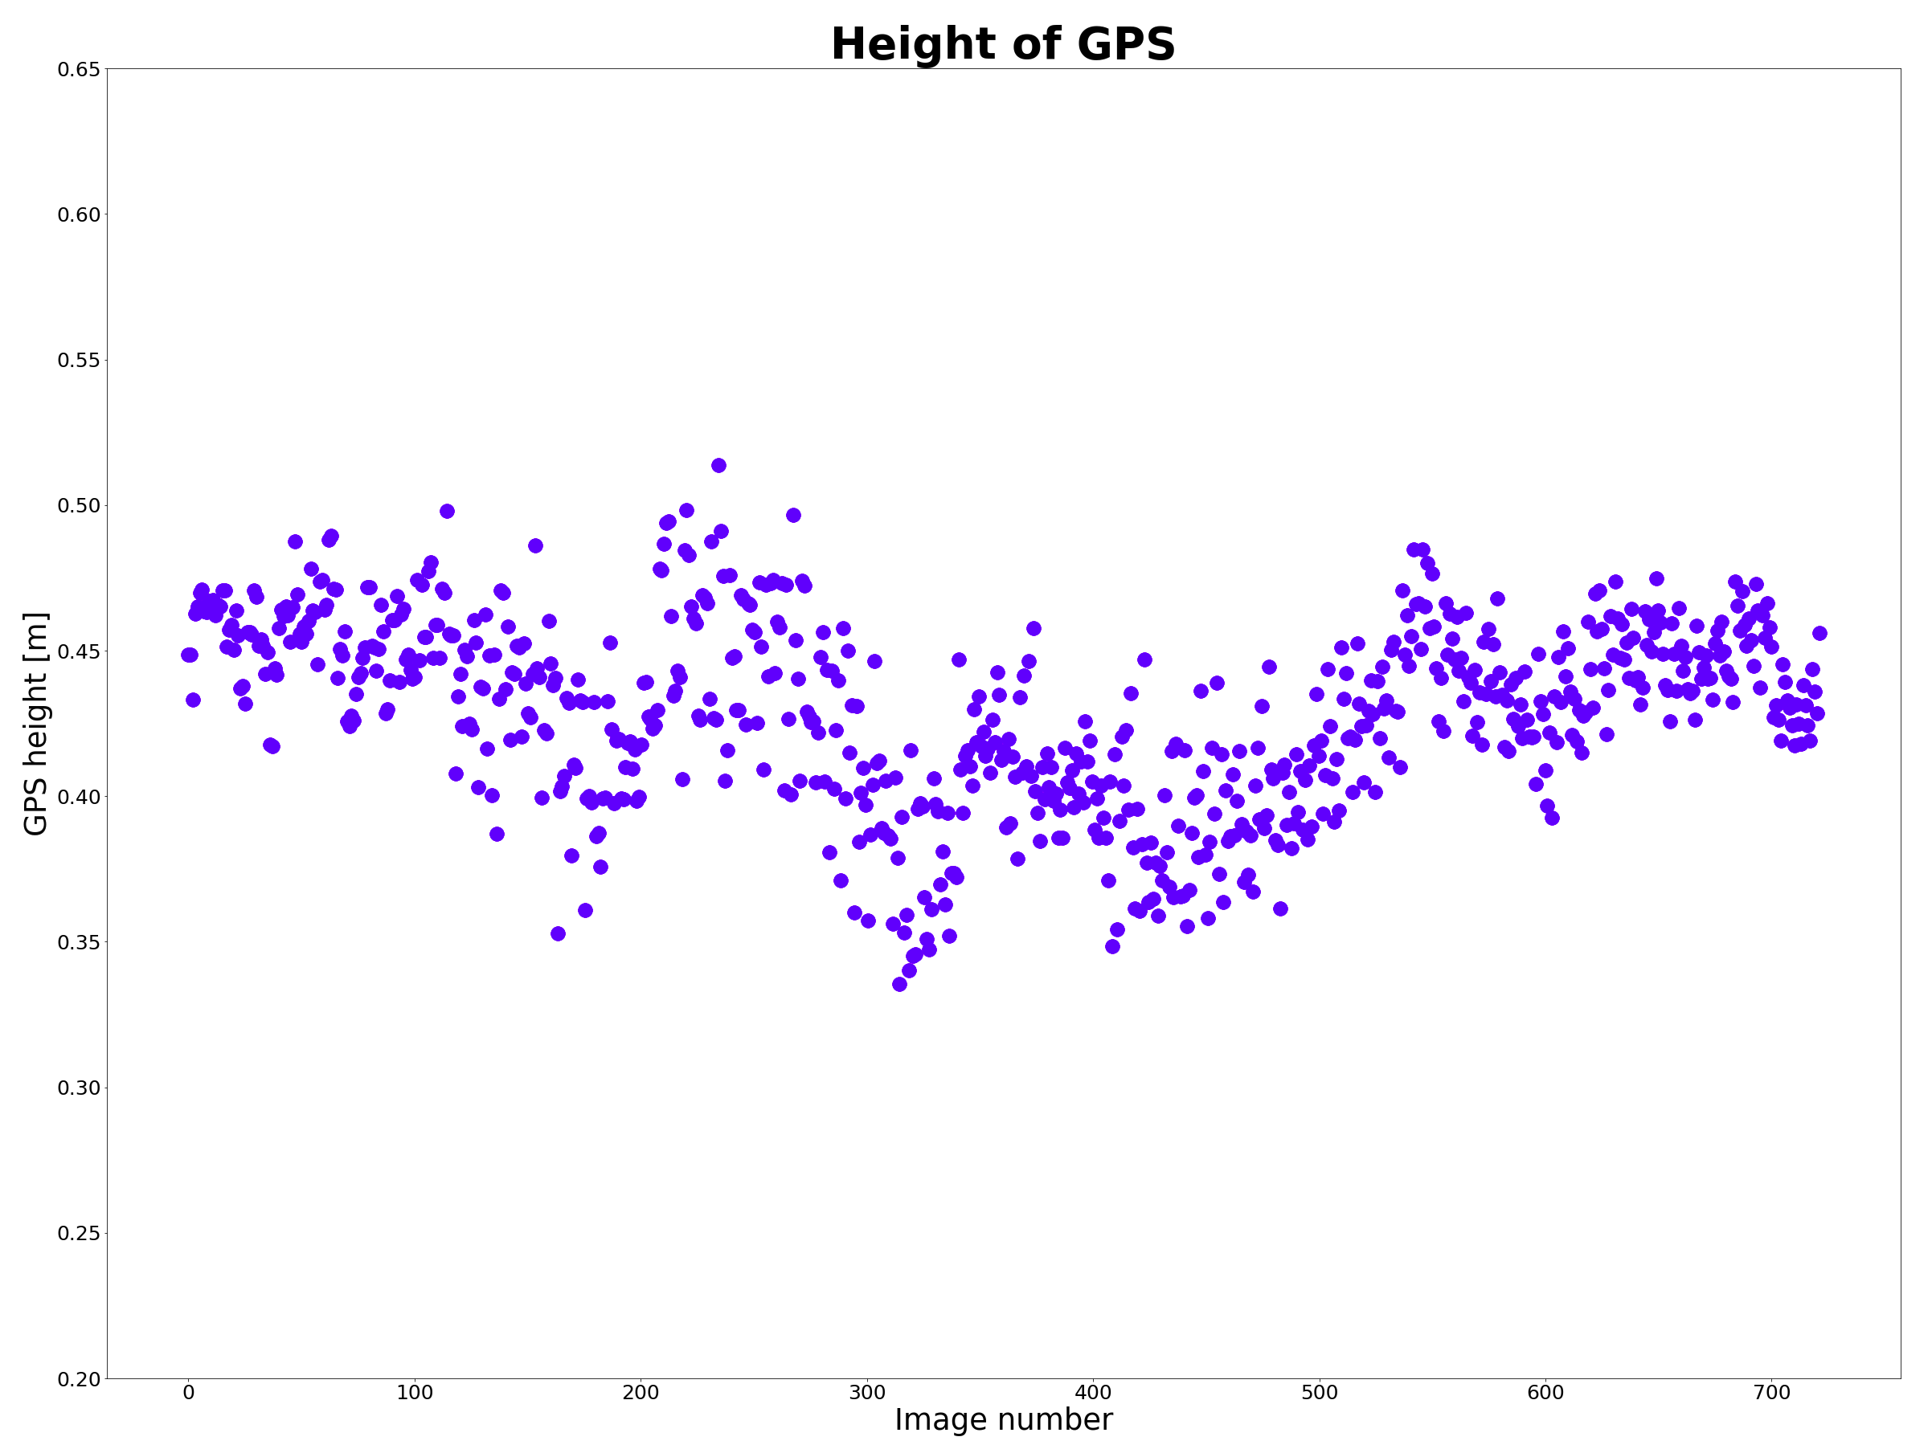
GPS height consistency
Consistency of RTK-GPS height with geobrooker.geobasis.de for elevation information:
  Median: 0.432
  Standard deviation: 0.03

Slide 31
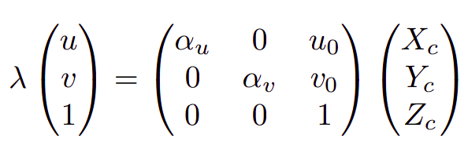
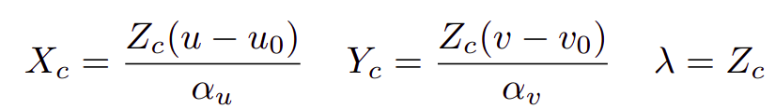

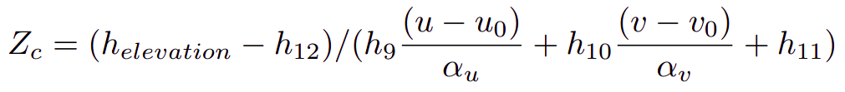
Horizontal and longitudinal offset detail
Express X_{C}, Y_{C} dependent of Z_{C}:
Use H_{w_cam} including estimates, substitute X_{C}, Y_{C}, Z_{C} for upper definitions.
Replace Z_{w} for known elevation at pole location, take third row and solve for Z_{C}:

