Slide 1
Face Mask Detection
CSC 481
Eric Vistnes

Slide 2



Introduction
Graduating Masters Student in Data Science
Full-time software Engineer at manufacturing company
Undergraduate in Economics; and Computer Science

Slide 3
Goals
Train Model
Locate Faces
Pass in Group Photo
Create a model based on VGGNet, a Convolutional Neural Network (CNN) with 13 convolutional layers and 3 fully connected layers
Smaller 3x3 filters
Use the Haar Cascade database of facial logic
Convert image to grayscale
Widen ROI width and height to encapsulate more of face
Implement the Facial Detector to pass individual faces to model to predict
Draw on red or green boxes to indicate presence of face masks

Slide 4
Literature Review
Facial Recognition System for People with and without Face Mask in Times of the COVID-19 Pandemic.
Talahua JS, Buele J, Calvopiña P, Varela-Aldás J.
Presents a highly accurate model with 99.64% accuracy. However, only works on the 10 people it was extensively made for. Can identify these people with or without a mask.
Still struggles if faces are at an angle
How to Correctly Detect Face-Masks for COVID-19 from Visual Information?
Batagelj B, Peer P, Štruc V, Dobrišek S.
Attempts to classify if face masks are not only worn but worn properly. The models achieve 97-98.6% accuracy in classification
However, the authors note that the face detection system is not as effective
73-93% accurate

Slide 5
The Model
VGGNet is a format with only 3x3 convolutions and layers are stacked deeper in the network prior to pooling
3 convolutional layers and 2 fully connected layers
Trained on images of single faces with or without masks
75 epochs
Batch size 32

Slide 6
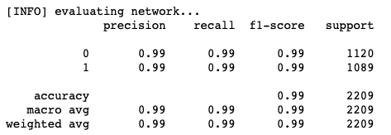
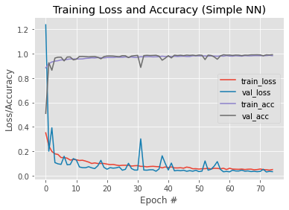
Results
Validation accuracy of 99.15%
Includes photos with different angles, lightings, and picture quality
Is this a difficult problem?
Overall, very performative

Slide 7
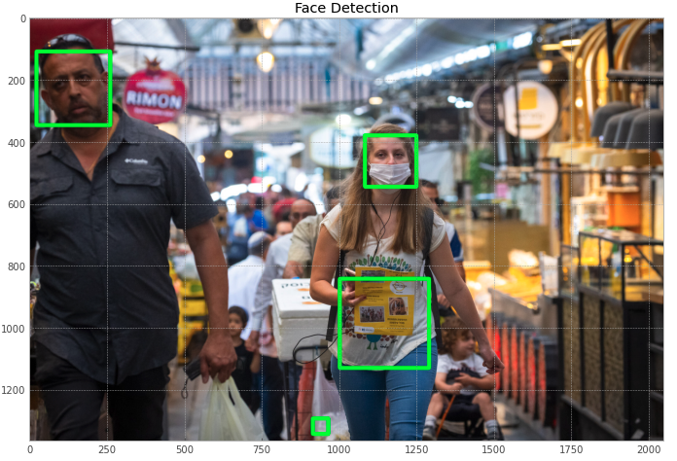
Face Detection

Slide 8
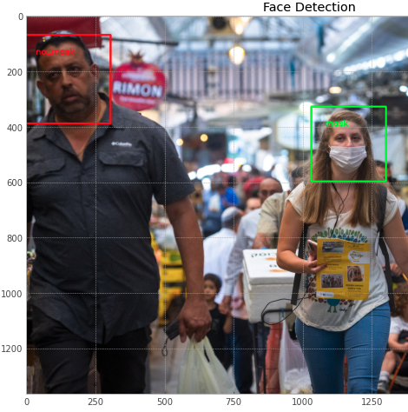

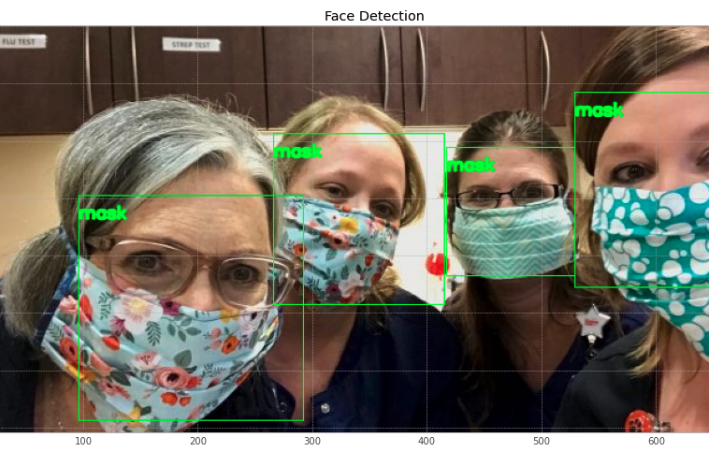
Real Photos
Improve the ROI Face Detection specifications for each image
Given a large box around a face, proves accurate to manual checks
Needed to try multiple images so they were all facing forward
Expanding the ROI size vastly improves performance

Slide 9
Conclusion
Common issue is Face Detection/Localization with face masks
Most models of a single face are trivial
Need new ROI face detectors for face masks
This is a project in and of itself
Can work well as a model of single faces, such as Face ID or face scanners

Slide 10
References
Talahua JS, Buele J, Calvopiña P, Varela-Aldás J. Facial Recognition System for People with and without Face Mask in Times of the COVID-19 Pandemic. Sustainability. 2021; 13(12):6900. https://doi.org/10.3390/su13126900
Batagelj B, Peer P, Štruc V, Dobrišek S. How to Correctly Detect Face-Masks for COVID-19 from Visual Information? Applied Sciences. 2021; 11(5):2070. https://doi.org/10.3390/app11052070

