Slide 1



Slide 2


WELCOME TO
Totem Island
Experience the magic and wonder of the native Indian culture of the Pacific Northwest
Created by
Eric Van Thorre

Slide 3
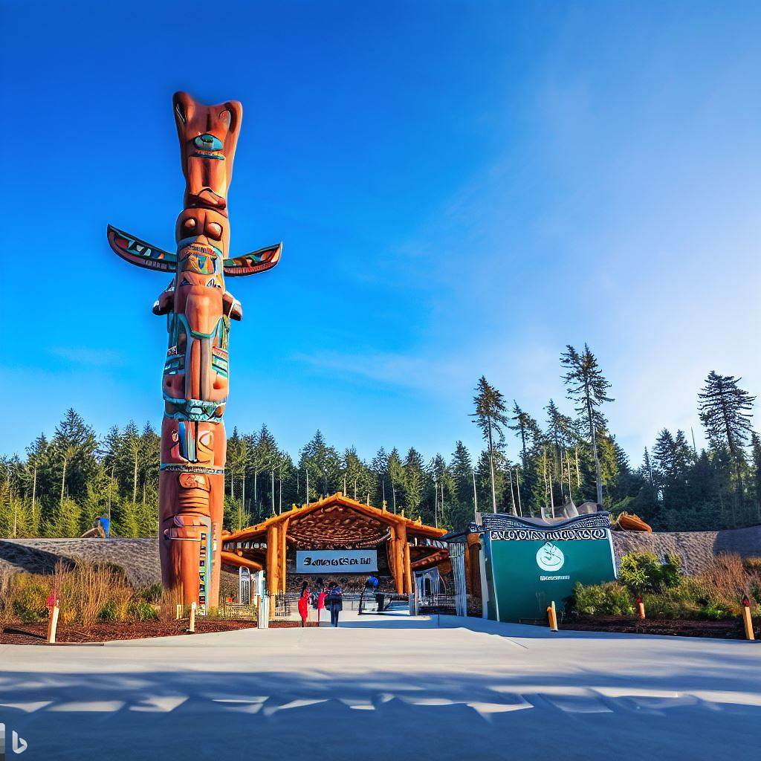
Come on in…
Totem Island is a new manmade island park that celebrates the rich and vibrant culture of the native Indians of the Pacific Northwest. You will be immersed in a series of experiences that showcase the native Indian art, history, and spirituality, as well as enjoy the scenic views of the water and nature. Totem Island is a destination that will enchant your senses, inspire your imagination, and connect you to a different way of living

Slide 4
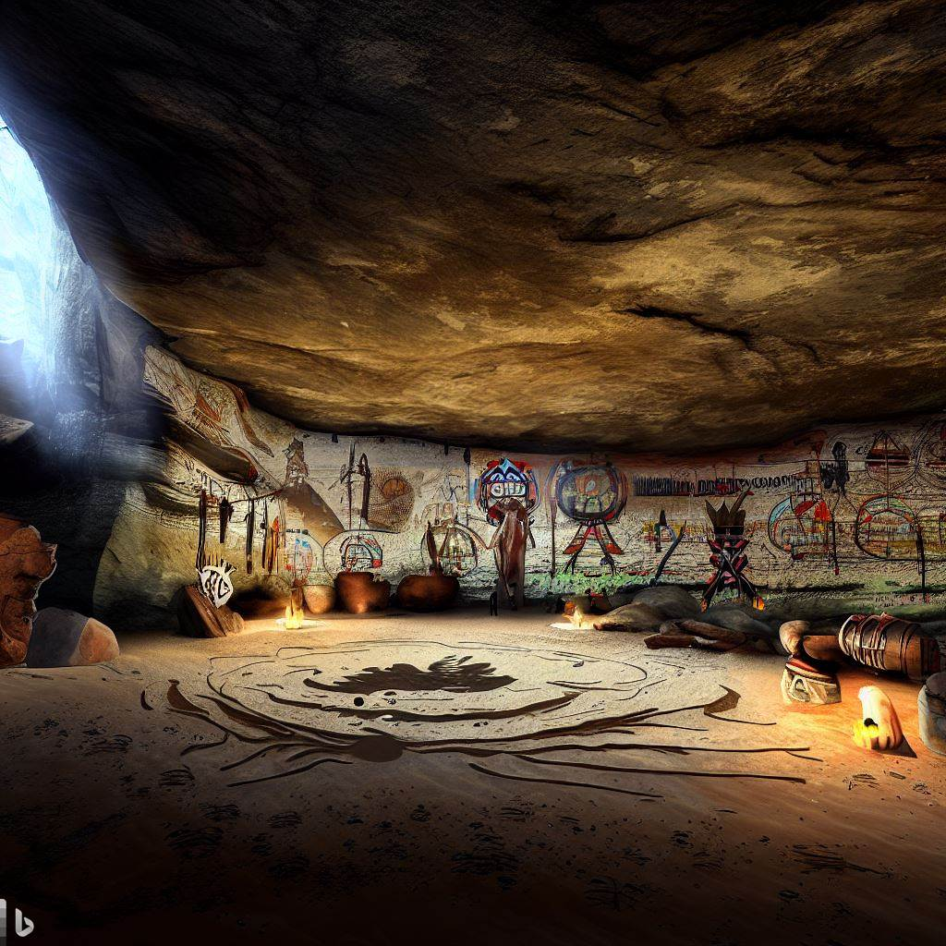
The Spirit Cave
The spirit cave is a dark and mysterious place that is hidden under the island park. It is where the native Indians go to communicate with their ancestors and their spirit guides. The spirit cave is filled with candles, incense, and offerings that create a sacred and mystical atmosphere. You can enter the spirit cave and experience a spiritual journey that will challenge your senses and your beliefs. You will also learn about the native Indian’s worldview and their connection to the spirit world.

Slide 5
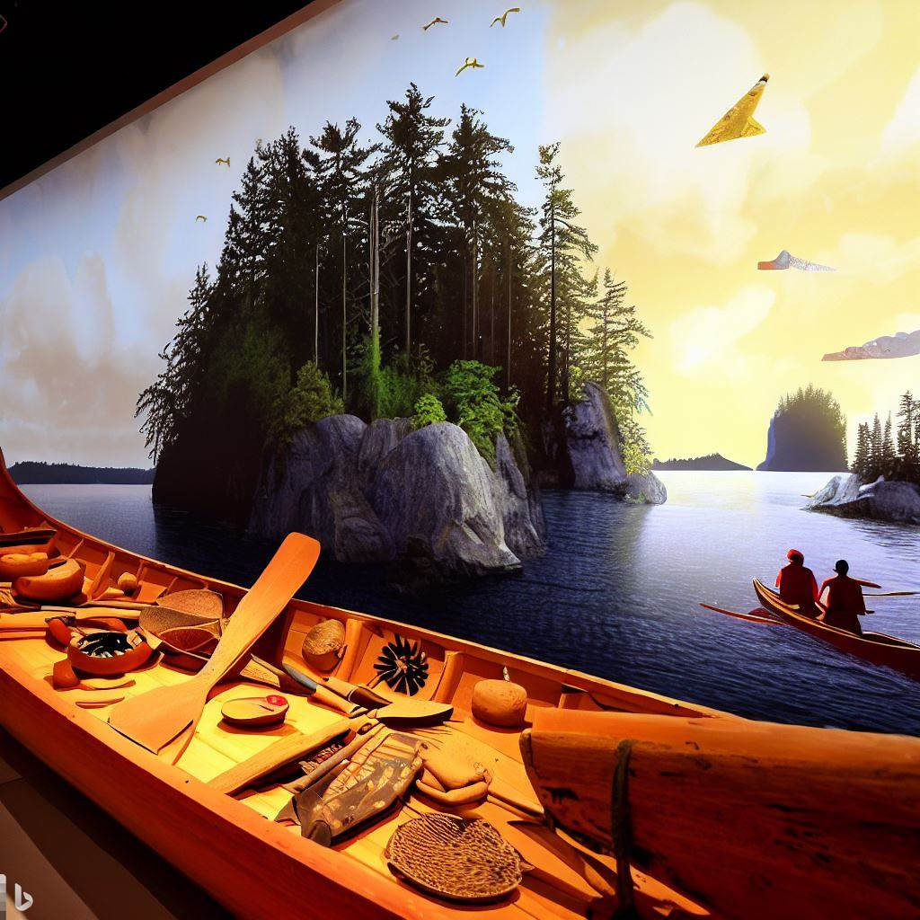
The Canoe
The canoe is a symbol of the native Indian’s connection to the water and the land. It is a vessel that they use for fishing, hunting, trading, and traveling. The canoe is made of cedar wood and has a sleek and elegant design. You can ride on a canoe and explore the island park from a different perspective, as well as enjoy the scenic views of the water and nature. You will also see some native Indian artifacts and objects along the way, such as totems, boats, masks, and more

Slide 6

The Menu
The island park offers some delicious food options that embrace the theme of the destination and surprise and delight people. You can enjoy some molecular cuisine dishes that celebrate the native Indian culture of the Pacific Northwest. Molecular cuisine is a style of cooking that relies on chemistry to create unexpected dishes that push the boundaries of traditional food

Slide 7
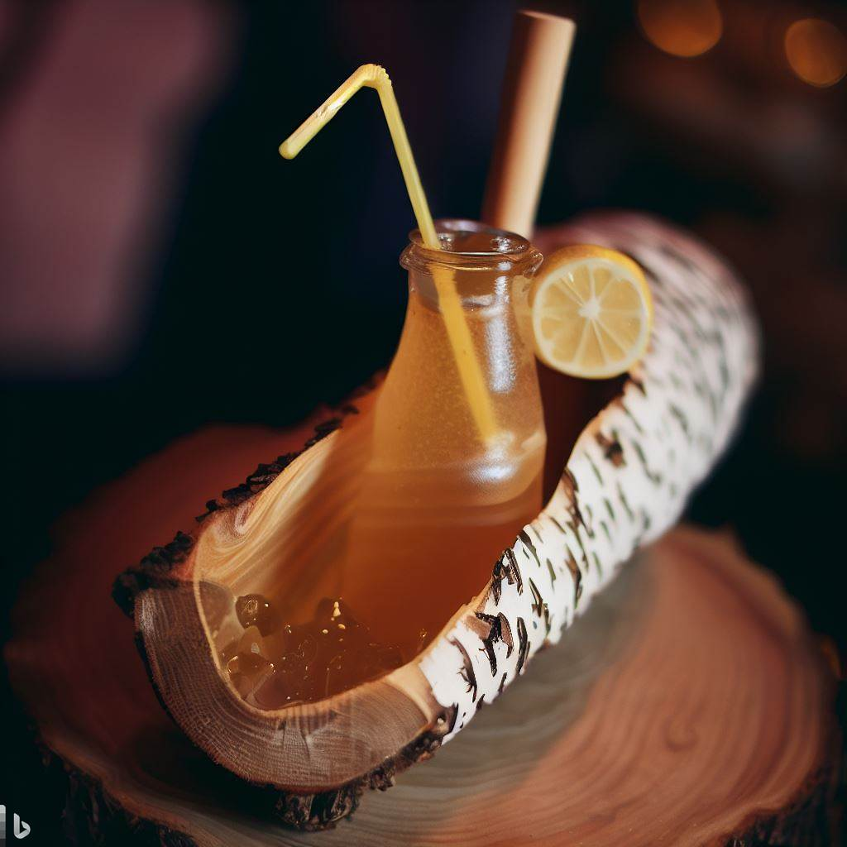
Signature Drink
Birch Sap Honey Lemonade A refreshing and natural drink made of birch sap, honey, and lemon. Birch sap is a traditional beverage of the native Indians of the Pacific Northwest, who tapped birch trees to collect the sweet and nutritious liquid. Honey and lemon add more flavor and health benefits to the drink. The drink is served in a hollowed-out birch log with a straw, creating a rustic and unique presentation.

Slide 8
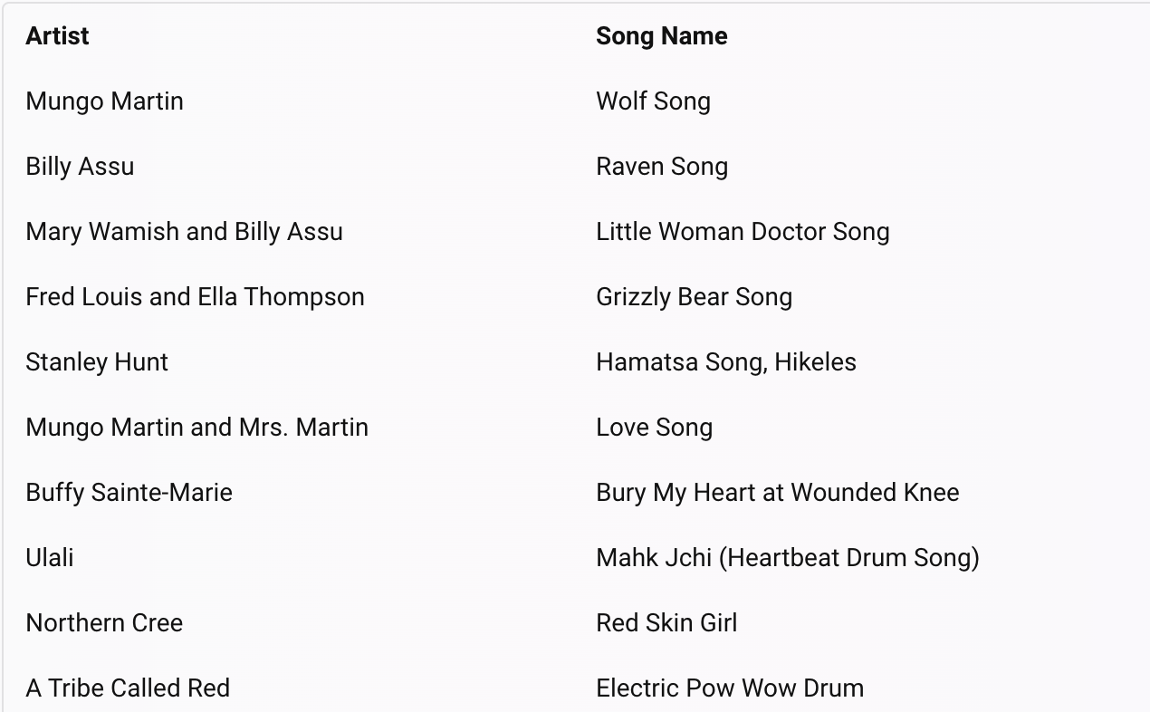
Musical Playlist

Slide 9
Eric Van Thorre
To Do
Slide is optional!
1 Minute
Put in the name of your Destination where it says Destination Name
Replace your name under the Created by
Delete and remove this sticky note
Created by
Eric Van Thorre

Slide 10



