Slide 1
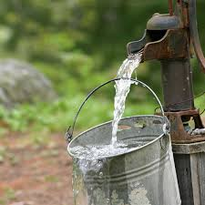
TANZANIA WATER WELL ANALYSIS
BY : ERIC W. NJERU
TM: SAMUEL KARU

Slide 2

Population : 67,438,106
Tanzania’s Profile
Population 67,438,106(2023)
39% of Households lack safe water

Slide 3
Table of Contents
Project Overview
Business Problem
Project Objective
Data Understanding
Modeling
Recommendation
Next Step

Slide 4
Project Overview
The project is aimed to develop a predictive classifier for assessing the condition of water wells in Tanzania to address the issue of limited access to clean water. This project serves the dual purpose of assisting NGOs in locating wells requiring repair and providing insights to the Tanzanian government for more effective well construction.

Slide 5
Business Problem
There is inadequate access to clean water in Tanzania due to the poor condition of water wells. There is need for a predictive solutions to identify wells in need of repair and influence future well construction.

Slide 6
Objectives
Predict the state of Tanzanian water wells to help NGOs locate repair-worthy wells.
Assist the Tanzanian government in improving future well construction.

Slide 7
Data Understanding..
The data was collected from a sample of 59,400 wells distributed across Tanzania
Features utilized included : construction_year, basin, region, extraction_type_class, management_group, payment, water_quality, quantity_group, source_type, source_class and waterpoint_type

Slide 8
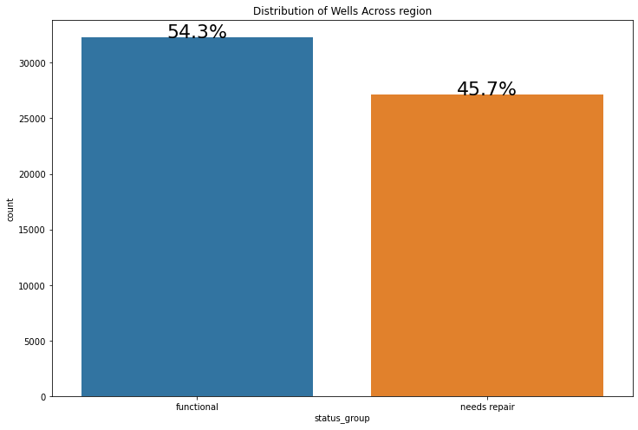
Dependent Variable
The status_group was engineered to functional wells and those that needed repairs

Slide 9
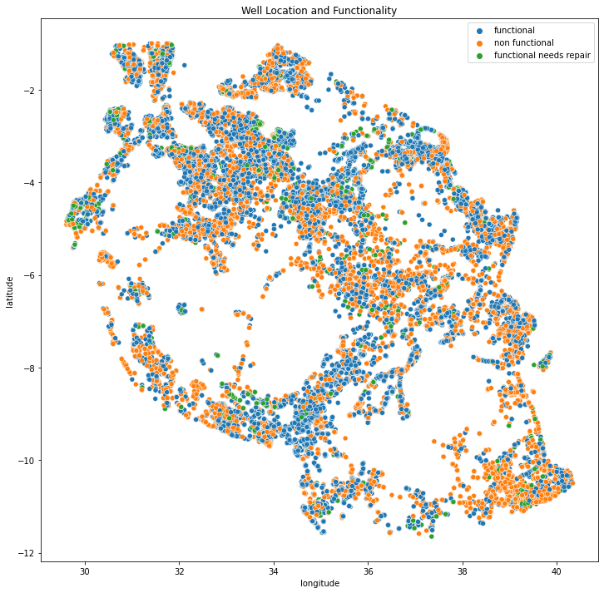
Well Location and Functionality
The wells locations are as per the map. Majority of the wells are located at the upper half of the map

Slide 10
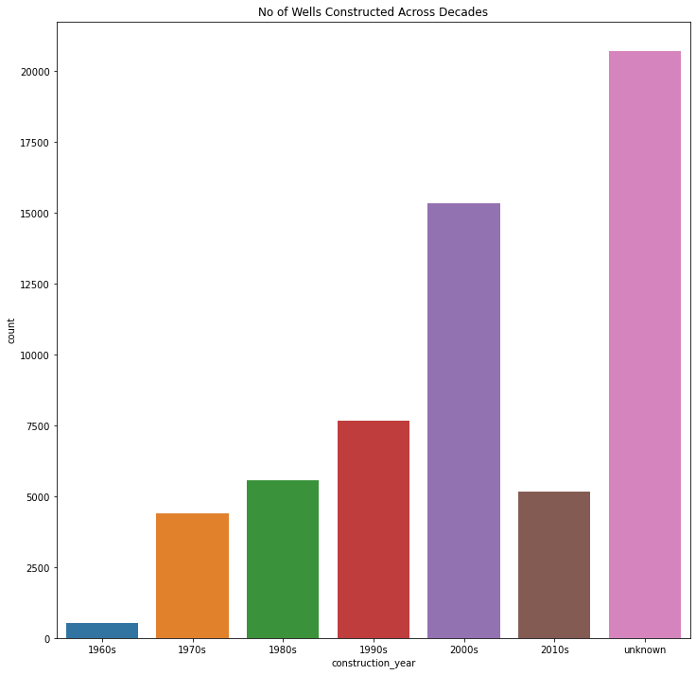
Year of Construction
Most of the wells had no known year of construction. Majority were constructed in the year 2000-2009, with the least being constructed between 1960-1969.

Slide 11
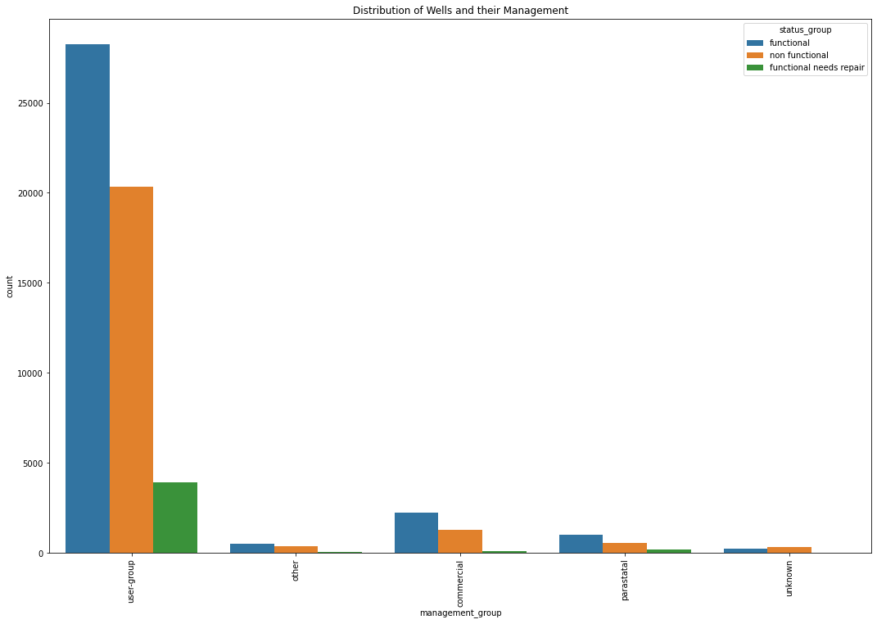
Management
Majority of the wells were user-group managed and they had the largest numbers of functional wells

Slide 12
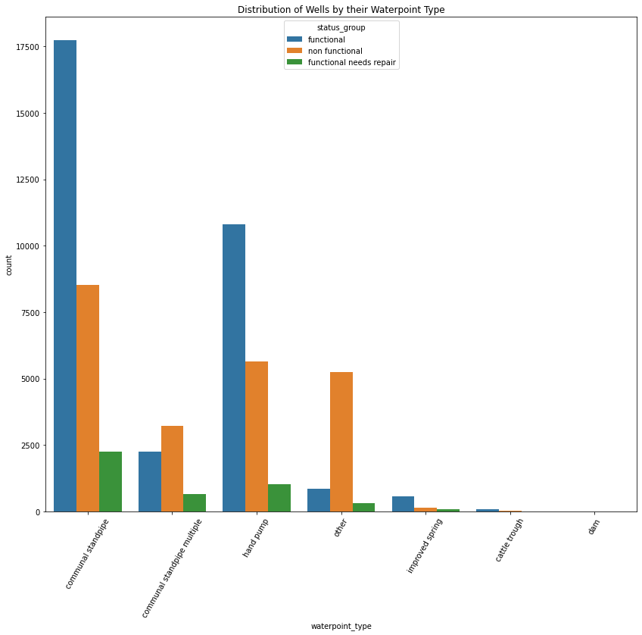
Water Point Type
Majority of the water points were communal standpipe followed by hand pumps with the least being dams.

Slide 13
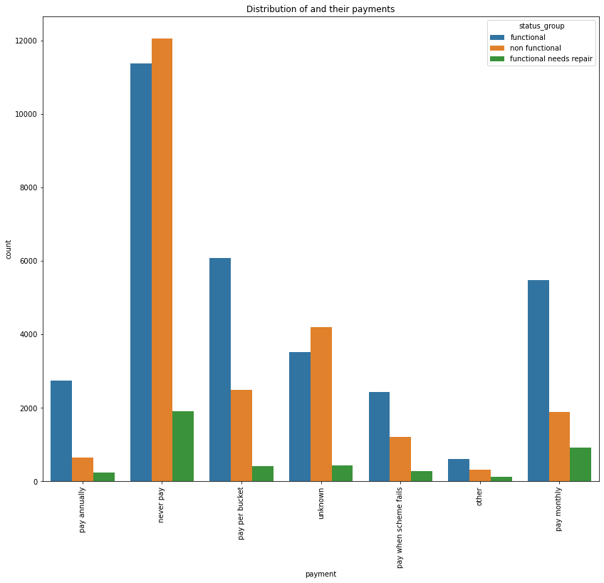
Water Payments
Most of the wells give water for free but also that category has the largest non-functional wells. Wells where one pays per bucket or monthly have a larger number of functional wells compared to non-functional ones

Slide 14
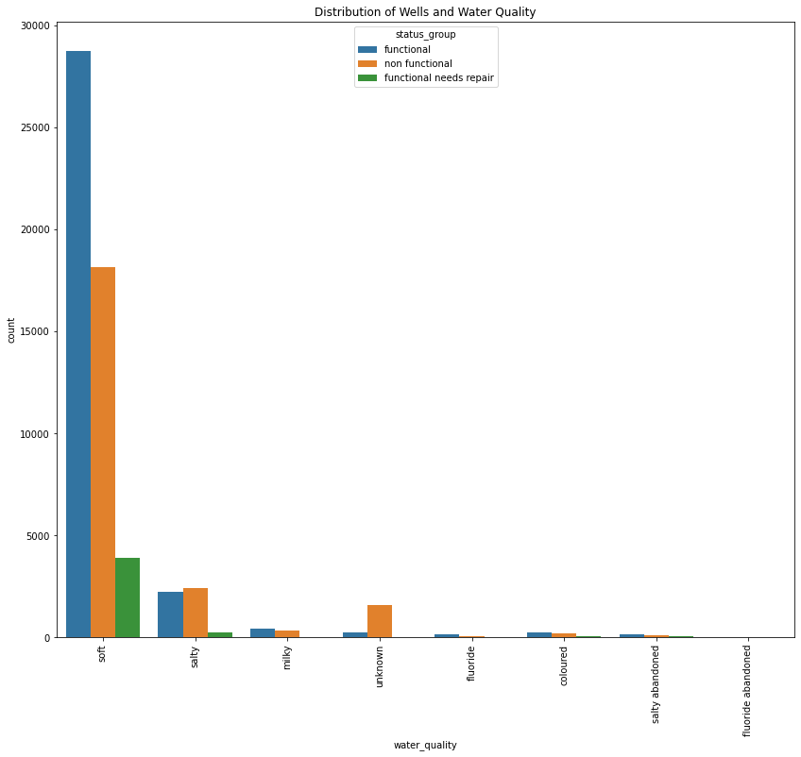
Water Quality
Most of the wells have soft water followed by the salty water while the well that had fluoride and were abandoned had the least numbers. The functional numbers were relatively high as compared to non-functional wells in the soft water wells

Slide 15
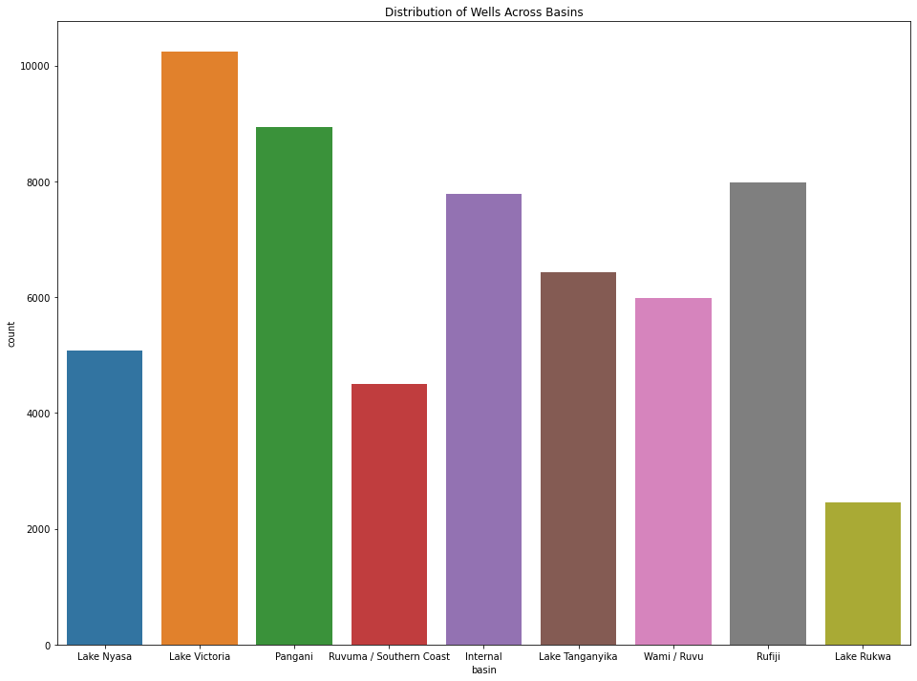
Water Basin
Most of the wells were found on the lake Victoria basin followed by Pangani. The least number of wells were found on the Lake Rukwa basin

Slide 16
Conclusion
Prioritizing the construction of wells with soft water
Introducing payment plans, no matter how modest
Entrusting well management to user groups has shown a consistent positive impact on functionality
Constructing wells that guarantee a sufficient water supply is vital.
Prioritizing the construction and maintenance of groundwater and Communal Stand Pipe wells is a strategic investment
The RandomForestClassifier model, with an 80% accuracy rate after tuning, proves to be a valuable tool for assessing well conditions

Slide 17
Recommendations
Prioritize Soft Water Wells
Implement Payment Plans
Utilize User Group Management
Ensure Sufficient Water Quantity
Invest in Ground Water and Communal Stand Pipes
Utilize the RandomForestClassifier Model

