Slide 1
Cache-Conscious Algorithms and Data Structures
Jon Bentley
Bell Labs
A Programming Puzzle
A Cost Model
Case Studies
Principles

Slide 2
A Programming Puzzle
Which is faster for representing sequences:
arrays or lists?
Technical details
  Random insertions
  Into a sorted sequence
Same sequence of comparisons
Different overhead
  Pointer chasing in lists
    Knuth, v. 3: Search is 4C in arrays, 6C in lists
  Sliding a sequence of an array

Slide 3
A Testbed
Main Loop in Pseudocode
  S = empty
  while S.size() < n
    S.insert(bigrand())
  About n²/4 comparisons
C++ Classes for Arrays and Linked Lists
  Which is faster?

Slide 4
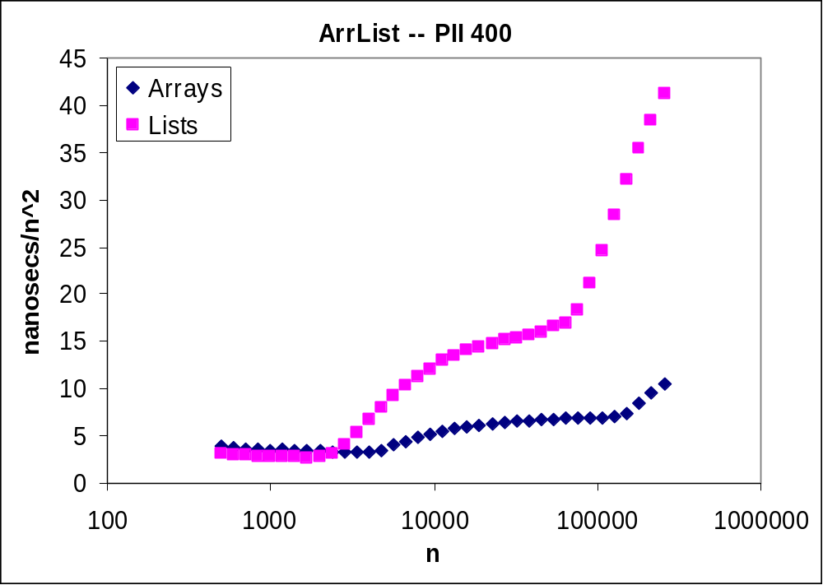
An Experiment
Average access time as a function of set size

Slide 5
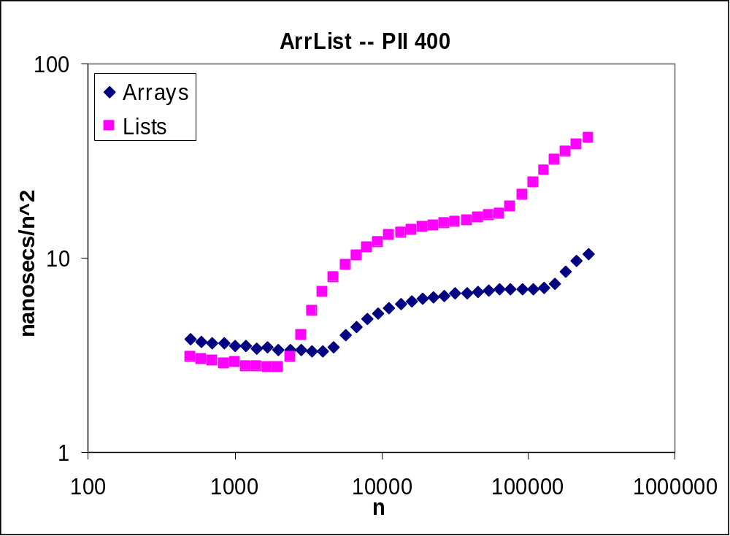
Display on a Log Scale

Slide 6
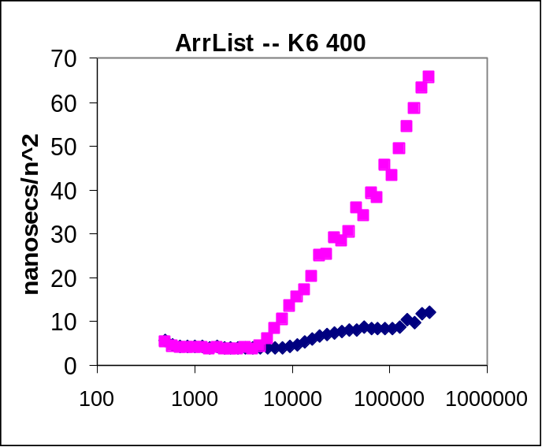
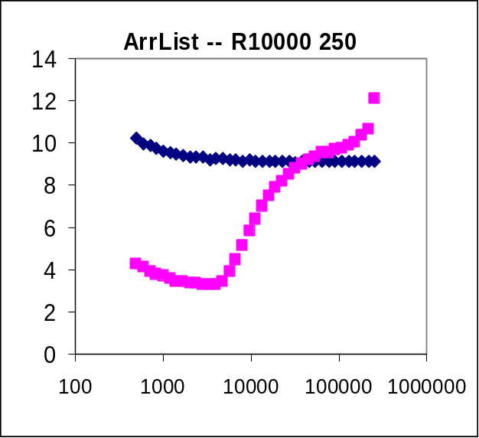
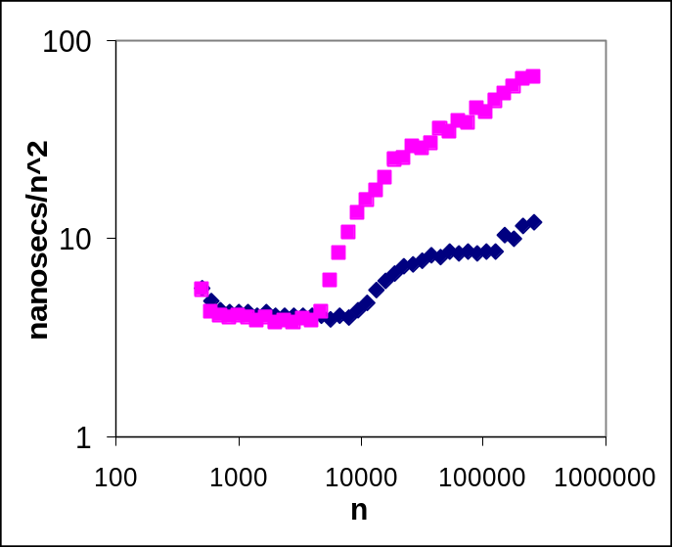
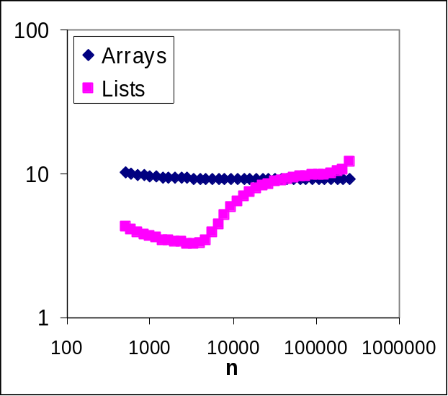
Other Machines

Slide 7
Lessons Across Machines
Knees at L1, L2, RAM boundaries
Smaller structures have later knees
In L1: All accesses are cheap
Above L1: Sequential is faster than random
RAM
Caches

Slide 8
A Cost Model for Memory
Goal: A Program to Estimate Access Costs
The Key Loop (n is array size, d is delta)
  for (i = 0; i < count; i++) {
  sum += x[j];
  j += d;
  if (j >= n)
  j -= n;
  }
A Real Program

Slide 9
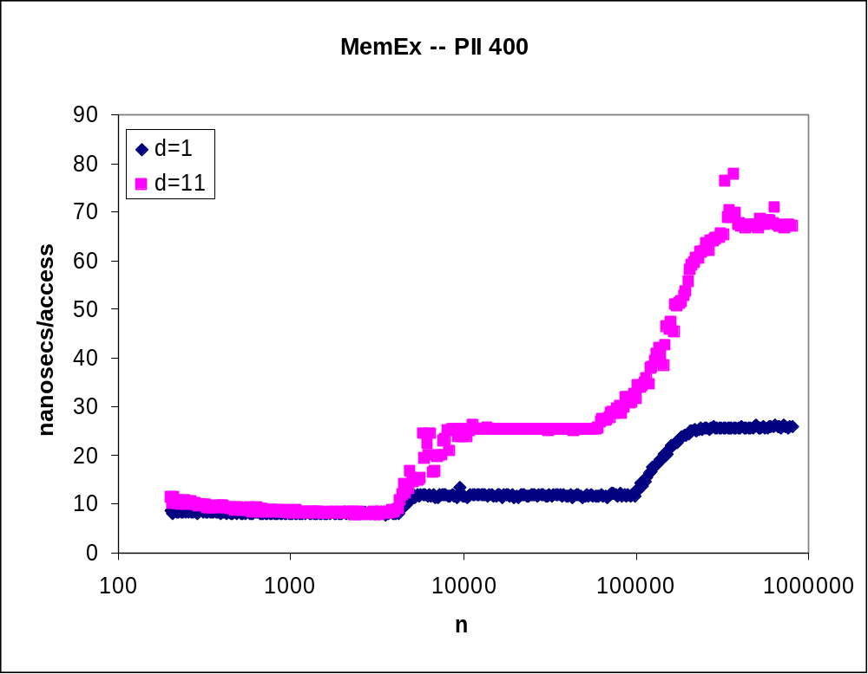
Results of the Model

Slide 10
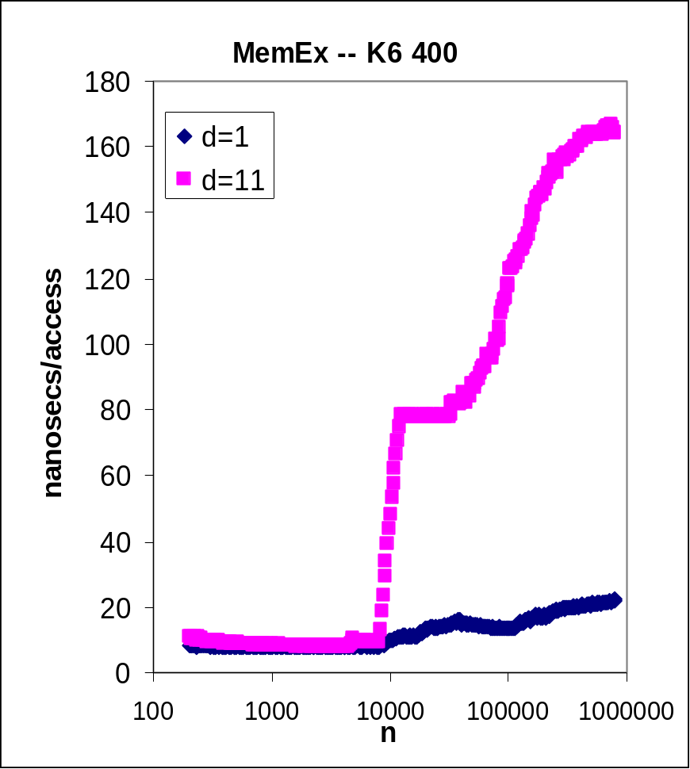
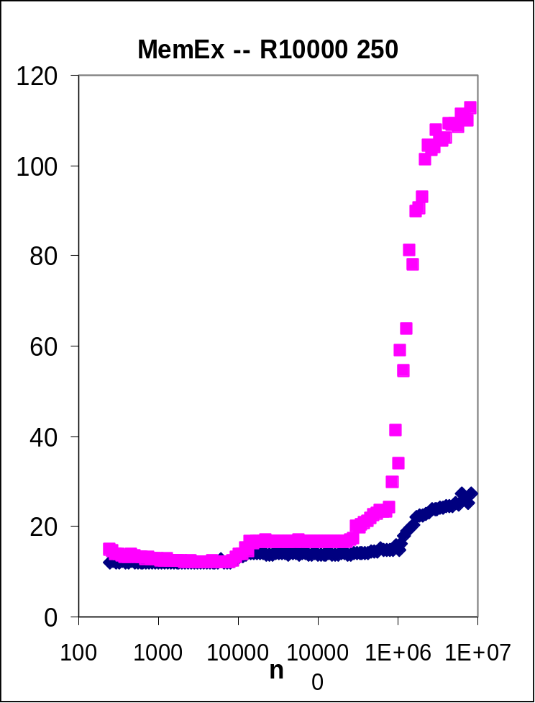
Other Machines

Slide 11
Trends Across Machines
Same shapes, different constants
Transitions at cache boundaries
Constant cost in L1
Sequential is cheaper above L1
  Differences grow substantially
What happens with complex software?

Slide 12
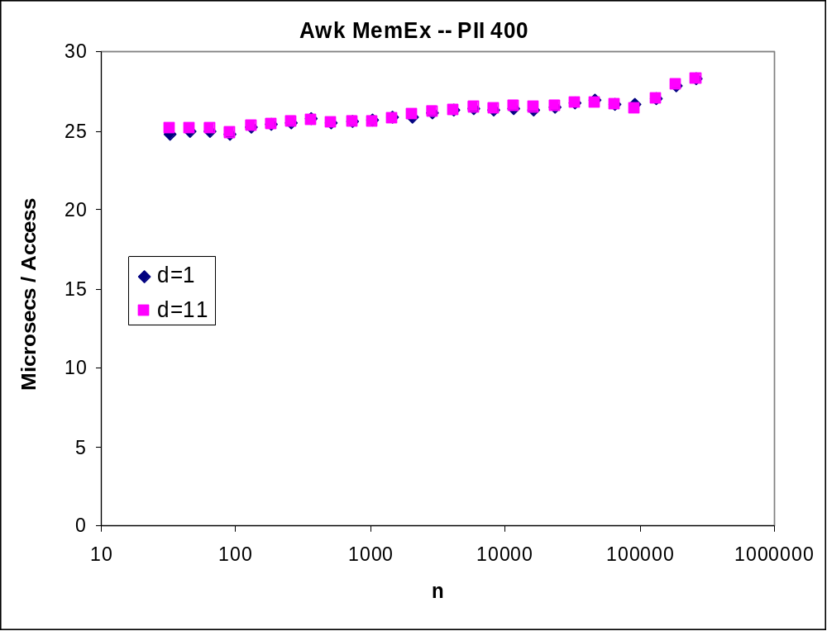
Awk’s Associative Arrays
Interpretation and data structures dominate
Algorithms in Awk are cache-insensitive

Slide 13
Sorting Algorithms
How do different sorts behave under caching?
Two easy O(n log n) sorts
  Quicksort
  Heapsort
Which is faster?

Slide 14
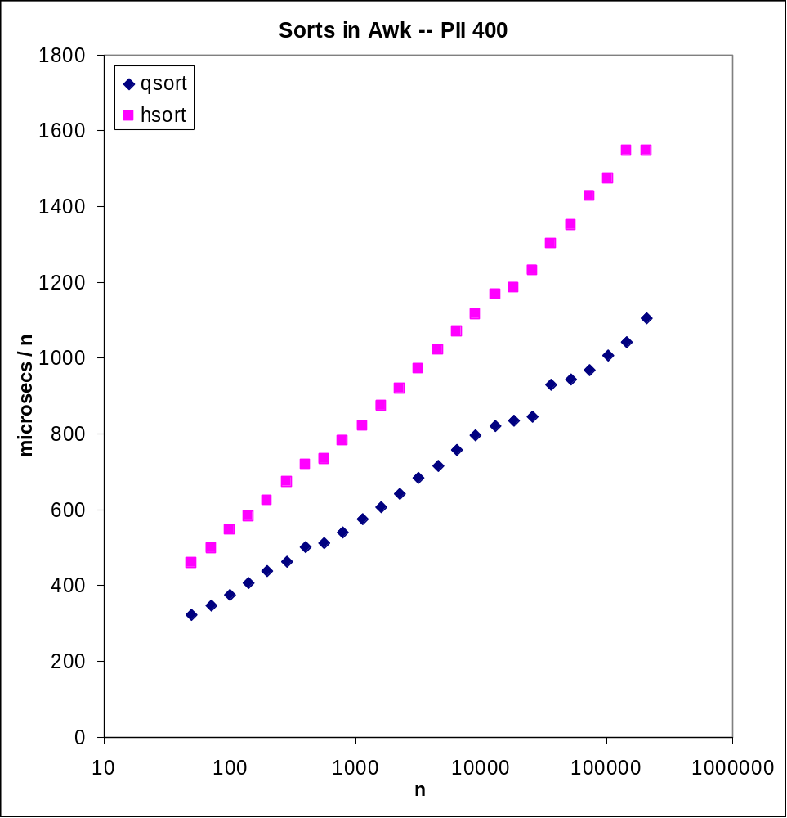
Cache-Insensitive Sorting

Slide 15
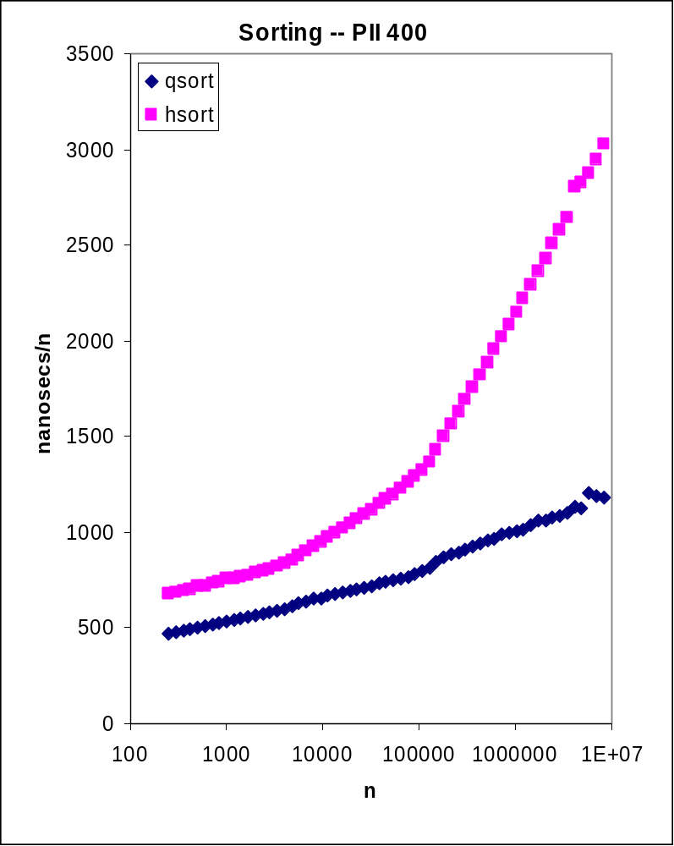
Quicksort vs. Heapsort

Slide 16
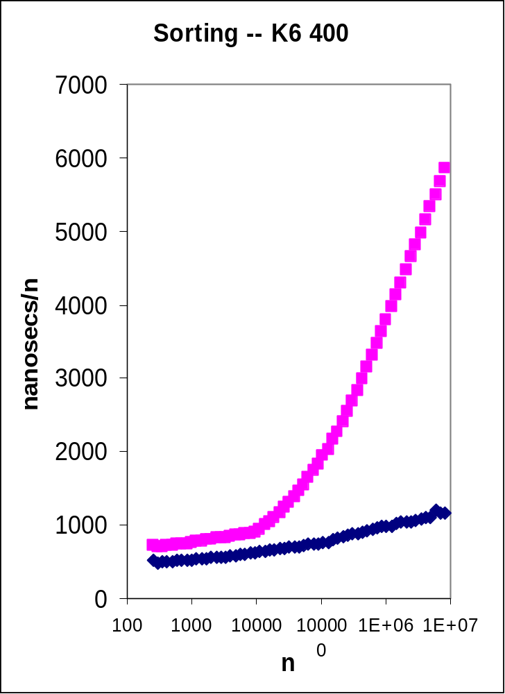
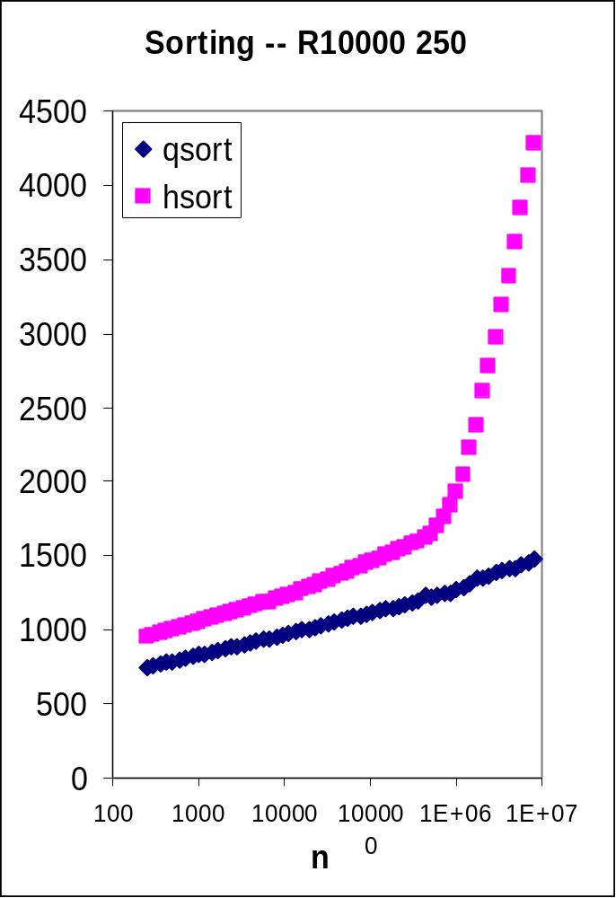
Sorting on Other Machines

Slide 17
Cache-Conscious Sorting
Early work on tapes and disks
LaMarca and Ladner, 1997 SODA
  Quicksort: Undo Sedgewick’s final sort; one multiway partition
  Heapsort: Build towards root; multiway branching
  Merge Sort: Tiling (sort a cache-full in the first pass); multiway merge
  Radix Sort
  Detailed Analyses

Slide 18
Searching
A Rich History
  Represent 3-level subtrees on disk pages
  Linear search within pages, followed by multi-way branch
  Landauer (IEEE TEC, 1963; ISAM)
  B-Trees (Bayer and McCreight, 1970)
Fun Problems
  Hashing (Binstock, DDJ April 1996)
  How to search in a (preprocessed) array?

Slide 19
Binary Search
Array: 0 1 2 3 4 5 6
Search Code
  l = 0;
  u = n-1;
  for (;;) {
  if (l > u)
  return -1;
  m = (l + u) / 2;
  if (x[m] < t)
  l = m+1;
  else if (x[m] == t)
  return m;
  else /* x[m] > t */
  u = m-1;
  }

Slide 20
Timing Binary Search
My First Timing Code
// start clock
for (i = 0; i < n; i++)
assert(search(x[i]) == i);
// end clock
Problems?

Slide 21
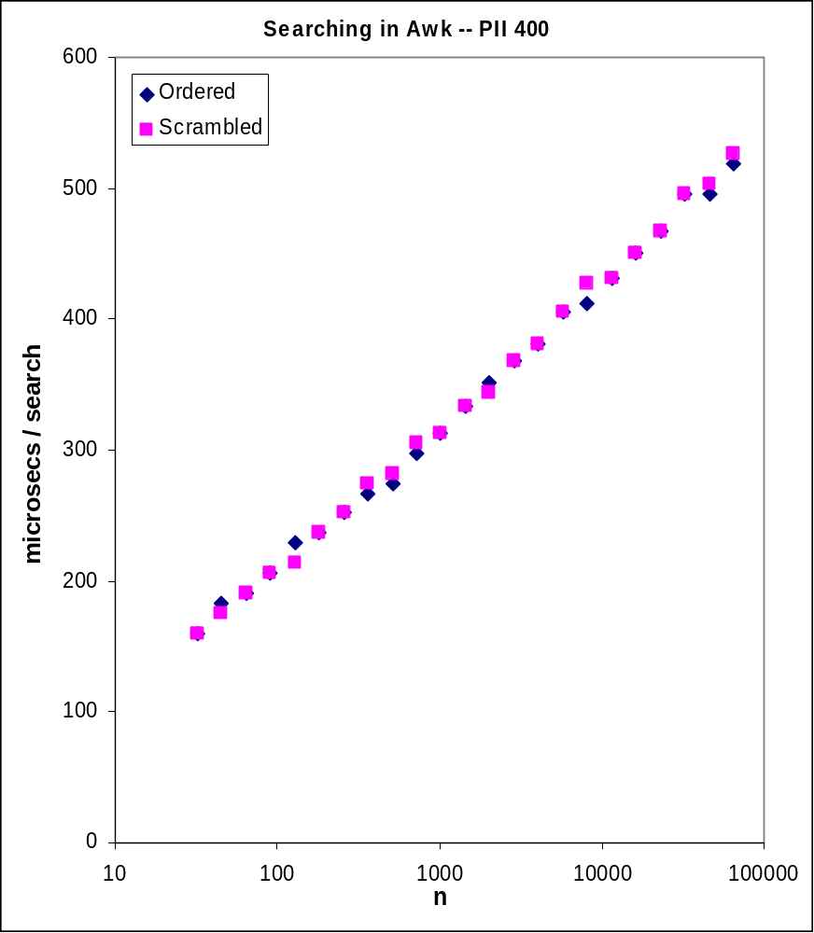
Cache-Insensitive Search

Slide 22
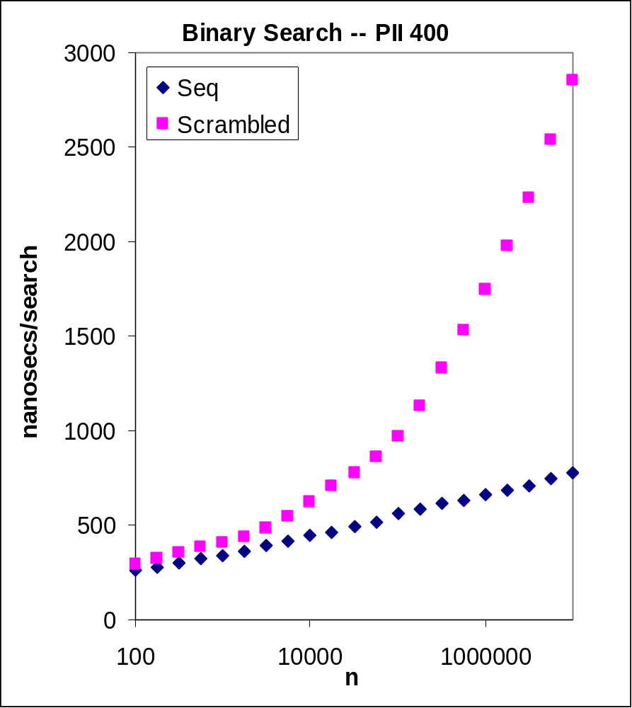
Observed Run Times

Slide 23
Timing Binary Search, cont.
Whack-a-Mole Cost Model
Final Timing Code
// scramble perm vector p
// start clock
for (i = 0; i < n; i++)
assert(search(x[p[i]]) == p[i]);
// end clock
A General Problem
  Perhaps a Solution?

Slide 24
HeapSearch
Tree: 3 Array:
1 5 3 1 5 0 2 4 6
Search Code 0 2 4 6
p = 1;
while (p <= n) {
if (t == y[p])
return p;
else if (t < y[p])
p = 2*p;
else /* t > y[p] */
p = 2*p + 1;
}
return -1;

Slide 25
Multiway HeapSearch
View as implicit, static B-trees
b-way branching
  b=8 for 32-byte cache lines
  Aligned on cache boundaries
Recursive code builds the array in linear time
Speed up by loop unrolling

Slide 26
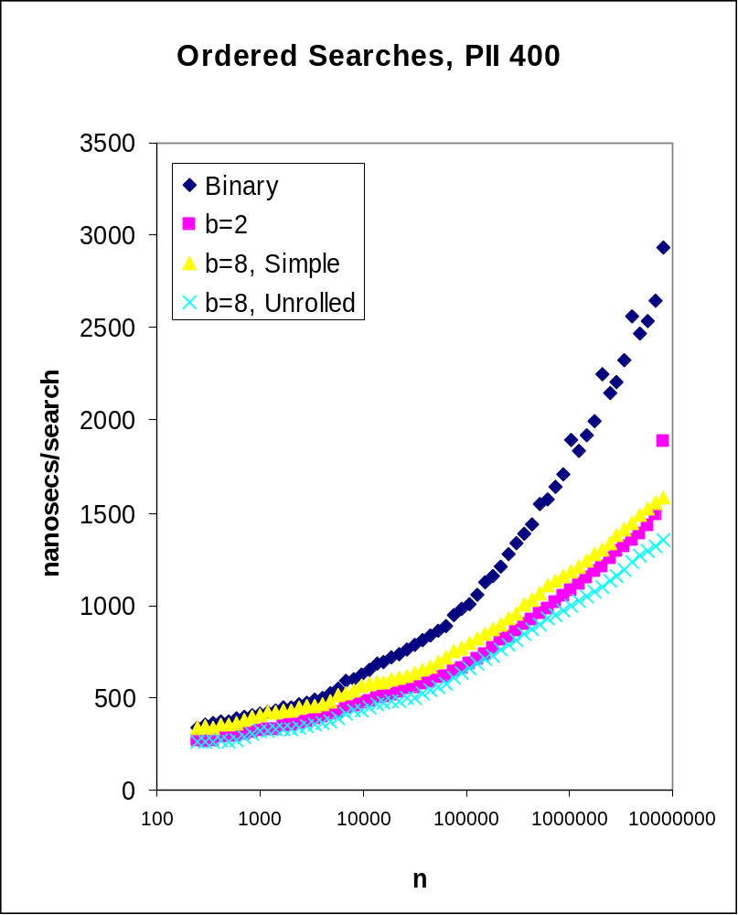
Search Performance

Slide 27
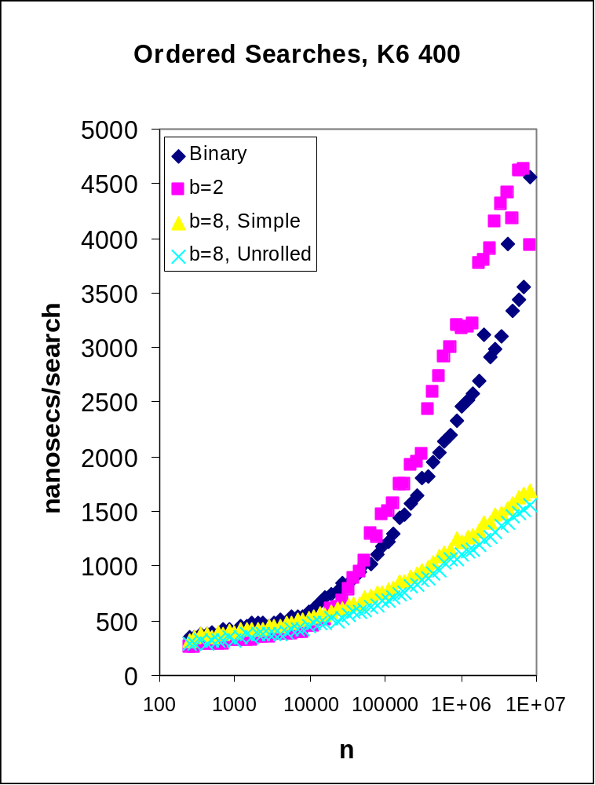
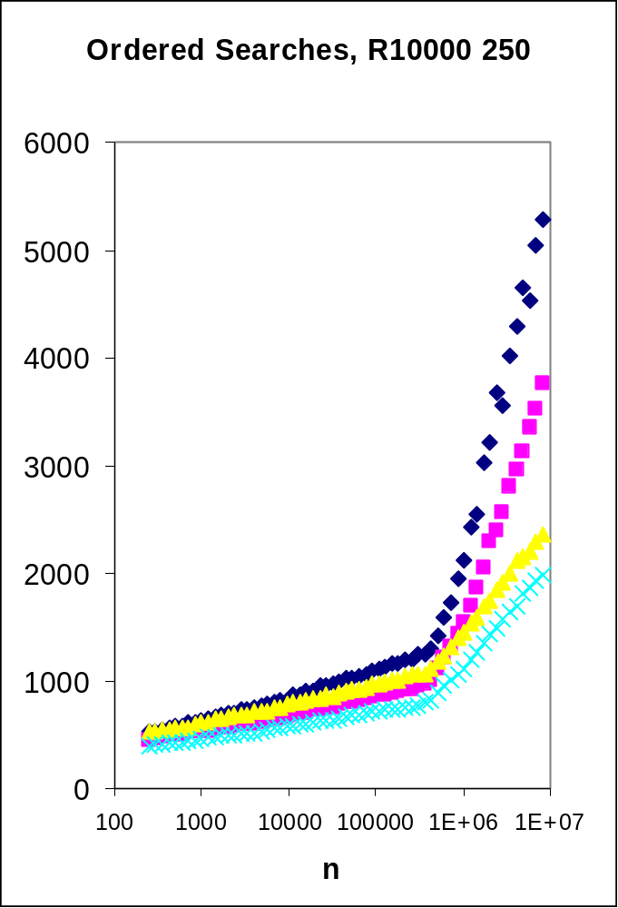
Searching on Other Machines

Slide 28
A Philosophical Digression
Approaches to Cache-Conscious Coding
  Head-in-the-sand big-ohs
  System Tools
    VTune
    Compilers (and more)
  Detailed Analyses
    Lamarca and Ladner
    Knuth’s MMIX Simulator
  High-level, heuristic, machine-independent
A Supermarket Analogy

Slide 29
Vector Chains
What is the longest chain in a set of n vectors in 3-space?
  Erdos and Szekeres; Ulam; Baer and Brock; Logan and Shepp; Vershik and Kerov; Bollobas and Winkler; Odlyzko and Rains
Key structure: a 2-d antichain
  Sequence of 2-d points with increasing x values and decreasing y values

Slide 30
Key Decisions
Represent points as (x, y) pairs, not by pointers
How to represent a sorted sequence of m=n^{1/3} points (n ~ 10⁹)?
  STL Maps: Search in O(lg m), insert in O(lg m)
    Tiny code; guaranteed performance
  Sorted Arrays: Search in O(lg m); insert in O(m)
    Long (buggy) code; small and sequential

Slide 31
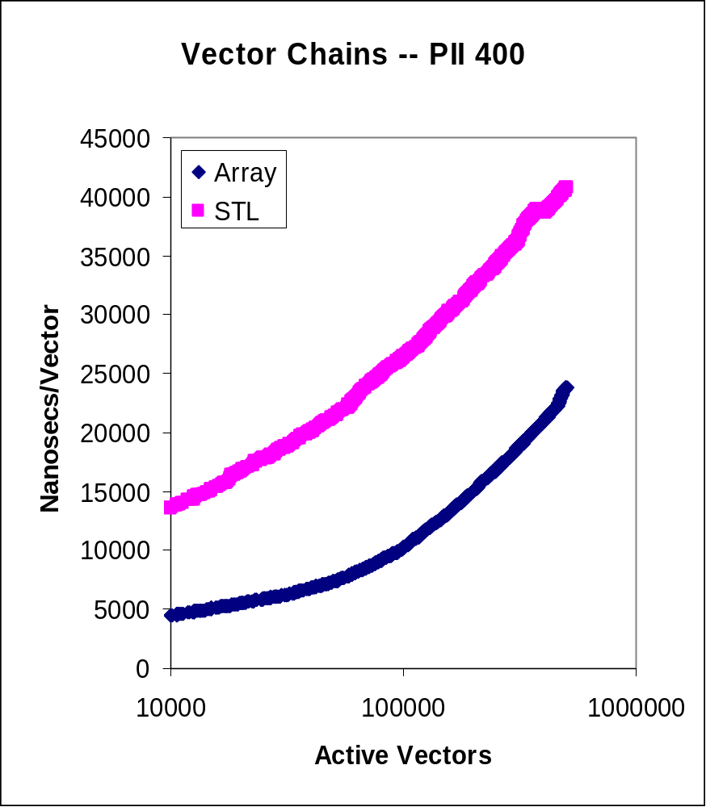
Run Times

Slide 32
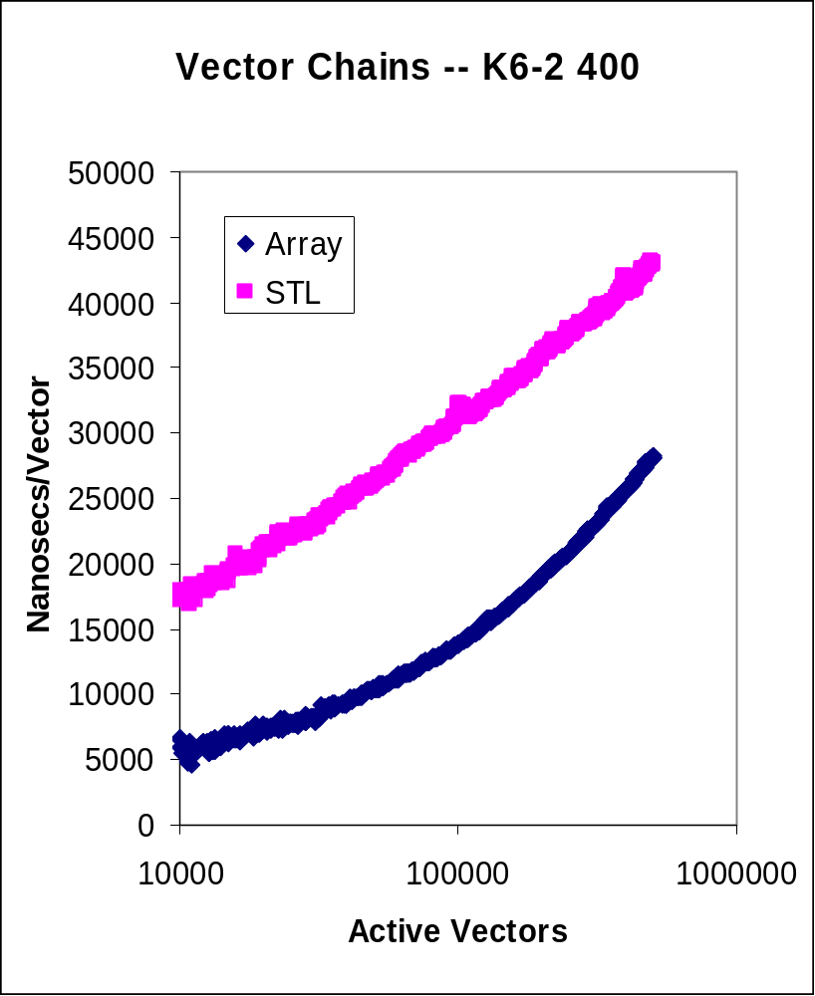
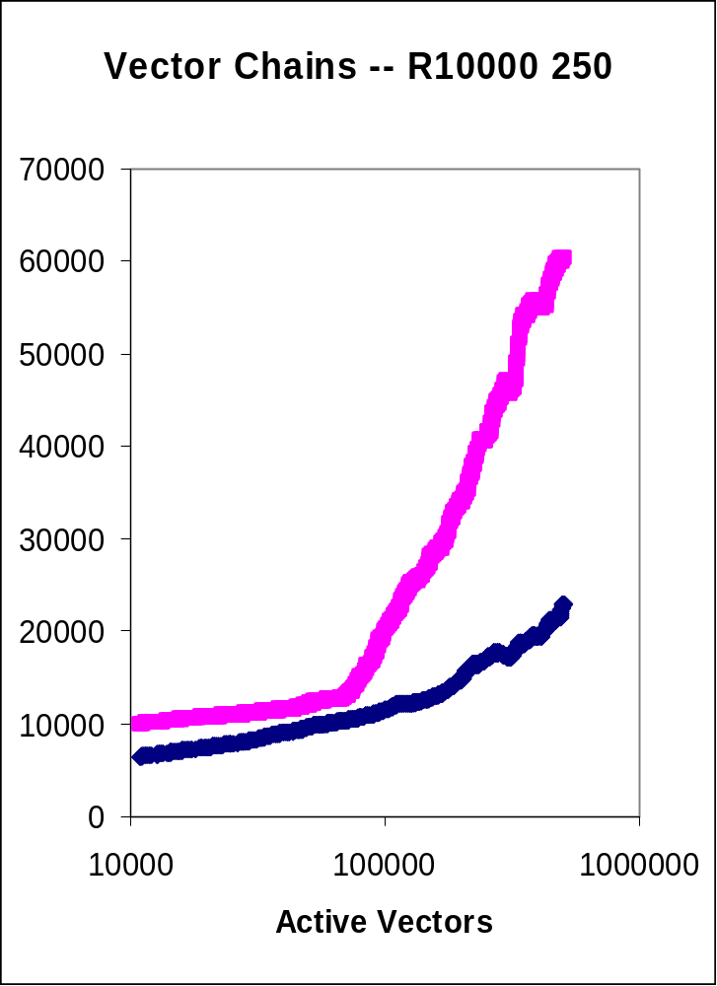
Other Machines

Slide 33
An Ancient Problem
  Ideally one would desire an indefinitely large memory capacity such that any particular [word] would be immediately available.… It does not seem possible to achieve such a capacity. We are therefore forced to recognize the possibility of constructing a hierarchy of memories, each of which has greater capacity than the preceding but which is less quickly accessible.
    “Preliminary discussion of the logical design of an electronic computing instrument”, Burks, Goldstine, von Neumann, 1946

Slide 34
k-d Trees
Search for All Nearest Neighbors
Internal Nodes (A Cutting Hyperplane)
  struct inode {
  char nodetype;
  char cutdim;
  int cutpt;
  iptr lokid;
  iptr hikid;
  }
External Nodes (A Set of Points)
  Two indices into a perm vector of point indices

Slide 35
Cache-Conscious k-d Trees
No pointers to (indices of) points
  Copy values (perhaps entire points)
Implicit Tree
Internal Nodes
  Parallel arrays: cutdim[], cutval[]
  Drop 24 bytes/node to 5
External Nodes
  Permutation vector of (copies of) points
Future
  Cluster subtrees by cache line size

Slide 36
Ordering the Searches
Recall Testbed for Binary Search
  Searching for x[0], x[1], x[2], … was very fast
  Random searches were slower (and more realistic)
Neighbor Searches in Random Order
  for (i = 0; i < n; i++)
  nntab[i] = nnsearch(i);
Searches in Permutation Order
  for (i = 0; i < n; i++)
  nntab[i] = nnsearch(perm[i]);

Slide 37
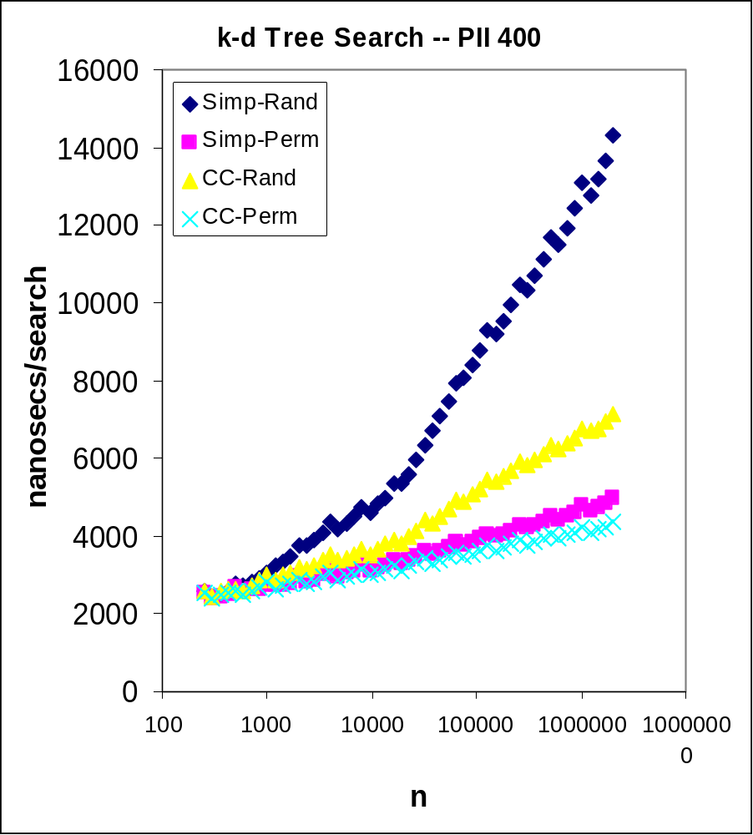
k-d Tree Run Times

Slide 38
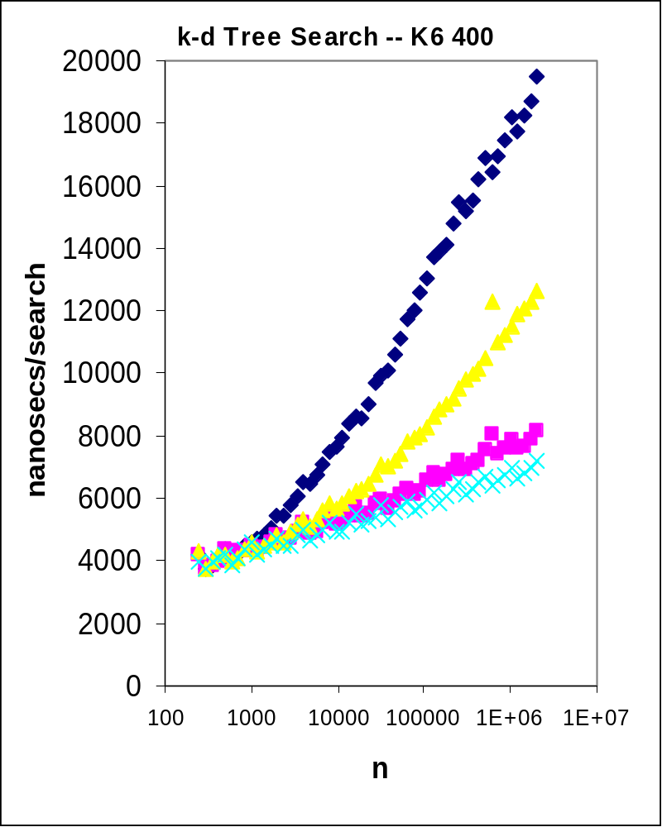
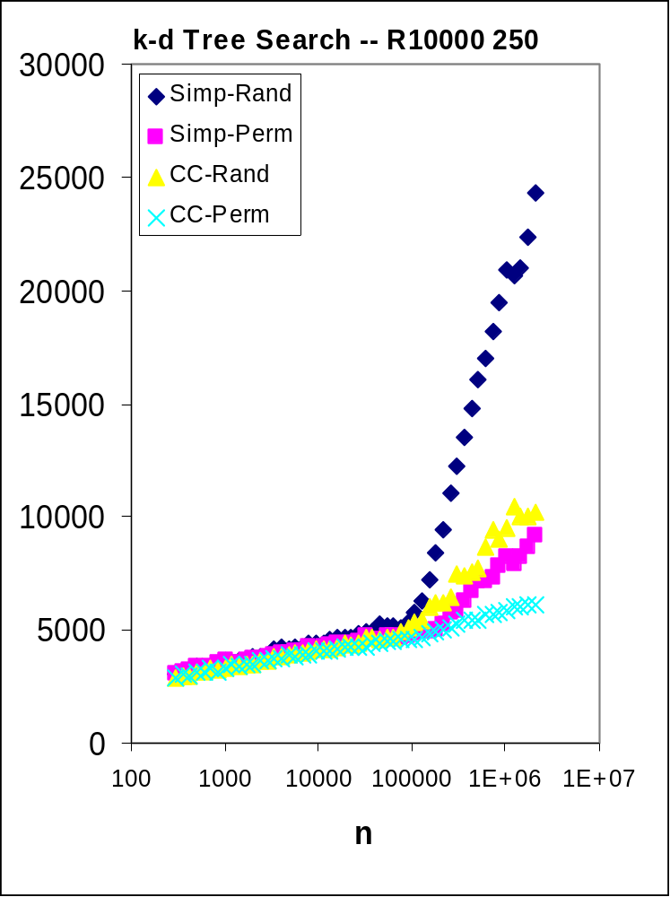
Times on Other Machines

Slide 39
Caches in Programming Pearls
Vector Rotation
  Dolphin vs. block swap vs. reversal
  Don’t optimize {I/O, cache}-bound code
Binary search
  Original testbed timed (adjacent, fast) searches
  Final timed random searches
Set representations
  Weird times on arrays vs. lists
  STL sets thrash

Slide 40
Markov Text
Order-1: The table shows how many contexts; it uses two or equal to the sparse matrices were not chosen. In Section 13.1, for a more efficient that ``the more time was published by calling recursive structure translates to build scaffolding to try to know of selected and testing
Order-2: The program is guided by verification ideas, and the second errs in the STL implementation (which guarantees good worst-case performance), and is especially rich in speedups due to Gordon Bell. Everything should be to use a macro: for n=10,000, its run time;
Order-3: A Quicksort would be quite efficient for the main-memory sorts, and it requires only a few distinct values in this particular problem, we can write them all down in the program, and they were making progress towards a solution at a snail's pace.

Slide 41
Markov Text Algorithms
Original Data Structures
  Original text as one long string
  Suffix array of pointers to each word
Algorithm
  Read input
  Sort words by k-grams
  Use binary search to make transitions
Cache-Conscious Version
  Hash each word on input
  Replace a pointer to a text string with an index into the hash table
  Sort (copied) k-grams of hash indices

Slide 42
A Choice About Binary Search
Find Equal Elements in a Sorted Array
Warm Start
  l = binarysearch(t, 0, n-1, <)
  u = binarysearch(t, l, n-1, =)
Cold Start
  l = binarysearch(t, 0, n-1, <)
  u = binarysearch(t, 0, n-1, =)
Whack-a-Mole Analysis
  Details in DDJ, March 2000
<
=
>
l
u

Slide 43
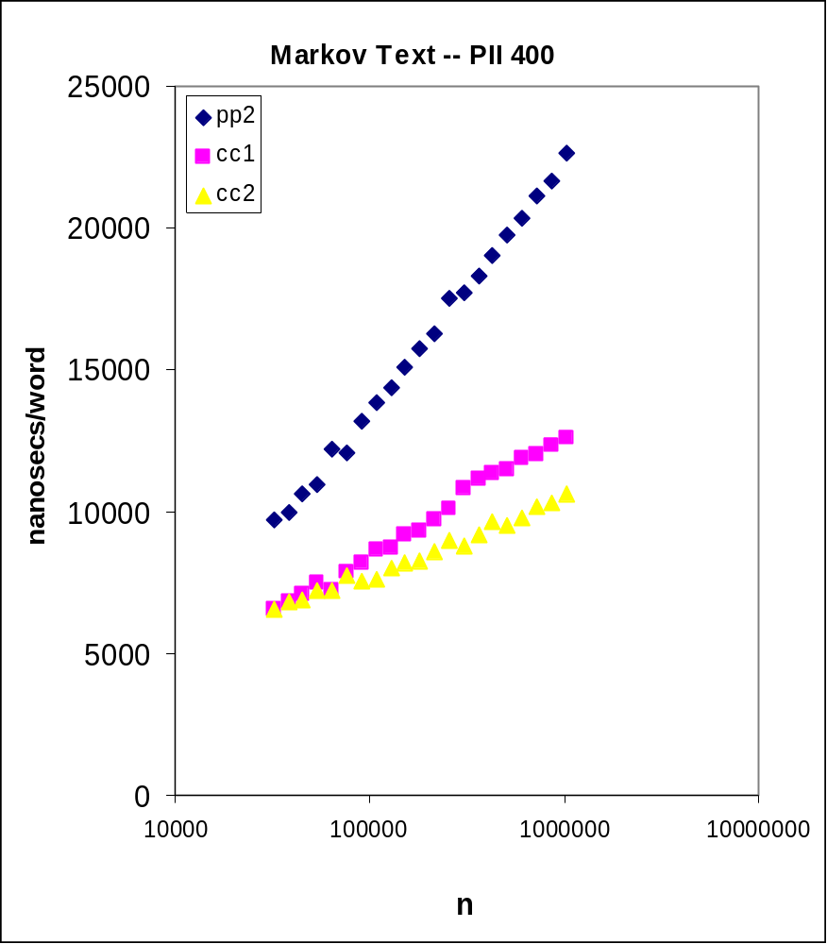
Time of Markov Algorithms

Slide 44
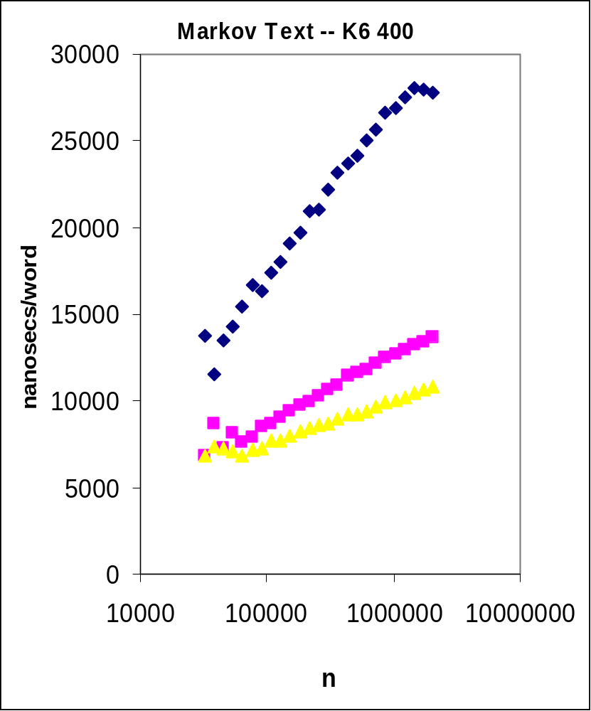
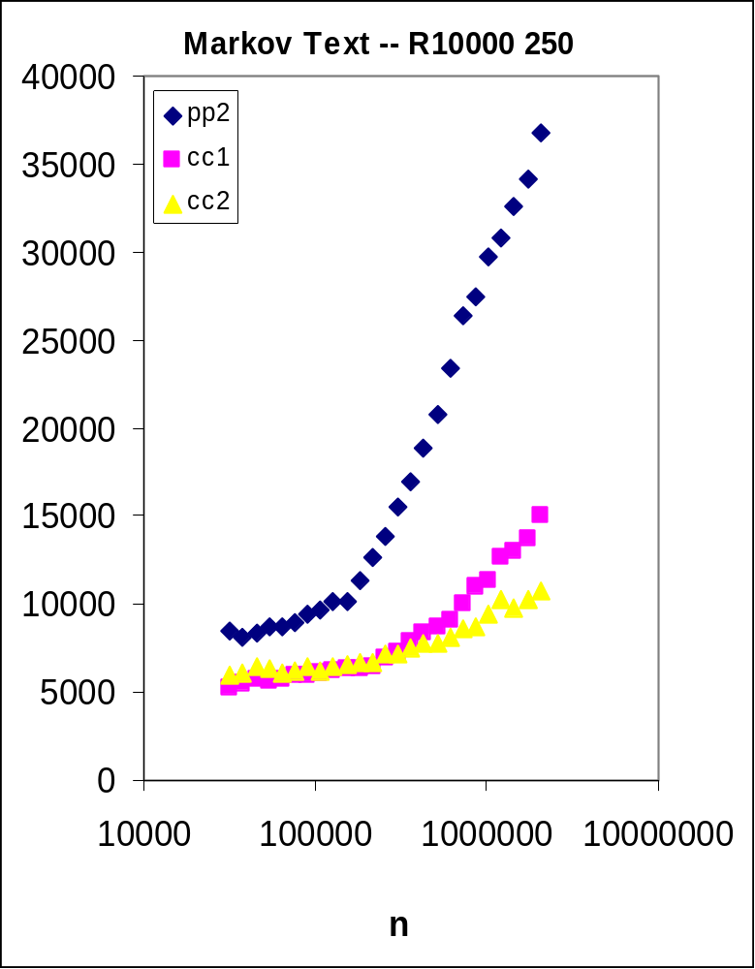
Times on Other Machines

Slide 45
A Sampler of Related Work
Cache-Conscious Databases, Object Code, Record Layouts, Compilers, Languages, ...
Scientific Computing: Blocking, etc.
Lamarca: Understanding and Optimizing Cache Performance
  www.lamarca.org/anthony/caches.html
Board, Chatterjee, et al: TUNE
  www.cs.unc.edu/Research/TUNE/
Vitter et al: External Memory Algorithms
  www.cs.duke.edu/~jsv/Papers/catalog/
Frigo, Leiserson, et al: Cache-Oblivious Algorithms
  1999 FOCS

Slide 46
Lessons for Programmers
Canonical Curves
  Experimenters beware
  Implementers exploit
    Down: Lower access cost
    Out: Shrink size
Cost Model
  Whack-a-Mole Analysis
Techniques from the Cases (Max slope reductions)
  Arrays vs. Lists (6) Vector Chains (3.6)
  Sorting an Array (16) k-d Trees (13)
  Searching in a Static Array (3.5) Markov Chains (6)

Slide 47
Cache-Conscious Coding
Traits of Fast Programs
  Small structures
  Arbitrary access → Repeated → Sequential
    Top-Down Heapsort → Bottom-Up → Quicksort
Programming Techniques
  Avoid pointers
    Copy information
    Links → Arrays
  Implicit structures
    Respect cache size and alignment
    Multiway branching
  Compression and recomputation
    Records → Parallel arrays
    Carry a signature of an object
  Order operations to induce locality

