Slide 1
Tricks of the Programming Trade
Jon Bentley
Bell Labs
www.programmingpearls.com/tricks
Notes:
03/05/100
1

Slide 2
Outline
Problem Definition
The Back of the Envelope
Debugging
Other Tricks
Notes:
03/05/100
3

Slide 3
Three Kinds of Knowledge
General
  1. Science
  2. Project Management
  3. “Tricks of the Trade”
Medicine
  1. Chemistry, Biology
  2. Operating teams, Medical records
  3. Blood samples
Software
  1. Program verification, algorithm design
  2. Team organization, scheduling
  3. This talk
Notes:
03/05/100
2

Slide 4
About This Talk
Goals
  For the listeners: a few amusing stories,and a prod to think about tricks
  For the talker: more stories and tricks
Rules
  Mandatory: real-time thought, some discussion
  Illegal: note taking,verbal answers from table-lookup
Notes:
03/05/100
3

Slide 5
Problem Definition
A public opinion polling firm wishes to draw a random sample from a (hardcopy) list of precincts
The User's Idea
  Input: The user types n precinct names (10-character strings) and an integer m < n. Typically, m ~ 20 and n ~ 200
  Output: Random selection of m names
Notes:
03/05/100
3

Slide 6
A Better Problem
Input: Integers m and n
Output: A sorted list of m integers in the range 1..n.
For example, if m = 3 and n = 8, the output might be 2, 3, 5.
Better Yet: Input is a hardcopy list of precincts.

Slide 7
Another Randomizing Problem
For n = 72 psychological subjects, randomly permute
  order of experimenters (1, 2, 3)
  stress conditions (High, Medium, Low)
Output of the Program
  1 3L 2M 1H
  2 3H 1M 2L
  3 1L 2H 3M
  4 1M 2L 3H
  ...

Slide 8
A More Elegant Solution
Why It Failed
213
MLH
132
LHM
123
LMH

Slide 9
A Quiz
How much water flows out of the Mississippi River per day?
One Possible Answer: The river is about a mile wide, twenty feet deep, and flows at five miles per hour.
1 mile x 1/250 mile x 120 miles / day
~ 1/2 mile³ / day
It discharges roughly one-half cubic mile per day.

Slide 10
Two Answers Are Better Than One
How much water flows out?
As much as flows in.
The Mississippi basin is about 1000 by 1000 miles; annual runoff from rain is about one foot. Yearly drainage is
1000 miles x 1000 miles x 1/5000 mile/year
~ 200 miles³ / year
Daily outflow is
200 miles³ / year / 400 days / year
~ 1/2 mile³ / day

Slide 11
A Cheating Triple Check
An almanac reports that the river's discharge is 640,000 cubic feet per second, or 0.4 cubic miles per day.
A crucial engineering technique: sheer dumb luck.

Slide 12
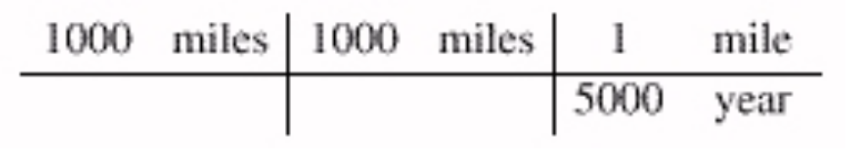
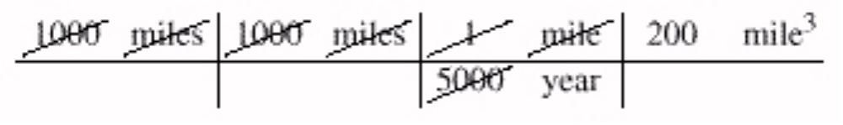
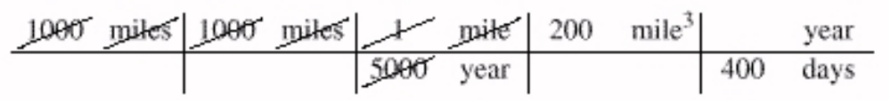
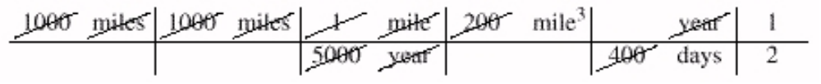
Tabular Computation
How much water flows in?
Cancel terms
Multiply by 1 year = 400 days (almost)
Cancel again

Slide 13
Reminders About Quick Calculations
How To Do Them
  Two answers are better than one.
  Tabular computations.
  Dimension checks; quick checks.
  Common sense.
  Rules of thumb.
  Safety factors
When To Do Them
  After design, before implementation
  Before any efficiency improvements
  Cost-benefits analysis

Slide 14
Exercises
When is a cyclist with removable media faster than a high-speed data line?
A newspaper asserts that a quarter has ”an average life of 30 years”. Is that reasonable?
An advertisement asserts that a salesperson drives a car 100,000 miles in a year. Is that reasonable?
How many tons of people are in this room? How many cubic feet of people? Of room?

Slide 15
Rules of Thumb
Pi seconds is a nanocentury
Rule of 72
Little's Law
90-10 (80-20) Rules. 10% of X accounts for 90% of Y: (population, beer) (code, run time) (code, function)
The cheapest, fastest and most reliable components of a computer system are those that aren't there.
Whenever possible, steal code.
[KISS] Keep it simple, stupid.

Slide 16
Approaches to Debugging
Program Verification
  Don't make any mistakes.
Theory of Test Data Selection
  Uncover all mistakes.
Advanced Debuggers
  Use 'em if you have 'em.
The Right Attitude

Slide 17
Debugging Steubenville, Ohio
From Roueche’s Medical Detectives
36 cases of salmonella from December 1980 through February 1982.
A Good Debugger.
  “I was prepared for hard work, for plenty of old-fashioned shoe-leather epidemiology.”
  “In such outbreaks, there is always a common denominator -- an eating place, a wedding reception,a picnic, a dinner party, a church social. Something in which everybody is involved.”
  Dominant age group: 20-29

Slide 18
Debugging Computer Systems
Some Puzzles
  A banking system “quits” on international data.
  The programmer can't log in standing up.
  The program worked once twice.
  The program works when the programmers are in the room, but fails half the time when they aren't.
A Moral.
  Debugging is usually unbelieving.
  The key is skepticism: the magician.

Slide 19
Ten Design Hints
Work on the right problem.
Explore the design space of solutions.
Look at the data.
Use the back of the envelope.
Exploit symmetry.
Design with components.
Build prototypes.
Make tradeoffs when you have to.
Keep it simple.
Strive for elegance.

Slide 20
Nurturing Trickiness
Observe
Read
Discuss
Practice
Reflect

