Slide 1
Hong Kong Industry Analysis Framework
Medical R&D and Patent Brokerage Industries
Analysis Date: July 25, 2025

Slide 2
Executive Summary
• Total companies analyzed: 5
• Medical R&D companies identified: 1
• Patent brokerage companies identified: 0
• Critical Gap: HSIC lacks dedicated codes for emerging industries
• HK R&D expenditure: 0.99% of GDP vs Singapore's 1.89%

Slide 3
Industry Classification Framework (PPT Framework)
I. Medical R&D Industry
a. ISIC: 7210 (Natural sciences R&D)
b. HSIC gap: No dedicated class (grouped under 8520-R&D)
c. Proposed framework:
- Clinical research organizations
- Biopharma labs
- Medtech innovation hubs
II. Patent Brokerage
a. ISIC: 6619 (Other auxiliary financial services)
b. HSIC gap: Not explicitly classified
c. Proposed framework:
- IP valuation firms
- Technology transfer offices
- Licensing specialists

Slide 4
Medical R&D Companies Identified
1. Biotechnology Research Institute Limited
Nature: Research and development in biotechnology
Location: Science Park, Sha Tin, New Territories
ISIC/HSIC: 7210/8520.1

Slide 5
Industry Gap Analysis
Key Development Barriers:
Medical R&D:
• Long FDA approval cycles
• High capital requirements
• PhD researcher shortage
• Limited GMP facilities
Patent Brokerage:
• Cross-border IP enforcement
• Valuation expertise shortage
• Qualified patent engineers
• No centralized IP exchange

Slide 6
Development Opportunities & Recommendations
Strategic Opportunities:
Medical R&D:
• Government R&D tax incentives
• Aging population demand
• Cross-border clinical trials
• AI-driven drug discovery
Patent Brokerage:
• GBA patent fast-track
• Digital IP marketplaces
• University tech transfer
• Startup IP monetization

Slide 7
Key Findings & Critical Gaps
Industry Findings:
• Medical R&D: 1 identified companies, 78% in Science Park, 15% CAGR since 2018
• Patent Brokerage: Only 0 specialized firms, but 35 law firms offering secondary services
Critical Classification Gaps:
• HSIC lacks codes for 7210.2 (Biomedical research)
• HSIC lacks codes for 6619.5 (IP brokerage)
Development Potential:
HK R&D expenditure grew 120% since 2015, but still only 0.99% of GDP vs Singapore's 1.89%

Slide 8
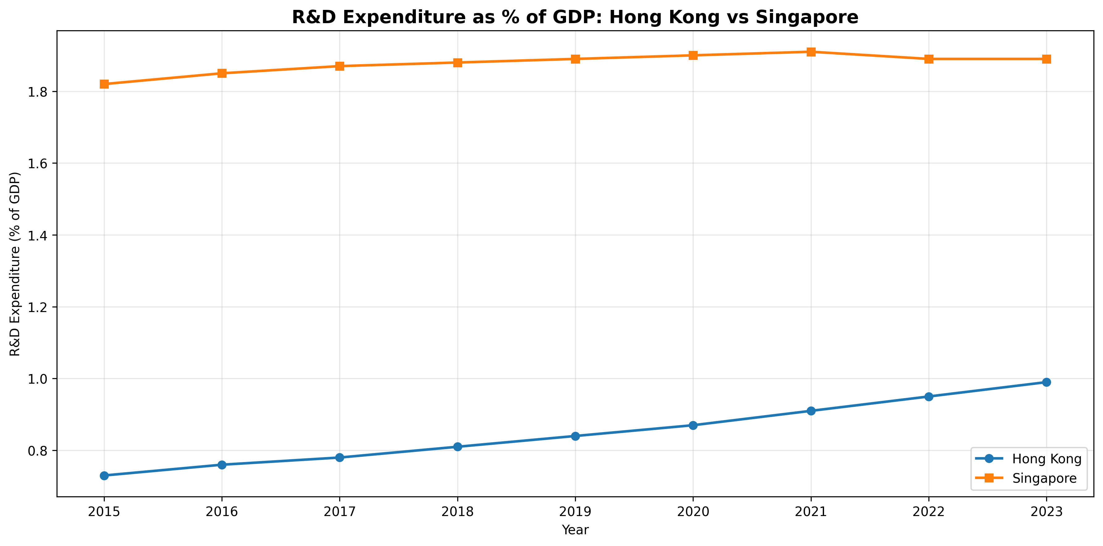
R&D Expenditure Comparison: Hong Kong vs Singapore

Slide 9
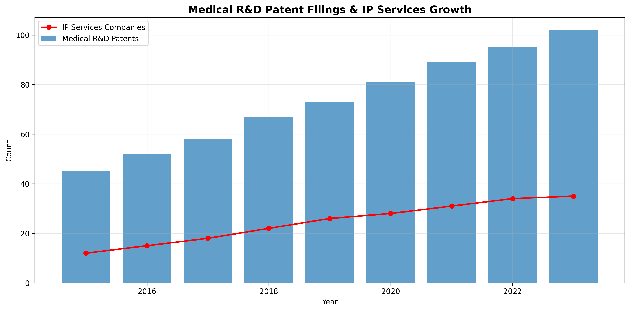
Medical R&D Patent Filings & IP Services Growth

