Slide 1
Charting a New Course with Excel
Day 3
The Data Bootcamp

Slide 2
Quick Refresher

Slide 3
What are the two parts of an excel formula?

Slide 4
Ooh… Coding! (Sort Of)
Function
=
SUM(
1, 2, 3
)
Arguments
In a way, Excel has introduced you to a sort of proto-programming. Throughout your time writing scripts you will rely on functions (methods) that do something to or with arguments.

Slide 5
Ooh… Coding! (Sort Of)
What about this example?
Which is the function? Which are the arguments?
= SUM( AVG(F4:F6), AVG(G4:G6) )
The AVG functions takes as their arguments the ranges provided.

Slide 6
What does Pivot Table do?

Slide 7
Get Pivot With It
Seller | Qty. Sold | Date
Joseph | $42.50 | 1/1/17
Jacob | $65.00 | 1/3/17
Jacob | $5.25 | 1/6/17
Joseph | $125.00 | 1/6/17
Jacob | $3.50 | 1/7/17
Matt | $32.00 | 1/9/17
Seller | Total Sold
Joseph | $167.50
Jacob | $73.75
Matt | $32.0
In essence, Pivot tables are a summative analytic tool that allows us to perform aggregate functions that along any combination of fields.
(The name comes from the fact that we are pivoting along a data axis)

Slide 8
What’s the third argument in vlookup()

Slide 9
=vlookup( <value>, <full table>, <column to retrieve>)

Slide 10
Regression Basic

Slide 11
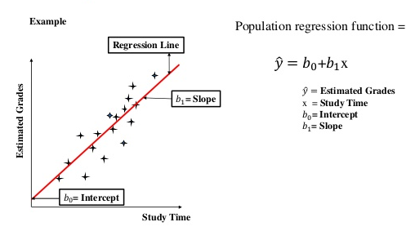
Regression Basic

Slide 12
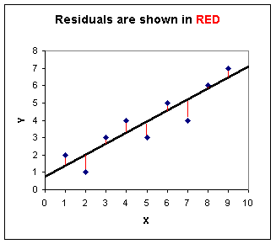
Regression Basic
Nearly every analytic method that establishes a regression does so by minimizing the sum of residual differences

Slide 13
Basic Chart
Notes:
It’s important to keep in mind why you joined this class. Let’s talk about your goals.

Slide 14
More Charts
Notes:
It’s important to keep in mind why you joined this class. Let’s talk about your goals.

Slide 15
Moving Average
Notes:
It’s important to keep in mind why you joined this class. Let’s talk about your goals.

Slide 16
Go Home
Notes:
It’s important to keep in mind why you joined this class. Let’s talk about your goals.

