Slide 1
Vexing VBA
Day 5
The Data Boot Camp

Slide 2
Today,
This is you…

Slide 3
Fundamentals of Coding
Time | Number | Activity | Duration
6:30 PM | 1 | Instructor Do: Welcome Students | 0:05
6:35 PM | 2 | Partners Do: Warm-up Activity (Budget Checker) | 0:16
6:51 PM | 3 | Instructor Do: Review Warm-up (Budget Checker) | 0:10
7:01 PM | 4 | Instructor Do: For Loop | 0:07
7:08 PM | 5 | Students Do: Chicken Nugget Loop | 0:10
7:18 PM | 6 | Instructor Do: Review Chicken Nuggets Loop | 0:05
7:23 PM | 7 | Instructor Do: Loop Conditionals | 0:10
7:33 PM | 8 | Students Do: Fizz Buzz | 0:20
7:53 PM | 9 | Instructor Do: Review Fizz Buzz | 0:10
8:03 PM | 10 | BREAK | 0:15
8:18 PM | 11 | Partners Do: Lotto Search | 0:20
8:38 PM | 12 | Instructor Do: Review Lotto Search | 0:07
8:45 PM | 13 | Instructor Do: Nested For Loops | 0:10
8:55 PM | 14 | Students Do: Hornets Nest | 0:25
9:20 PM | 15 | Instructor Do: Review Hornets Nest | 0:10
9:30 PM |  | END

Slide 4
Class Objective
Students will understand the basic syntax of a VBA for loop
Students will understand how to utilize for-loops in conjunction with conditionals to direct logic flow
Students will understand the value of a nested for-loop and gain basic proficiency in their use
Students will refine their fundamental coding skills (syntax recollection, pattern recognition, problem decomposition, and debugging)

Slide 5
Refresher

Slide 6
Fundamentals of Coding
What is meant by the phrase:
“Coding requires thinking procedurally?”

Slide 7
How a Computer Thinks (Procedurally)
Complex Real-World Problem
Every problem in software development begins with a complex and abstract real-world need.

Slide 8
How a Computer Thinks (Procedurally)
Complex Real-World Problem
Step
Step
Step
Step
1
2
3
4
In order for a computer to handle things, this “real-world” problem needs to be broken into a set of procedural steps.

Slide 9
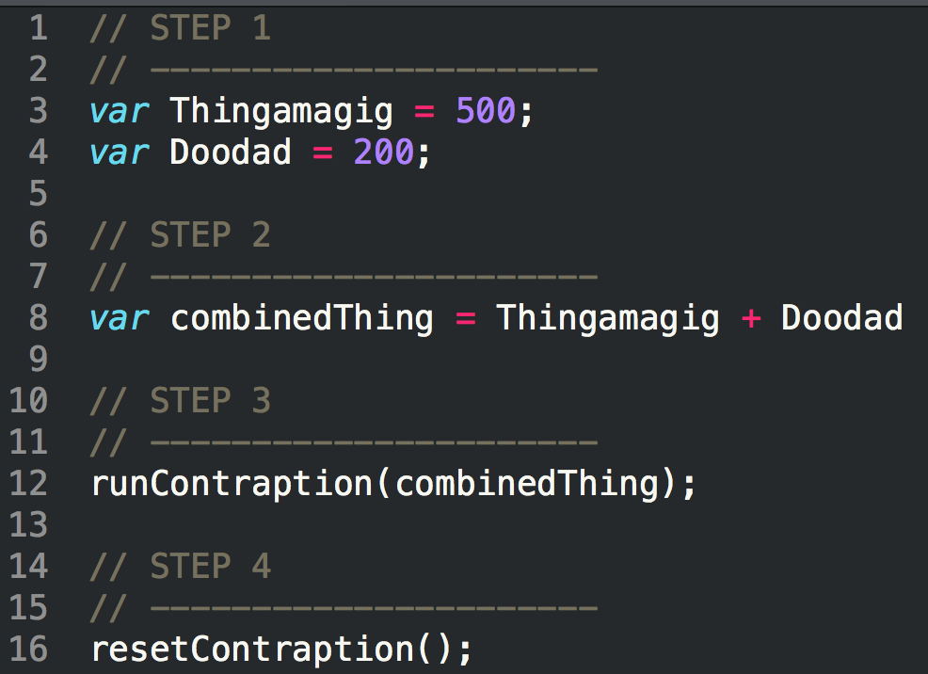
How Code is Written (Procedurally)
Code (JavaScript)
Steps
1
2
3
4

Slide 10
Fundamentals of Coding
What are the four building blocks in programming?

Slide 11
Fundamental Building Blocks
Common structures in nearly all languages:
Variables / Arrays
Conditionals
Iterations
Functions

Slide 12
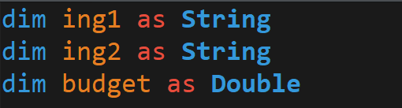
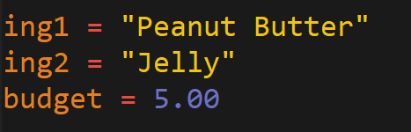
Variables: The Nouns of Code
Variables are effectively the items in a procedure.
They can be physical things (like an ingredient) or abstractions (like a counter).
In VBA, items can be declared as variables by using the dim followed by the type. They can then be assigned a value.
Variable Declaration
Variable Assignment

Slide 13
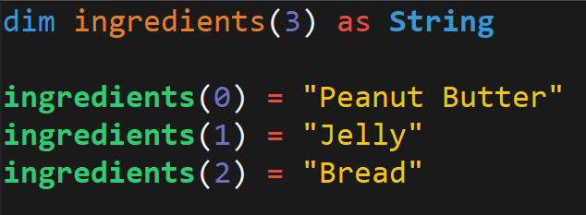
Arrays: A Collection of Items
Arrays are effectively groups of related items. It presents another way to store and reference like pieces of information.
[
Item: 0
Item: 1
Item: 2
[
Peanut Butter
,
Jelly
,
Bread

Slide 14
Conditionals: If This… Then That.
Conditionals present a way to control the flow of logic based on certain conditions being met.
In most languages, we’ll be using if / else code for this purpose.
Step
Step
If Condition a…
2a
1
If Condition b…
2b

Slide 15
Iteration: Round and Round We Go!
Iteration is the concept of using loops to perform a group of tasks repeatedly for a number of times.
In almost all languages, we’ll be using for-loops and while loops.
Step
1
2
Repeat X times…

Slide 16
Functions: For When One Block Can’t Do it All
Functions are, in essence, a sort of “sub-processes”. They allow us to create pre-made, re-usable blocks of code which can be called on demand.
Main Process
1
2
3
4
1
2
3
1
2
3
3
Sub-Processes

Slide 17
Let’s Start Coding

Slide 18
Questions / Discussion
Notes:
It’s important to keep in mind why you joined this class. Let’s talk about your goals.

