Slide 1
Chi Square Test

Slide 2
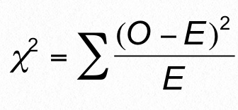
The Chi Square Test Formula
Math formulas with Greek symbols can look intimidating.
But the idea is simple, and we’ll walk through what everything here means.
O=observed
E = expected

Slide 3
What is it used for?
To answer the question: Is the distribution of frequencies in the dataset meaningful?
In other words, does the data match our expectations?
In still other words, do we accept or reject the null hypothesis?

Slide 4

Example
Out of 300 dinosaurs,
220 eat everything
55 eat only meat
25 eat only plants
Null hypothesis: no statistical significance exists in the distribution of omnivores, carnivores, and herbivores. That is, this data can be explained by random distribution.
The chi square test can help us accept or reject the null hypothesis.

Slide 5
Chi square test formula
Σ (sigma): the sum of…
O: observed values:
220 omnivores
55 carnivores
25 herbivores
E: expected values (in randomly distributed data):
100 omnivores
100 carnivores
100 herbivores

Slide 6
Chi square test example
χ² = (220-100)²/100 + (55-100)²/100 + (25-100)²/100
= 144 + 20.25 + 56.25
= 220.5

Slide 7
Steps
Determine chi square value
Determine degree of freedom
3. Choose a p-value
4. Determine critical value
5. Make a decision

Slide 8
Degrees of freedom
To determine the degree of freedom, take the number of rows and subtract one:
omnivores: 220
carnivores: 55
herbivores: 25
There are three rows. So the degree of freedom is 3-1 = 2.
The degree of freedom is the number of figures required to fill out the table (like Sudoku).
If we have two of the numbers, we can figure out the value of the third.

Slide 9
Steps
Determine chi square value
Determine degree of freedom
3. Choose a p-value
4. Determine critical value
5. Make a decision

Slide 10
P-value
The confidence level, i.e. acceptable risk of a false positive.
p = 0.05 is widely accepted in academia; may be higher in business settings.
We’ll say 0.05 in this example.

Slide 11
Steps
Determine chi square value
Determine degree of freedom
3. Choose a p-value
4. Determine critical value
5. Make a decision

Slide 12
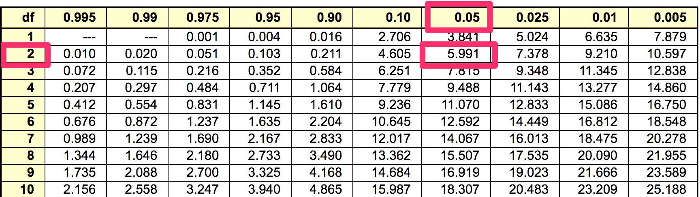
Critical value
Found by consulting a table:
df = 2
P = 0.05
Critical value = 5.991

Slide 13
Steps
Determine chi square value
Determine degree of freedom
3. Choose a p-value
4. Determine critical value
5. Make a decision

Slide 14
Making a decision
The calculated chi square value is 220.5
The critical value is 5.991
Since the chi square exceeds the critical value, we decide that the difference between observed values and expected values are statistically significant.

Slide 15

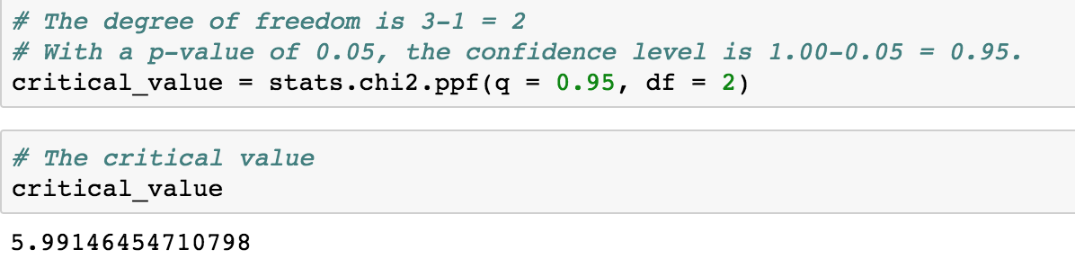
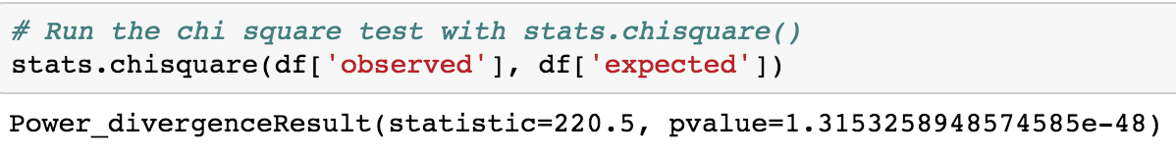
In Python…
Import the scipy.stats module
2. Determine the critical value
3. Run the chi-square test

Slide 16
A few more considerations
Chi square test is used to test categorical variables. It cannot be used on continuous data.
The categories must be mutually exclusive.
We have covered using the chi square to test goodness of fit.
It can also be used to test independence. (Feel free to explore this on your own. Not hard.)

