Slide 1
Outlier Analysis in Live Systems from Application Logs

Slide 2
Structure of EU CO2StoP dataset
Content from report: (P6 section 2.3 first paragraph)
Each reservoir formation contains one or more storage units. A storage unit is defined as a part of a reservoir formation that is at depths greater than 800 m and which is covered by an effective cap rock. These storage units are considered to have potential for CO2 storage and they form the basis of the CO2 storage estimates made in the CO2StoP project. Each storage unit may contain on or more daughter units. Daughter units are defined as structural or stratigraphic traps which have the potential to immobilise CO2 within them, e.g. domes in saline water-bearing parts of the reservoir rock that are completely sealed by cap rocks (aquifer daughter units), or proven oil and gas fields (hydrocarbon field daughter units). Daughter units have the potential to be able to store CO2 at higher saturations than the remainder of a storage unit, so their storage potential can be estimated separately in CO2StoP.
Formation
Storage Unit
HC field
Aquifer daughter units

Slide 3
Dataset detail: Capacity Tables
Storage Unit Table (basic storage structure | normal saturation)
Storage unit ID
Capacity attributes of a storage unit:
Storage Unit
HC field capacity
Daughter Unit Table (special part of a storage unit | higher saturation)
Daughter Unit ID
Capacities attributes of a daughter unit
Aquifer unit
Gas field
Oil field
Formation Table (useless, not basic storage structure)
Estimation value
MIN
MAX
Storage structure
MEAN
MIN
Original data
MAX
MEAN

Slide 4
Dataset detail: Location Maps
Daughter unit and storage have separate map, but same structure
Most important attributes:
ID (correspond to ID in each capacity table)
Polygon (3D)
Arbitrary (Mostly None)
Overlap:
Different storage units may in same area but in different layers (3D)

Slide 5
Data Quality Check
Choose which capacity
Which capacity attribute have least missing value?
Institute estimation capacity Mean in both capacity tables has least missing value
Institute estimation capacities have less missing value than original data from countries
Decision: Use institute estimation capacity as base capacity in each table
Which capacity attribute is am closest to already knows value ? (EU: 126 Gt)
MIN Original most close to 126 Gt
MEAN and MAX several times lager than 126Gt
Decision: Separately treat MIN, MEAN, MAX ; Finally create three different capacities
Is Map in CO2Stop dataset close to CO2stored (UK) dataset?
Yes, Daughter Map + Storage Unit Map = CO2stored UK dataset

Slide 6
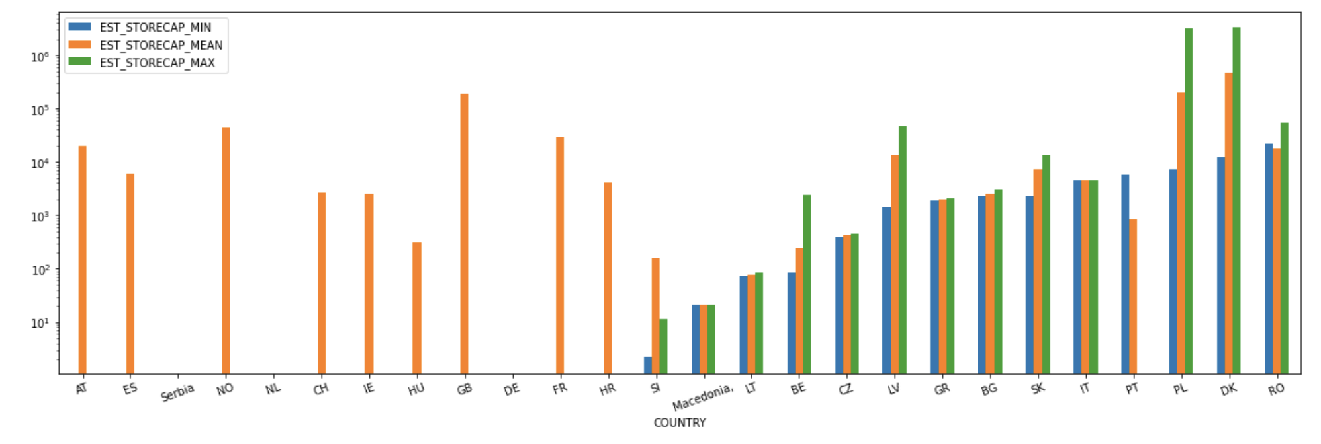
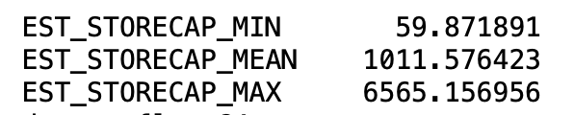
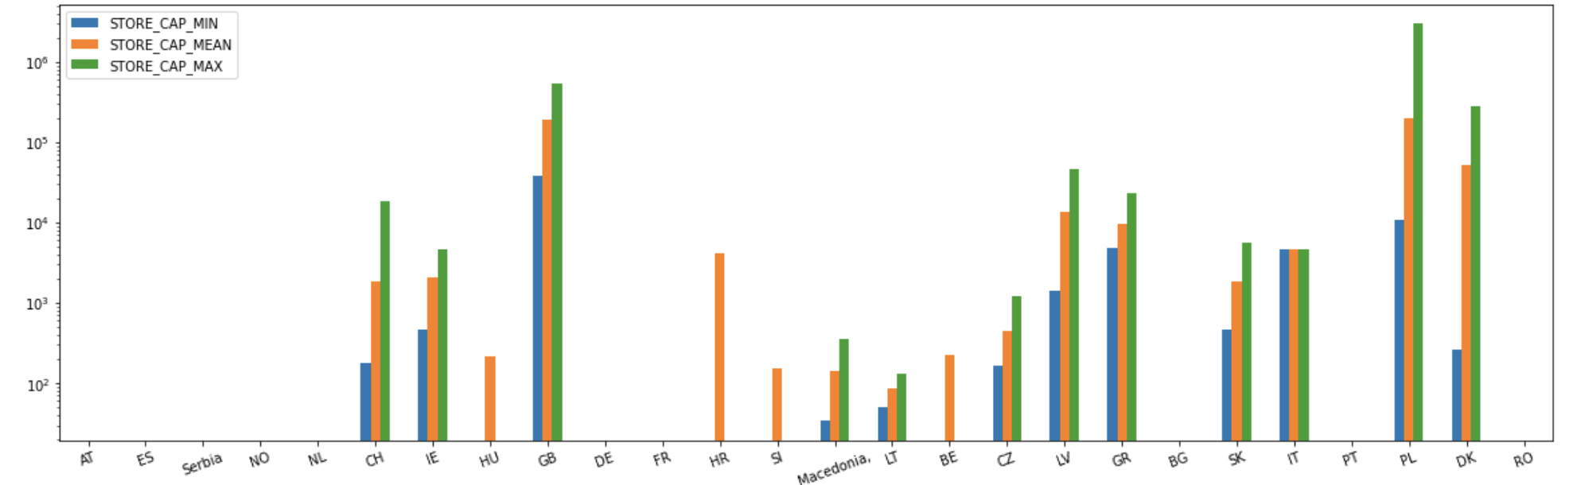
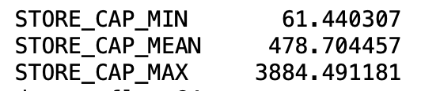
Mt
Unit: Gt
MEAN has less missing value
Mt
Estimation table has less missing value
Unit: Gt

Slide 7
Daughter Unit Map and capacity table
ALL records in capacity table can find a unique match in Map except one record this record in table is in GB
Map id
Table id
Storage Unit Map and capacity table
ALL records in capacity table can find a unique match in Map except record in Nederland
no capacity (sum is 0) | no coordinate data | only storage unit id in table
Table id
Map id

Slide 8
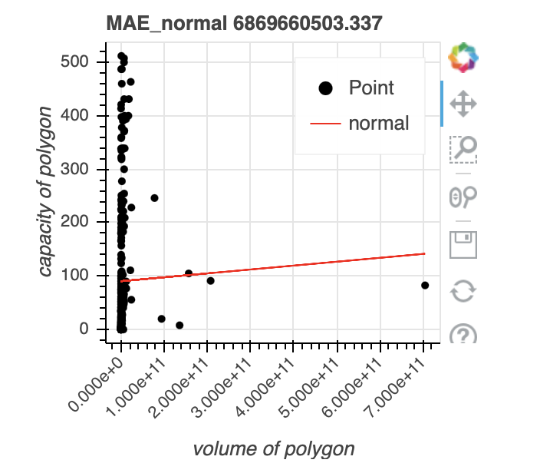
Missing value filling
Before merge capacity table with polygon map
Storage Unit and Trap
Fill missing value in base capacity with original data
Fill missing value in neutral estimation with conservative estimation
Fill missing value in optimistic estimation with conservative estimation
After merge
Only in Storage Unit (estimation mainly based on volume)
Some how use polygon volume to fill missing value (TODO)
Problem:
no obvious correlation between capacity and polygon volume

Slide 9
Combine Map and Capacity Table
All MIN Capacities
All MEAN Capacities
All MAX Capacities
Map
Base capacities missing value filling
Calculate total base capacity of each ID
Merge polygons with same ID
Conservative estimation
Neutral
estimation
optimistic estimation
Merge on ID
Final dataset
Final dataset
Filling missing value based on size of polygons

Slide 10
Question
Which attributes in Polygon Map do we need?
Missing value filling algorithm make sense?

