Slide 1
ROSMAP and SEAAD sex/APOE key-driver analysis
How mitochondrial DEG queries become non-core-MT network-driver candidates
PART I
PART II
ROSMAP reaggregation
SEA-AD validation
295 included runs → returned-only non-MT ACAT → 689 category units
42 active KDA calls → returned-only non-MT ACAT → 96 category units
Notes:
Teaching goal: Introduce the two cohorts and signal that both parts use the same returned-only aggregation rule.
Walk through: Part I aggregates the 295 included ROSMAP fine-cell KDA runs into sex/APOE by broad-network categories with the returned-only non-MT ACAT rule, giving 689 category units. Part II applies the identical rule to the 42 active SEA-AD supertype calls, giving 96 category units.
Scientific boundary: The two unit counts are not interchangeable evidence tiers: both are exploratory post-selected aggregates, and the SEA-AD call distribution is heavily concentrated in M_e33.
Transition: First compare the cohorts at a glance, then unpack the ROSMAP branch before turning to SEA-AD.

Slide 2
Two cohorts, one returned-only aggregation rule
Both apply the same returned-only non-MT ACAT rule; the cohorts differ in run availability and balance.
ROSMAP FINE-CELL REAGGREGATION
SEA-AD VALIDATION
Where does a gene recur across fine-cell evidence?
Do drivers return in an independent human cohort?
648
295
689
1,548
42
96
planned directional slots
included KDA runs
gene × category units
planned directional slots
active KDA calls
gene × category units
Groups fine-cell runs within sex/APOE × broad network.
Applies the same returned-only non-MT ACAT rule.
Aggregates stock-significant returns only; ACAT for ≥2 calls.
Relaxed tier: donor ≥3 per arm, FDR-only query, n ≥ 3.
Final 689 units represent 433 distinct genes in 32 categories.
40 of 42 calls are M_e33; 4 categories have returns.
Notes:
Teaching goal: Give the audience a mental map of the discovery cohort and the validation cohort before the details.
Walk through: The left card summarizes the ROSMAP fine-cell reaggregation: 648 planned slots, 295 included runs, and 689 non-MT gene-by-category units representing 433 genes. The right card summarizes SEA-AD: 1,548 planned supertype slots, 42 active relaxed-tier calls, and 96 units representing 91 genes.
Scientific boundary: The SEA-AD tier is deliberately relaxed (donor at least 3 per arm, FDR-only query, no fold-change cutoff), and 40 of its 42 active calls are M_e33, so absence of a category is availability, not a tested null.
Transition: Begin Part I with the ROSMAP counting units, then return to SEA-AD in Part II.

Slide 3
PART 1
ROSMAP sex/APOE KDA reaggregation
IN THIS PART
1
Run universe
54 fine cell types define the planned universe; 295 included runs from 41 fine types are aggregated within six groups and seven broad networks.
2
Filter funnel
3
ACAT candidates
4
Result figures
Notes:
Teaching goal: Introduce the fine-cell branch and its sequence from setup to results.
Walk through: The section first defines comparisons, directional slots, KDA calls, included runs, and final candidate units. It then explains DEG construction, run eligibility, complete evidence, coverage, support, ACAT, category BH, and display-only ranking.
Scientific boundary: The branch reconstructs complete evidence from the validated Phase 12 calls at effective query n ≥ 3; it does not rerun KDA or pool sex/APOE groups.
Transition: Start with the four counting units that appear in the funnel.

Slide 4
Four steps
1
2
3
4
DEG comparison
Directional slot
KDA run
Candidate unit
fine cell type × sex/APOE
+ AD-up or AD-down
validated completed call
gene × group × broad network
One signed AD-versus-NCI result
A planned query opportunity
DEG contrast valid and
Effective query n ≥ 3
One or more fine runs; either or both directions
Notes:
Teaching goal: Separate the comparison, slot, run, and candidate-unit concepts before showing counts.
Walk through: Move from left to right. A comparison is one model result. Its sign creates two planned slots. A slot becomes a KDA call when at least three effective query genes remain, and every validated completed call at that execution floor enters the cross-run aggregate. The final unit adds gene identity to group and broad network.
Scientific boundary: The word candidate does not mean mitochondrial DEG. Candidate drivers may be non-DEG, non-mitochondrial network genes.
Transition: Apply those definitions to the complete 648-slot run universe.

Slide 5
54 fine cell types create 648 planned directional slots
Up and down are two query directions from one signed DEG comparison—not two model fits.
54 fine cell types
324 signed results
295 call_key_driver calls
× 6 sex/APOE groups = 324 contrasts
× up/down = 648 directional slots
All valid source and queries ≥3
Mutually exclusive slot outcome
Slots
KDA called?
Source DEG contrast not validated
6
No
Validated source; effective query = 0
246
No
Effective query 1–2
101
No
Effective query 3–9
134
Yes
Effective query ≥10
161
Yes
TOTAL
648
295 calls
Notes:
Teaching goal: Show exactly how 648 planned slots become 295 included KDA runs.
Walk through: The rows are mutually exclusive outcomes derived from the canonical source manifest. Phase 12 calls KDA when at least three effective query genes remain. All 295 completed calls enter Phase 20, including 134 calls with query size three through nine and 161 with at least ten genes.
Scientific boundary: The 6 unavailable slots come from three non-estimable source contrasts times two directions. They are unavailable models, not completed tests with null results. The effective-query-zero row combines absent directional queries and complete loss during network mapping.
Transition: Zoom out once to see how the counting unit changes through the full fine-cell funnel.

Slide 6
Source validity and query size decide whether KDA is called
One canonical query-size gate
What ‘source contrast not valid’ means
≥3
295
The upstream MAST comparison could not be fitted because one arm had fewer than three cells.
included runs with query n>=3
Fine cell type
Group
AD cells
NCI cells
All 295 validated completed calls enter the aggregate.
Fib SLC4A4
M_e2
0
11
CAMs
M_e2
45
1
That includes 295 ≥3.
Mic MKI67
M_e2
2
9
74 completed calls returned no original q≤0.05 gene; they still contribute complete evidence.
3 unavailable comparisons × 2 directions = 6 unavailable slots
Notes:
Teaching goal: Clarify the eligibility statuses and the canonical minimum of three effective query genes.
Walk through: A query of at least three genes allows the Phase 12 call and Phase 20 inclusion. The 134 calls with three through nine genes retain Phase 12's below-ten warning but are included alongside the 161 larger-query calls. The right panel gives the three concrete non-estimable comparisons and shows why they create six unavailable direction slots.
Scientific boundary: Small-query calls use the same KDA and support predicates as larger-query calls, but their smaller queries warrant cautious interpretation. Non-estimability is a data/model condition, not evidence against a biological effect.
Transition: With 295 runs fixed, inspect what one KDA call actually tests.

Slide 7
Mitochondrial query genes
DEG rule
2,864,117
118,297
9,262
tested gene × comparison rows
Passed DEG
core-MT query genes
Detected in ≥10% of AD or NCI nuclei.
58,112 up • 60,185 down
4,258 up • 5,004 down
Within-contrast BH FDR < 0.05.
|log₂ fold change| > log₂(1.3) ≈ 0.379.
NETWORK-BACKGROUND INTERSECTION
9,262 provisional query genes
Positive and negative results form AD-up and AD-down queries.
− 1,329 absent from the background
= 7,933 query genes
Query = DEG rule ∩ core_mito_protein ∩ requested direction
Membership counts can repeat the same gene across contrasts and directions.
Notes:
Teaching goal: Explain how the mitochondrial KDA query is derived from the full fine-cell DEG analysis.
Walk through: The paper-DEG filters first act within each fine-cell by group comparison. Only passing core mitochondrial proteins in the requested sign become provisional query memberships. The matching broad network is induced on genes tested in that contrast, so out-of-background query memberships are removed before run eligibility is assessed.
Scientific boundary: These are membership counts, not unique-gene counts. A query membership also does not mean the gene will be a candidate driver.
Transition: Next distinguish source failure, an empty effective query, a one- or two-gene query, and the canonical three-gene execution floor.

Slide 8
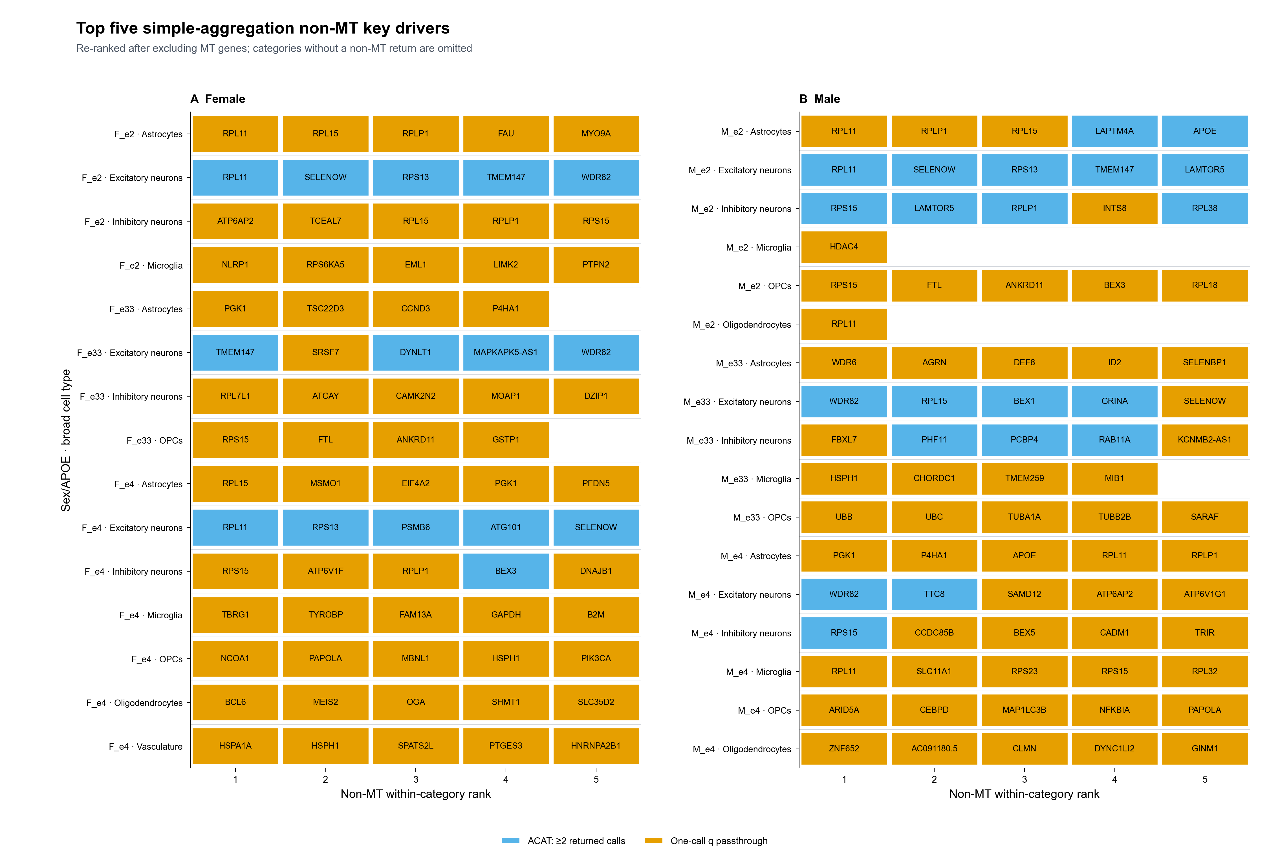
Top-five display: 149 non-MT entries across 32 categories
Notes:
Teaching goal: Interpret the non-MT top-five display after excluding mitochondrial candidate drivers and recalculating display ranks.
Walk through: The figure contains 149 tiles across 32 categories. Blue means ACAT across at least two returned calls; orange means a one-call within-run BH q passthrough. Color identifies the calculation route, not an evidence tier.
Scientific boundary: Top five is a display cap, not a significance threshold. The returned-only score is post-selected and has no final across-gene BH adjustment; categories without a non-MT return are omitted.
Transition: The summary slide translates the displayed results into returned-row, category-unit, distinct-gene, and recurrence counts.

Slide 9
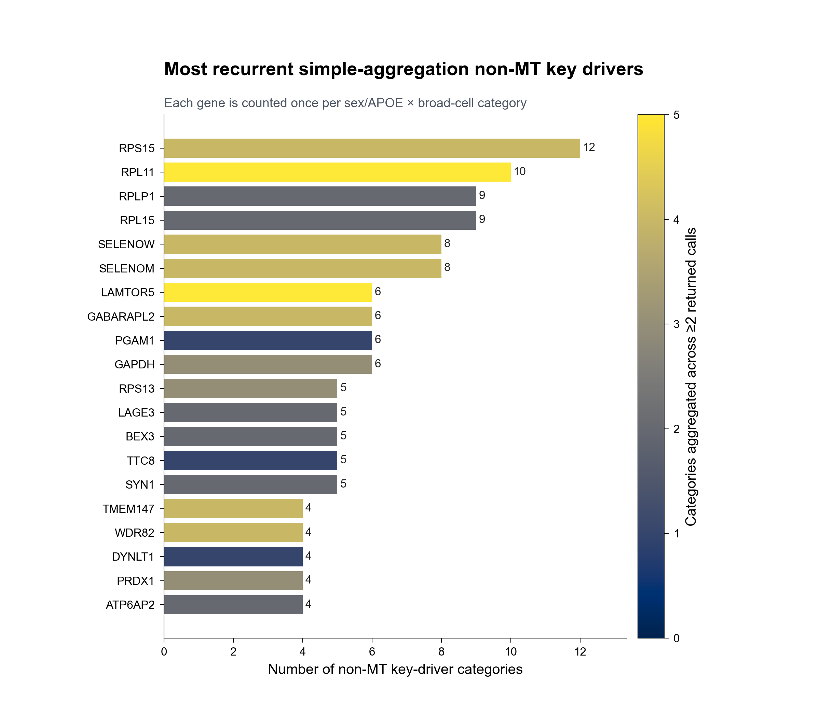
RPS15 recurs across 12 returned-only categories
Returned-only recurrence is descriptive across sex/APOE × broad-cell categories.
How to read it
Bar length = number of categories containing the gene.
Fill = categories whose score combines ≥2 returned calls.
RPS15: 12 categories, 6 groups, 5 networks; ACAT in 4.
RPL11: 10 categories, 6 groups, 4 networks; ACAT in 5.
Top 20 by category count, best exploratory score, then symbol.
Fill shows calculation route—not evidence strength.
Notes:
Teaching goal: Interpret returned-only category recurrence without confusing category breadth, call count, and score construction.
Walk through: Bar length counts each sex/APOE by broad-cell category once. Fill counts the subset whose score combines at least two returned calls. RPS15 appears in 12 categories and RPL11 in 10; their total returned-call counts are 28 and 29, respectively.
Scientific boundary: Inputs were preselected stock-significant within-call q values. Fill shows the calculation route, not evidence strength. Recurrence is descriptive, not an independent replication or FDR-controlled significance test.
Transition: The next slide shows which non-MT genes rank in the top five within each populated category.

Slide 10
Simple output: 689 non-MT category units represent 433 genes
1,033
689
433
32
149
non-MT returned call rows
non-MT gene × category units
distinct gene symbols
categories with non-MT returns
top-five displayed rows
Where non-MT driver units occur
Most recurrent returned-only genes
By sex/APOE group
RPS15
12
M_e2 139 • F_e4 133 • M_e4 127 • F_e2 101 • M_e33 97 • F_e33 92
RPL11
10
RPLP1
9
RPL15
9
By broad network
SELENOW
8
Excitatory 363 • Inhibitory 175 • Astrocytes 63 • OPCs 33 Oligo 27 • Microglia 23 • Vasculature 5
SELENOM
8
Counts are category presence—not independent replication or call counts.
Notes:
Teaching goal: Summarize the scale and distribution of the simple returned-only non-MT result set.
Walk through: The 1,033 non-MT returned call rows form 689 gene-by-category units representing 433 genes across 32 populated categories. The lower panels show where those units occur and the genes with the broadest category presence.
Scientific boundary: These descriptive counts condition on stock-significant returns and differ across categories with unequal opportunities. They do not use nonreturns, coverage, support gates, or a final FDR-controlled cross-gene family.
Transition: Part II now returns to the direct broad-cell branch, where each eligible direction remains a separate KDA result.

Slide 11
PART 2
SEA-AD sex/APOE KDA validation
IN THIS PART
1
Run universe
129 SEA-AD supertypes define the planned universe; 42 active relaxed-tier calls are aggregated with the same returned-only non-MT ACAT rule used in Part I.
2
Query + tier rules
3
Returned-only rule
4
Result figures
Notes:
Teaching goal: Introduce the SEA-AD validation branch and its sequence from setup to results.
Walk through: The section first defines the SEA-AD run universe of 129 supertypes, six sex/APOE groups, and two query directions. It then explains the relaxed exploratory tier, the returned-only non-MT ACAT rule reused from Part I, and the two requested figures.
Scientific boundary: The branch reuses the validated 42 SEA-AD KDA calls without rerunning KDA; it validates the aggregation recipe, not a formally FDR-controlled candidate list.
Transition: Start with how 1,548 planned directional slots reduce to 42 active calls.

Slide 12
129 SEA-AD supertypes create 1,548 planned directional slots
The planned universe mirrors the ROSMAP design: supertype × sex/APOE contrast × AD-up/AD-down mito query.
129 SEA-AD supertypes
774 signed contrasts
42 active KDA calls
× 6 sex/APOE groups = 774 contrasts
× up/down = 1,548 directional slots
estimable source and query n ≥ 3
Mutually exclusive slot outcome
Slots
KDA called?
Source DEG contrast not estimable
786
No
Estimable source; FDR-only query = 0 genes
703
No
Effective query 1–2
17
No
Effective query 3–9
21
Yes (small query)
Effective query ≥10
21
Yes
TOTAL
1,548
42 calls
Group availability is unbalanced: 40 of the 42 active calls are M_e33; F_e33 and F_e4 contribute one each.
Notes:
Teaching goal: Show exactly how 1,548 planned SEA-AD directional slots become 42 active KDA calls.
Walk through: The five outcomes are mutually exclusive. 786 slots inherit non-estimable source contrasts, 703 have no FDR-only mitochondrial query gene, and 17 keep only one or two genes. The remaining 42 slots meet the minimum of three effective query genes; 21 are small queries of three to nine genes and 21 are Phase 18-sized.
Scientific boundary: A skipped slot has no KDA result and must not be counted as a completed null run. The active calls concentrate in M_e33, so category-level breadth is bounded by availability.
Transition: Next, the relaxed tier rules and the returned-only aggregation that reuses the Part I recipe.

Slide 13
Relaxed-tier queries feed the same returned-only rule as Part I
The SEA-AD calls come from a deliberately relaxed exploratory tier; the aggregation recipe is unchanged.
42
27
15
201
121
active KDA calls
calls with significant returns
completed-empty calls
stock returned rows
non-MT rows retained
Relaxed exploratory tier
Returned-only rule (same as Part I)
Donor support ≥3 per disease arm in each supertype contrast.
Start from stock call_key_drivers() returns (within-call q ≤ 0.05).
Mito DEG query: within-contrast BH FDR < 0.05 only.
Drop core-MitoCarta drivers: 80 of 201 rows excluded.
No fold-change cutoff (fdr_only_query_sensitivity).
One returned row → copy its within-call q unchanged.
Effective KDA query needs ≥3 network-mapped genes.
≥2 returned rows → equal-weight ACAT of returned q values.
Frozen tier: posthoc_exploratory__fdr_only__donor3__query3__coverage80__q05.
No P=1 backfill for unreturned calls; no across-gene BH.
The resulting score is exploratory and post-selected—not a formally FDR-controlled cross-call q value.
Notes:
Teaching goal: State the SEA-AD tier rules and confirm the aggregation recipe is identical to Part I.
Walk through: The 42 active calls completed as 27 with significant returns and 15 valid empties, producing 201 stock returned rows. Removing 80 core-MitoCarta rows leaves 121 non-MT rows. Singleton genes keep their within-call BH q; genes with two or more returned rows get an equal-weight ACAT of only those returned q values.
Scientific boundary: Inputs are preselected within-call significant returns, ACAT is applied to adjusted values, and no final across-gene correction is made; use the score for exploratory ranking only.
Transition: The two requested figures now display the top-five candidates and driver recurrence.

Slide 14
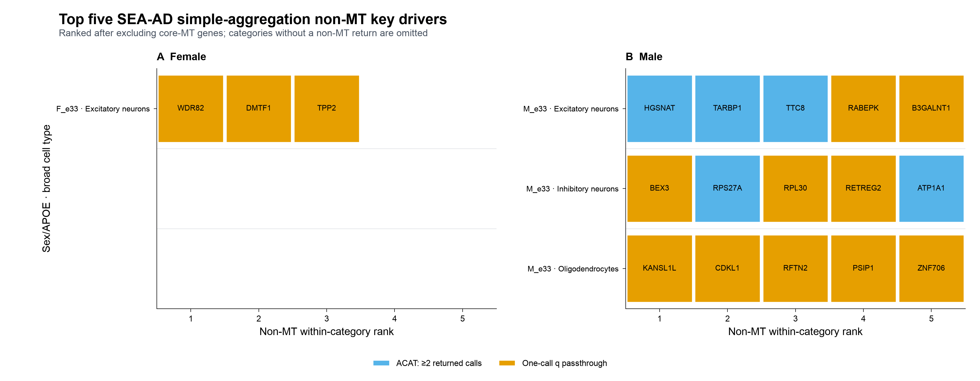
Top-five display: 18 non-MT entries across 4 categories
Notes:
Teaching goal: Interpret the SEA-AD non-MT top-five display and its sparse category structure.
Walk through: The figure contains 18 tiles across 4 return-bearing categories: F_e33 excitatory neurons with three genes, and the M_e33 excitatory, inhibitory, and oligodendrocyte categories with five each. Blue means ACAT across at least two returned calls; orange means a one-call within-call BH q passthrough.
Scientific boundary: Top five is a display cap, not a significance threshold. Color identifies the calculation route, not an evidence tier, and 38 structural categories without a non-MT return are omitted.
Transition: The next slide shows which genes recur across the four populated categories.

Slide 15
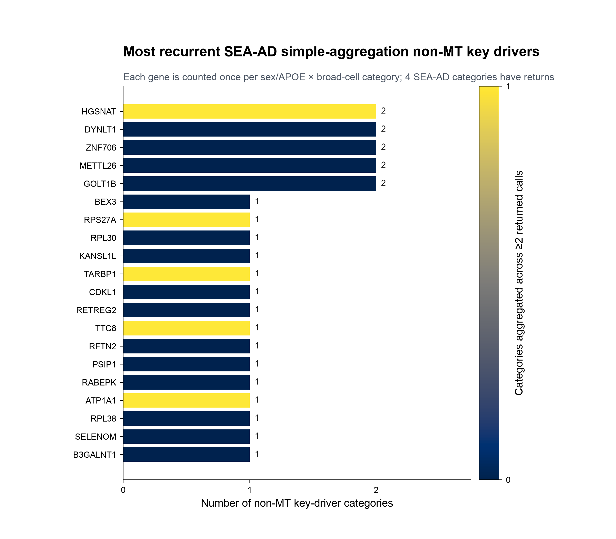
HGSNAT recurs across 2 SEA-AD returned-only categories
Returned-only recurrence is descriptive across sex/APOE × broad-cell categories.
How to read it
Bar length = number of categories containing the gene.
Fill = categories whose score combines ≥2 returned calls.
HGSNAT: 2 categories, 1 group, 2 networks; ACAT in 1.
DYNLT1, ZNF706, METTL26, GOLT1B also recur in 2 categories.
Top 20 by category count, best exploratory score, then symbol.
Only 4 categories have returns—recurrence ceilings are low.
Notes:
Teaching goal: Interpret SEA-AD returned-only recurrence without over-reading the small category universe.
Walk through: Bar length counts each sex/APOE by broad-cell category once. HGSNAT appears in two categories (M_e33 excitatory and oligodendrocytes) with nine total returned calls; DYNLT1, ZNF706, METTL26, and GOLT1B also appear in two categories. The remaining displayed genes appear once and are ordered by best exploratory score.
Scientific boundary: With only four return-bearing categories, the maximum possible recurrence is small; fill shows the calculation route, not evidence strength, and recurrence is not independent replication.
Transition: The summary slide translates the SEA-AD results into returned-row, unit, gene, and category counts.

Slide 16
SEA-AD output: 96 non-MT category units represent 91 genes
121
96
91
4
18
non-MT returned call rows
non-MT gene × category units
distinct gene symbols
categories with non-MT returns
top-five displayed rows
Where non-MT driver units occur
Most recurrent returned-only genes
By sex/APOE group
HGSNAT
2
M_e33 93 • F_e33 3 • all other groups 0
DYNLT1
2
ZNF706
2
METTL26
2
By broad network
GOLT1B
2
Excitatory 58 • Inhibitory 33 • Oligo 5 Astrocytes, Microglia, OPCs, Vasculature 0
BEX3
1
Counts are category presence—not independent replication or call counts.
Validation breadth is bounded by availability: 40 of 42 active SEA-AD calls are M_e33.
Notes:
Teaching goal: Summarize the scale and distribution of the SEA-AD returned-only non-MT result set.
Walk through: The 121 non-MT returned call rows form 96 gene-by-category units representing 91 genes across 4 populated categories. The left panel shows the M_e33 concentration; the right panel shows the five genes recurring in two categories, led by HGSNAT.
Scientific boundary: These descriptive counts condition on stock-significant returns and on a call distribution dominated by M_e33. They do not use nonreturns, coverage, support gates, or a final FDR-controlled cross-gene family.
Transition: This closes the SEA-AD validation part of the deck.

Slide 17
PART 3
Do the same drivers appear in both cohorts?
IN THIS PART
1
Comparison design
The ROSMAP and SEA-AD returned-only results are compared at gene level and at matched sex/APOE-by-cell-type level.
2
What overlaps
3
Matched categories
4
What it means
Notes:
Teaching goal: Frame the final question: does the SEA-AD validation reproduce the ROSMAP drivers?
Walk through: Part 3 compares the two returned-only non-MT result sets. It moves from the comparison design to gene-level overlap, the exactly matched categories, and finally the stratum-specificity findings.
Scientific boundary: Both inputs are exploratory post-selected rankings; the comparison describes convergence and does not test formal replication.
Transition: Start with the two levels at which agreement can be measured.

Slide 18
Two ways to ask whether a driver replicates
Gene-level agreement is permissive; category-level agreement also requires the same sex/APOE group and cell type.
GENE LEVEL
CATEGORY LEVEL
Does the same gene return from both?
Same gene, same group, same cell type?
433
91
689
96
ROSMAP driver genes
SEA-AD driver genes
ROSMAP gene × category units
SEA-AD gene × category units
Ignores which sex/APOE group or cell type produced the return.
The strictest agreement: the driver keeps its full context.
Agreement is only possible where SEA-AD has returns: one female e33 excitatory category and three male e33 cell types.
Notes:
Teaching goal: Define the two agreement levels before showing any overlap number.
Walk through: Gene level asks only whether the same symbol returns in both cohorts. Category level additionally requires the same sex/APOE group and the same broad cell type, which is the counting unit used throughout the deck.
Scientific boundary: Because SEA-AD has returns in only four categories, category-level agreement has a hard ceiling set by availability, not biology.
Transition: First result: how many genes are shared at the permissive level.

Slide 19
35 of 91 SEA-AD drivers also return in ROSMAP
Gene-level agreement is substantial despite different cohorts, platforms, and run availability.
91
35 (38%)
8
SEA-AD driver genes
also ROSMAP drivers
exact category matches
Shared genes visible in this deck's figures
On both recurrence charts: BEX3, DYNLT1, SELENOM, TTC8.
SEA-AD's most recurrent gene, HGSNAT, is also a ROSMAP driver — but in different sex/APOE groups.
ROSMAP’s most popular gene RPS15 returns in SEA-AD male e33 inhibitory neurons.
One message: a third of the SEA-AD drivers are re-discoveries of ROSMAP drivers.
Notes:
Teaching goal: Establish the headline gene-level overlap before adding context requirements.
Walk through: Thirty-five of the ninety-one SEA-AD non-MT drivers, thirty-eight percent, appear somewhere among ROSMAP's four hundred thirty-three. Eight of those keep their exact category, previewed here and detailed on the next slide.
Scientific boundary: Gene-level overlap ignores context; the following slides show that context agreement is much rarer.
Transition: Next: the eight pairs that match exactly.

Slide 20
Eight driver-category pairs match exactly
Same gene, same sex/APOE group, and same broad cell type in both cohorts.
Sex/APOE · cell type
Gene
SEA-AD q (rank)
ROSMAP q (rank)
F_e33 · Excitatory neurons
WDR82
0.028 (#1)
9.7e-5 (#5)
F_e33 · Excitatory neurons
DMTF1
0.045 (#2)
0.043 (#42)
F_e33 · Excitatory neurons
TPP2
0.048 (#3)
0.048 (#48)
M_e33 · Excitatory neurons
TTC8
0.008 (#3)
0.020 (#24)
M_e33 · Inhibitory neurons
RPL30
8.1e-4 (#3)
0.048 (#27)
M_e33 · Inhibitory neurons
RPS15
0.020 (#9)
0.036 (#20)
M_e33 · Inhibitory neurons
PAFAH1B1
0.027 (#19)
0.046 (#26)
M_e33 · Inhibitory neurons
PIP5K1A
0.027 (#20)
0.049 (#30)
The whole female e33 excitatory trio matches; the remaining five pairs are male e33 neurons.
Notes:
Teaching goal: Show the complete list of exact category-level matches with both cohorts' scores.
Walk through: Three matches are the entire female e33 excitatory category: WDR82, DMTF1, and TPP2. The remaining five are male e33: TTC8 in excitatory neurons and RPL30, RPS15, PAFAH1B1, and PIP5K1A in inhibitory neurons.
Scientific boundary: Ranks are within-category display ranks of exploratory scores; a match is convergence, not a significance statement.
Transition: One of these eight deserves a closer look: WDR82.

Slide 21
WDR82 anchors the cleanest replication
Three storylines stand out among the exact matches.
WDR82
The female trio
RPS15
Female e33 · excitatory neurons
3 of 3 genes match
Male e33 · inhibitory neurons
#1 SEA-AD driver in the category; ROSMAP ranks it #5 in the same category from 11 returned calls. It tiles on both cohorts' top-five figures.
Every SEA-AD driver in the female e33 excitatory category — WDR82, DMTF1, TPP2 — is also a ROSMAP driver in that exact category.
ROSMAP's most recurrent driver (12 categories) returns in SEA-AD at rank #9 of its category.
Notes:
Teaching goal: Give the audience three concrete, memorable replication examples.
Walk through: WDR82 is the only gene that is top-five in the same category in both cohorts. The female e33 excitatory category replicates completely, though it holds only three genes. RPS15, the most recurrent ROSMAP driver, also returns in SEA-AD male e33 inhibitory neurons.
Scientific boundary: The female trio is three genes; treat its perfect match rate as an anecdote, not a rate estimate.
Transition: These examples suggest strong agreement — but the group-resolved view complicates that.

Slide 22
Shared genes are not tied to the matching sex/APOE group
Where the shared SEA-AD male e33 drivers land inside ROSMAP.
32 of the 88 SEA-AD male e33 drivers are also ROSMAP drivers. Counting where they appear in ROSMAP:
ROSMAP group
Shared genes (of 32)
Note
M_e2
14
highest overlap
F_e33
10
F_e4
9
M_e4
9
M_e33
8
the matching group
F_e2
7
The matching male e33 group ranks fifth of six — cross-cohort overlap is largely blind to sex/APOE.
Notes:
Teaching goal: Deliver the central negative finding: shared genes do not preferentially match the same sex/APOE group.
Walk through: If replication were stratum-specific, the male e33 row would dominate. Instead male e2 shares the most genes with the SEA-AD male e33 set, and the matching group is near the bottom. The same genes simply recur in different strata.
Scientific boundary: These counts are descriptive; group gene-set sizes differ, and no calibrated enrichment test is claimed.
Transition: If the stratum is not preserved, what is? The cell type.

Slide 23
Cell type is preserved far better than sex/APOE group
All 84 cross-cohort pairings of the shared genes, scored for matching context.
62%
13%
of pairs share the broad cell type
share the sex/APOE group
random pairing would give ≈41%
context transfers by cell type, not stratum
Example: excitatory drivers that switch strata
CSTF2, DHDDS, DIDO1, and POLR3F are excitatory-neuron drivers in both cohorts — female e33 in ROSMAP, male e33 in SEA-AD.
Notes:
Teaching goal: Quantify what survives the cohort change: the cell-type context, not the stratum.
Walk through: Pairing every SEA-AD unit with every ROSMAP unit of the same gene gives eighty-four pairs. Sixty-two percent agree on the broad cell type, well above the roughly forty-one percent expected from random pairing, but only thirteen percent agree on the sex/APOE group.
Scientific boundary: The chance baseline comes from the two cohorts' cell-type distributions; it is a descriptive reference, not a formal null model.
Transition: A few genes are the exception and keep their sex context.

Slide 24
A few drivers do keep their sex context
Most shared genes ignore the stratum — these are the exceptions worth remembering.
HGSNAT
The overall picture is mixed
male-only in both cohorts
Male-only in ROSMAP
SEA-AD's most recurrent driver (2 categories).
14
In ROSMAP it appears only in male e2 and male e4.
Female-only in ROSMAP
11
Always male, and always excitatory neurons in ROSMAP.
Both sexes in ROSMAP
TARBP1 and RPS27A show the same male-only pattern.
7
Of the 32 shared male e33 drivers, ROSMAP shows them in male-only, female-only, or both-sex categories in roughly equal measure.
Notes:
Teaching goal: Balance the stratum-agnostic finding with the genes that are genuinely sex-consistent.
Walk through: HGSNAT never appears in a female category in either cohort and is always an excitatory-neuron driver in ROSMAP; TARBP1 and RPS27A repeat the male-only pattern. But across all thirty-two shared male e33 genes the ROSMAP sex distribution is fourteen male-only, eleven female-only, and seven both.
Scientific boundary: Male-only status reflects where returns happened to occur; unequal run availability across strata can create such patterns without a biological sex effect.
Transition: Close with what this comparison does and does not establish.

Slide 25
What this comparison does—and does not—show
Supported
Not supported / limits
35 of 91 SEA-AD drivers are ROSMAP re-discoveries.
Sex/APOE stratum assignments largely do not transfer between cohorts.
Cell-type context transfers: excitatory drivers stay excitatory, inhibitory stay inhibitory.
Only the male e33 stratum is well powered in SEA-AD; other strata are near-empty.
Eight exact category matches, led by WDR82 and the full female e33 excitatory trio.
Scores are exploratory and post-selected — convergence, not a formal replication test.
HGSNAT is a reproducible male excitatory driver in both cohorts.
Recurrent housekeeping-like genes may overlap partly because they return broadly.
Takeaway: SEA-AD supports the driver genes and their cell-type contexts, not the ROSMAP stratum assignments.
Notes:
Teaching goal: Leave the audience with a precise statement of what the cross-cohort comparison establishes.
Walk through: The supported column collects the positive results: gene-level re-discovery, cell-type fidelity, the eight exact matches, and HGSNAT. The limits column lists why stratum claims should not be made: strata do not transfer, only one stratum is powered, scores are exploratory, and broadly returning genes overlap more easily.
Scientific boundary: None of the findings are formally FDR-controlled replication tests; they are structured descriptive convergence.
Transition: End of the deck.

