Slide 1
HUMAN VALIDATION
SEA-AD independently recovers a focused neuronal mitochondrial signal from ROSMAP
Post-hoc exploratory rerun: independent SEA-AD expression on a shared network/KDA scaffold
11
6
SEA-AD selected units
same-network MT matches
Focused neuronal MT rediscovery—not broad reproduction of every ROSMAP driver
Source: validated VH10C SEA-AD selection and VH10D strict overlap outputs
Notes:
What to point at: Start with the two large numbers. The post-hoc exploratory SEA-AD rerun produced 11 SEA-AD selected units, and six match a frozen ROSMAP unit in the same broad network and driver class.
Main takeaway: Independent SEA-AD expression evidence recovers a focused neuronal mitochondrial signal rather than the entire ROSMAP list. MT denotes the frozen core-MitoCarta driver class.
Boundary / transition: A unit is a network plus gene plus driver class, so one gene can count in more than one network. These are exploratory rerun results, not a confirmatory primary analysis. Next I will show which evidence was independent and which scaffold was shared.

Slide 2
STUDY SETUP
02
SEA-AD evidence was independent; the network and KDA scaffold were shared
1
SEA-AD donors
2
Amended DEG queries
3
Shared KDA scaffold
4
Select, then compare
78 donors Dementia vs No dementia
129 supertypes × 6 groups Donors ≥3/arm • FDR only
Matching broad network Same aggregation and selection math
SEA-AD selector reads no ROSMAP candidate files
Shared: 7 broad networks • MitoCarta annotation • fKDA • selection math
Post-hoc exploratory amendment: donor minimum 3/arm • no active fold-change cutoff
Source: validated VH02/VH04/VH08/VH10A–C outputs; frozen network and selector authorities
Notes:
What to point at: Follow the four boxes from SEA-AD donors to donor-level expression, the amended signed mitochondrial DEG queries, KDA on the matching frozen network, and comparison with ROSMAP. The rerun used at least three donors per disease arm and FDR below 0.05 with no fold-change cutoff.
Main takeaway: Donors, expression values, DEG results, and queries came from SEA-AD. The seven broad networks and KDA/aggregation scaffold were shared for comparability; ROSMAP candidate files were not read by the SEA-AD selector.
Boundary / transition: The threshold amendments were made after the earlier analysis, so this rerun is post-hoc exploratory. It is not an independent network reconstruction. Next I will show how the planned grid narrowed to executed calls.

Slide 3
FROM DESIGN TO EXECUTED CALLS
03
Only 42 directions produced mitochondrial gene sets large enough for KDA
1,548
762
42
planned fine cell type × group × direction combinations
directions from completed DEG contrasts
mitochondrial gene sets large enough for KDA
Four of six sex/APOE groups contributed completed fine-supertype contrasts
Female ε3/ε3 • Female ε4 • Male ε3/ε3 • Male ε4
Independent donors determine contrast estimability; more nuclei do not add biological replicates
Source: VH08 fine_contrast_status.tsv; VH10A query_attrition.tsv
Notes:
What to point at: Read the three boxes left to right: 1,548 planned supertype-by-group-by-direction combinations, 762 directions from 381 completed DEG contrasts, and 42 mitochondrial gene sets large enough for KDA. Four sex/APOE groups contributed completed contrasts: F_e33, F_e4, M_e33, and M_e4.
Main takeaway: A planned direction is not an executed KDA call. Lowering donor support to three per arm made more contrasts estimable, but most completed directions still had fewer than three effective mitochondrial query genes.
Boundary / transition: Independent donors determine biological replication; more nuclei do not add independent samples. M_e4 completed 77 contrasts but all 154 signed FDR-only queries were empty, so it produced no KDA call. Next we show the selected drivers.

Slide 4
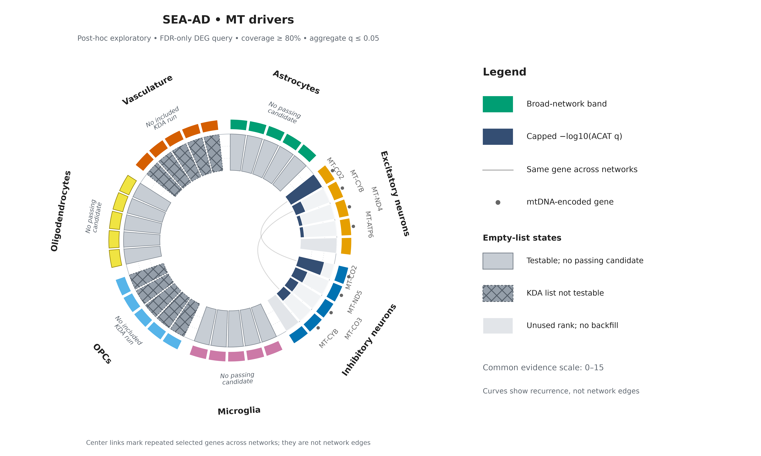
04
Source: validated VH10C selection; canonical seaad_two_case_circular figure package
Notes:
What to point at: Focus on the Excitatory and Inhibitory arcs. Eight selected MT units represent six genes. MT-CO2 and MT-CYB occur in both neuronal networks, which is why two recurrence curves cross the center.
Main takeaway: The post-hoc exploratory SEA-AD MT result is compact and neuronal rather than broadly distributed across all seven networks.
Boundary / transition: The curves show recurrence of a selected gene across network lists; they are not biological network edges. Gray and hatched slots distinguish testable lists with no passing driver from networks with no included run. Next we show the three non-MT selections.

Slide 5
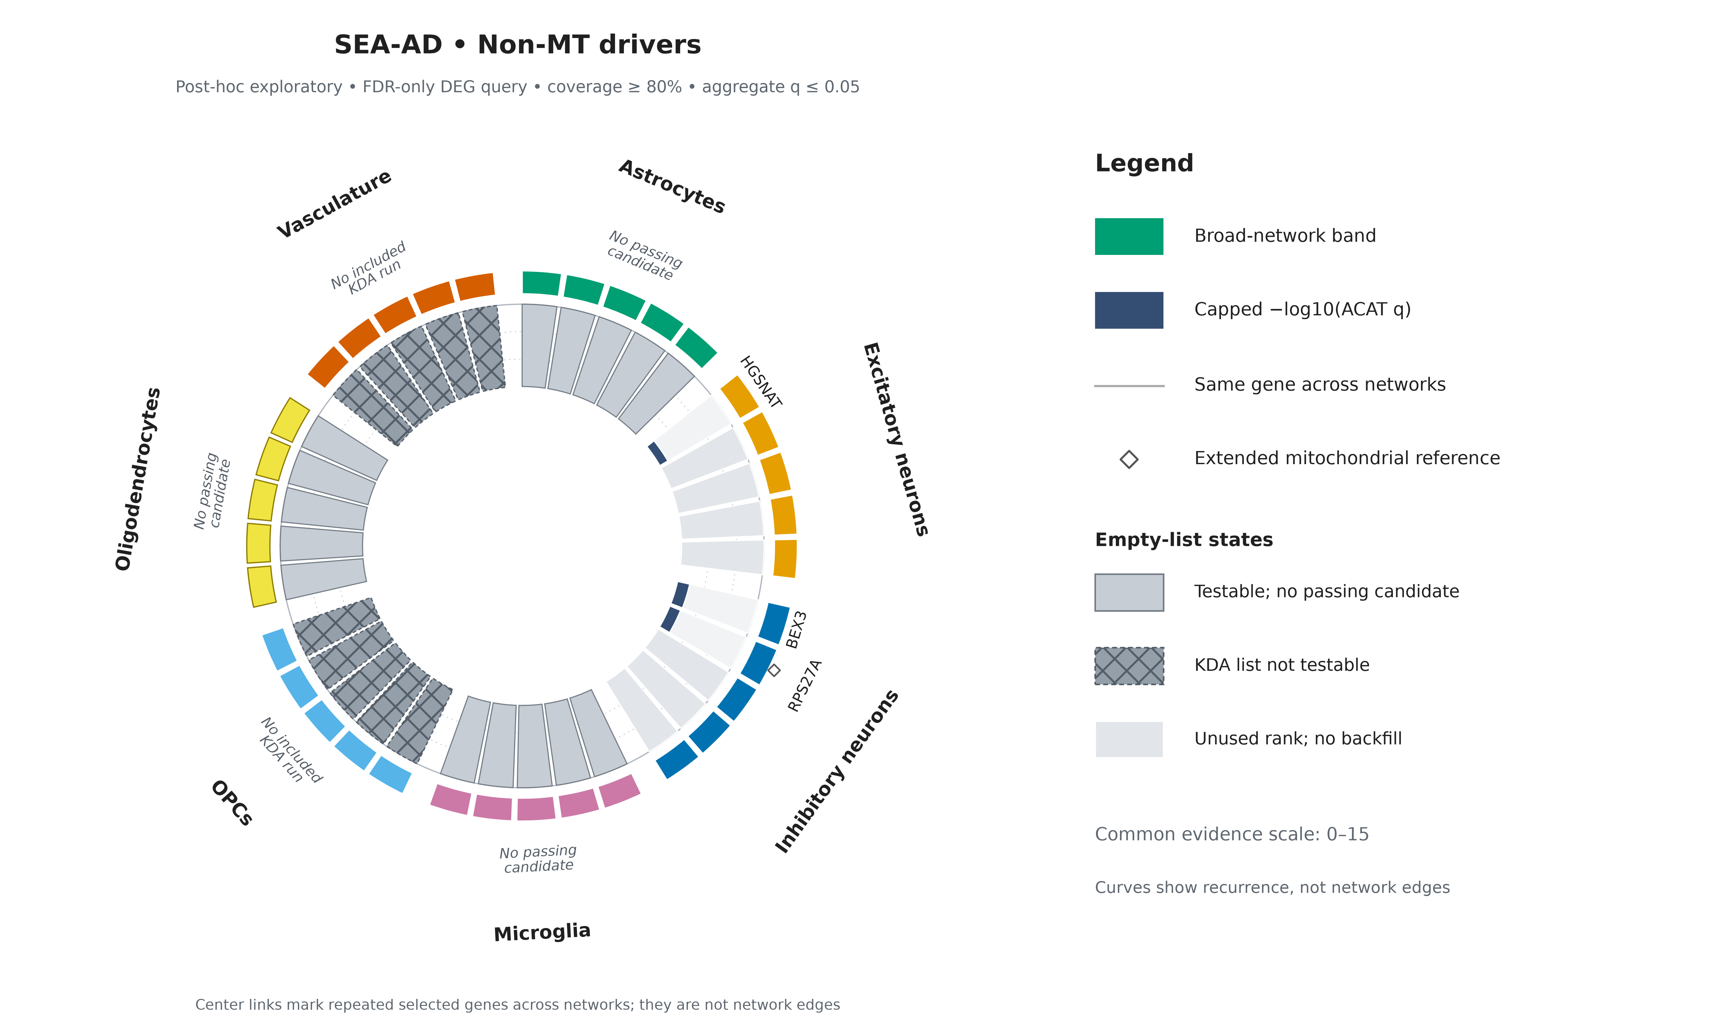
05
Source: validated VH10C selection; canonical seaad_two_case_circular figure package
Notes:
What to point at: The three selected non-MT genes are HGSNAT in Excitatory neurons and BEX3 plus RPS27A in Inhibitory neurons. The empty slots are deliberate and do not indicate omitted top-ranked genes.
Main takeaway: SEA-AD did select non-MT drivers. The later zero overlap means these three genes differ from the frozen ROSMAP non-MT selections, not that SEA-AD produced no non-MT result.
Boundary / transition: Non-MT means outside the frozen core-MitoCarta class; it does not mean unrelated to mitochondrial biology. OPC and Vasculature lists lacked included KDA runs and should not be treated as negative evidence. Next we make the strict cross-cohort comparison.

Slide 6
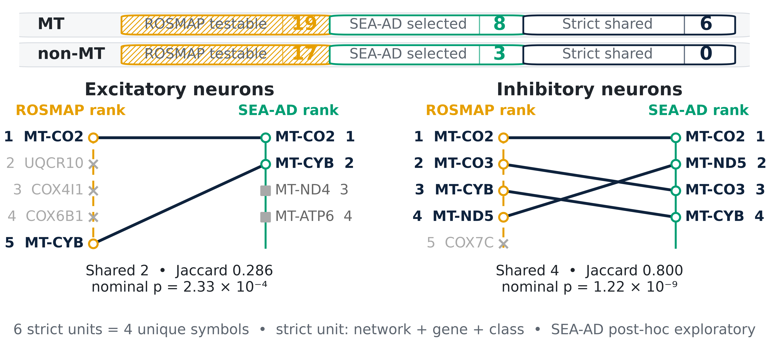
POST-HOC EXPLORATORY • STRICT COMPARISON
06
Six ROSMAP units reappear in the same neuronal network and driver class
Source: validated VH09 frozen ROSMAP units and VH10D strict-overlap tables
Notes:
What to point at: Follow the rank lines in Excitatory and Inhibitory neurons. Six same-network, same-gene, same-class units recur. Because MT-CO2 and MT-CYB recur in both networks, these six units represent four unique gene symbols.
Main takeaway: Within the post-hoc exploratory rerun, the strict comparison yields six neuronal MT matches and zero strict non-MT matches. Thirty-six of 47 frozen ROSMAP units were in a matching testable SEA-AD universe.
Boundary / transition: The printed p-values are nominal per-list overlap tests. Eleven ROSMAP units had no eligible SEA-AD run and are not negative replications. The next slide collapses network identity for a simpler descriptive gene-level view.

Slide 7
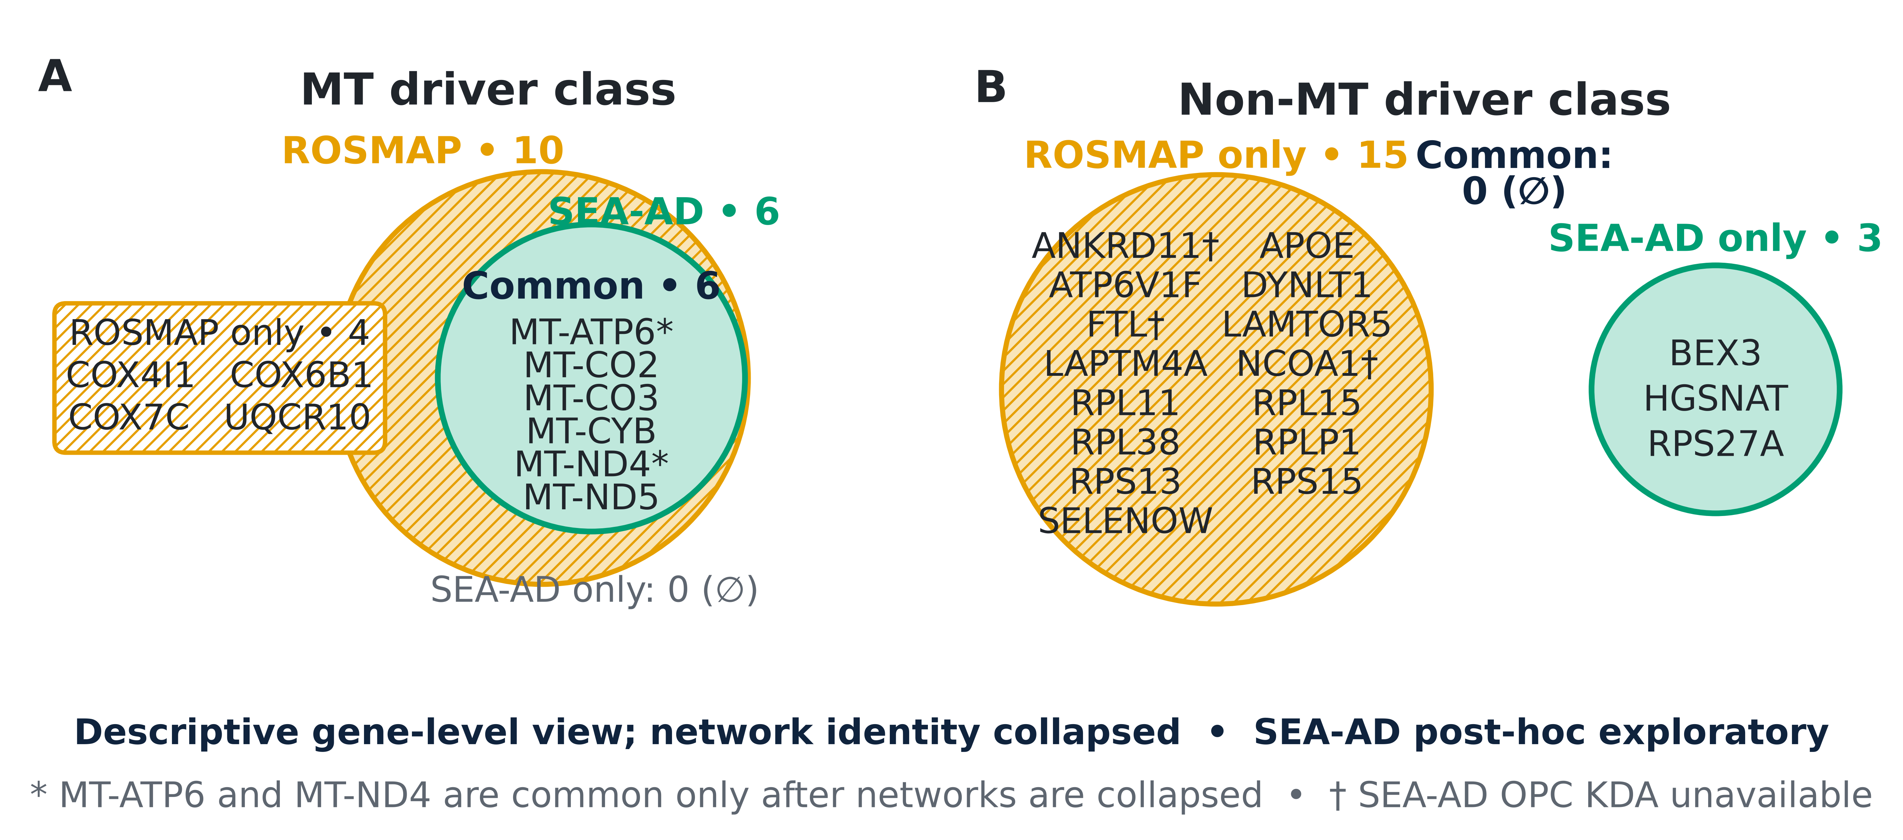
POST-HOC EXPLORATORY • GENE-LEVEL VIEW
07
Ignoring network, all six SEA-AD MT genes occur in ROSMAP; non-MT overlap is zero
Source: validated VH09/VH10C selected lists and VH10D gene-level overlap
Notes:
What to point at: In the MT panel, the SEA-AD set is contained inside the ROSMAP set: all six SEA-AD MT genes occur somewhere in ROSMAP. In the non-MT panel, the 15 ROSMAP genes and three SEA-AD genes are disjoint.
Main takeaway: Counting each gene once, regardless of network, shows six shared MT genes and no shared non-MT genes in this exploratory rerun.
Boundary / transition: This is secondary to the strict same-network result. MT-ATP6 and MT-ND4 overlap only after networks are ignored, so six common genes here is not the same quantity as six strict units. No gene-level overlap p-value is claimed. Next we unpack the non-MT mismatch.

Slide 8
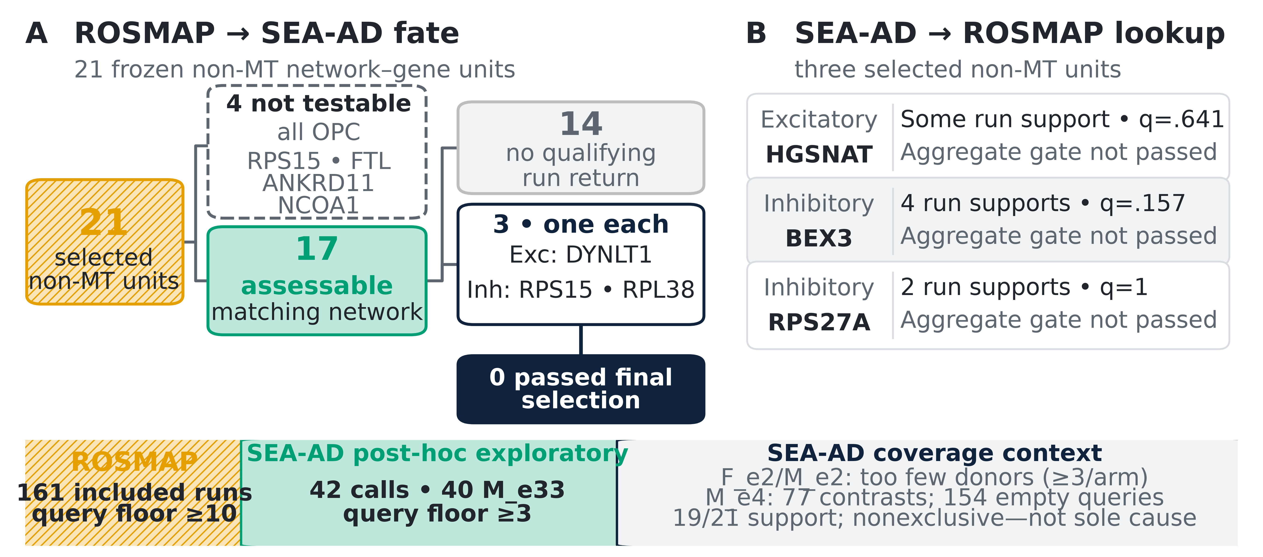
INTERPRETING THE NON-MT RESULT
08
Zero non-MT overlap does not mean the biology is absent
Source: validated VH09, VH10A/B/D outputs and frozen Phase 18 call-return authority
Notes:
What to point at: Panel A follows 21 frozen ROSMAP non-MT units. Four OPC units were not testable. Of 17 assessable units, 14 had no qualifying same-network SEA-AD return and three had exactly one—DYNLT1, RPS15, and RPL38. None passed final across-run selection. Panel B reverses the comparison for HGSNAT, BEX3, and RPS27A.
Main takeaway: Zero final overlap reflects sparse and differently distributed cross-run evidence; it is not evidence that the genes or biology are absent.
Boundary / transition: F_e2 and M_e2 were not estimable because one disease arm had fewer than three independent donors. M_e4 was estimable but its queries were empty. These patterns provide context, not a sole causal explanation. The zero occurred before the five-gene display cap.

Slide 9
TAKE-HOME • POST-HOC EXPLORATORY
09
SEA-AD supports a focused neuronal MT signal; broader validation remains incomplete
Supported
Not established
Next step
Same-network neuronal MT rediscovery
Replication of the non-MT list or untestable groups
Better donor-balanced cohorts and independently reconstructed networks
Focused cross-cohort support—not causal proof or broad validation of every driver
Source: synthesis of validated VH08–VH10 results
Notes:
What to point at: Read the three cards as supported, not established, and next step. The supported result is same-network neuronal MT recurrence. Broad non-MT replication and groups without eligible runs remain unresolved.
Main takeaway: This post-hoc exploratory rerun provides focused independent SEA-AD expression support for a neuronal mitochondrial signal, while the wider ROSMAP driver list is not broadly reproduced.
Boundary / transition: Shared networks and selection machinery limit how independent the full workflow is, and KDA prioritization is not causal proof. Better donor-balanced external cohorts and independently reconstructed networks are the practical next step. The appendix contains the detailed setup and audit evidence.

Slide 10
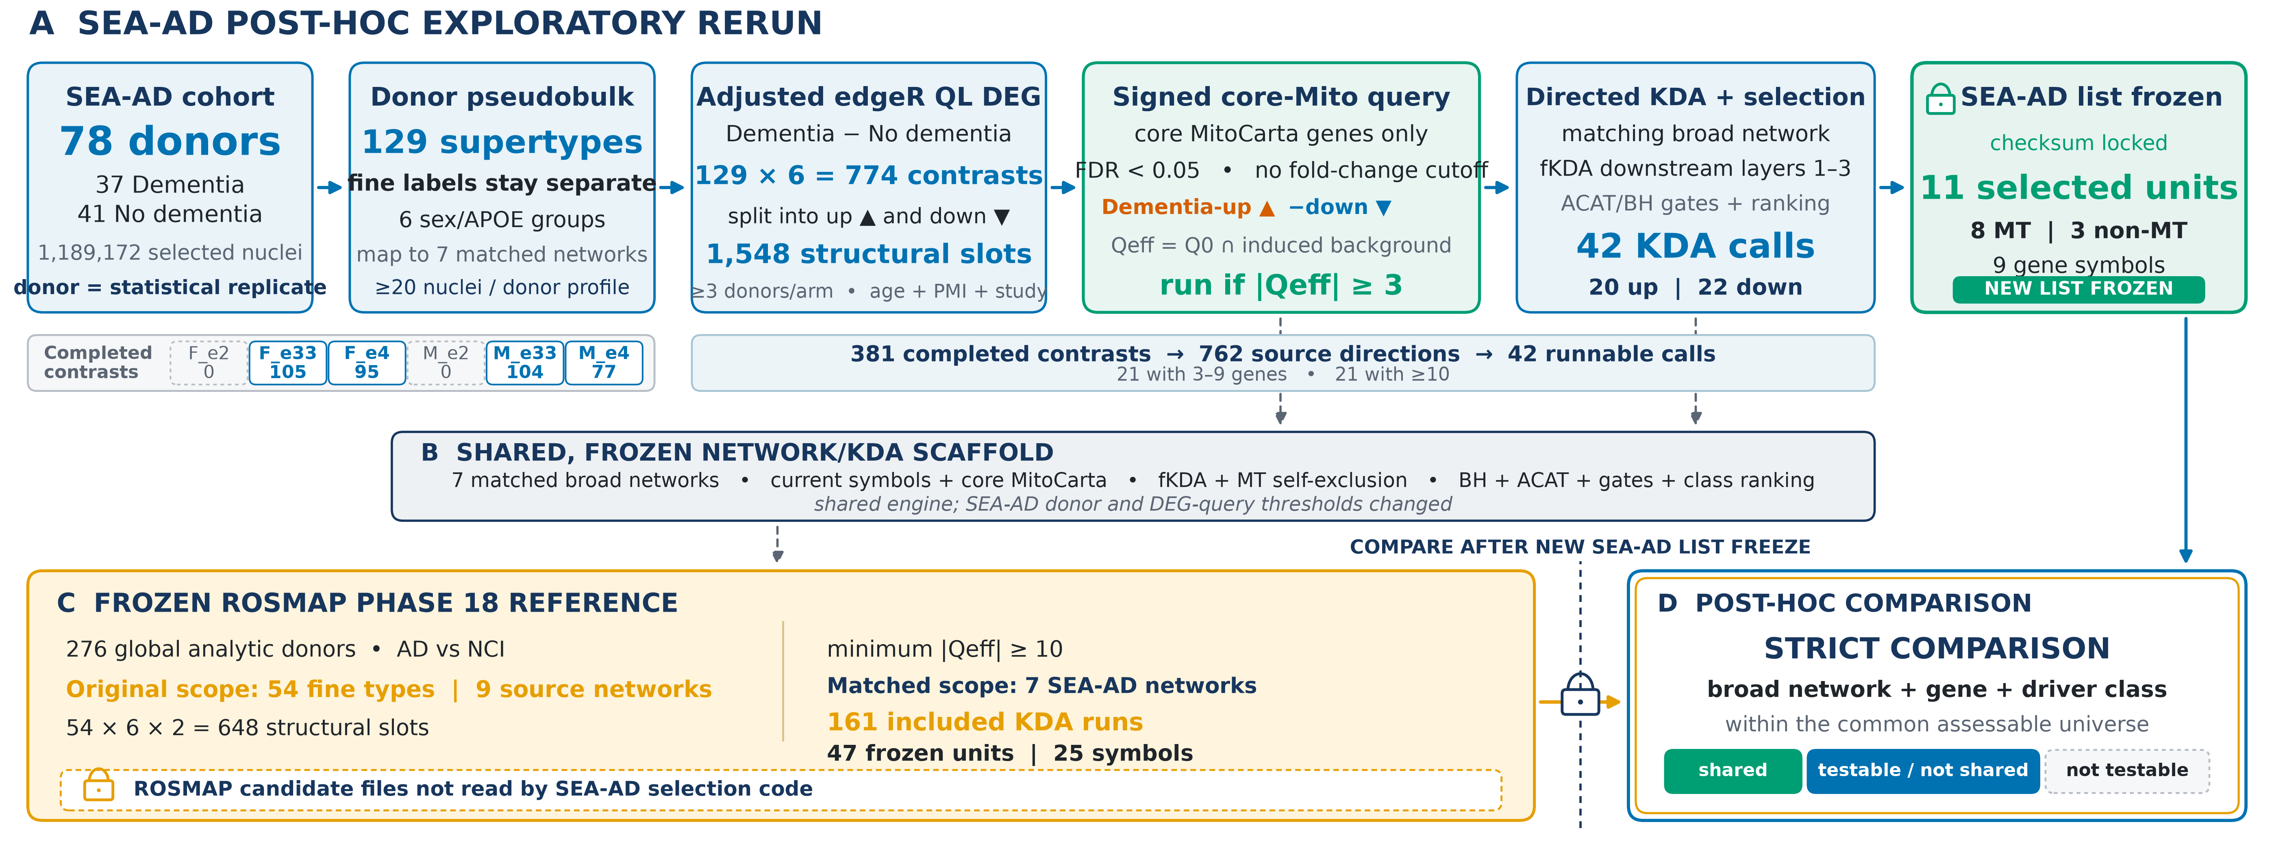
APPENDIX A1
10
Detailed validation setup
Source: validated VH02/VH04/VH08/VH09/VH10 inputs; setup figure package
Notes:
What to point at: This detailed setup records the active post-hoc exploratory rerun: at least three donors per disease arm, FDR below 0.05 without an active fold-change gate, 381 completed contrasts, 762 completed-source directions, 42 KDA calls, and 11 selected units representing nine genes.
Main takeaway: The main-deck workflow is backed by validated inputs and explicit separation between SEA-AD evidence and the shared technical scaffold. ROSMAP candidate files were not inputs to SEA-AD selection.
Boundary / transition: The 1,548 count is a structural grid, not a run count. The threshold amendments make this an exploratory rerun rather than the original confirmatory contract. The next appendix slide shows where the active FDR-only signal was concentrated.

Slide 11
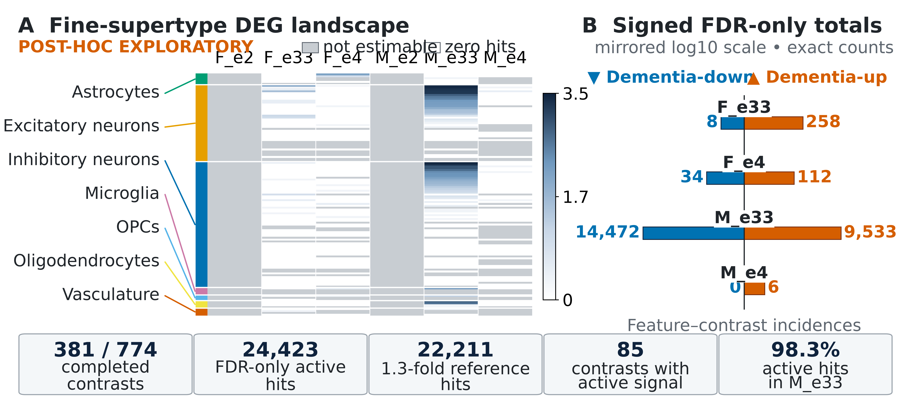
APPENDIX A2
11
Fine-supertype DEG landscape
Source: validated VH08 fine-supertype DEG summaries
Notes:
What to point at: The heatmap shows all 129 supertypes and six groups. Of 774 structural contrasts, 381 completed and 85 contained at least one active FDR-only hit. The active total is 24,423 feature-by-contrast incidences, with 24,005, or 98.3 percent, in M_e33.
Main takeaway: Removing the active fold-change cutoff increased the query source, but the signal remained highly concentrated in male APOE ε3/ε3 contrasts. Four groups contributed completed contrasts.
Boundary / transition: The 22,211 incidences that also meet the old 1.3-fold threshold are shown only as an auxiliary reference. Counts are incidences, not unique genes, and occur before MitoCarta filtering and network intersection.

Slide 12
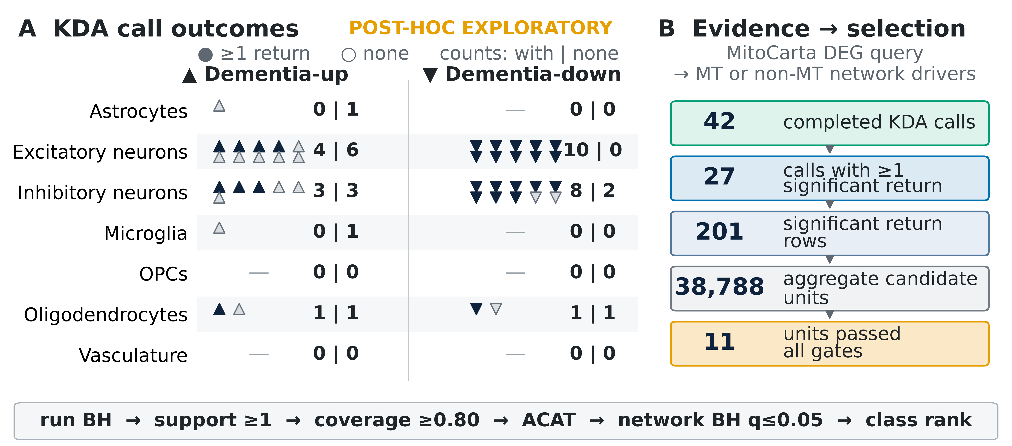
APPENDIX A3
12
KDA call outcomes
Source: validated VH10A–C KDA and selection outputs
Notes:
What to point at: Panel A separates the 27 of 42 calls with at least one significant return from the 15 calls with none. Panel B shows 201 significant return rows, 38,788 aggregate candidate units, and 11 units passing all final gates, representing nine genes.
Main takeaway: A call-level return is not a selected driver. Across-run coverage, conservative support, ACAT aggregation, and within-network correction substantially reduce the final list.
Boundary / transition: The 201 rows are not unique genes, and run-level q-values differ from aggregate ACAT/BH q-values. These outcomes belong to the post-hoc donor-3/FDR-only tier. The next slide summarizes the active rules in plain language.

Slide 13
APPENDIX A4
13
Query and selection rules
1
Define query
2
Run KDA
3
Select across runs
4
Display
Signed core-MitoCarta DEG set FDR < 0.05; no fold-change cutoff ≥3 donors per disease arm
Intersect with induced-network background SEA-AD ≥3 genes; ROSMAP ≥10
Coverage ≥0.80 • ≥1 support run aggregate ACAT/BH q ≤0.05
Rank by q, p, then symbol maximum five; no backfill
Mitochondrial genes define the query; every assessable network gene can be a candidate driver
Source: frozen SEA-AD validation config and Phase 18 KDA/selection authorities
Notes:
What to point at: Read the four cards in order. The active signed core-MitoCarta query uses FDR below 0.05 with no fold-change cutoff and requires at least three donors per disease arm. KDA runs with at least three effective query genes. Final candidates require coverage of at least 0.80, at least one supporting run, and aggregate q at most 0.05.
Main takeaway: The donor and fold-change rules were amended for this post-hoc exploratory rerun; the coverage, support, aggregate correction, driver classification, ranking, and five-gene display cap stayed unchanged.
Boundary / transition: Mitochondrial genes define the query, but every assessable network gene can be a candidate driver and is later classified as MT or non-MT. Prioritization is not causality.

Slide 14
APPENDIX A5
14
Selected drivers and ROSMAP testability
All 11 SEA-AD selected units
ROSMAP comparison
Excitatory
MT
MT-CO2 • MT-CYB • MT-ND4 • MT-ATP6
47
frozen selected units
Excitatory
non-MT
HGSNAT
36
testable in SEA-AD
Inhibitory
MT
MT-CO2 • MT-ND5 • MT-CO3 • MT-CYB
6
strict shared units
Inhibitory
non-MT
BEX3 • RPS27A
11
no eligible SEA-AD run
SEA-AD list states
4 ranked • 6 tested/no passing • 4 no runs
Ranked lists are capped at five and are not backfilled.
Source: VH10C seaad_top5/list_status; VH10D candidate-overlap status
Notes:
What to point at: The left panel lists all 11 selected SEA-AD units by network and class. The right panel shows the 47-unit frozen ROSMAP denominator and three SEA-AD list states: four ranked lists, six testable lists with no passing candidate, and four lists with no included run.
Main takeaway: All 11 passing units are displayed because no list exceeded the five-gene cap. Thirty-six ROSMAP units were testable and six were strict matches; 11 had no eligible SEA-AD run.
Boundary / transition: Tested but not selected and not testable are different outcomes. The table summarizes the same-network, same-gene, same-class comparison in the exploratory rerun, not the network-collapsed gene view.

Slide 15
APPENDIX A6
15
Provenance and interpretation limits
Reproducibility controls
Interpretation limits
• Validated source status and checksum gates • Validated color/grayscale figure packages • Embedded PNGs verified byte-for-byte • Source lines, alt text, and speaker notes • Deck inventory, checks, and SHA-256 status
• Shared broad networks and selector • Uneven independent-donor coverage • SEA-AD query floor 3 vs ROSMAP 10 • Post-hoc donor-3/FDR-only amendment • KDA prioritization is not causal proof
VH05/VH06 QC figures are not required for the scientific claims in this deck
Source: validated input/figure manifests and deck build report
Notes:
What to point at: The left column lists the reproducibility controls: validated source tables, validated current figure packages, byte-identical embedded images, alt text, notes, checks, and hashes. The right column names the active post-hoc donor-3/FDR-only amendment and the main interpretation limits.
Main takeaway: This deck is a reproducible presentation of a post-hoc exploratory rerun. Its conclusions should be framed as exploratory rather than primary or confirmatory.
Boundary / transition: The networks were shared rather than independently reconstructed, donor coverage remained uneven, M_e4 produced no nonempty KDA query, and KDA prioritization is not causal proof. VH05/VH06 figures are not required for the claims shown here.

